Slide 1
THE WEATHER

Slide 2

It’s sunny.
The sun is shining.
It’s a sunny day.

Slide 3
It’s rainy.
It’s raining.
It’s a rainy day.

Slide 4

It’s windy.
The wind is blowing.
It’s a windy day.

Slide 5

It’s cloudy.
It’s a cloudy day.

Slide 6
It’s snowy.
It’s snowing.
It’s a snowy day.

Slide 7
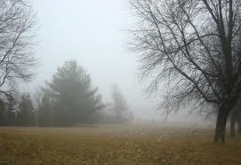
It’s foggy.
It’s a foggy day.

Slide 8
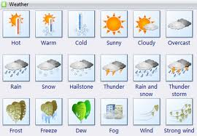
It’s
hot = vroče
warm = toplo
cool = sveže
cold = hladno
wet = mokro
dry = suho

Slide 9
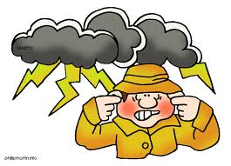
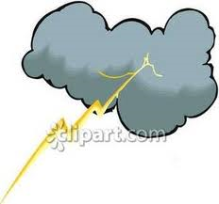
Thunder
Lightning

Slide 10

POINTS OF THE COMPASS
north (S)
south (J)
west (Z)
east (V)

Slide 11

SEASONS
WINTER - zima
(December, January, February)
SPRING - pomlad
(March, April, May)
SUMMER - poletje
(June, July, August)
AUTUMN - jesen
(September, October, November)

