Slide 1
Going – to - Future

Slide 2
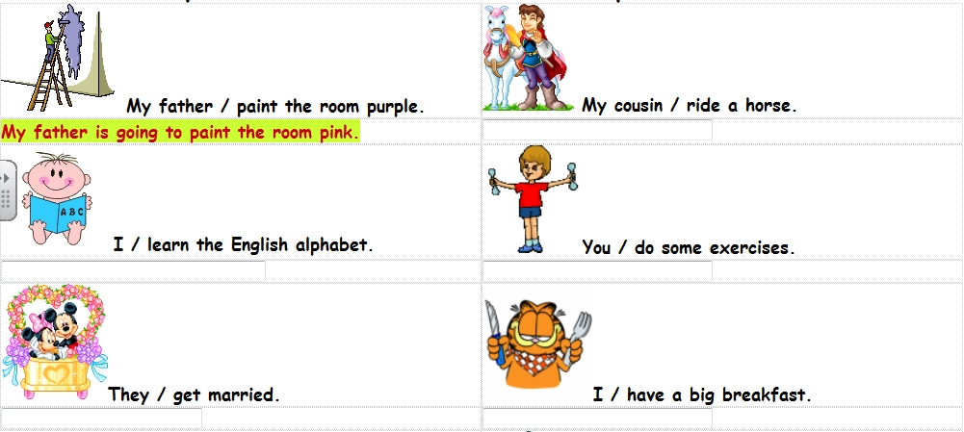
What are they going to do?

Slide 3
We use going to:
to talk about what we have decided to do in the future (planned actions)
We are going to sing at the party.
if we are certain that something is going to happen in the future
Look at that car! It is going to crash into the yellow one.

Slide 4
AFFIRMATIVE:
I | am ‘m | going to | sing at the party.
He She It | is ‘s
We You They | are ‘re

Slide 5
NEGATIVE:
I | am not ‘m not | going to | phone Tim.
He She It | is not isn’t
We You They | are not aren’t

Slide 6
QUESTIONS:
Am | I | going to | rain this afternoon?
Is | he she it
Are | we you they
What is she going to sing?

