Slide 1
Funny things
That are funny

Slide 2
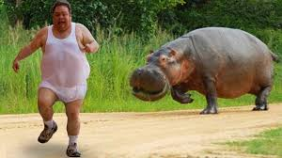
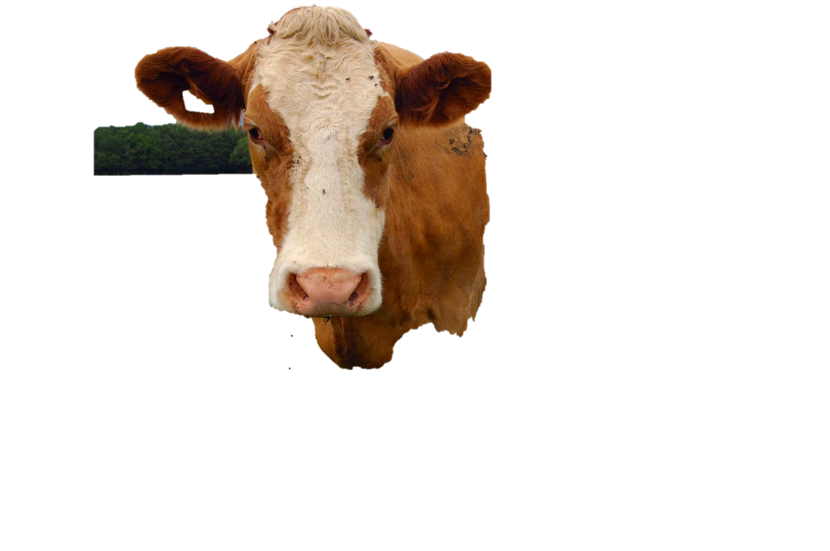
When you are veegan

Slide 3
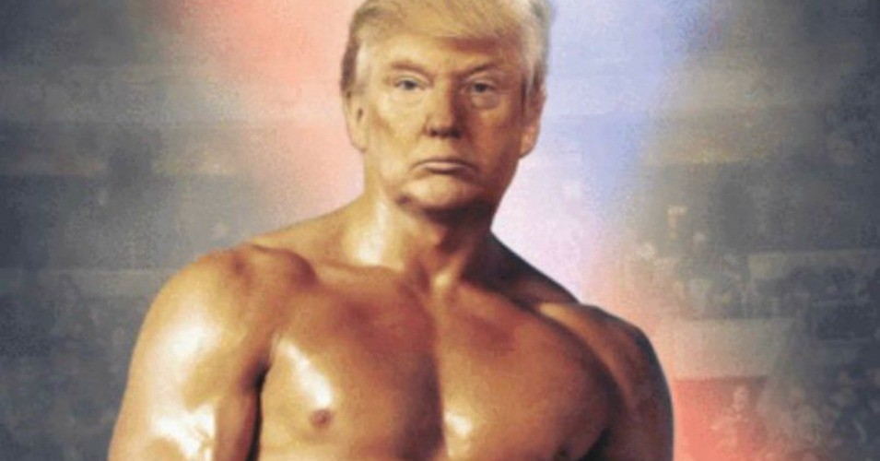
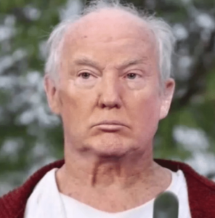
Haw people thin donald trump looks like . How he acctualy looks.

Slide 4
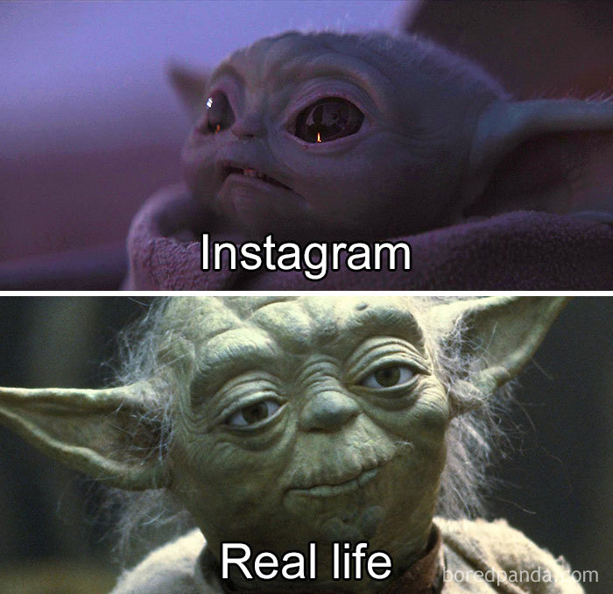

Slide 5
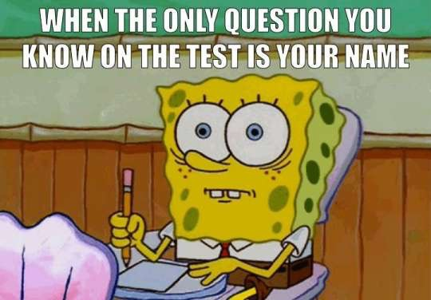

Slide 6

When ronny 2k ban explosive behind the back
I woon to die

