Slide 1
IDEJE ZA MAKETE

Slide 2
EKOSISTEMI:
- TROPSKI DEŽEVNI GOZD
- SAVANA
- PUŠČAVA
- POLARNO OBMOČJE

Slide 3
TROPSKI DEŽEVNI GOZD
RAIN FOREST DIORAMA
How to Make Rainforest in a Shoebox - School Project
https://www.youtube.com/watch?v=WUGTWSIjQ2M
FILM_IZDELATI_MAKETO_TROPSKI_DEZEVNI_GOZD
https://www.pinterest.com/pin/122582421078190220/
KAKO_NAREDITI_DREVESA
KAKO_NAREDITI_DREVESA_2

Slide 4
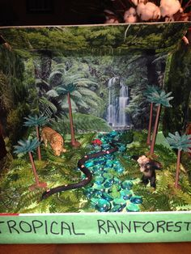
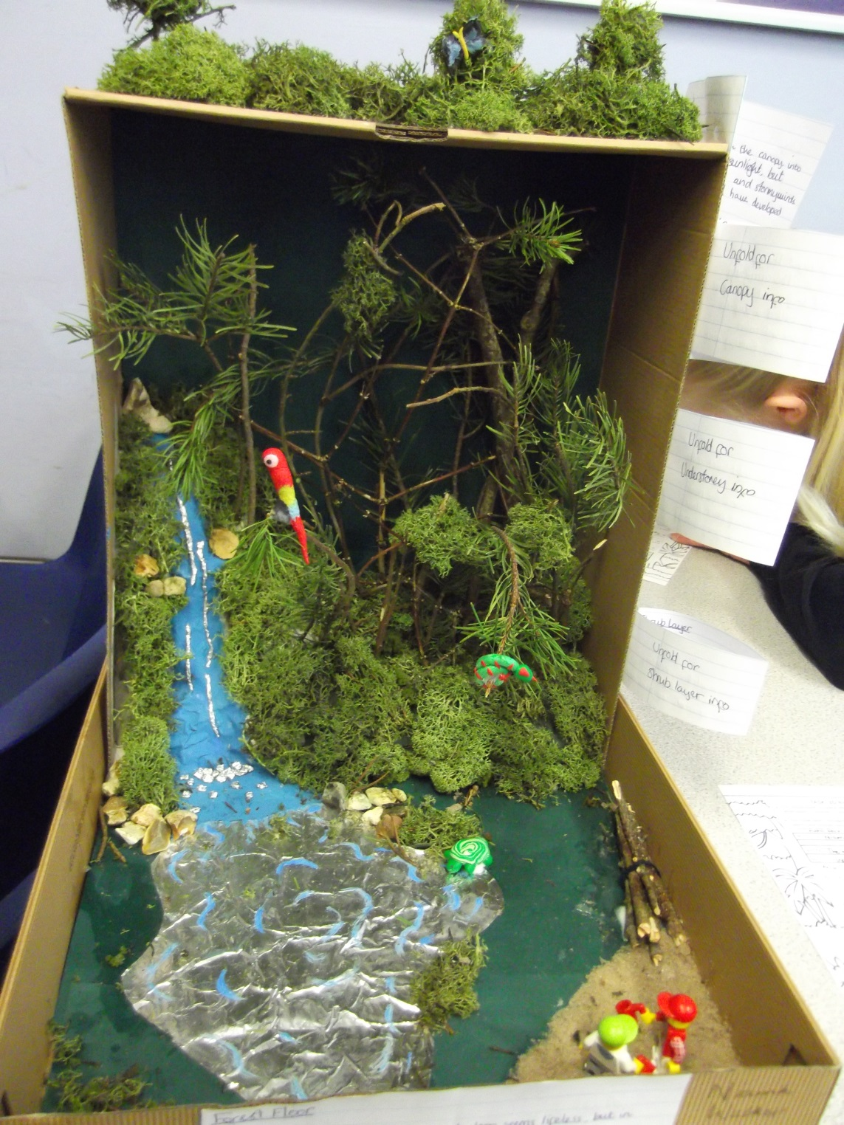

Slide 5
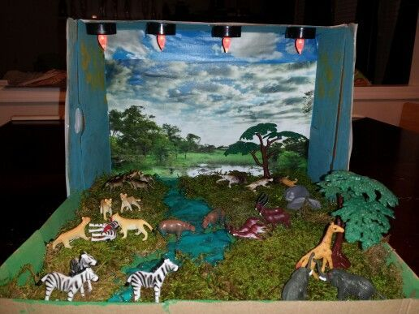
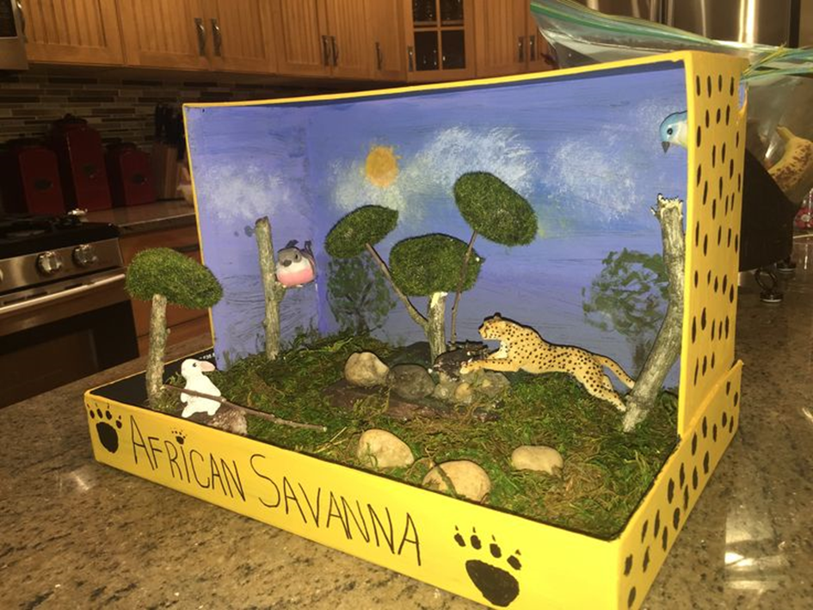
savana

Slide 6
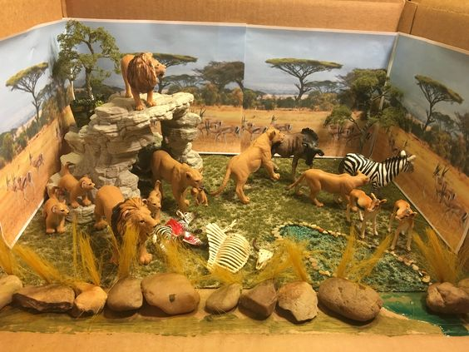
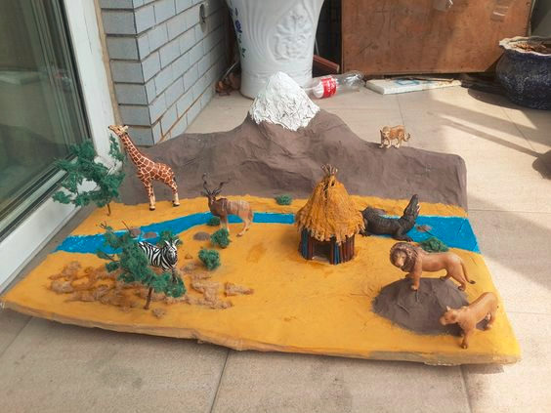

Slide 7
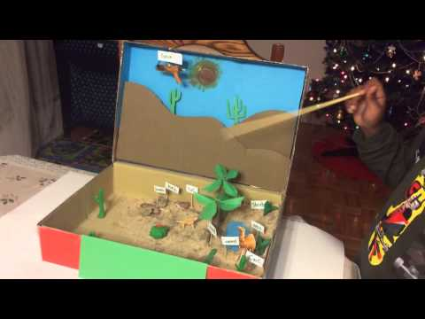
puščava
MAKETA V ŠKATLI (https://www.youtube.com/watch?v=zp03TjTfzRY&spfreload=1)
IDEJA ZA IZDELAVO LJUDI -https://www.pinterest.com/pin/144889312984130769/

Slide 8
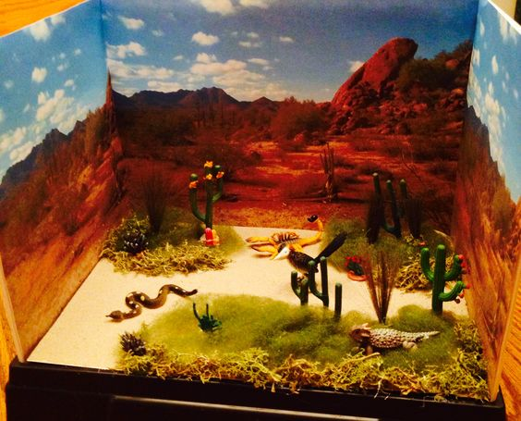
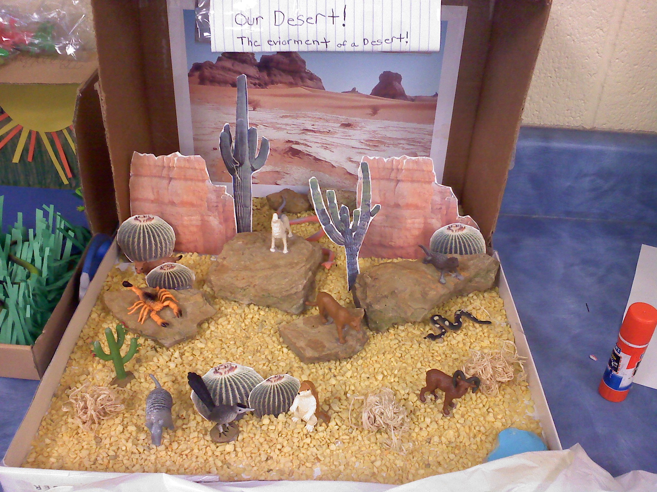

Slide 9
POLARNO OBMOČJE
ARCTIC HABITAT SCHOOL MODEL
INUIT DIORAMA PROJECT IMAGES
HABITAT ARCTIC SCHOOL PROJECT (https://www.youtube.com/watch?v=Ne2BQ-sctS0)
https://www.youtube.com/watch?v=pCBHJ0iTDhM
https://www.pinterest.com/pin/360569513887082334/

Slide 10
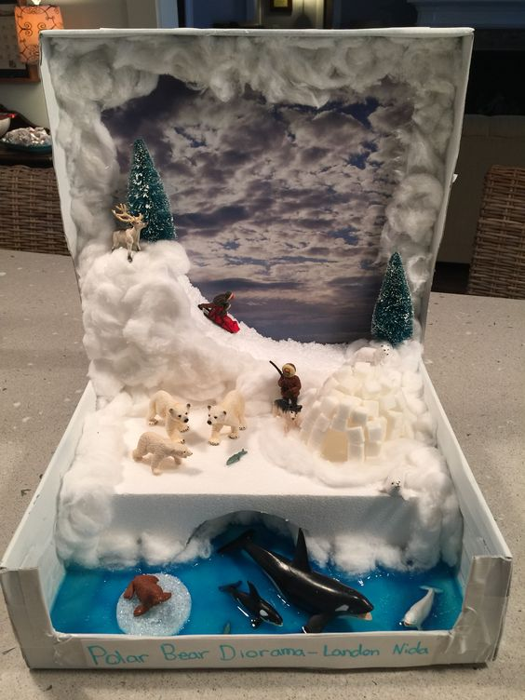
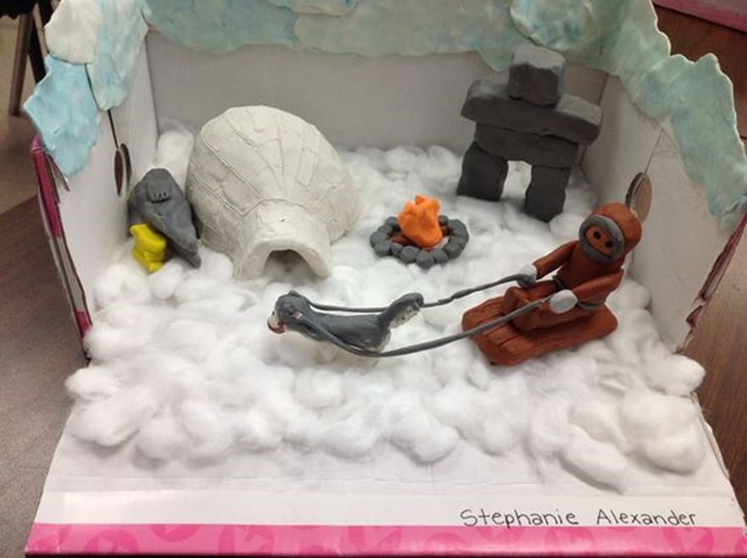

Slide 11
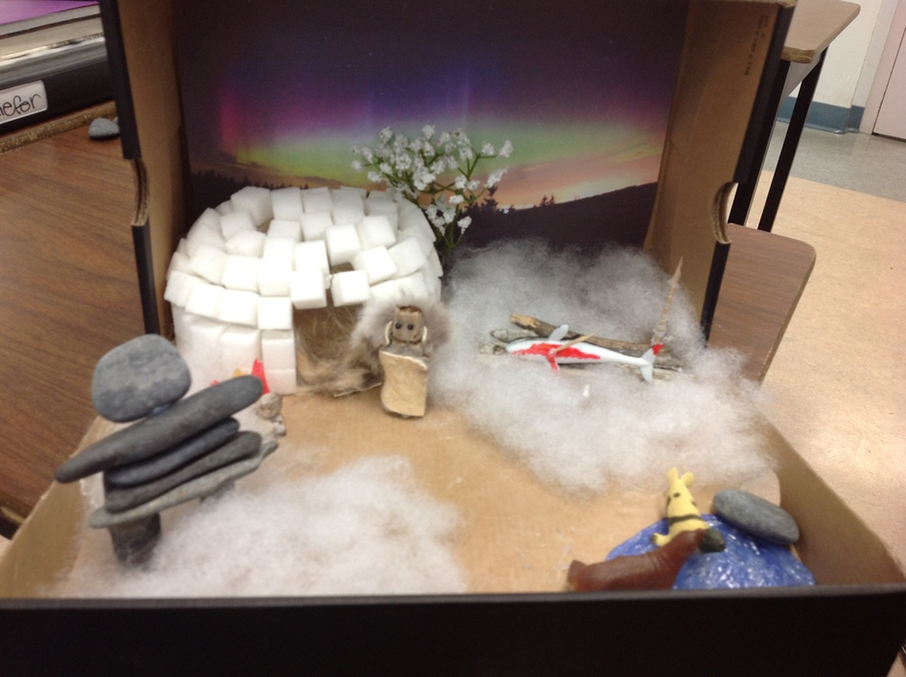
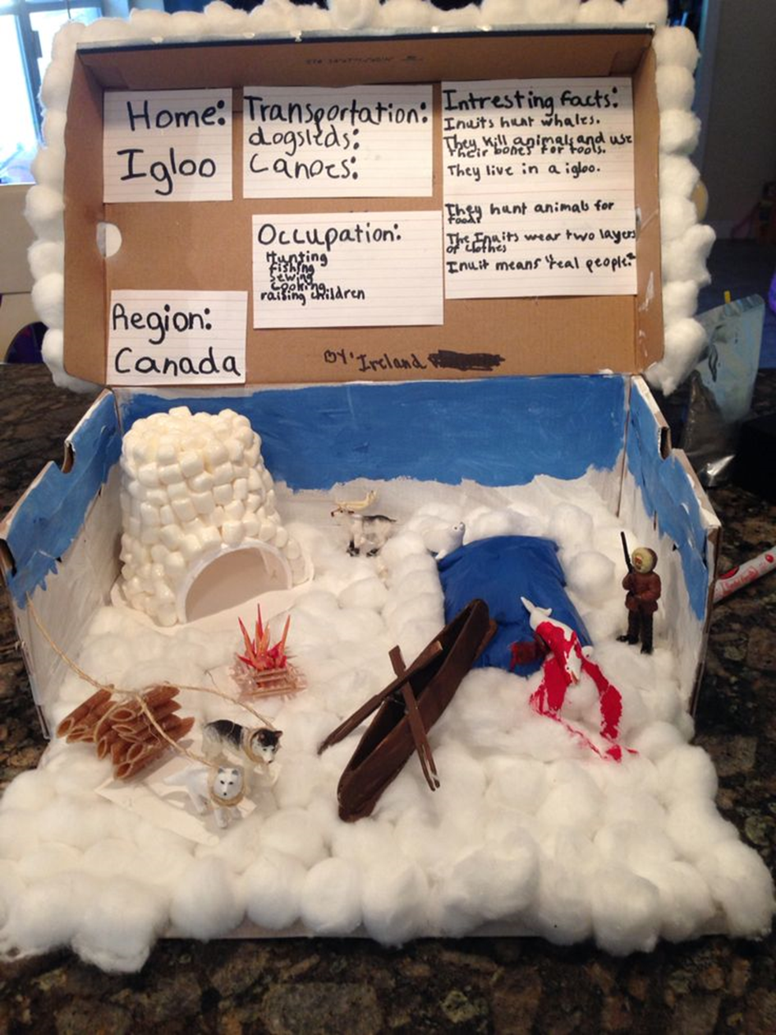

Slide 12
