Slide 1

DAN SLOVENSKE HRANE
20. 11. 2020
ZAKAJ?
https://www.youtube.com/watch?v=OnQHO2uX1pA

Slide 2


MLEKO
JABOLKA
MASLO
KRUH
MED

Slide 3
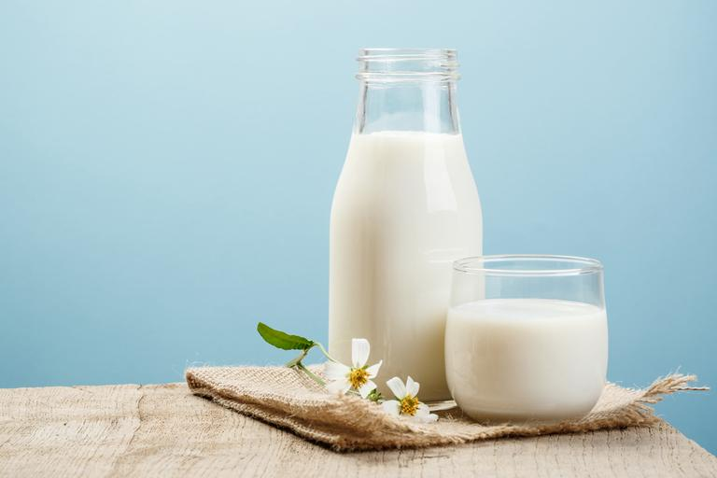
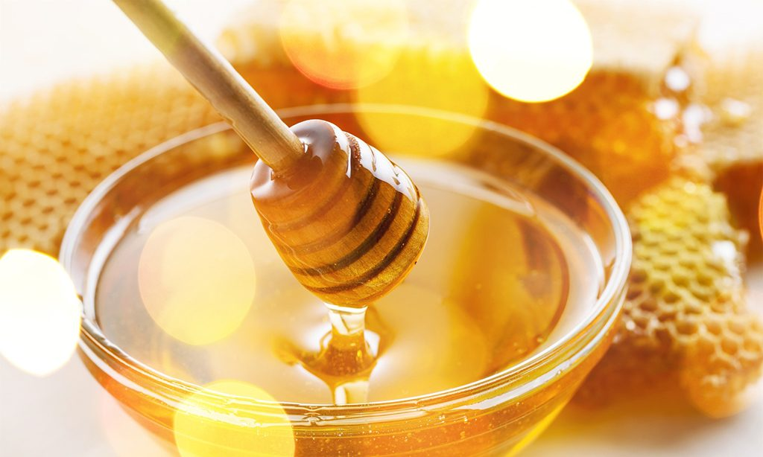
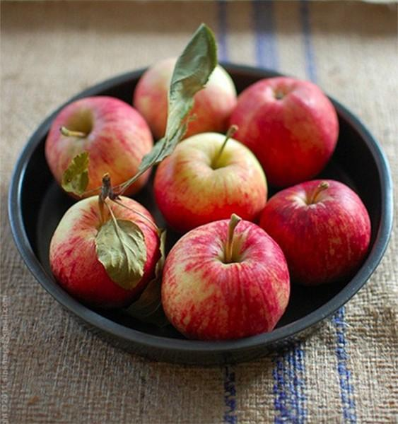
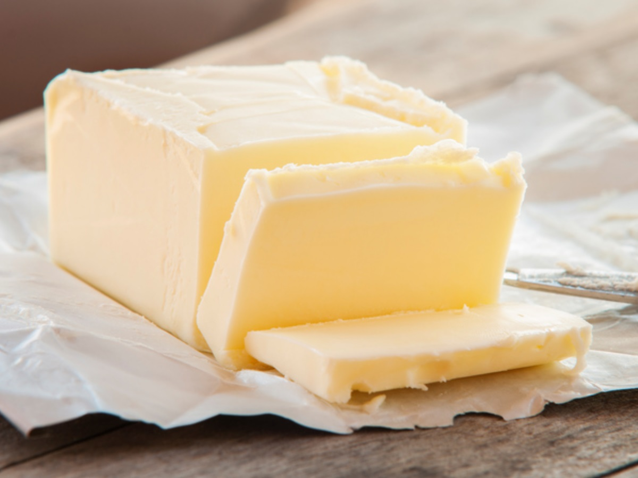
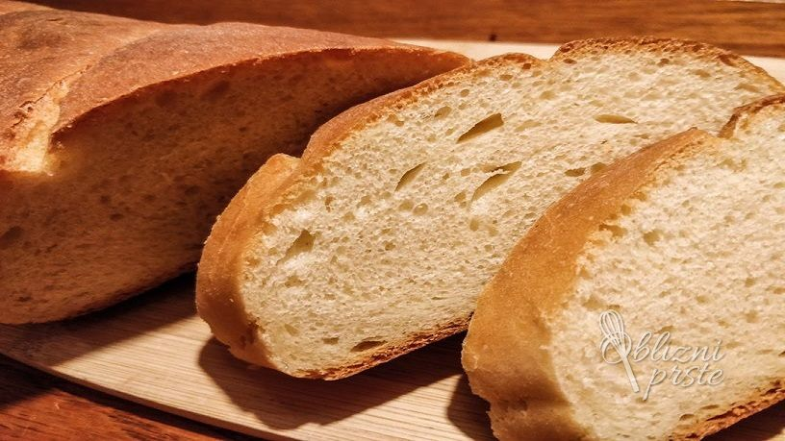
https://www.youtube.com/watch?v=pWXA69d6PCk
https://www.youtube.com/watch?v=ebl_GIjYJKo
TRADICIONALNI SLOVENSKI ZAJTRK
https://www.youtube.com/watch?v=ZBEyi63qXak
https://www.youtube.com/watch?v=SVZym3s-RGM
https://www.youtube.com/watch?v=fiuEcvI8Hgo

