Slide 1
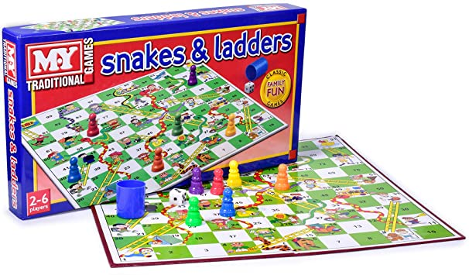
SNAKES AND LADDERS
BOARD GAME

Slide 2
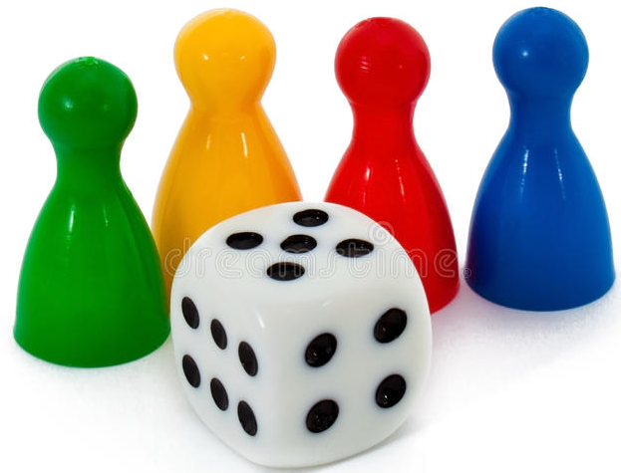
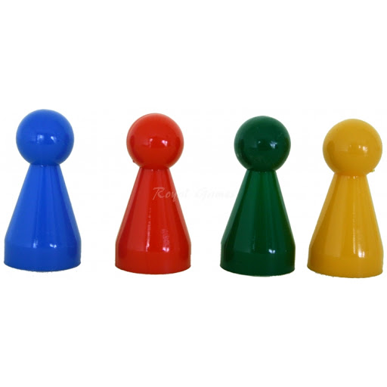
1. WHAT DO I NEED?
https://freeonlinedice.com/

Slide 3
2. HOW DO I PLAY?
1. ROLL THE DICE. WHEN YOU GET NUMBER 6, YOU START.
2. WHEN YOU STEP ON THE PICTURE, YOU NAME IT. IF YOU DON‘T NAME IT, YOU GO BACK TO START.
3. IF YOU STEP ON THE LADDER AND YOU NAME THE PICTURES CORRECTLY, YOU SKIP A FIELD OR MORE.
4. IF YOU STEP ON THE SNAKE‘S HEAD, YOU GO BACK DOWN HER TAIL.
5. THE FIRST WHO GETS TO FINISH IS THE WINNER.

Slide 4
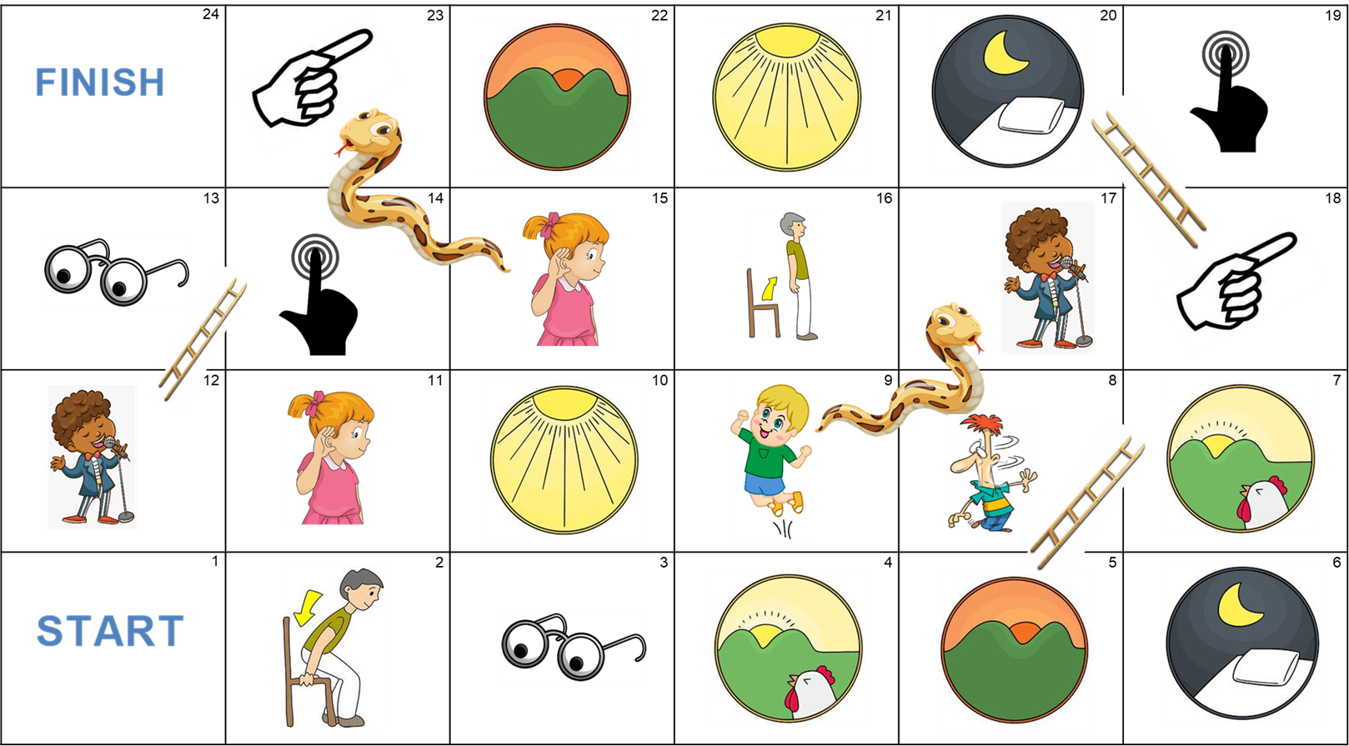

Slide 5
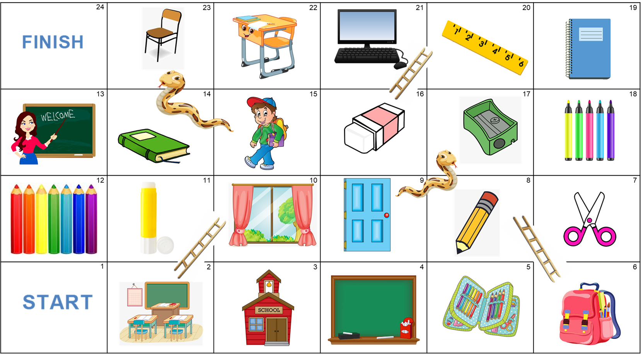

Slide 6

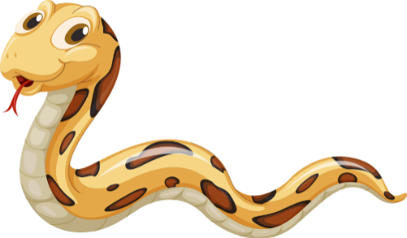
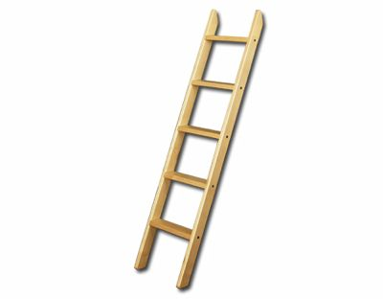

24 | 23 | 22 | 21 | 20 | 19
13 | 14 | 15 | 16 | 17 | 18
12 | 11 | 10 | 9 | 8 | 7
1 | 2 | 3 | 4 | 5 | 6

