Slide 1


Hello, how are you?
I hope you are fine!

Slide 2
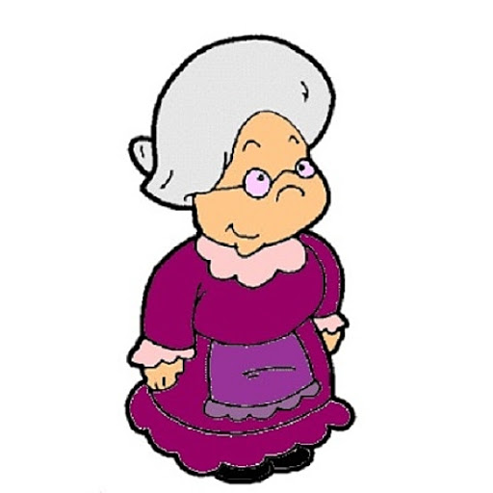
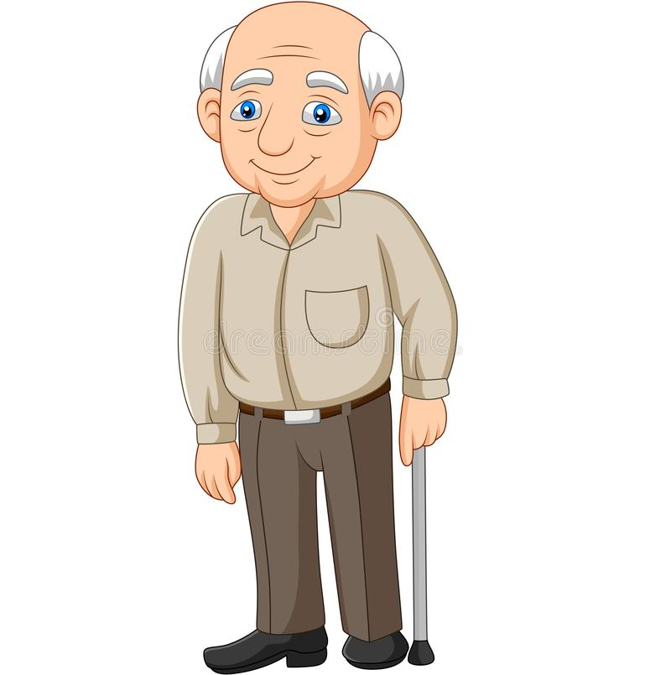
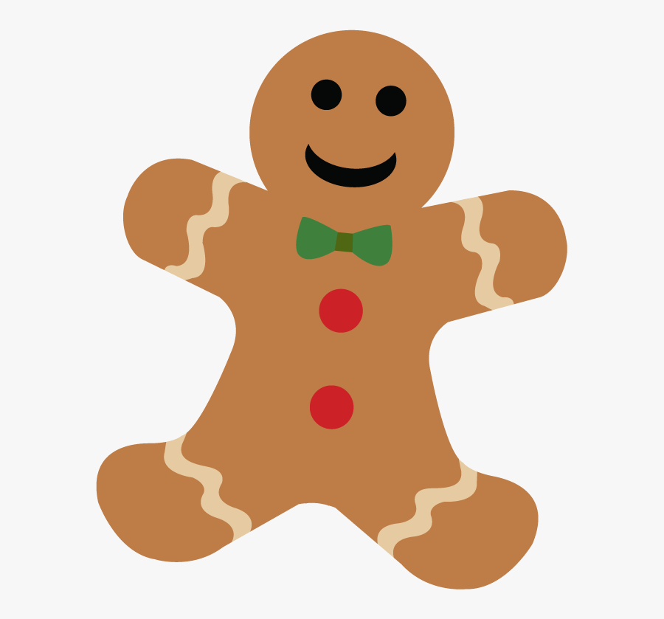

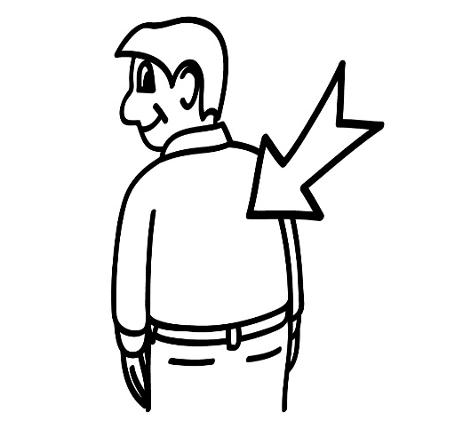

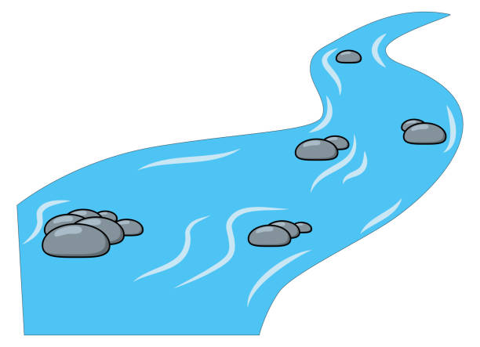
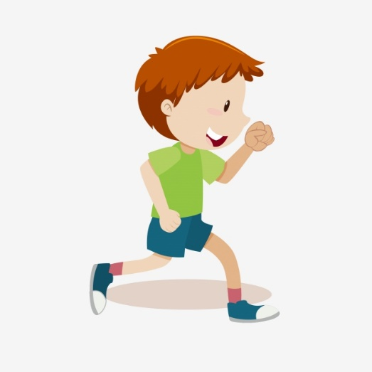

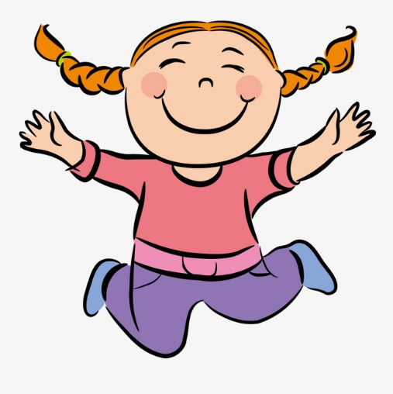

Slide 3
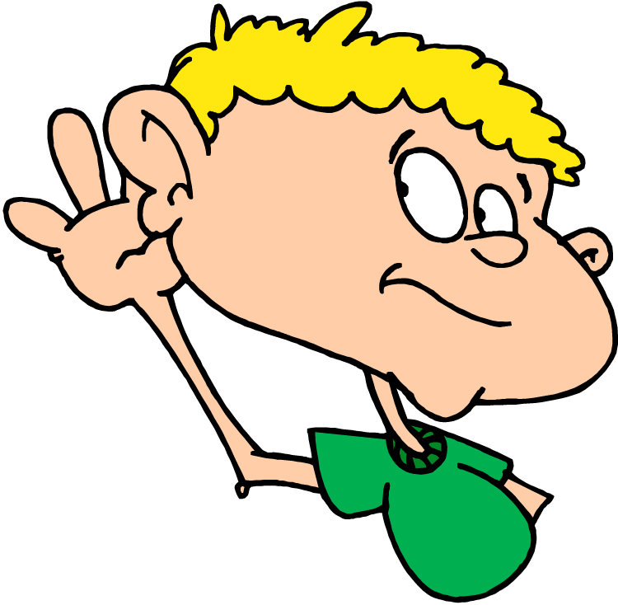

Listen and repeat:

Slide 4
AN OLD MAN

Slide 5
AN OLD WOMAN

Slide 6
A GINGERBREAD MAN

Slide 7
A FOX

Slide 8
A RIVER

Slide 9
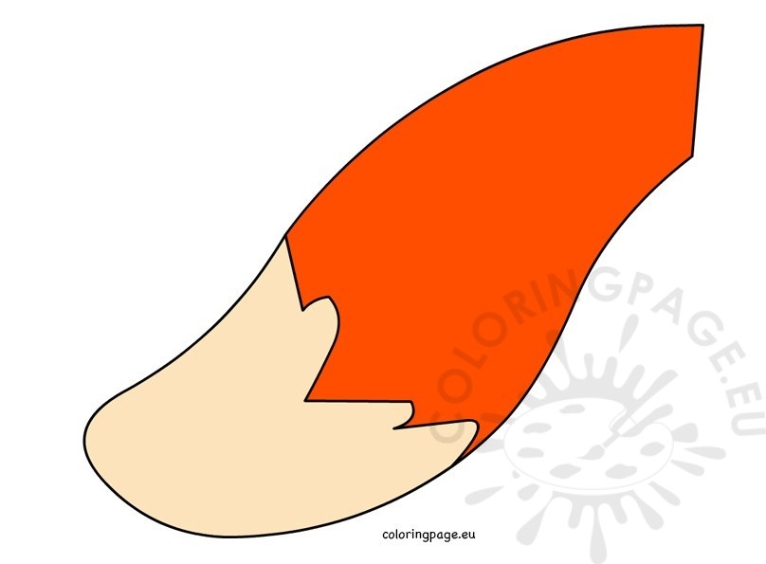
A TAIL

Slide 10

A BACK

Slide 11
RUN

Slide 12
SWIM

Slide 13
JUMP

Slide 14

WELL DONE.

