Slide 1


HELLO CHILDREN!
HOPE YOU ARE WELL AND EXCITED THAT WE ARE ONLY A WEEK AWAY FROM CHRISTMAS.

Slide 2
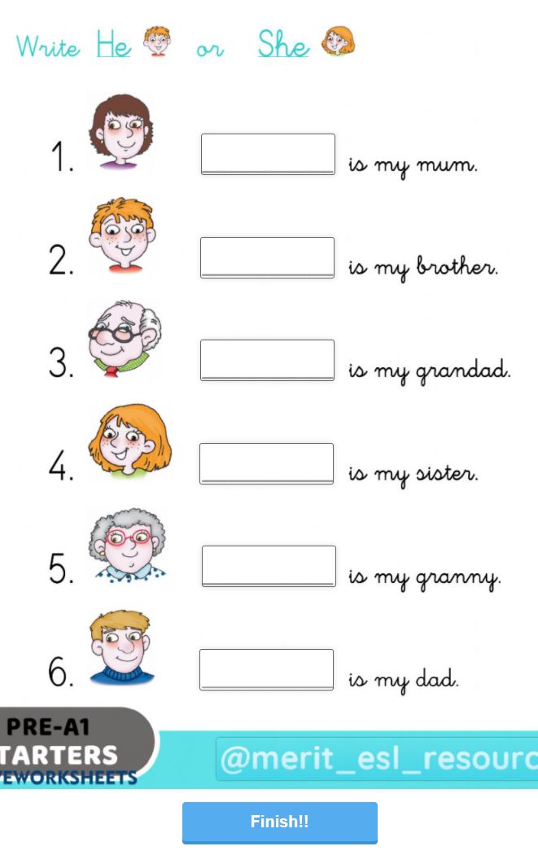
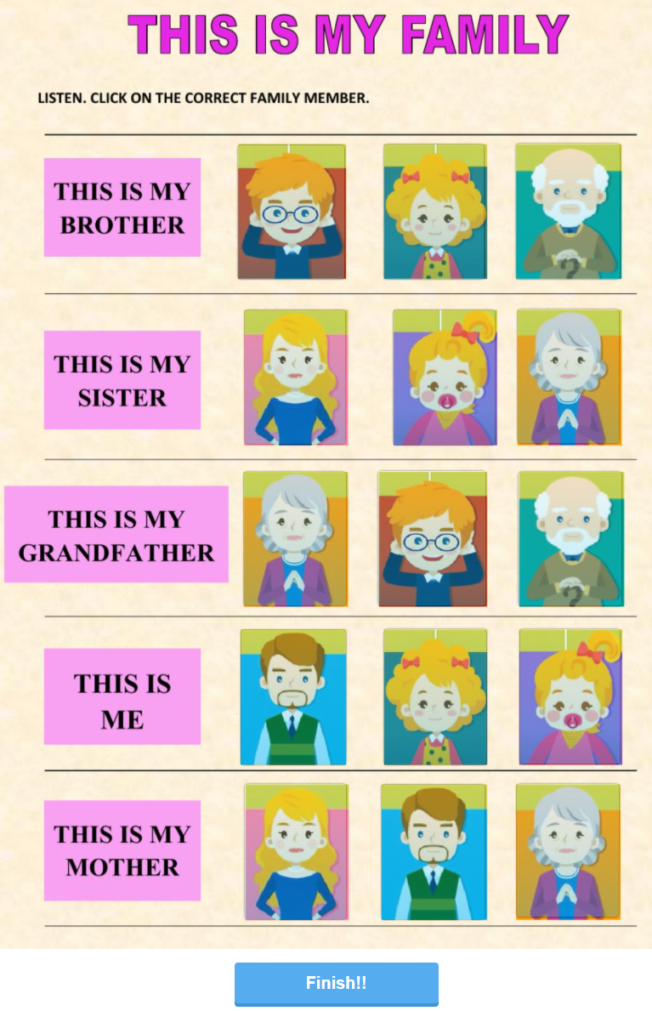
Vaji, ki ju vidite na straneh, najdete na povezavah spodaj. Desno poslušajte (v brskalniku Chrome preverjeno deluje) in nato kliknete pravo sliko v vrsti. Ko pridete do konca kliknete na gumb FINISH in vpišete svoje ime ter kliknete SEND.
Levo pa v prostorčke vpišete HE ali SHE ter končate na enak način kot prejšnjo.
https://www.liveworksheets.com/c?a=s&g=3.c&s=angle%C5%A1%C4%8Dina&t=a0fajthz66&l=qx&i=tszuz&r=vf&db=0
https://www.liveworksheets.com/c?a=s&g=3.c&s=angle%C5%A1%C4%8Dina&t=a0fajthz66&l=vz&i=cfxotx&r=mv&db=0

Slide 3


Slide 4
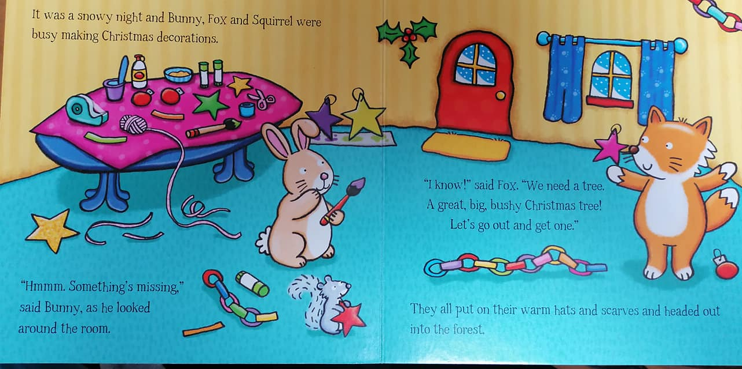

Slide 5
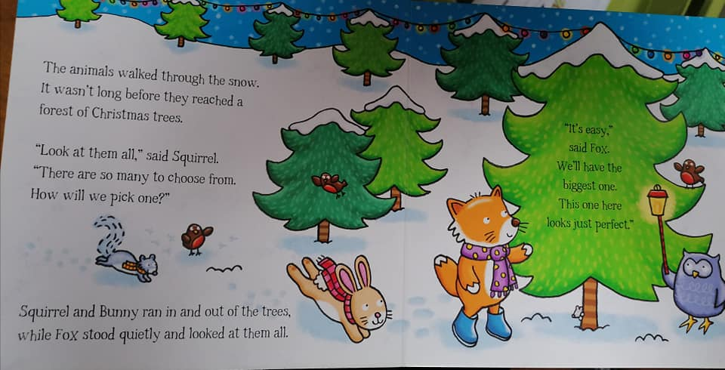

Slide 6
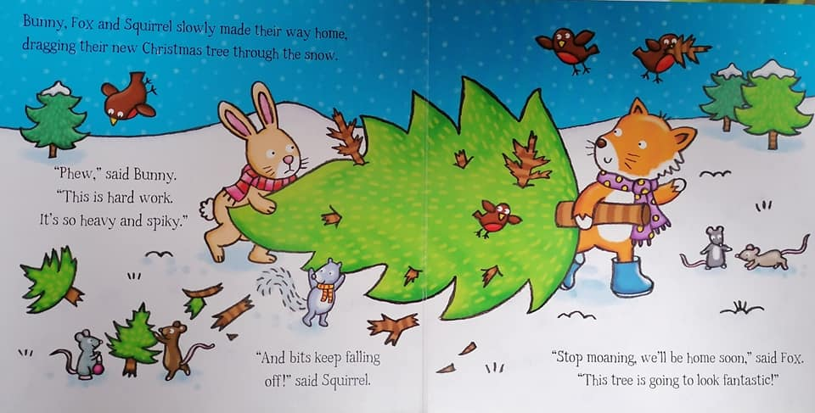

Slide 7
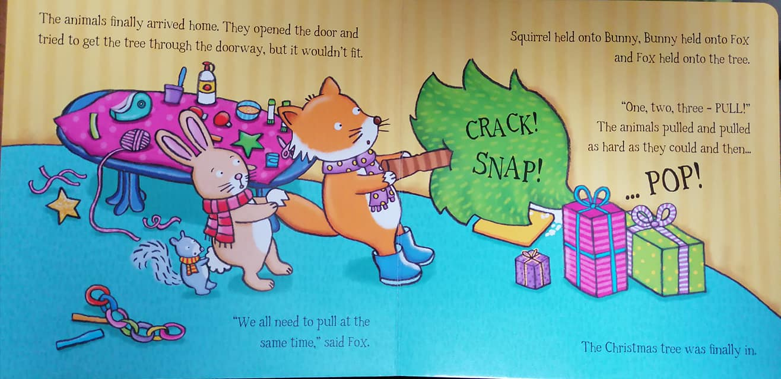

Slide 8
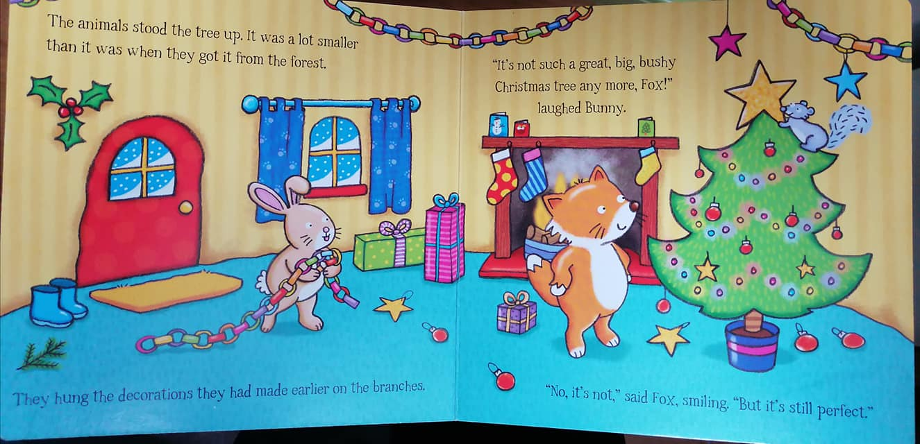

Slide 9
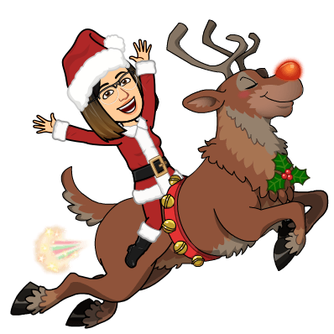
GOODBYE.
SEE YOU NEXT WEEK.

