Slide 1
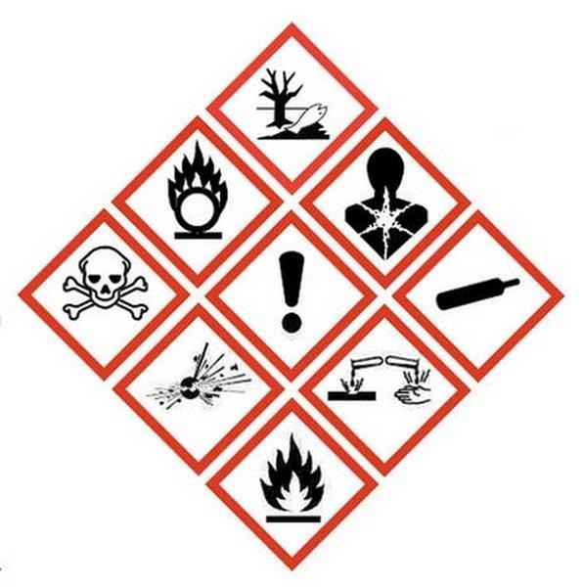

HAZARDOUS WASTE
SYMBOLS FOR LABELING OF HAZARDOUS SUBSTANCES

Slide 2
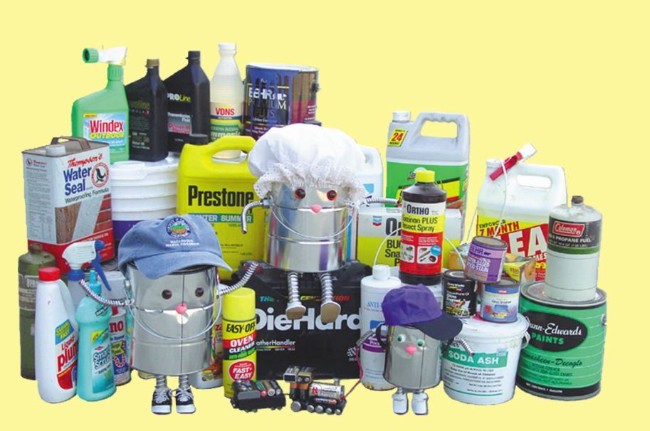
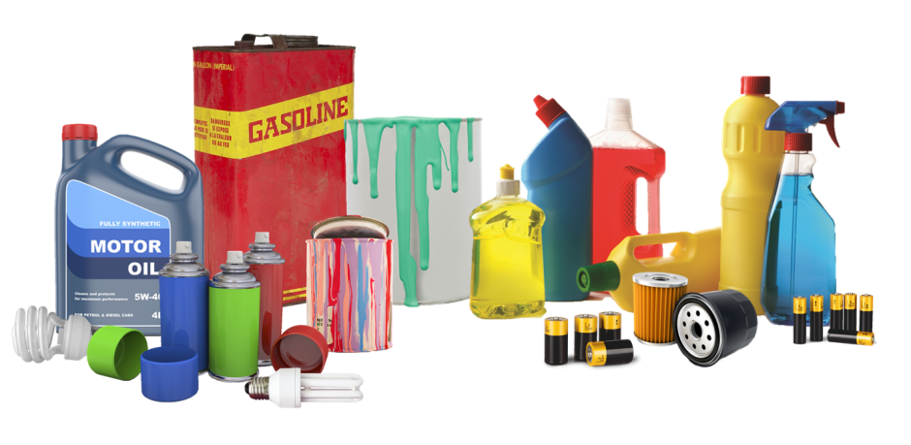
WHAT IS HAZARDOUS WASTE?
old automotive batteries,
batteries,
paints and solvents,
chemicals,
oils and grease,
pesticides (agents used to spray plants),
detergents and cosmetics containing dangerous substances,
medicines,
neon tubes (neon bulbs).

Slide 3
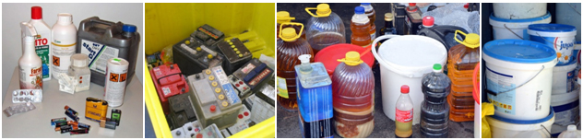
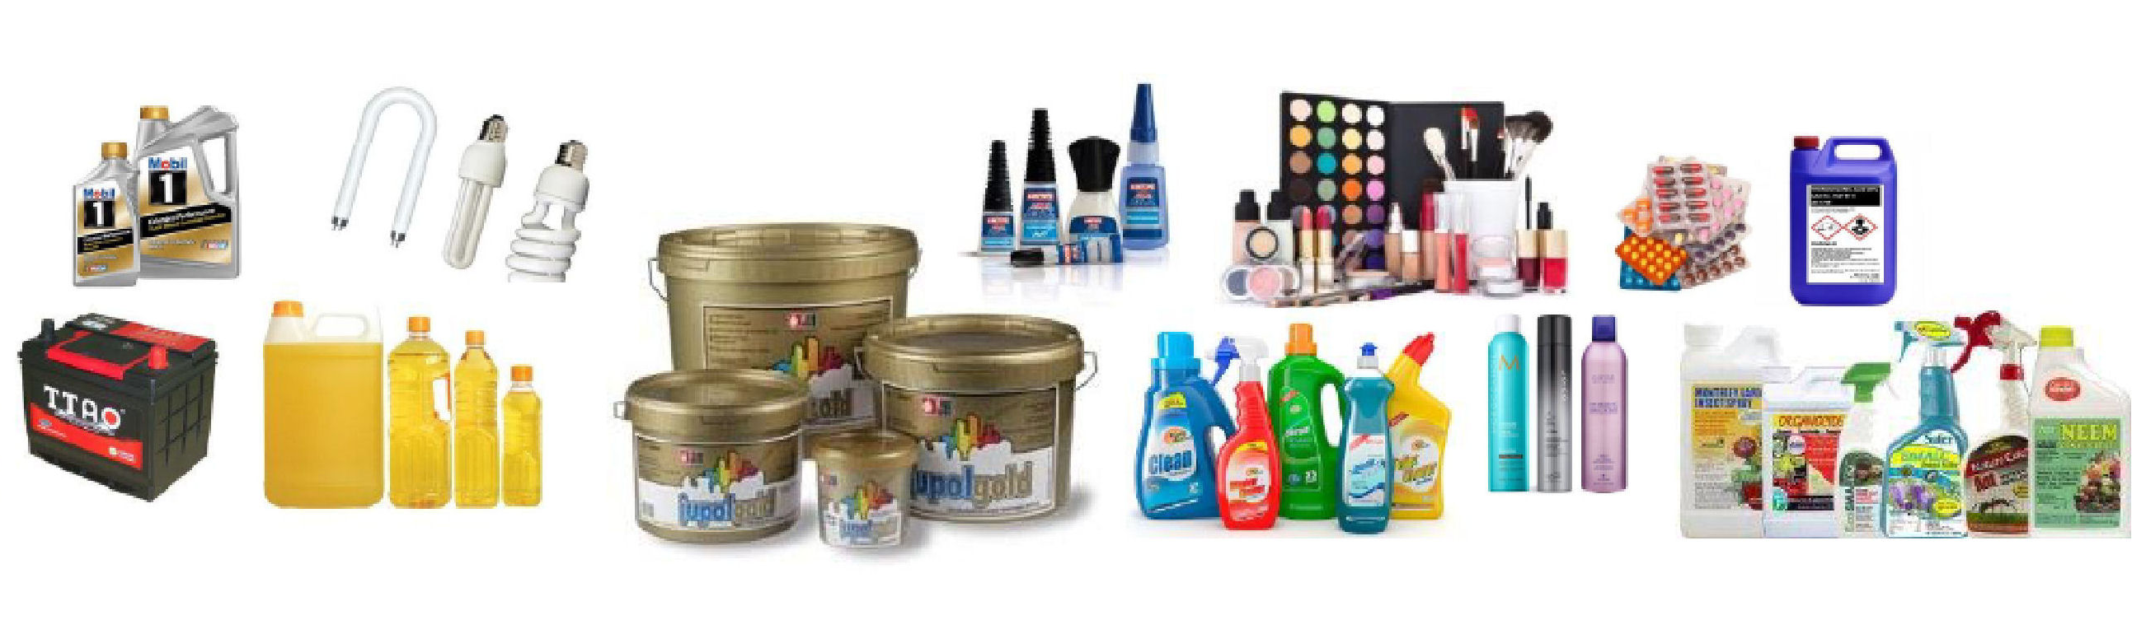
PRODUCTS CONTAINING HAZARDOUS SUBSTANCES

Slide 4
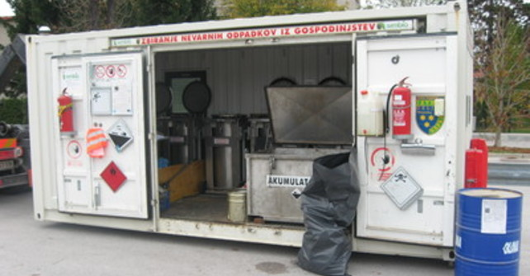
WHERE DO WE DISPOSE HAZARDOUS WASTE?
Hazardous waste is disposed in special containers, which are placed according to a schedule by the municipal service that takes care of waste management of a place.
Where we buy batteries or light bulbs, the store must have a special box where we can dispose used and unusable batteries or light bulbs.

Slide 5
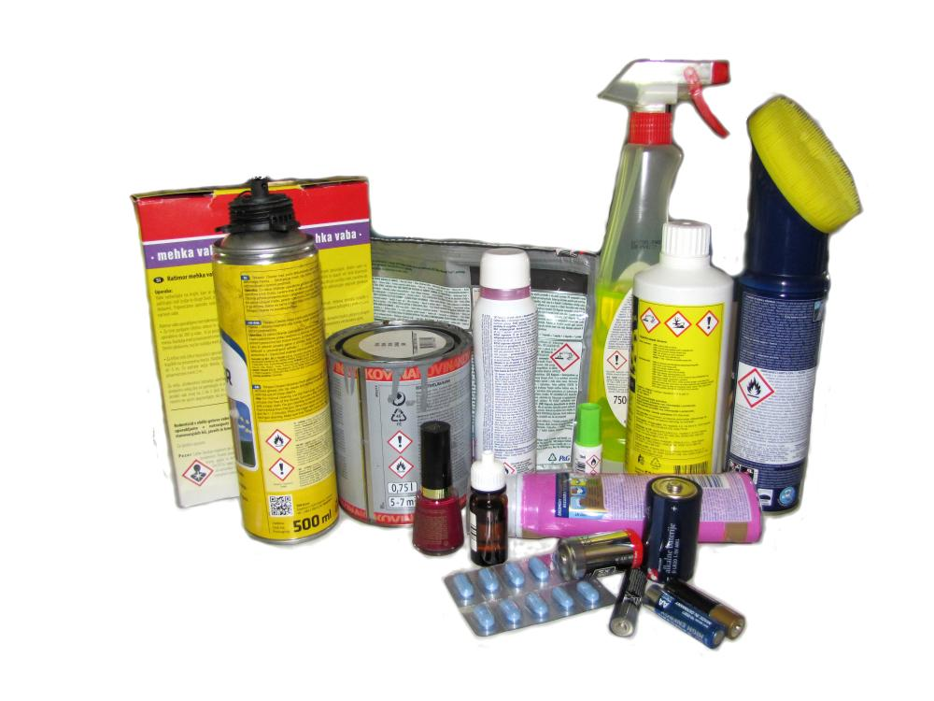
HOW CAN I REDUCE THE AMOUNT OF HAZARDOUS WASTE?
The amount of hazardous waste can already be reduced by shopping, as we can give preference among similar products to those that are not dangerous for the environment or contain less environmentally hazardous substances.
Symbols of hazardous substances can be found on their packaging and are of great help in identifying hazardous waste.

Slide 6
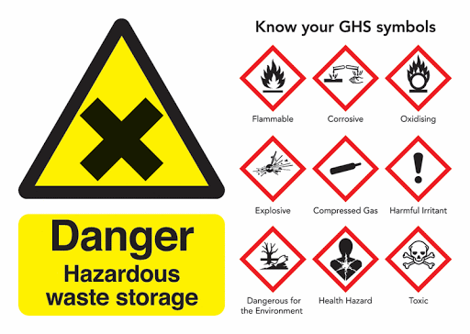
LABELS FOR HAZARDOUS WASTE

Slide 7
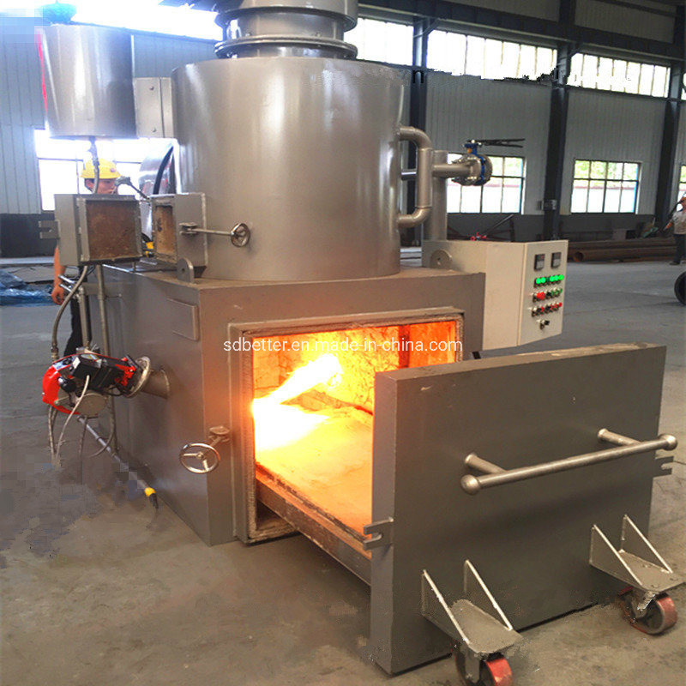
WHAT IS DONE WITH HAZARDOUS WASTE?
Some waste is processed (oils and thinners),
some is burned (medicines, plant protection products),
acids are neutralized,
batteries are recycled.

Slide 8
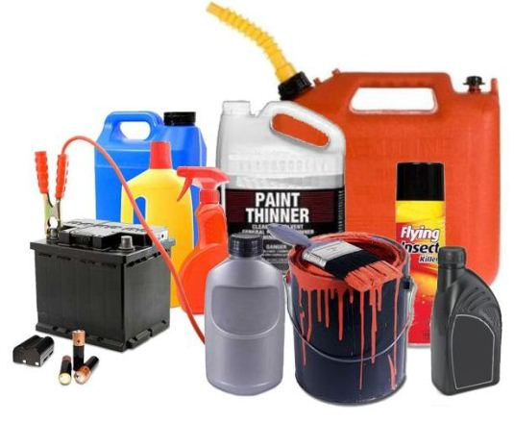



WRITTEN BY:
“The sense of responsibility
for Environment”
Teachers of
OŠ Cvetka Golarja Škofja Loka:
MAJDA OVSENEK, Jerneja Bokal
and Nina Granda.
November 2020

