Slide 1
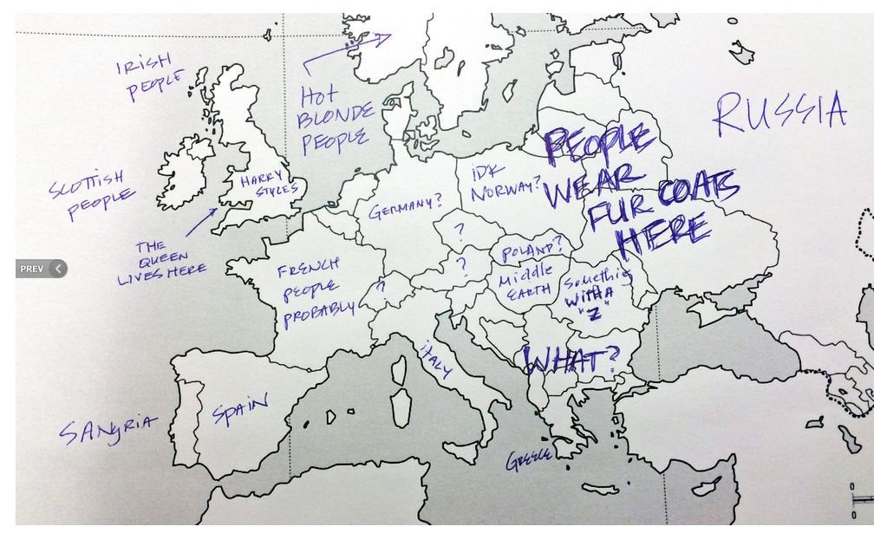
How Americans see Europe ☺
Source: https://www.reddit.com/r/funny/comments/1rn74r/how_americans_see_europe/

Slide 2
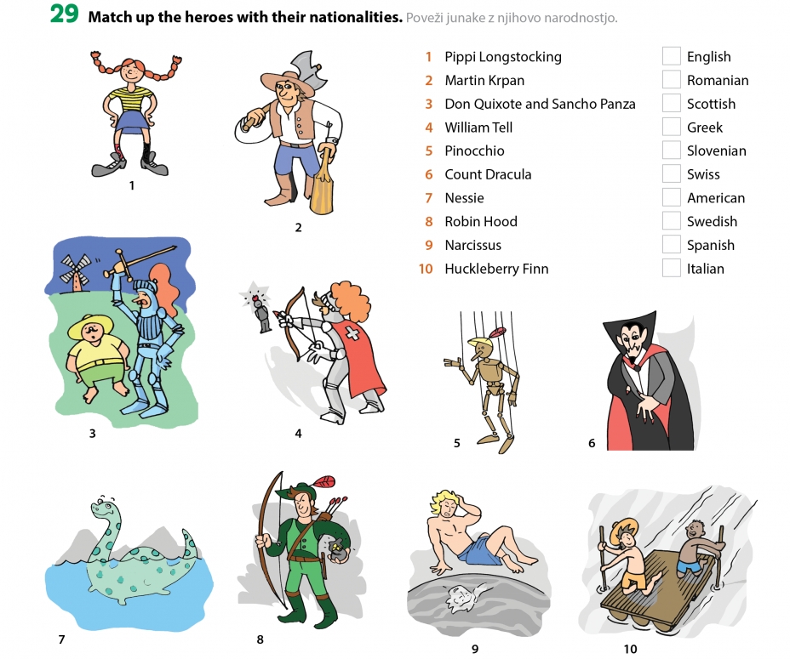

Slide 3
