Slide 1
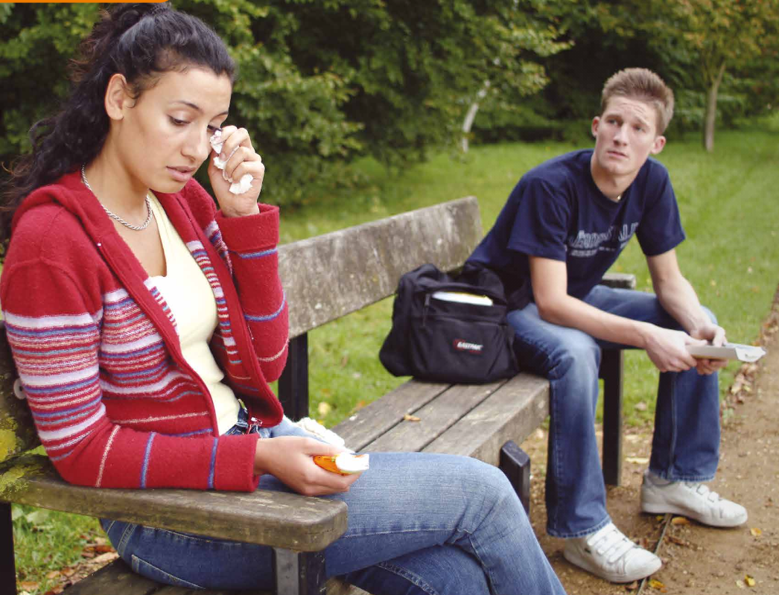

Slide 2
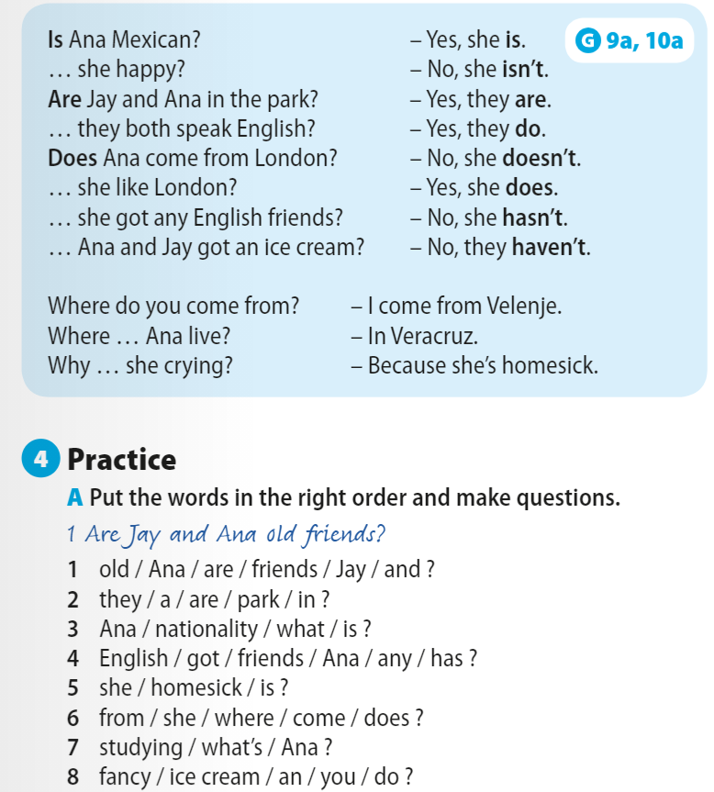
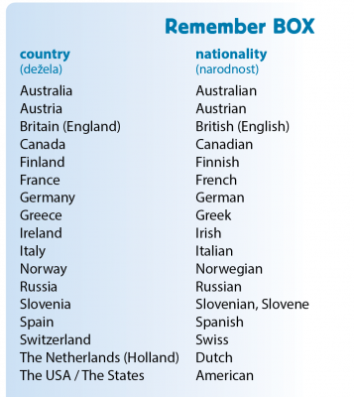

Slide 3
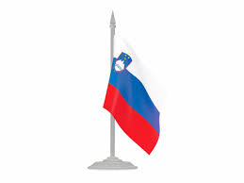



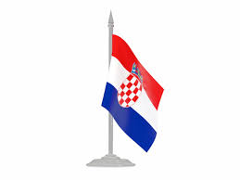



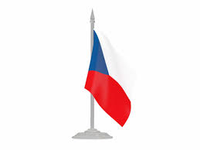
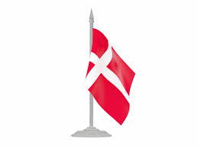



Slide 4
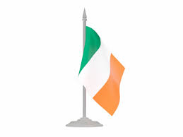
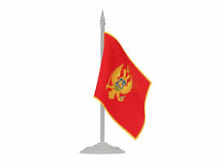

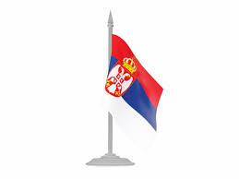

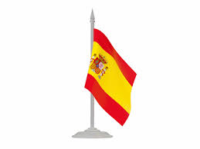


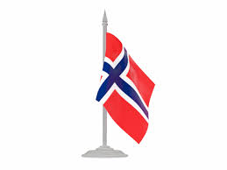

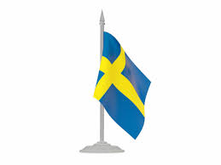


Slide 5



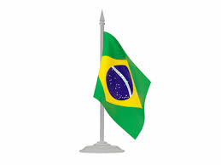

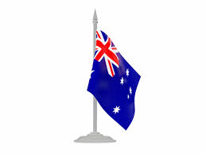

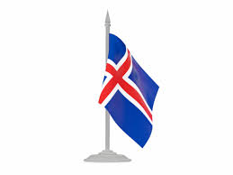

Slide 6
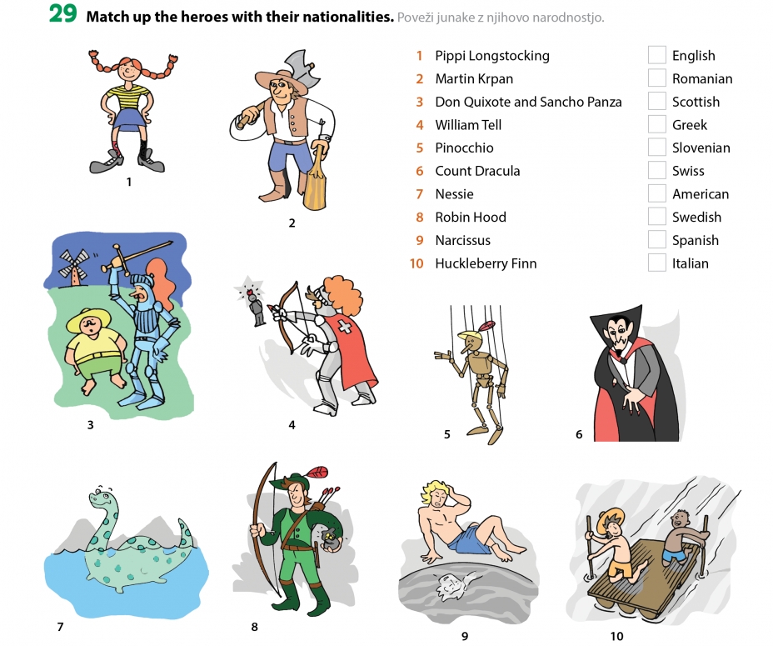

Slide 7
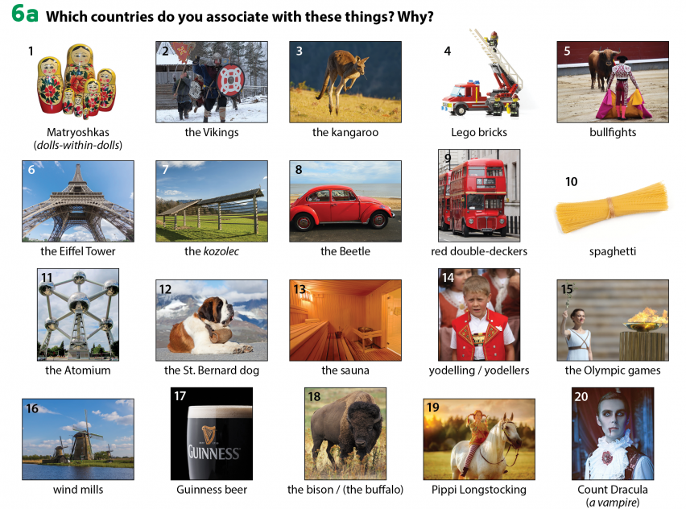
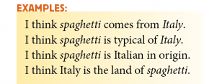
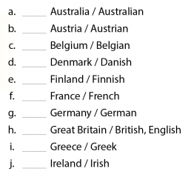
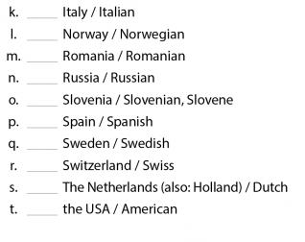

Slide 8
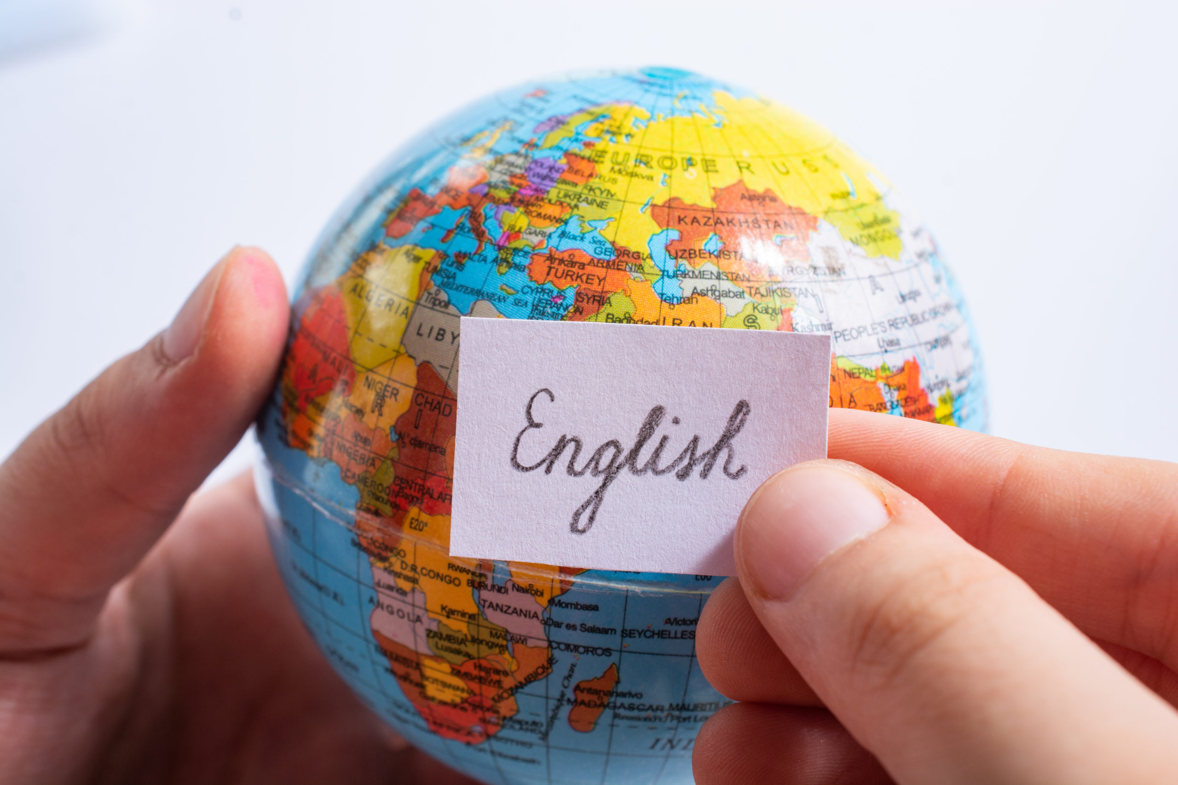

Slide 9


English worldwide-vocabulary
→ First language-second language
→ Official language
→ Population (n)
→ Population (n); Slovenia has the population of 2,1 million people.
→ Travel abroad
→(non)native speaker of English
→ Estimate (n, v)
→ communicate (v) → communication (n)
→ Change (v,n)
→ Research (v, n) → do/conduct/carry out/perform a research
→ One billion=milijarda!

Slide 10
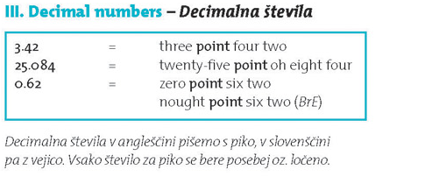
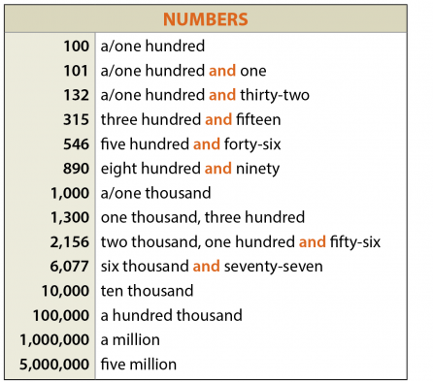
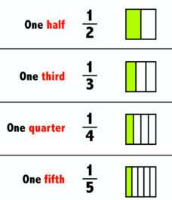


Pri pisanju tisočice ločimo z vejico, ne s piko!
Besede hundred, thousand in million nimajo množine!

Slide 11
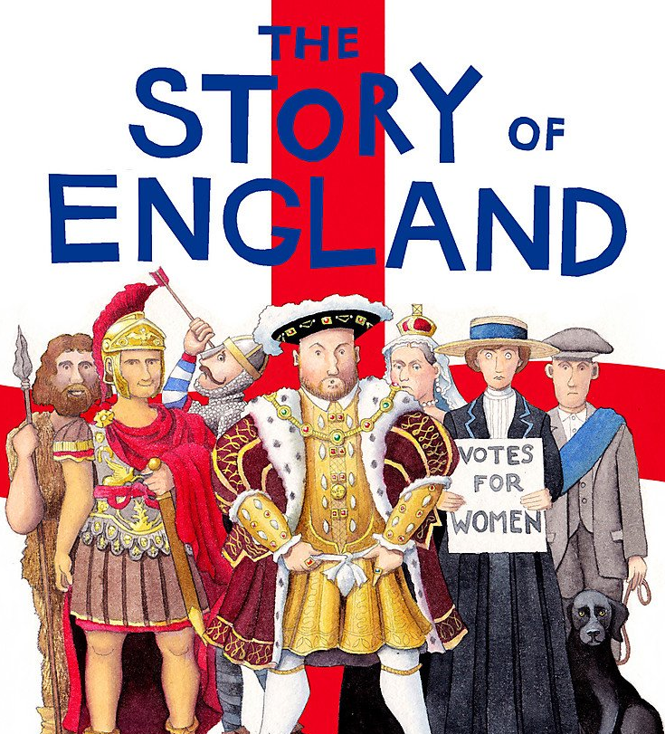

Slide 12
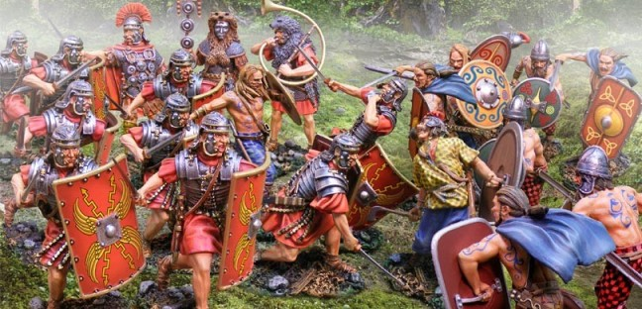
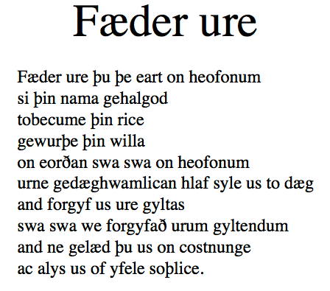
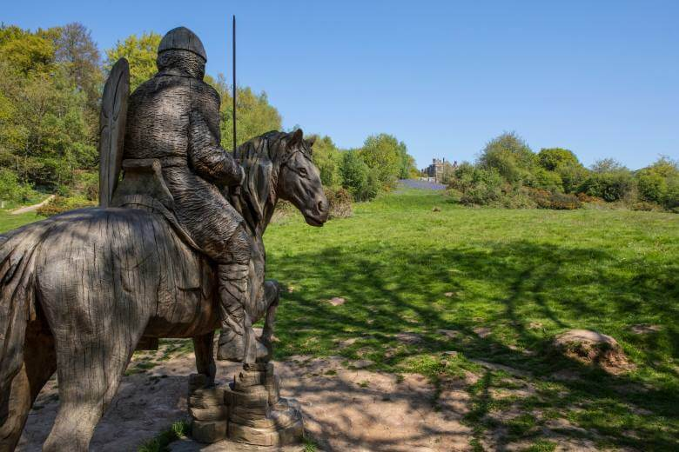
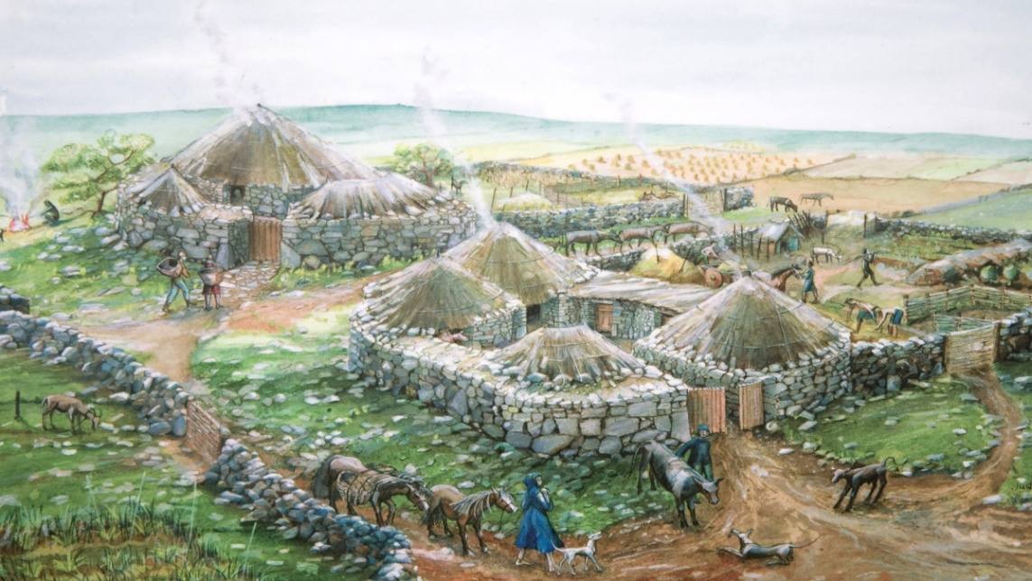


Slide 13
vocabulary
a mixture of (n) → to mix (v)
a dictionary (n) SLOVAR
law (n) → a new law lawyer!
ODVETNIK
to explain (v) → explanation (n) POJASNITI
PRAVO/ZAKON
a parliament (n)
spelling (n) → to spell a word ČRKOVANJE
an inhabitant (n) → !ancestor PREDNIK !descendant POTOMEC
the pronunciation (n) → to pronounce (v) IZGOVORJAVA
a settler (n) → to settle (v) NASELJENEC
strange (adj), confusing (adj) ČUDEN/ZAPLETEN
to arrive (v) → arrival (n) PRISPETI
alphabet (n), numerals (n)
to invade a country (v) → invaders (n) → invasion (n)
NAPASTI
God/GODDESS (n)
to defeat (v) → a defeat (n)=poraz
BOGINJA
PREMAGATI
to rule (v)
to make an agreement = to agree WITH sth DOGOVORITI SE
VLADATI
to replace (v) → a replacement (n)
the royal court
ZAMENJAVA
KRALJEVI DVOR
to appear (v) → appearance (n)
POJAVITI SE
to publish (v)
OBJAVITI
an accent (n)
NAGLAS
a conversation (n) → to converse (v)
POGOVOR

