Slide 1

ANIMAL BODY PARTS

Slide 2
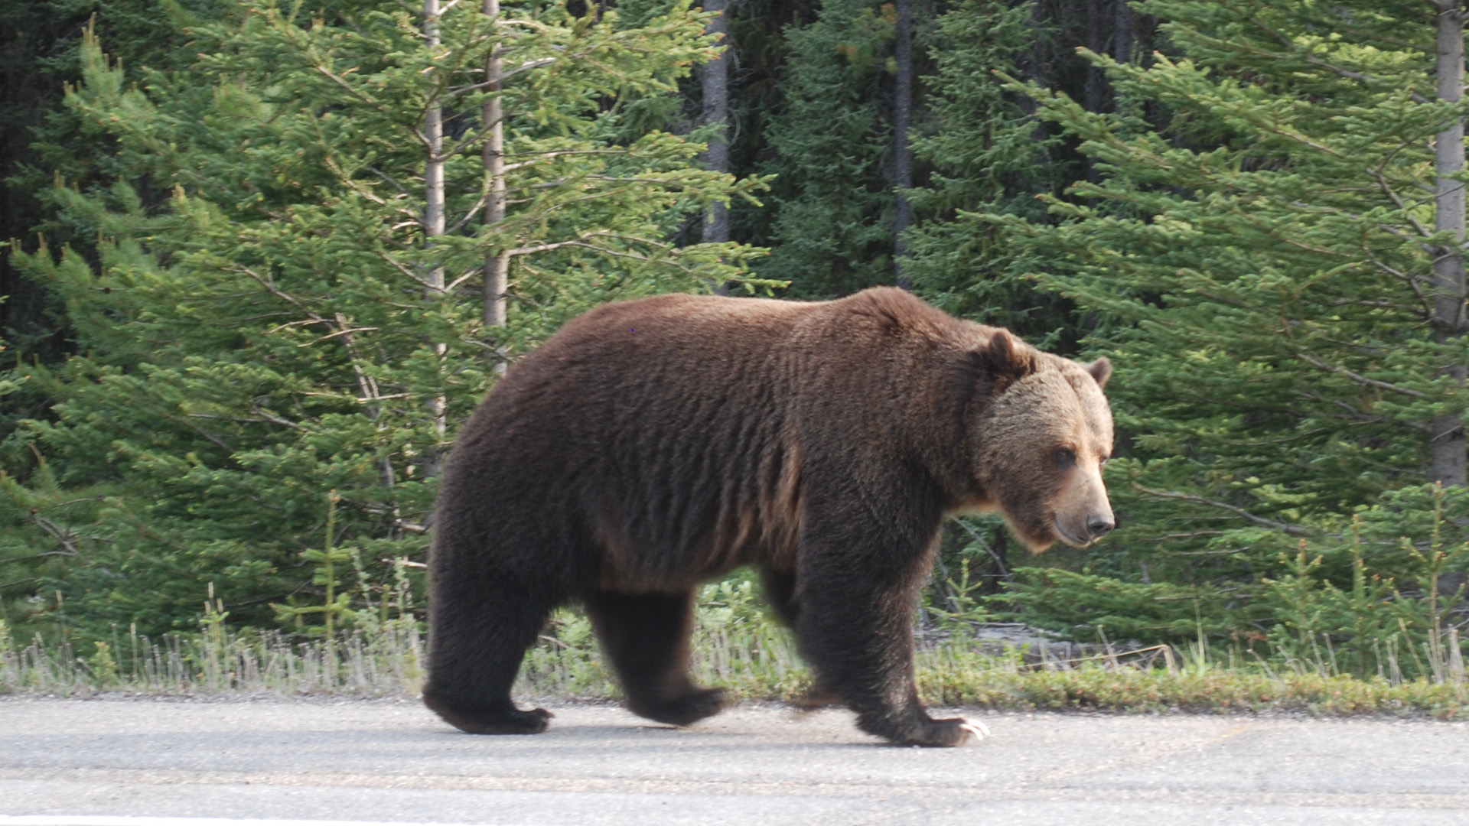
LET‘S DESCRIBE A BEAR
ANIMAL
COLOUR
BIG / SMALL
FAST / SLOW
LEGS
EATS
LIVES

Slide 3

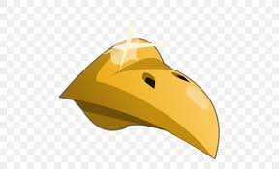
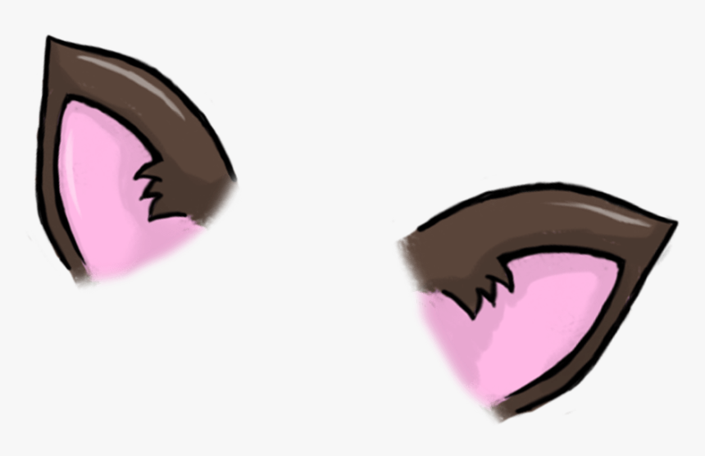





ANIMAL BODY PARTS

Slide 4
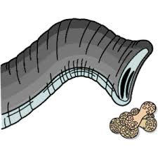

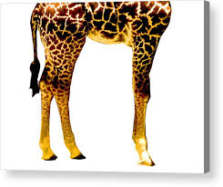
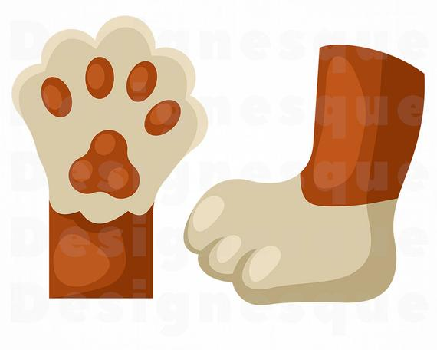
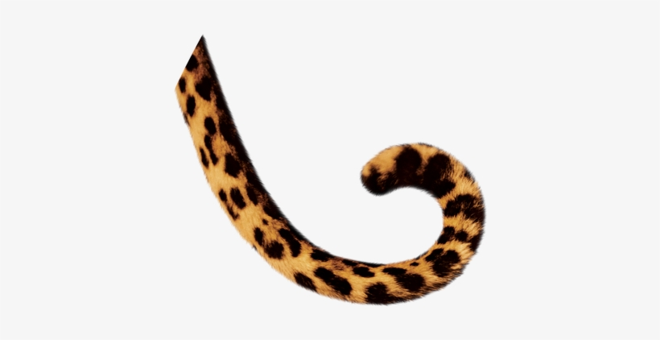


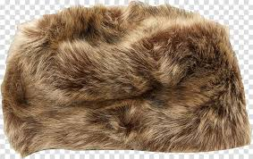


ANIMAL BODY PARTS

Slide 5
HOMEWORK
Napiši stavke, tako da uporabiš živalske dele telesa npr:
A cat has got whiskers.
A parrot has got a beak.

