Slide 1
Regular and irregular plural

Slide 2
Add - s

Slide 3



2. Add - es
bus es Box es class es fox es watch es brush es beach es tomato es

Slide 4
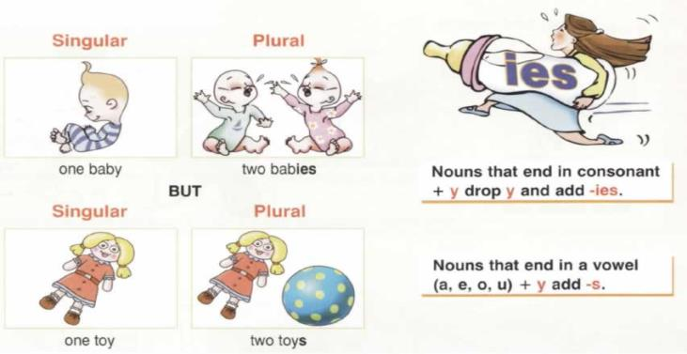
3.Drop –Y and add – ies
BAB
Y
+
IES
BAB
IES

Slide 5


Slide 6
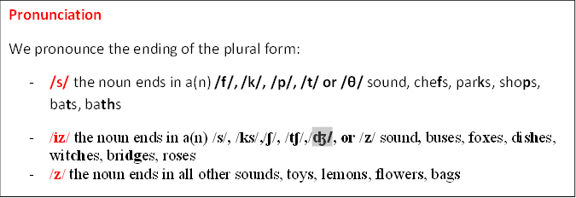

Slide 7

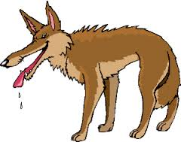


Nouns ending in ‘f’ or ‘fe’, change ‘f’’ to ‘v’ and add ‘es’.
life – lives
wife – wives
loaf – loaves
knife – knives
wolf – wolves
thief-thieves

Slide 8
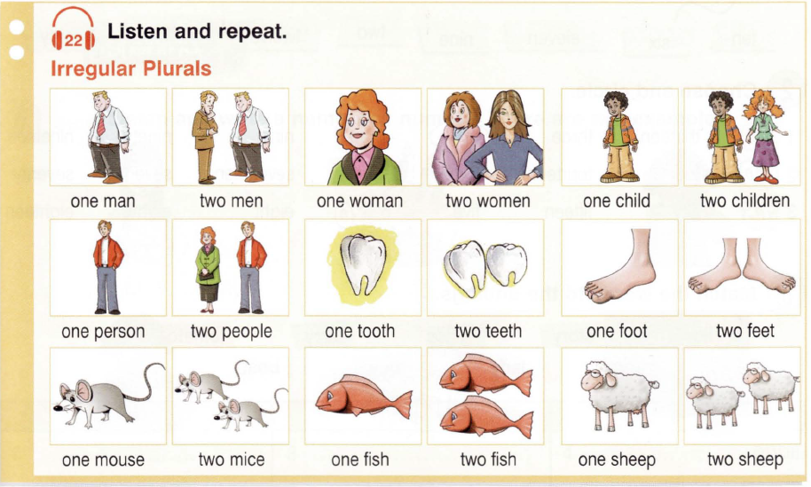

Slide 9

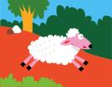


child
tooth
foot
children
teeth
feet
mouse
sheep
woman
mice
sheep
women
man
person
fish
men
people
fish

Slide 10
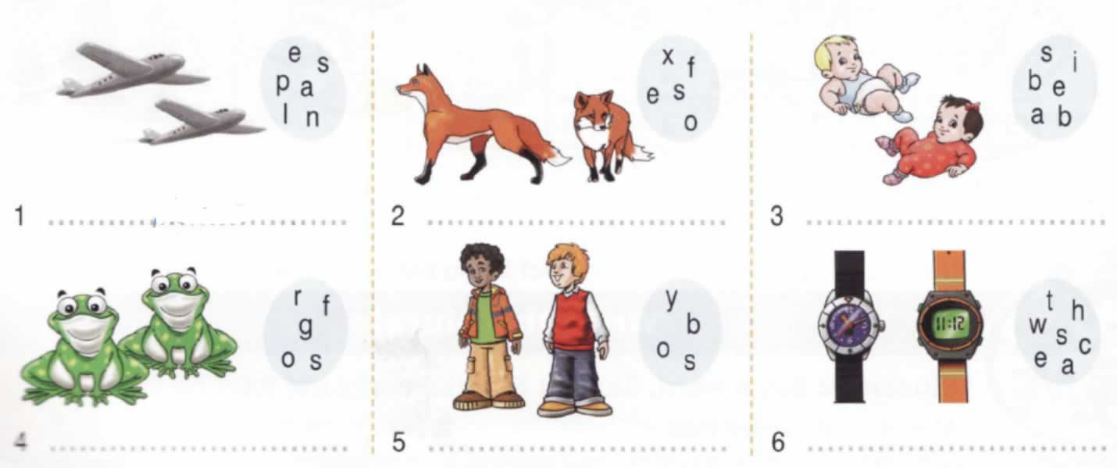
Plane fox baby
Frog boy watch
planes
foxes
babies
frogs
boys
watches

Slide 11
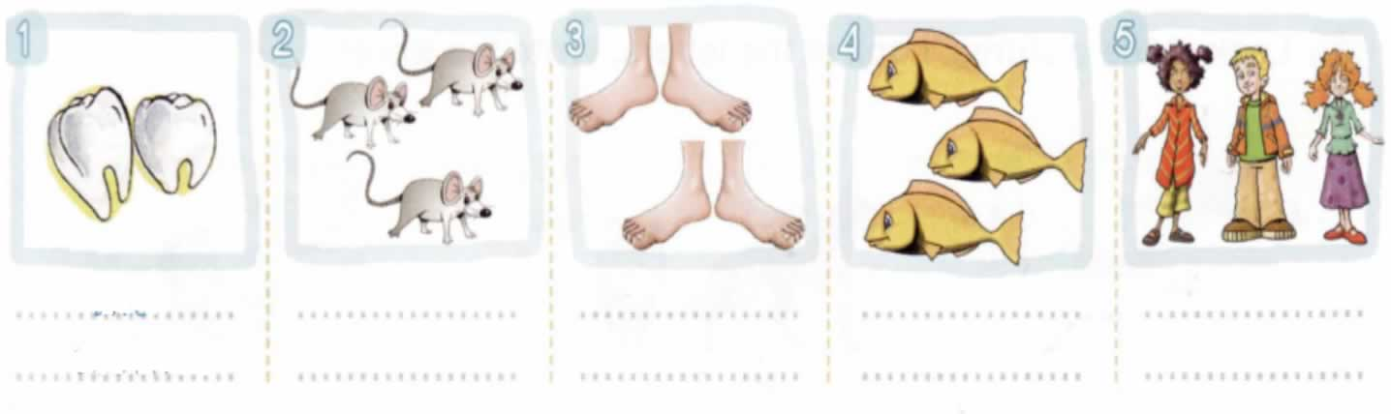
Tooth mouse foot fish child
Two teeth
Three
mice
Four feet
Three fish
Three children

