Slide 1












Means of transport

Slide 2


a train

Slide 3


a car

Slide 4


a lorry, a truck

Slide 5
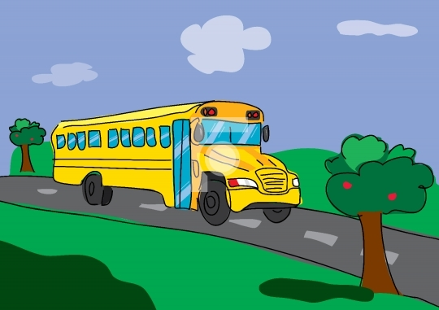
a bus

Slide 6

a school bus

Slide 7



Slide 8

a ship

Slide 9

a row boat

Slide 10

a plane

Slide 11

a helicopter

Slide 12

a rocket

Slide 13


a hot air
balloon

Slide 14
PREPIŠITE ZDAJ V ZVEZEK ZA ANGLEŠČINO NASLOV, NATO BESEDE:
Means of transport (prevozna sredstva)
avto = a car
tovornjak = a lorry, a truck
avtobus = a bus
vlak = a train
kolo = a bicycle, a bike
ladja = a ship
čoln = a row boat
letalo = a plane
helikopter = a helicopter
balon na vroč zrak = a hot air balloon
raketa = a rocket

Slide 15
Zapojte si to pesmico:
KLIKNI NA POVEZAVO ODSPODAJ:
https://www.youtube.com/watch?v=cSw50Jw0H34

