Slide 1

Family and the three good men
NAVODILO: Zapiši naslov z rdečo. Na vsaki strani te čaka:
ali nekaj za prepisati. To prepiši v zvezek za angleščino.
ali nekaj za izgovarjati,
ali nekaj za odgovoriti, po angleško. Klikaj.

Slide 2
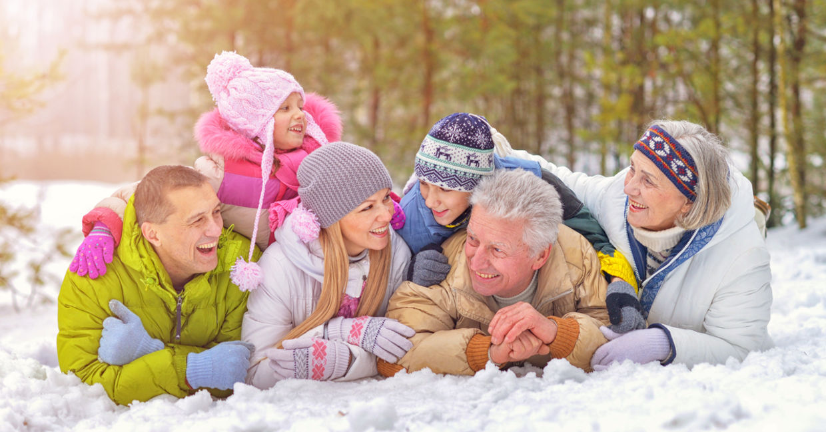
A typical family is mother, father, sister, brother, grandmother and grandfather. (Ne pozabi prepisati.)

Slide 3
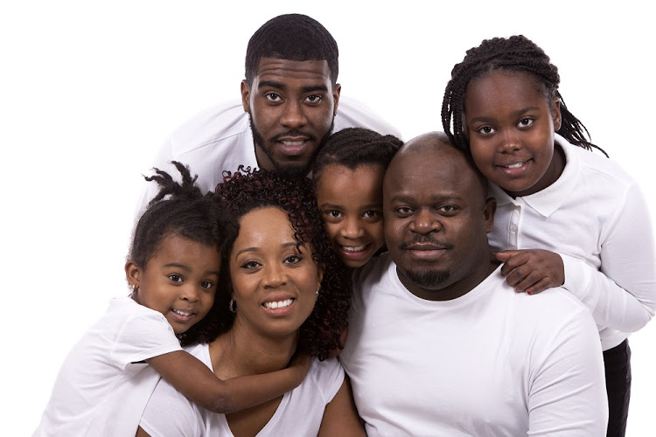

Slide 4


Slide 5
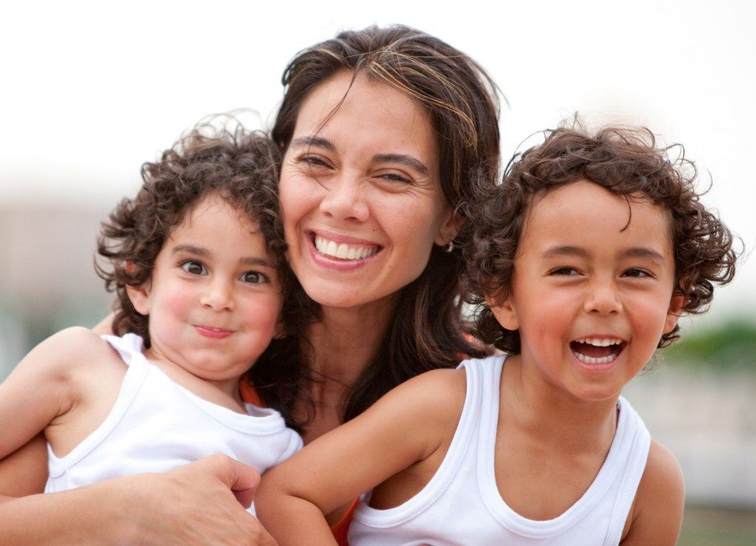

Slide 6
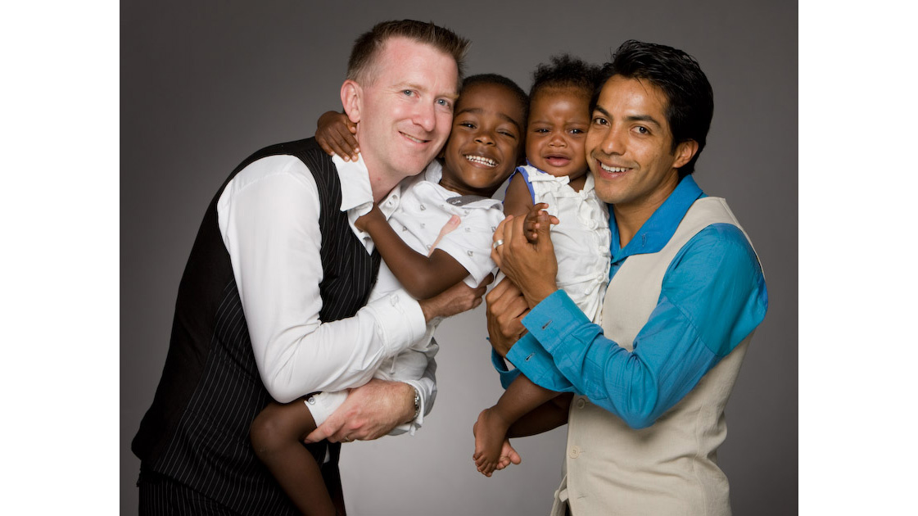

Slide 7
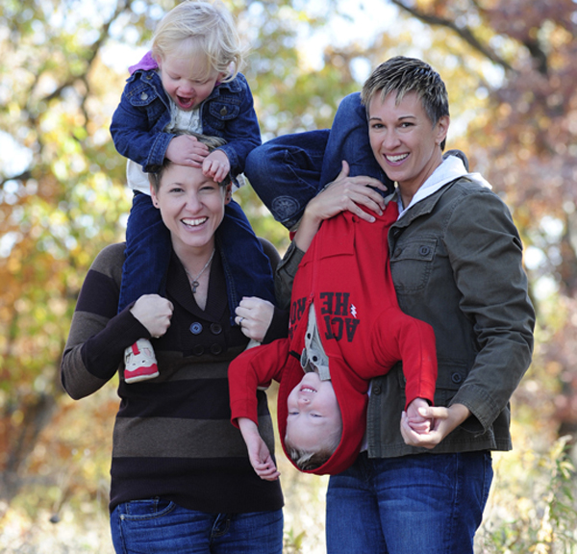

Slide 8
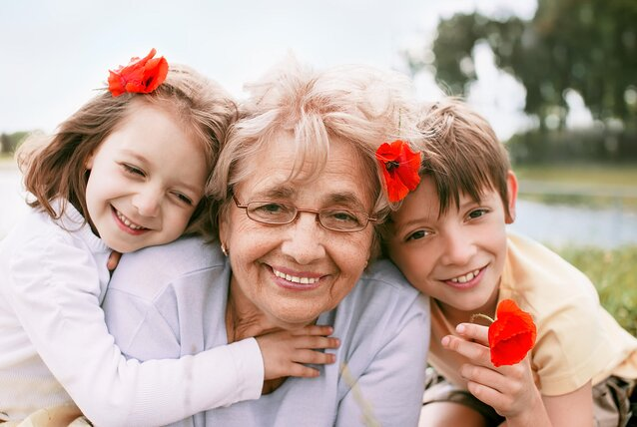

Slide 9


Slide 10
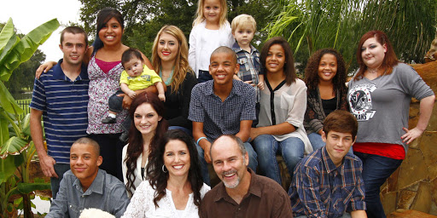

Slide 11
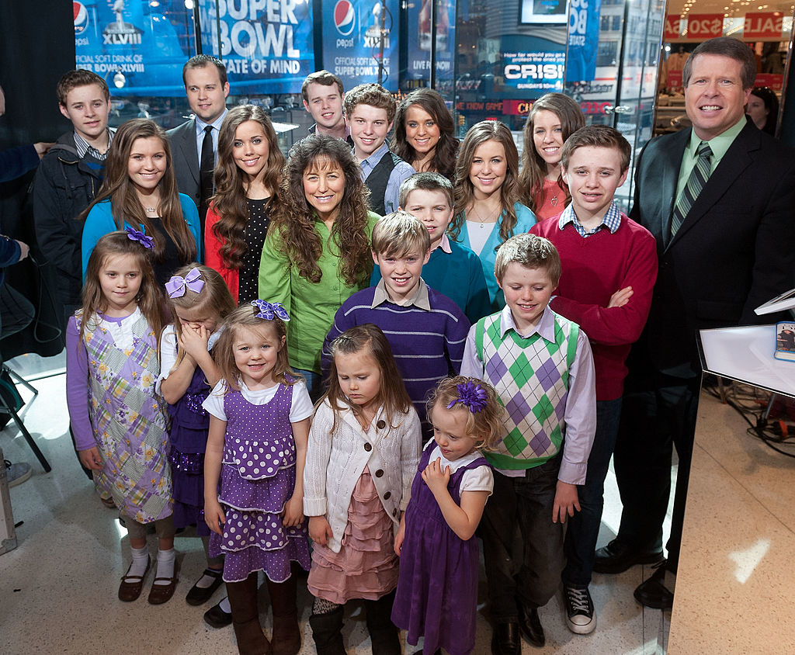


Slide 12

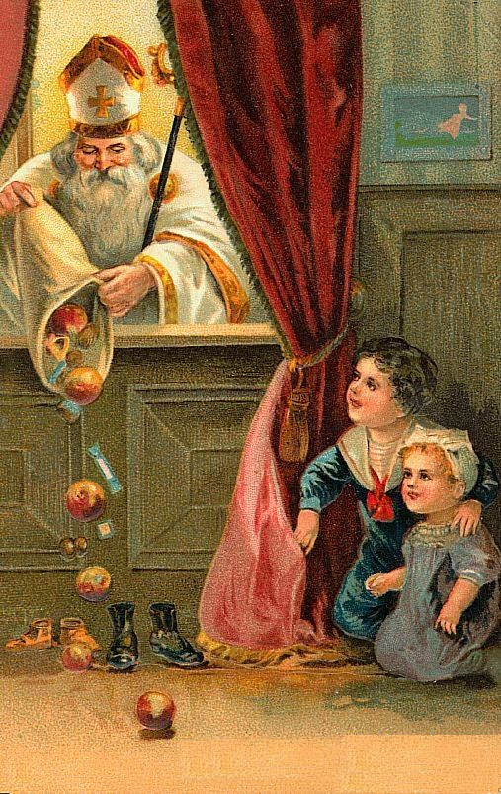
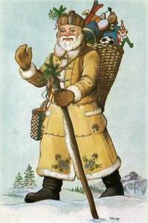
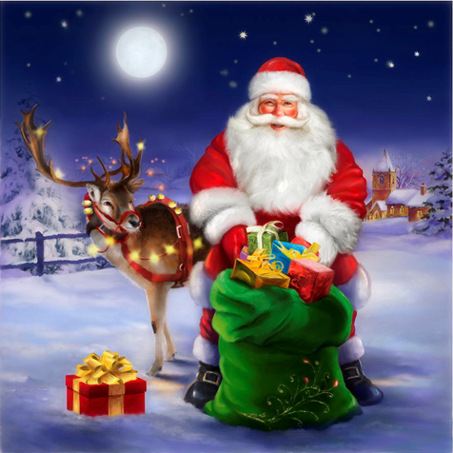
The three good men are Saint Nickolas, Santa Claus and Father Frost.

Slide 13
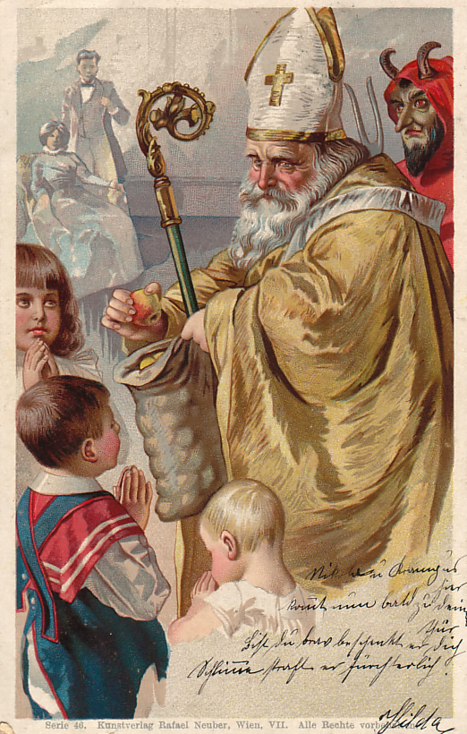
Saint Nickolas brings apples and oranges to children.

Slide 14
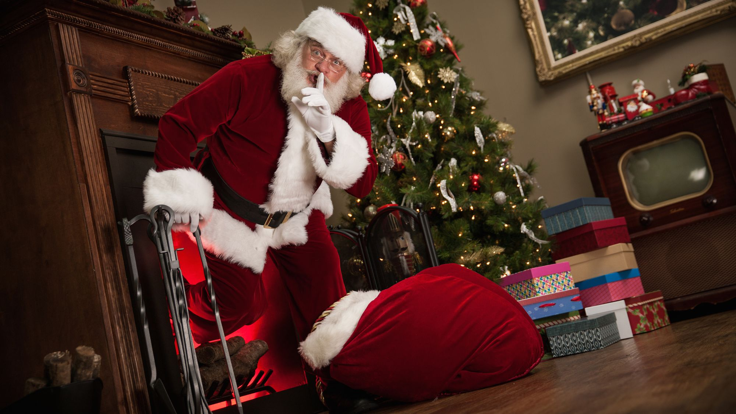
Santa Claus brings presents at night.

Slide 15
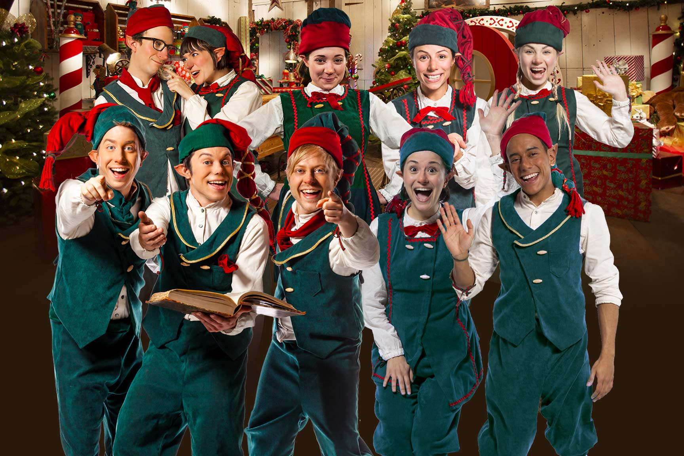
The elves help Santa Claus.

Slide 16
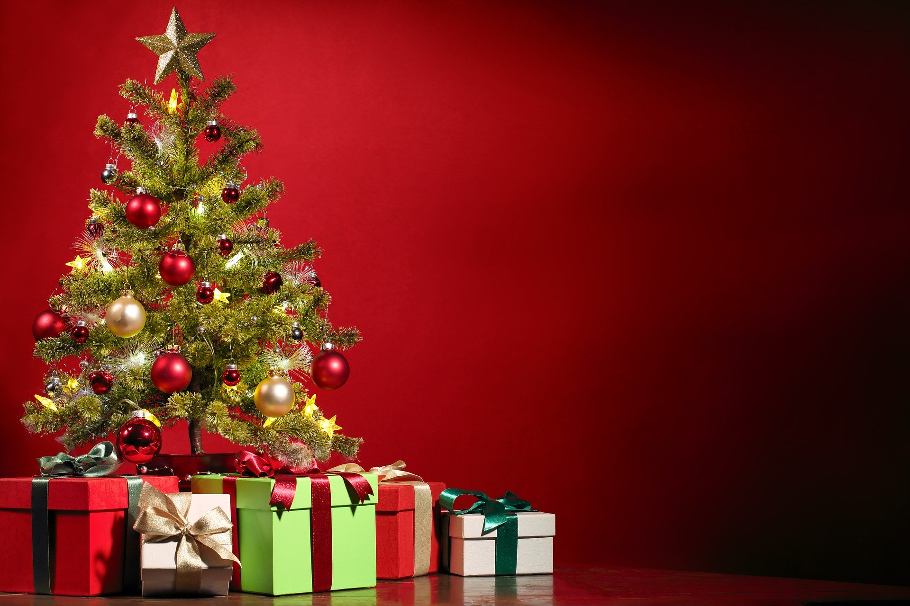
Darila pod jelko. = Presents under the Christmas tree.

Slide 17
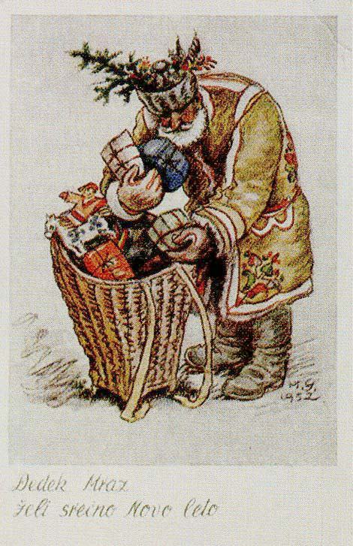
Father Frost comes at the end of the year.
He brings presents, too.

