Slide 1
Hello, clunk
Angleška bralna značka

Slide 2
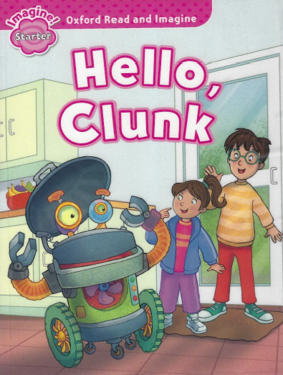

Slide 3
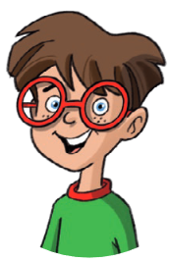
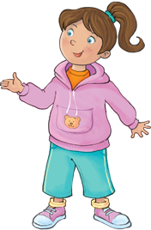
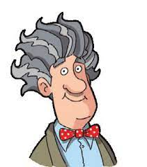
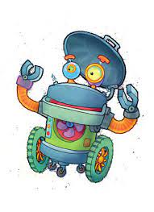
Who is this?
BEN
GRANDPA
ROSIE
ROBOT CLUNK

Slide 4

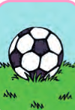



What‘s this?
A ball
A book
To eat
A banana
An arm

Slide 5





What‘s this?
Colour yellow
A robot
A wheel
Number two
Kitchen

Slide 6



What‘s this?
Hello
Number five
Head

Slide 7
Who says this?
What‘s this, grandpa?
It‘s an arm.
Is this a banana?

Slide 8
Say YES or NO.
Grandpa is in the school.
Ben and Rosie are in the kitchen.
Clunk is a dog.
Bananas are yellow.
Clunk doesn‘t like bananas.
You can eat bananas.
NO
YES
NO
YES
NO
YES

Slide 9
Say TRUE or FALSE
This is a robot.
This is an arm.
TRUE
FALSE
This is a book.
This is a an arm.
FALSE
TRUE

Slide 10
Who says this?
Is this a banana?
No. It‘s a book.
No. It‘s a ball.

Slide 11
Which one is it?
A wheel
A book

Slide 12

Which one is it?
An arm
Hello

