Slide 1
CULTURES

Slide 2
Your roots
Where do your family originally come from?
Have they always lived in your town?
Where were your grandparents born?
Did they ever move to another town or country? When? Why?
Has anyone in your family ever emigrated? Where did they go? Why?

Slide 3
PAIRWORK
Write down all the things that define a certain culture:

Slide 4
Things that define a culture:
Customs
Clothing
Religion
Language
Architecture
Music
Geography
History
Food
Arts and design
Literature
…

Slide 5
CULTURAL IDENTITY
defined by a group or culture with which you identify (BELONGING)
the identification with + perceived acceptance into a group that has a shared system of symbols and meanings as well as norms for conduct
“the reflective self-conception or self-image that we each derive from our family, gender, cultural, ethnic, and individual socialization process” (Ting- Toomey, 1999)

Slide 6
Discuss:
Why is it difficult to define the word ‘culture’?
Why do people identify with cultures and cultural groups?
How important is it to know other cultures (for adults/children)?
How would you present this topic to children? Which culture would you present?

Slide 7
    Culture as identity or belonging – one’s roots:
  involves understanding the groups we belong to,
  similarities and differences of these and other groups and associated beliefs and practices;
  the assumption our own beliefs or understanding are ‘normal’.

Slide 8
Culture both bonds those who do fit in and excludes those who do not.
Belonging provides a framework for security, based on shared experiences – symbols, clothes, religion, music, language.

Slide 9
Cultural bumps/clashes
e.g. signs of friendship, punctuality in one culture may be different from ours.
Can you think of any cultural clash events that happened to you/your friends or you‘ve heard of?
Can these be seen as opportunities to learn something new about cultures?

Slide 10
Cultural identities
• PERSONAL IDENTITIES – unique attributes that we associate with our individuated self in comparison to those of others
• SOCIAL IDENTITIES
Cultural or ethnic membership
Gender
Sexual orientation
Social class
Age
Regional identity
Disability identity
Professional identity
Others
(Ting- Toomey,1999)

Slide 11
Different cultural perceptions
age
In some cultures (e. g. Asia), elderly people are considered to have very high status because, as their life nears its biological end, they are considered to be “closer to God”.
gender
influenced by the way we are treated by our parents, relatives, neighbours and friends
boys and girls - dressed in different colours; introduced to different types of toys
in every culture - communications and interactions which are considered feminine or masculine

Slide 12
Personal identities - may change often - people have new experiences and develop new interests and hobbies
Social identities do not change as often because they take more time to develop, as one must become interpersonally invested in social groups
Cultural identities - the least changeable
based on socially constructed categories that teach us a way of being and include expectations for our thoughts and behaviors
we are often a part of them since birth

Slide 13
Different cultural identities

Slide 14
Which words would you put into the gaps?
Personal | Social | Cultural

Slide 15
Cultural identity can be expressed in various ways
belief structure or religion
personal appearance (dress, hair)
type of foods eaten
social relationships
language and gestures
courtship, marriage and family customs
…

Slide 16
Discussion questions
What do you do when you meet a person? Shake hands, hug, nod…?
When you are invited to someone‘s house for dinner, how much earlier or later do you arrive?
How do you indicate to people that you want them to leave your party?
Do you have close friends from different countries/religious groups/sex groups?
Are there any gestures in your culture that are not present in others?
Is there any special ritual in courtship and/or wedding that is unique for your culture?
Which customs do you think are typical of your culture?

Slide 17
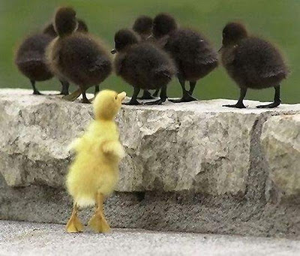
Dark side of identity
in-group and out-group stereotypes
  Ethnocentrism
    The values and standards of my culture are universally applicable.
    My culture is superior to other cultures.

Slide 18
2 approaches to ethnic minorities in society:
1. MELTING POT THEORY - expected to ‘blend’ in with society and adapt to the culture of the country they have moved to.
2.MOSAIC THEORY – accepted into the country but are free to practice their religion, their heritage does not have to be left behind
(Gutmann 2001)

