Slide 1
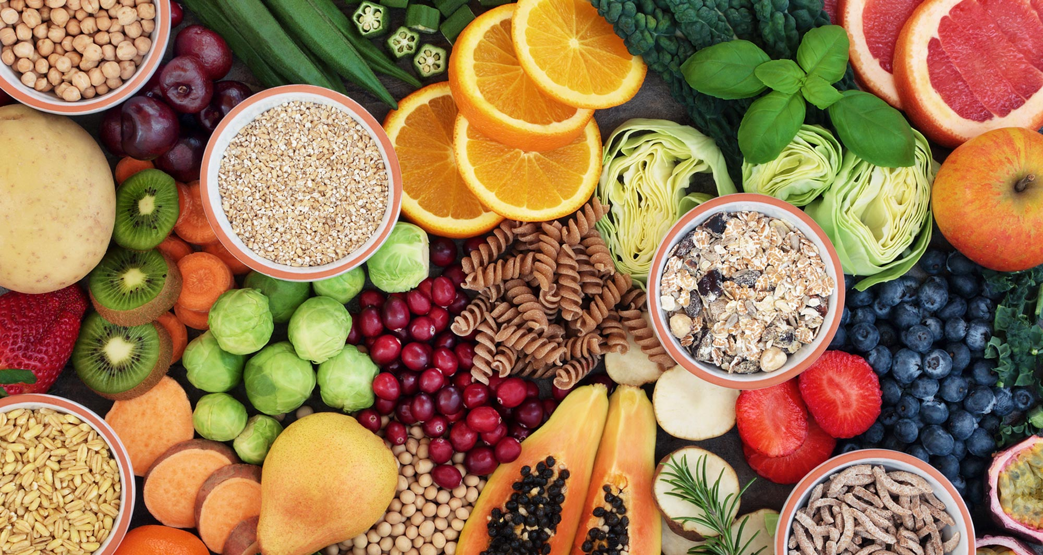
FOOD AND IDENTITY
Mateja Dagarin Fojkar

Slide 2
Food and Identity
What kinds of influences, beliefs, and needs beyond what tastes good influence your decisions about what to eat and what not to eat?
Do your own eating habits differ from those of your family members or from your friends?
How do you respond to eating habits or foods that are unfamiliar to you? How do other people respond to the kinds of food that you choose to eat?

Slide 3
Food and identity: Bread
Close your eyes and concentrate on the mental image you get when you hear the word “bread”.
Now draw it and show someone else or describe it to them. What differences are there in your drawings and descriptions?
Macmillan dictionary: types of bread: brown, French, granary, home-baked, homemade, naan, organic, pitta, rye, sliced, unleavened, white, wholegrain, wholemeal; fresh: fresh, fresh baked, freshly baked, warm; chunk, crust, hunk, loaf, piece, slice

Slide 4
Food and identity
1.How much bread do people eat in your culture? Do you eat it with every meal?
2. How often do most people buy (or make) bread where you come from? Where do you or your living companions get your bread from: the local baker, shop, supermarket, etc.?
3. What sort of bread do you eat? Is it made with white flour, wholemeal flour or any other kind of flour? Which particular types of bread are eaten with particular meals or at particular times? In what ways do you combine bread with other foods (in sandwiches, etc.) or cook it (toasted, fried bread, etc.)?
4. In your opinion, do most people in your culture tend to eat to keep going or do they place a lot of emphasis on enjoying good dishes on social occasions? Are eating habits in your culture related to social class?
5. Have the eating habits of your culture changed over the last fifty years? Would your grandparents have answered these questions in the same way?
6. Are there any types of food that in your culture you can only eat at certain times, at particular meals?

Slide 5
Food and Identity
“Tell me what you eat and I will tell you what you are.”
French gourmand Jean-Anthelme Brillat-Savarin in his gastronomic masterpiece The Physiology of Taste (1826)
"Der Mensch ist, was er ißt."
Ludwig Feuerbach in an essay titled Concerning Spiritualism and Materialism (1864)
Meaning: The food one eats has a bearing on one's state of mind and health.

Slide 6
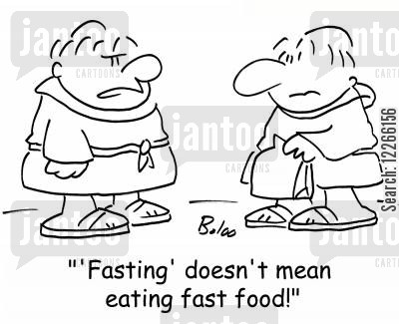

Slide 7
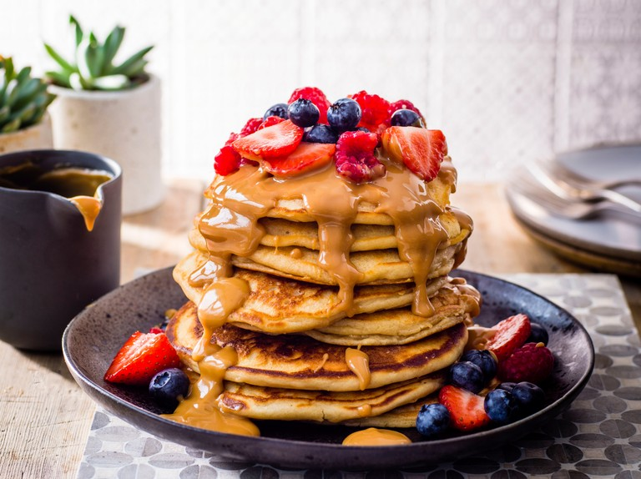
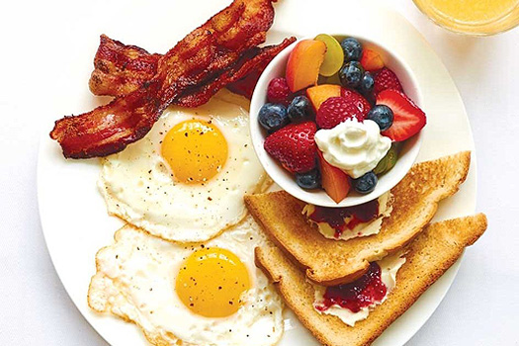
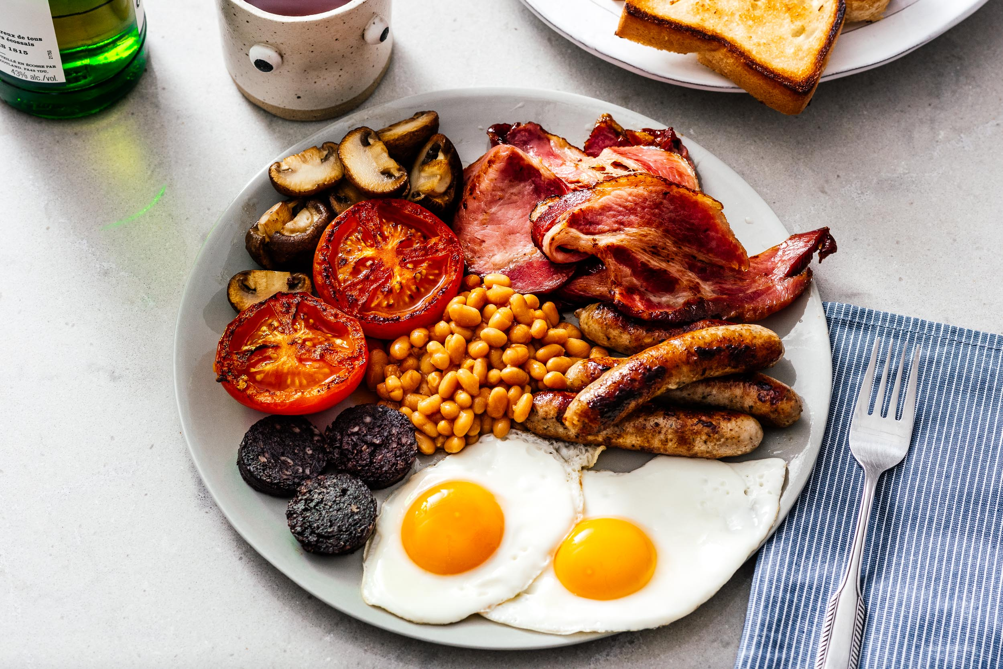
Breakfast
What do you usually eat for breakfast?
What does the world eat for brekfast?
https://www.youtube.com/watch?v=ry1E1uzPSU0

Slide 8
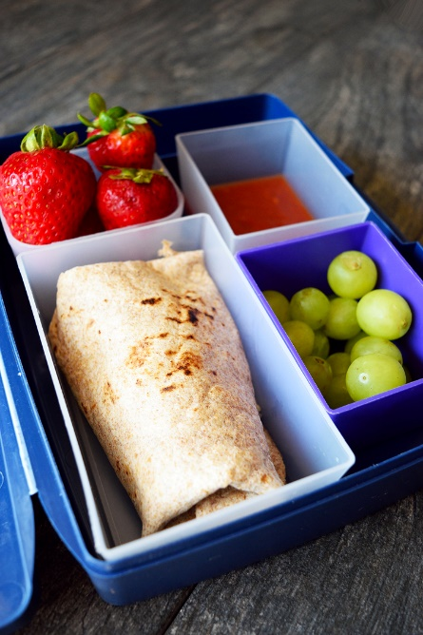
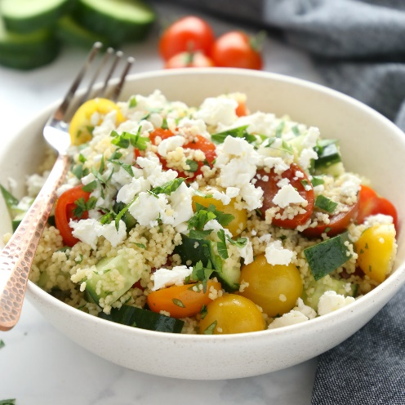
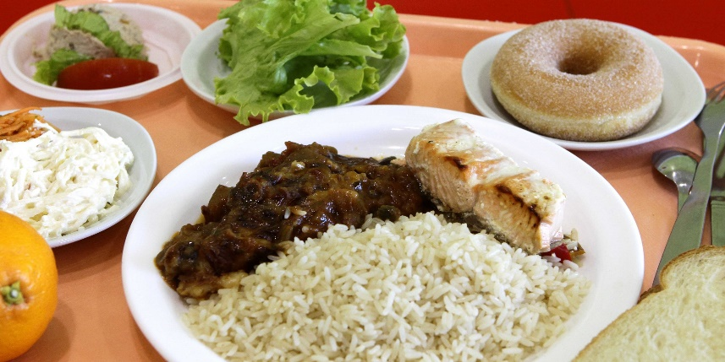
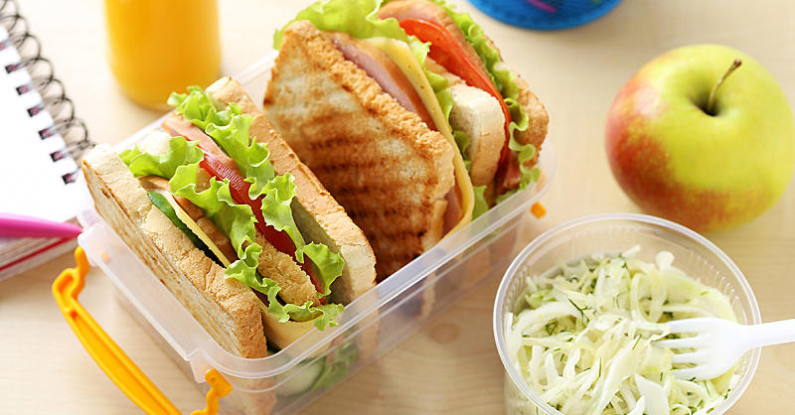
Lunch time?
When do you eat lunch?
Do you eat alone or with your family?
Do you eat lunch at home or at school?
Are school lunched for children subsidised in your country?

Slide 9
Finish the sentences.
“The main meal is served at ….”
“In schools, you eat….”
“The evening meal is often ….”
“Dinner usually consists of ….”
“Breakfast/lunch is usually substantial enough to ….”
“At midday ….”
“The rituals of eating together ….”
“Snacking ….”

Slide 10
‚Bon appetit‘
It may be significant that English-language cultures do not have an equivalent of “bon appetit”, wishing your eating companions “good appetite”. Perhaps these cultures feel that bodily functions are private.
Note: some waiters will say: “Enjoy your meal”, but in principle, you say nothing at the start or end of a meal in an English-language culture. However, there are still many people who say a prayer before eating. For example, “For what we are about to receive we are truly thankful, Amen.”
Are there obligatory comments or wishes in your culture before or after a meal in company?
Are there rules governing when to start eating or who to wait for before starting?
Whart kinds of expressions or rituals do you know of?

Slide 11
Food and Identity
Associations food/identity can often slip into stereotypes: Which countries are associated with which food?
  ?????- chocolate, cheese
  ????? - meatballs
  the English - ??????
  ????? - hamburgers/cheeseburgers, chewing gum
  Italians – ?????
stereotypes can be offensive, e.g.:
  “frogs” - ?????
  “krauts” - ?????
  “cheeseheads” - ?????

Slide 12
What do these food idioms mean?
It‘s no use crying over spilt milk.
He brings home the bacon.
She‘s bitten off more than she can chew.
Don‘t put all your eggs in one basket.
If I butter her up, she‘ll probably agree.
It‘s a piece of cake.
You can‘t have your cake and eat it.
They‘re selling like hot cakes.
The party was the icing on the cake.
She is the salt of the earth.
The world‘s your oyster.
Can you translate these sayings?
Do you have any food idioms in your language?

