Slide 1
NEW ZEALAND

Slide 2
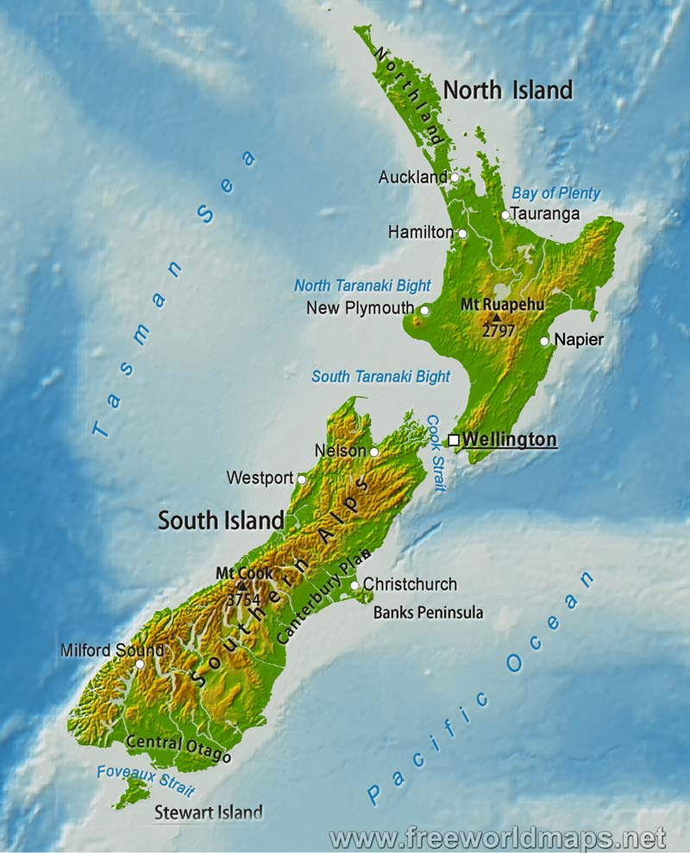
New Zealand
=
North Island
+
South Island
+
Stewart Island
+
many smaller islands

Slide 3
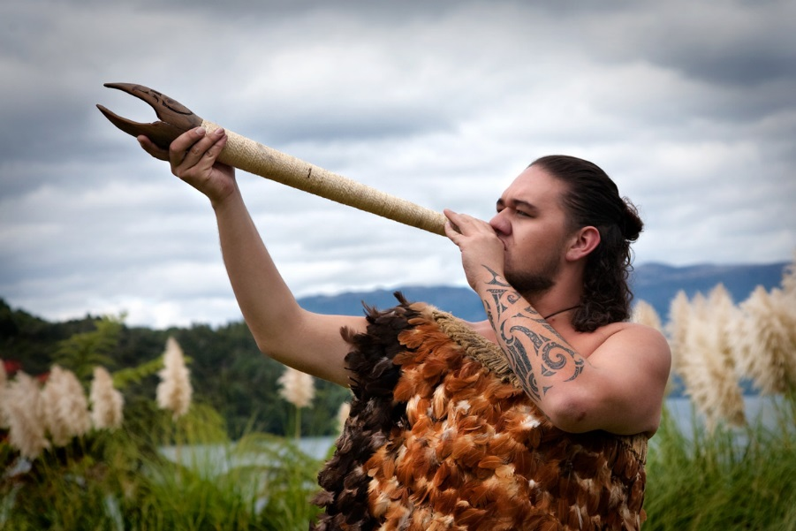
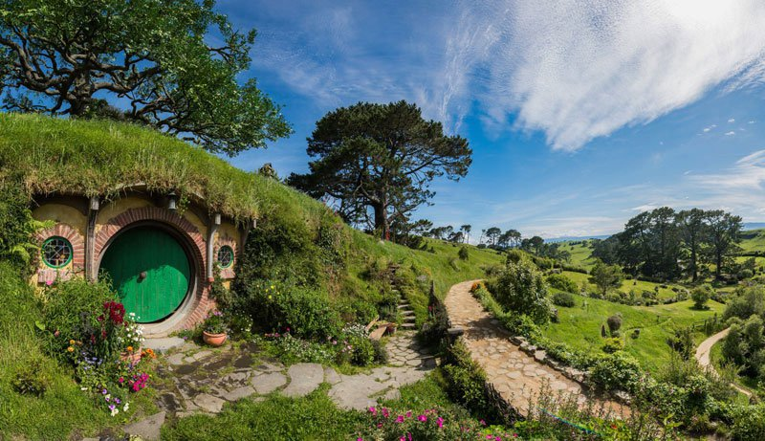
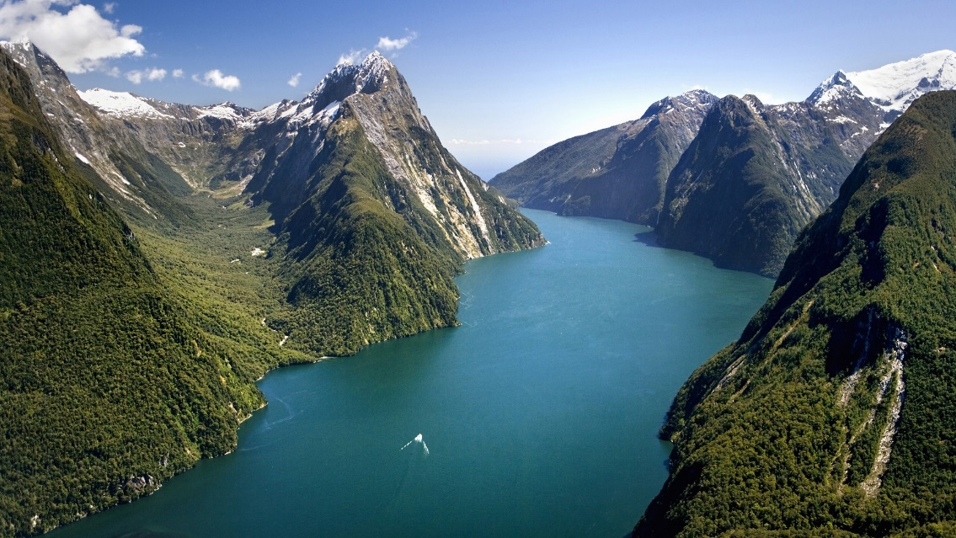
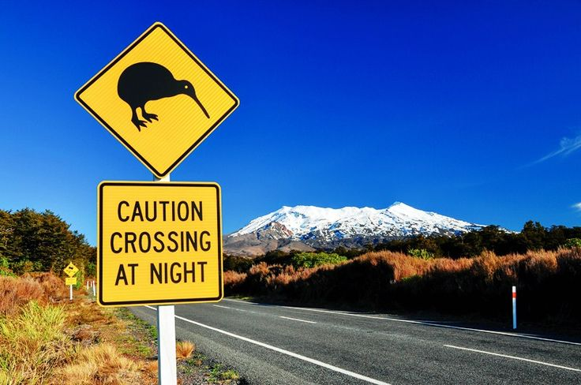
What is the first thing that comes to mind when you think of New Zealand?

Slide 4
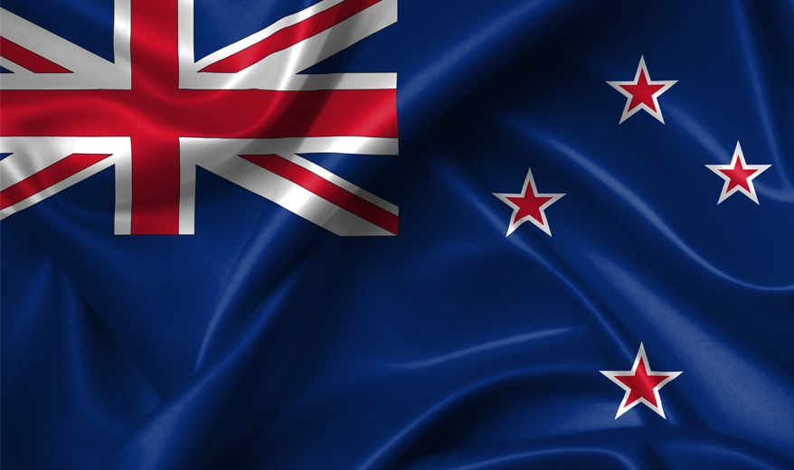
NEW ZEALAND FLAG

Slide 5
GENERAL INFORMATION
AREA: 269,000 sq m
POPULATION TOTAL: 5.123 (2021)
URBAN POPULATION: 86 %
FORM OF GOVERNMENT: a parliamentary democracy and a constitutional monarchy; Head of State: King Charles III
CAPITAL: Wellington

Slide 6
GENERAL INFORMATION
LONGEST RIVER: the Waikato, 425 km
HIGHEST MOUNTAIN: Aoraki-Mount Cook, 3,754 m
LARGEST LAKE: Lake Taupo, 606 sq km
CLIMATE: temperate with sharp regional contrasts
OFFICIAL LANGUAGES: English, Maori
CURRENCY: New Zealand Dollar (NZD)
HDI in 2023: 0.937

Slide 7
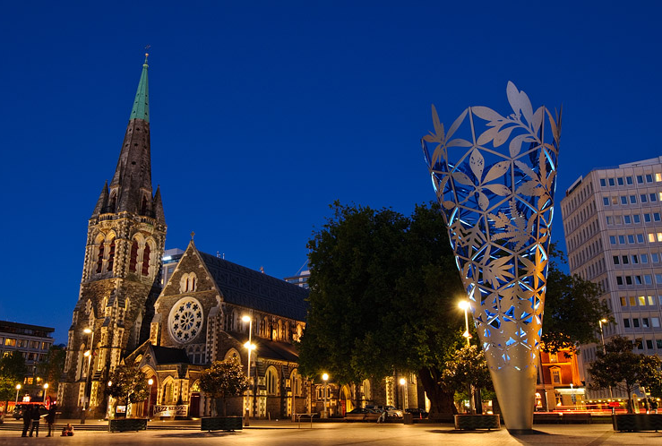
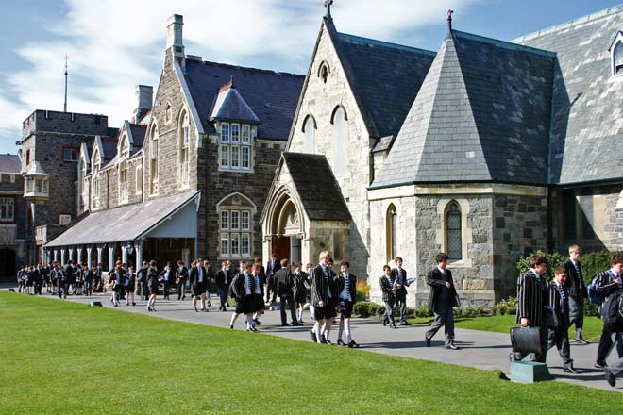
CHRISTCHURCH

Slide 8
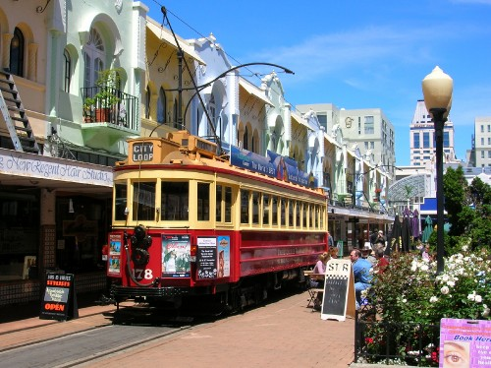
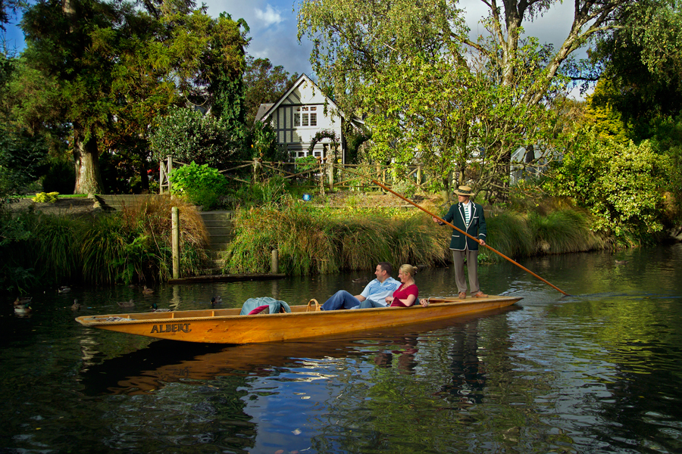
CHRISTCHURCH

Slide 9
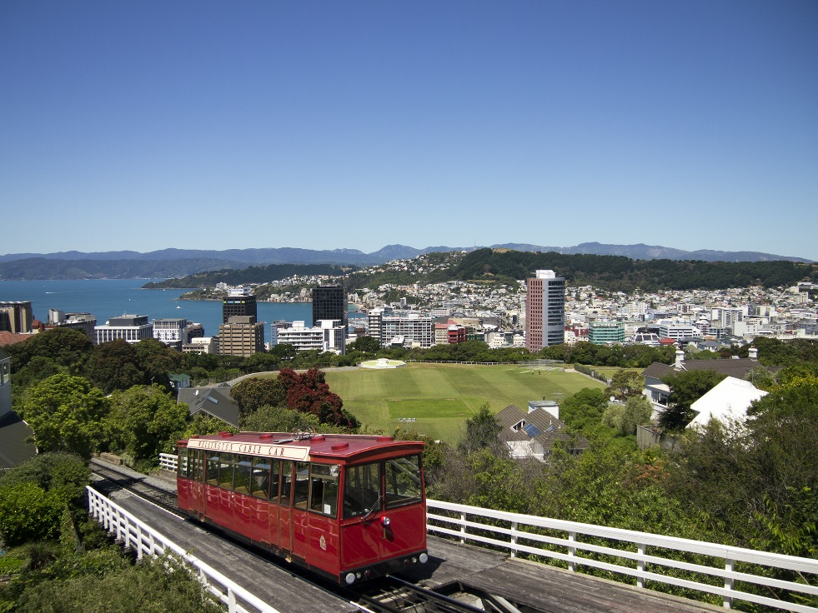
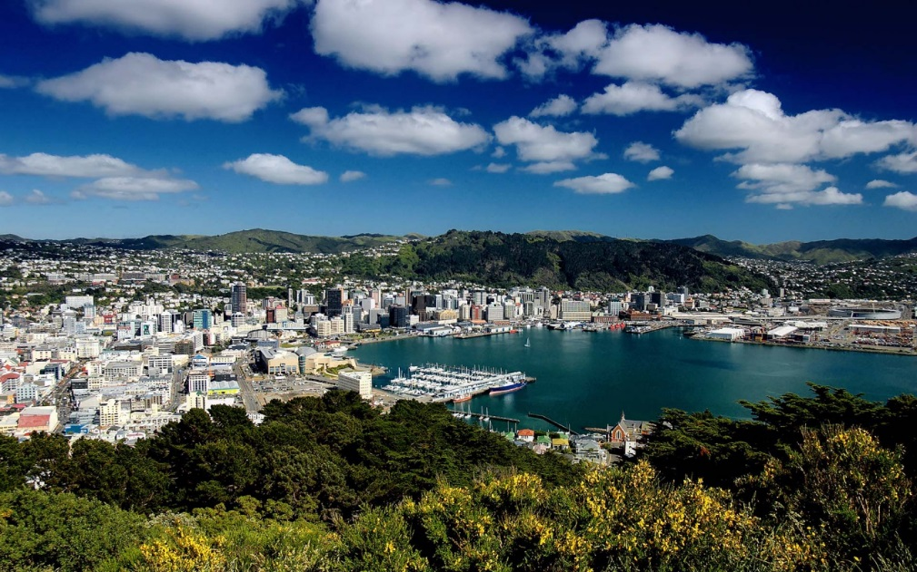
WELLINGTON

Slide 10
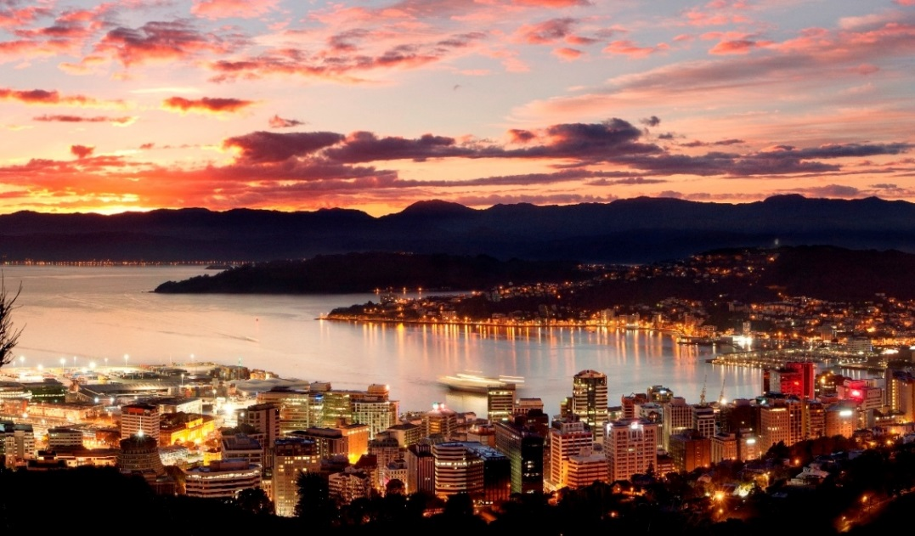
WELLINGTON

Slide 11
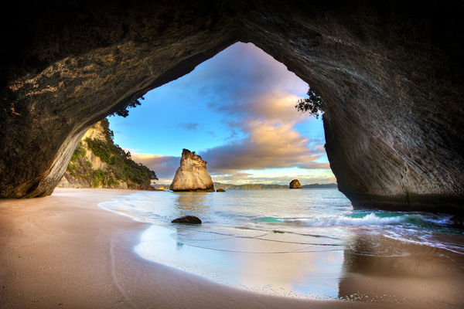
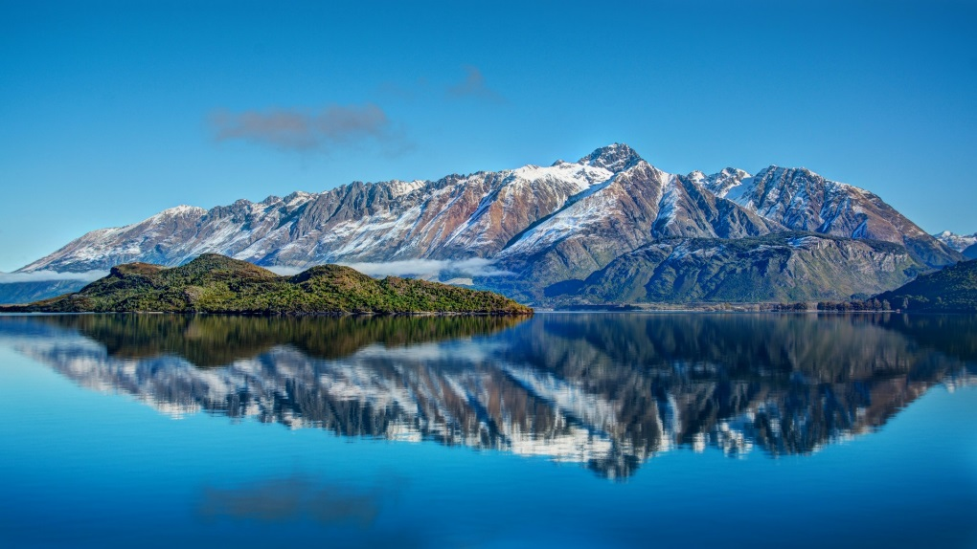
BEAUTIFUL SCENERY

Slide 12
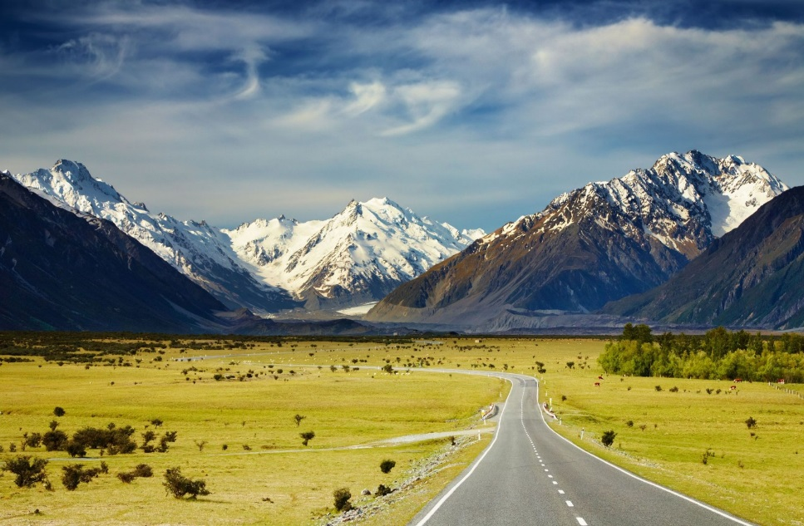
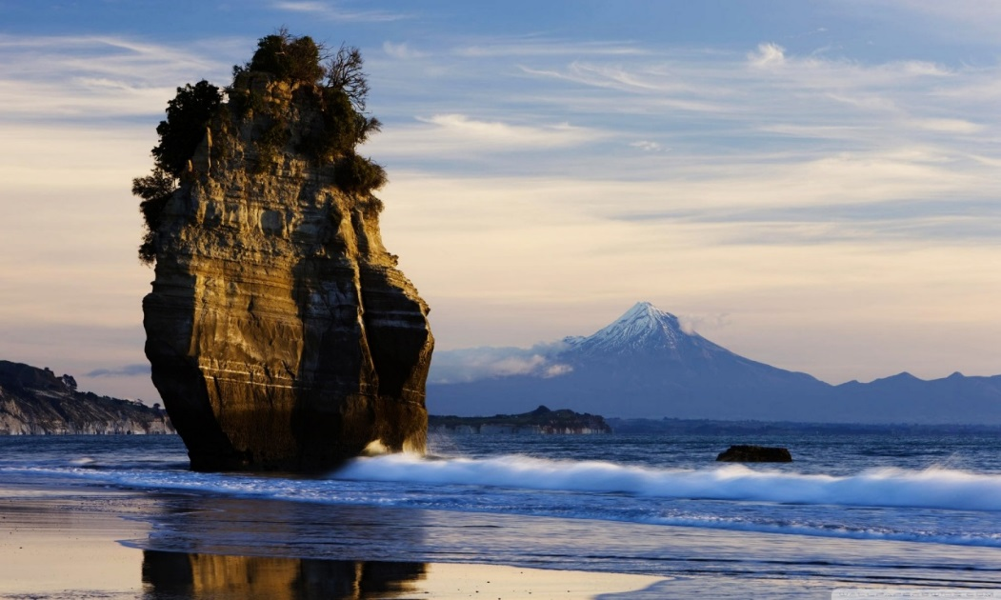
BEAUTIFUL SCENERY

Slide 13
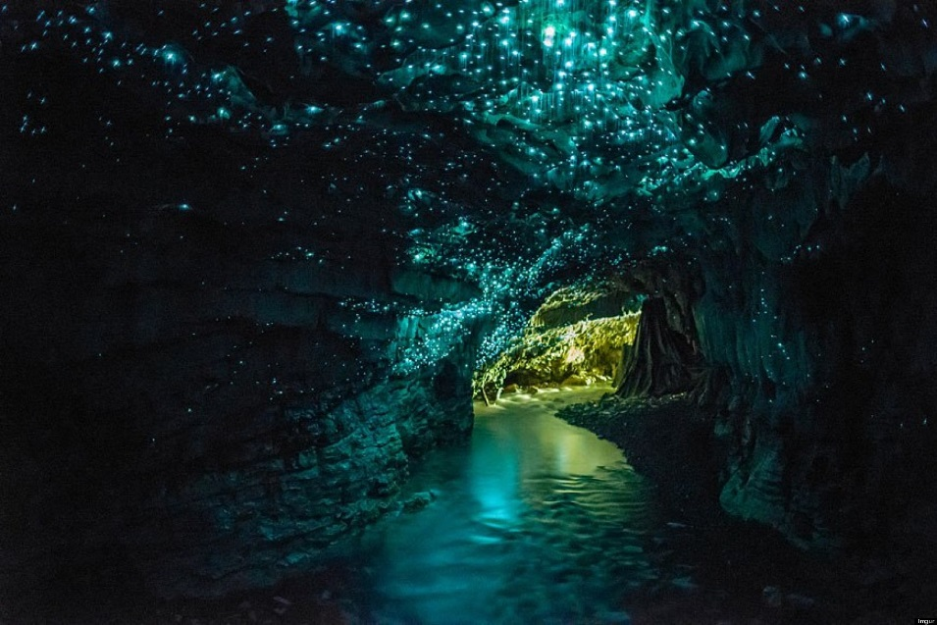
WAITOMO CAVES

Slide 14
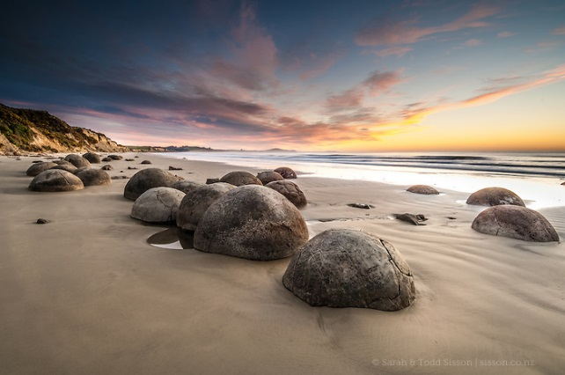
MOERAKI BOULDERS

Slide 15
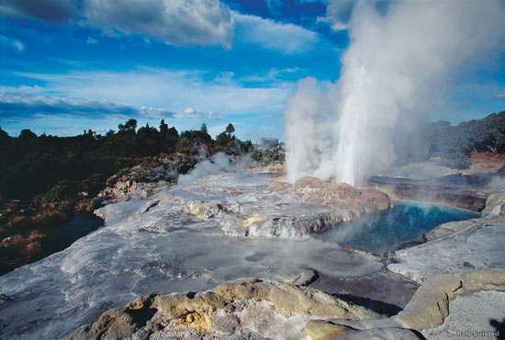
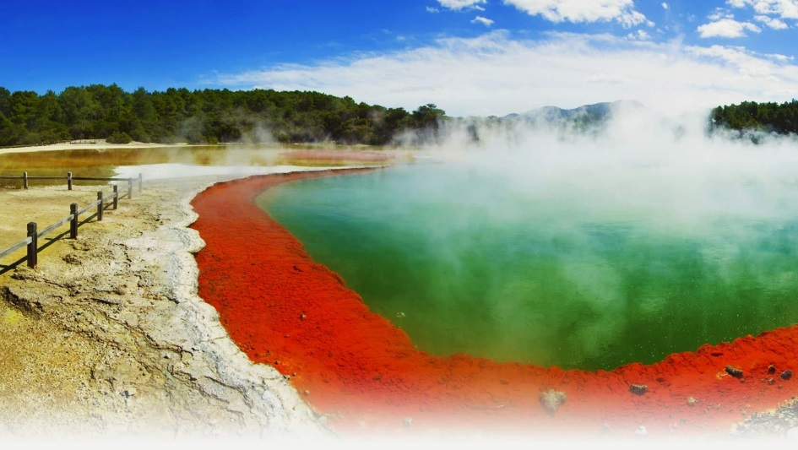
ROTORUA

Slide 16
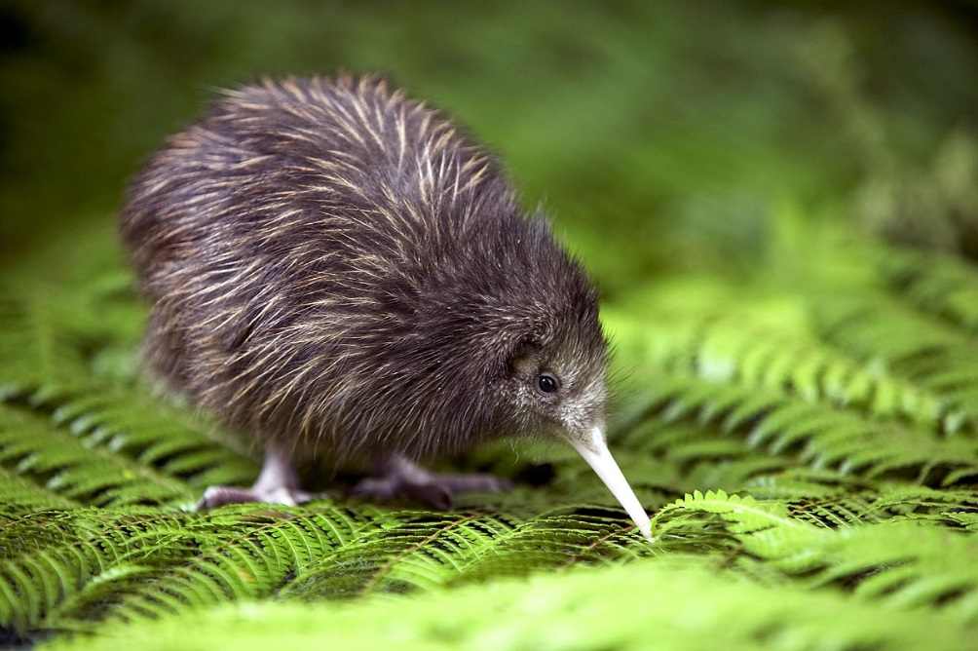
NEW ZEALAND ANIMALS
Kiwi

Slide 17
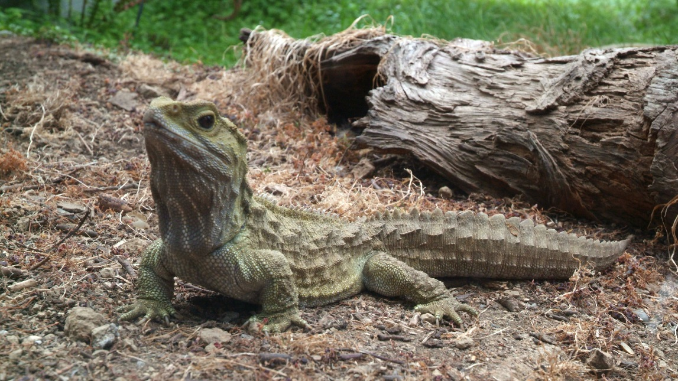
NEW ZEALAND ANIMALS
Tuatara

Slide 18
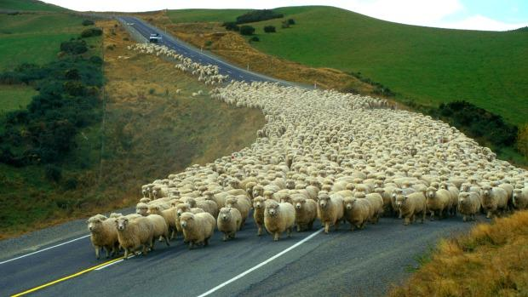
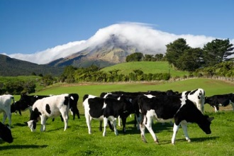
NEW ZEALAND ANIMALS
Sheep & cows

Slide 19
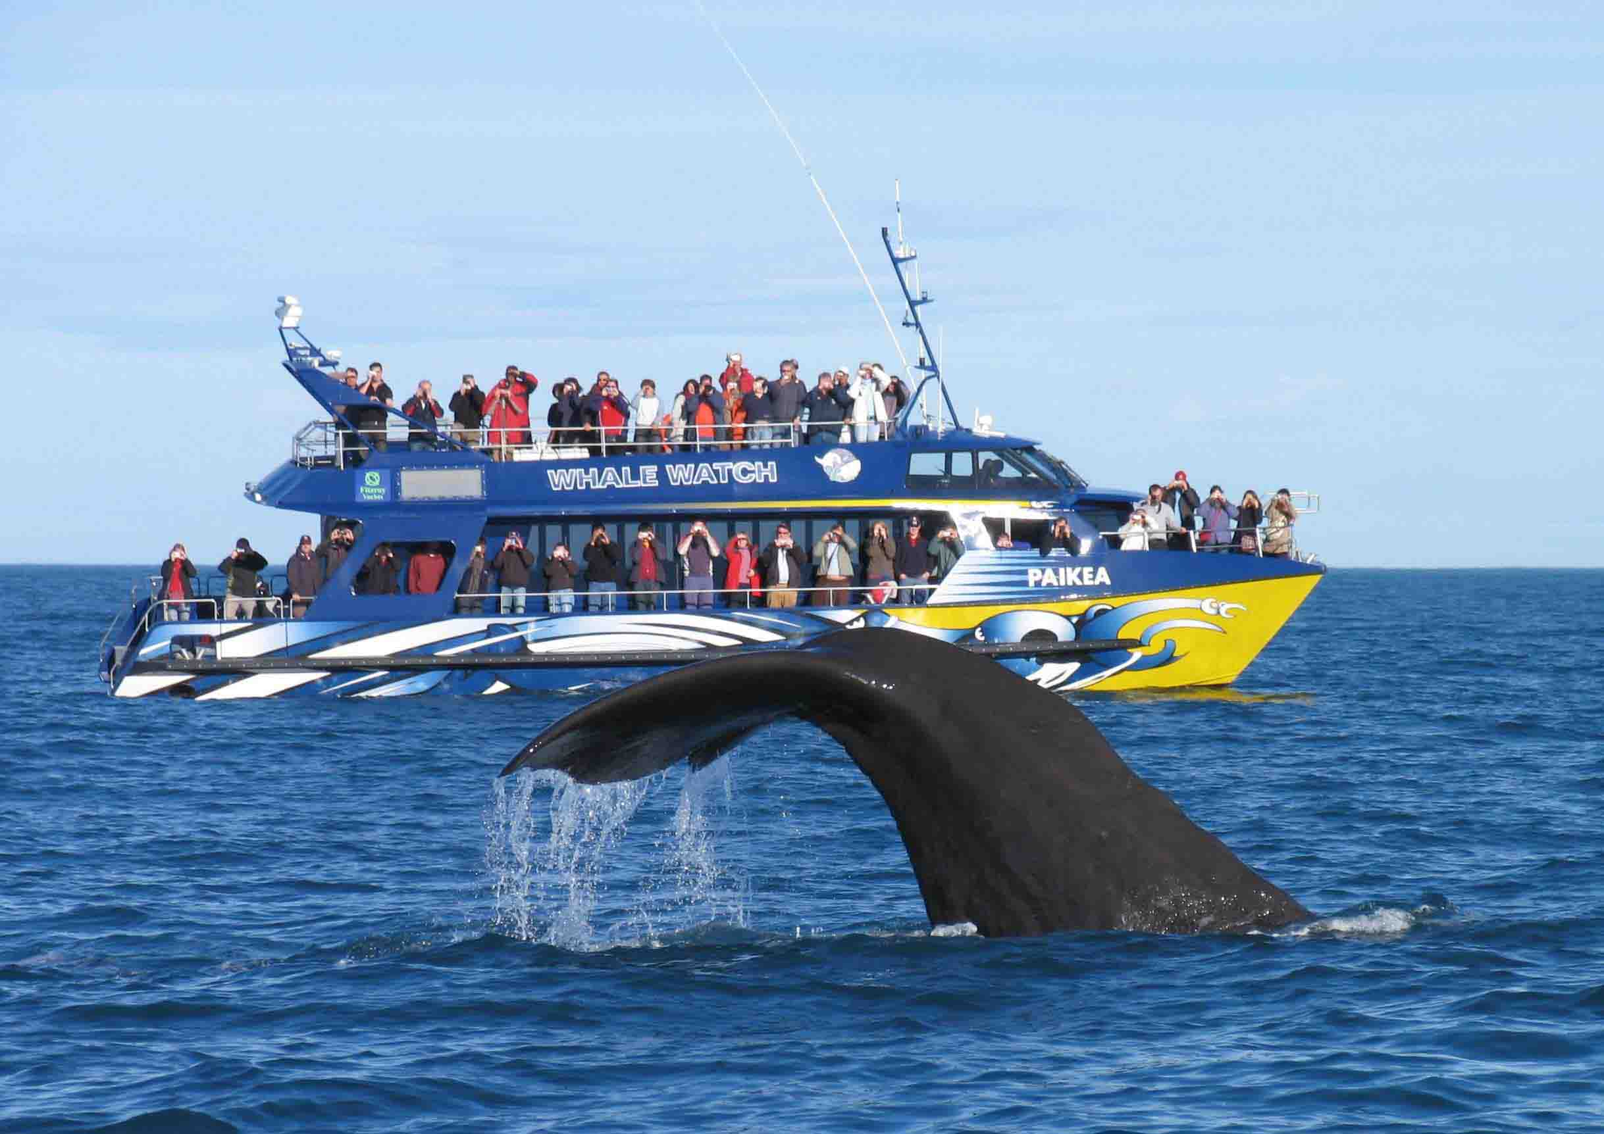
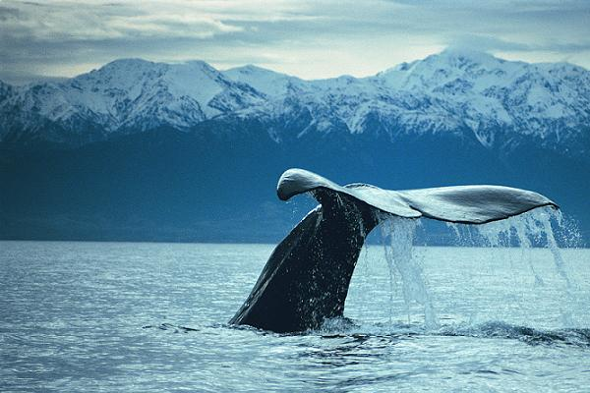
WHALE WATCHING

Slide 20
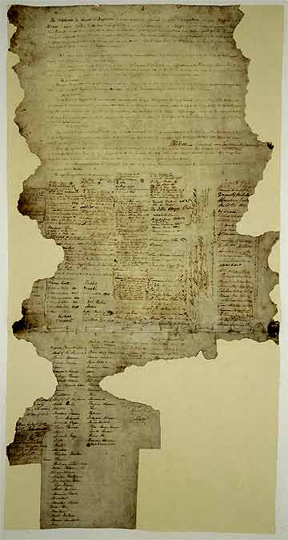
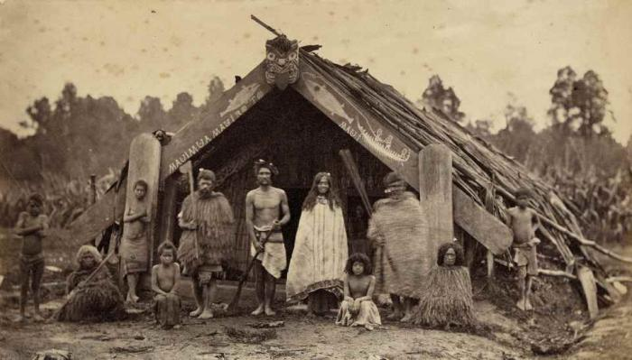
HISTORICAL BACKGROUND
a young country (the first Māori arrived around 1000 years ago)
1840: The Treaty of Waitangi

Slide 21
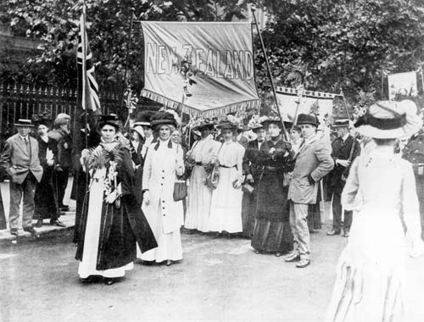
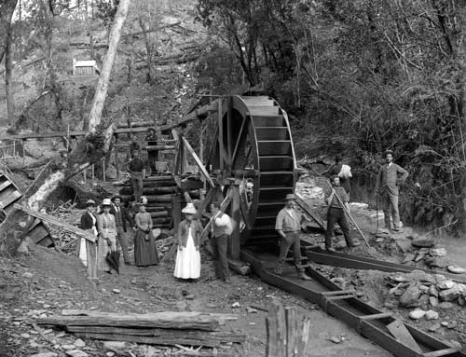
HISTORICAL BACKGROUND
1863: discovery of gold in the South Island
1893: first country to give women the right to vote

Slide 22
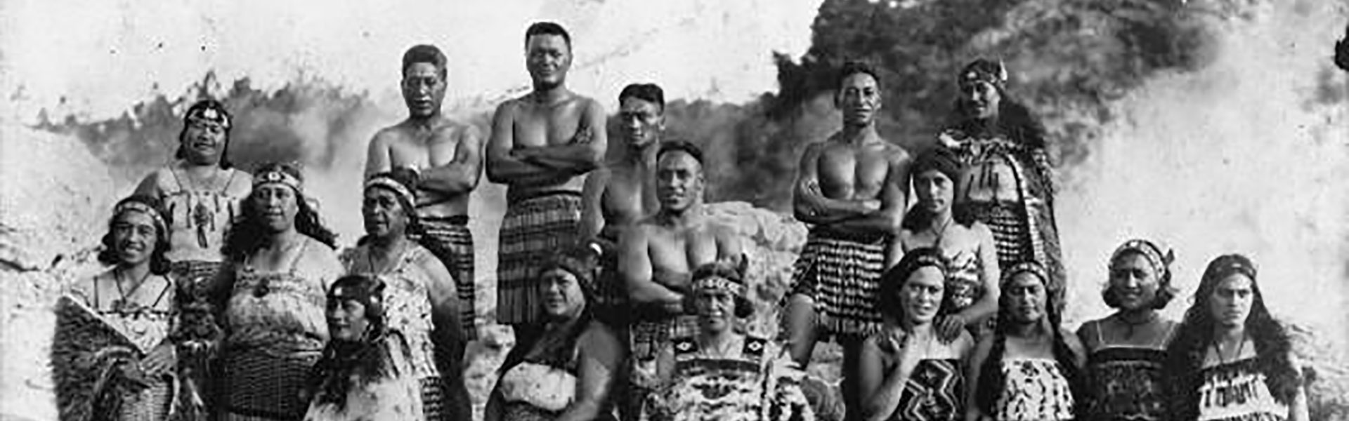
MĀORI CULTURE
Indigenous Polynesian people of Aotearoa (The Long White Cloud)
15% of the population

Slide 23
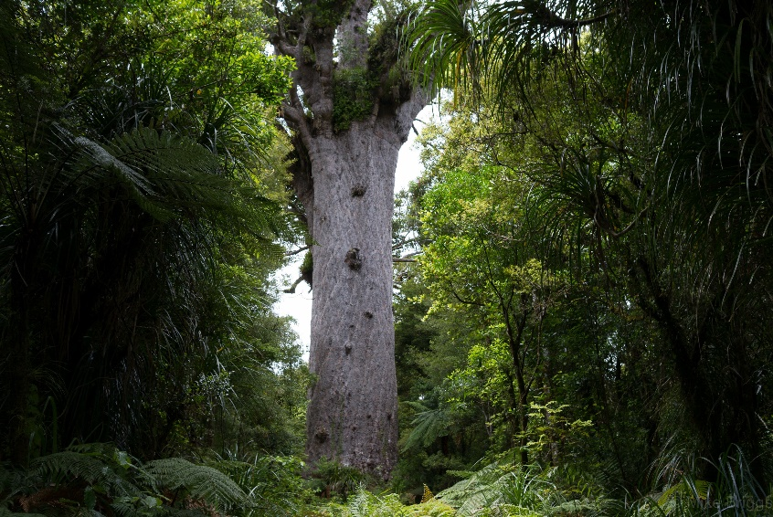
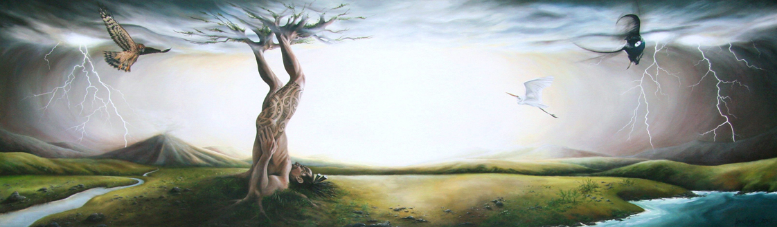
PŪRĀKAU - MĀORI LEGENDS
Tāne-mahuta creates the world of light
Waipoua forest – kauri trees

Slide 24
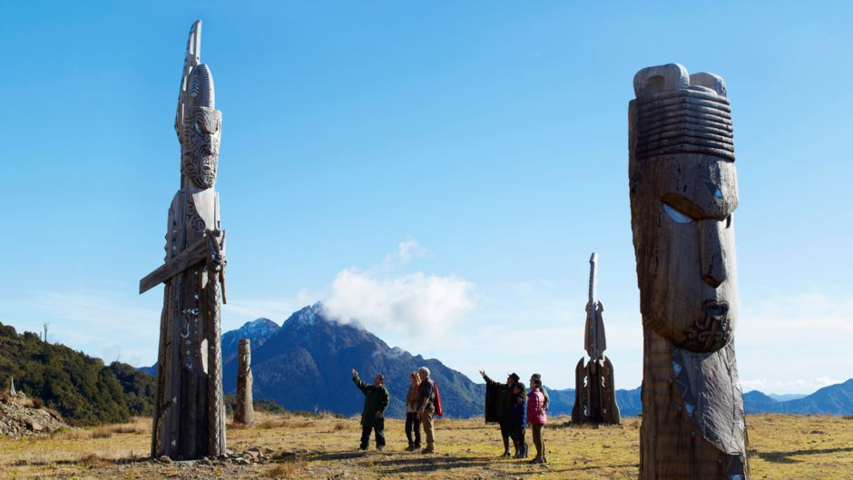
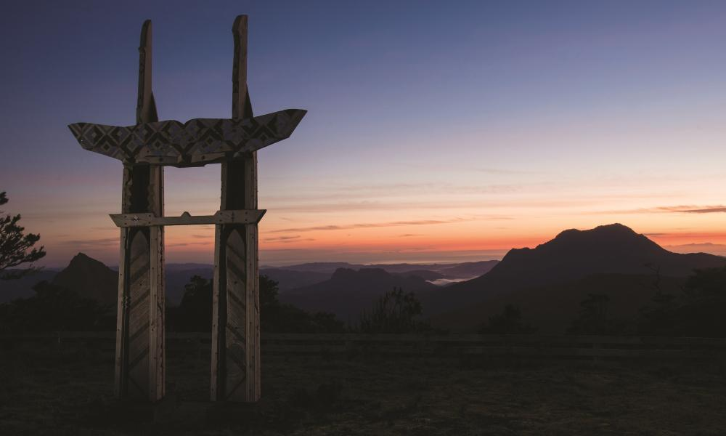
PŪRĀKAU - MĀORI LEGENDS
Māui-tikitiki-a-Taranga fishes up the North Island
Mount Hikurangi

Slide 25
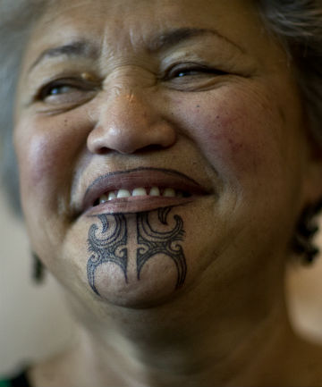
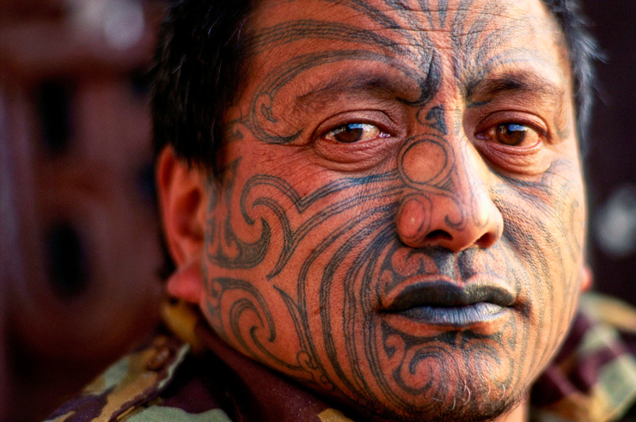
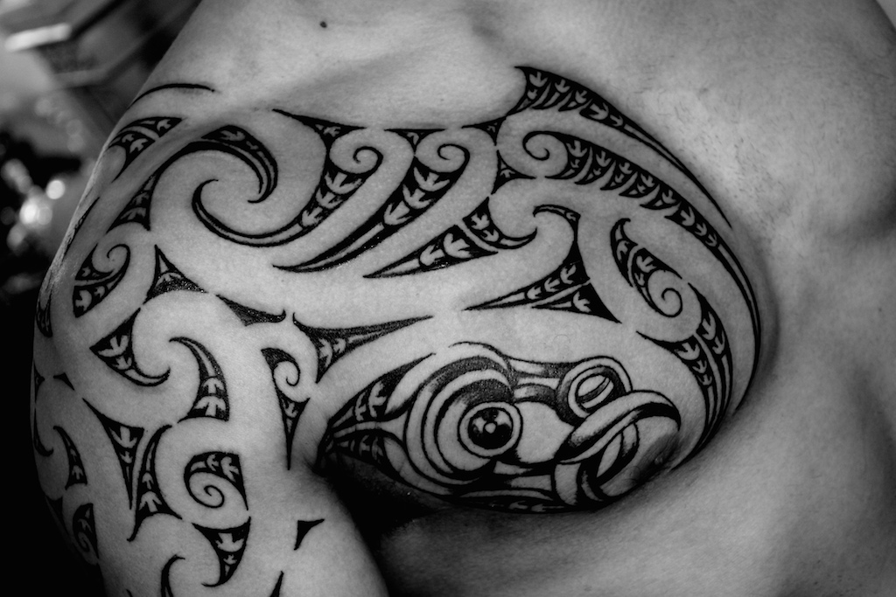
TA MOKO
in the past: a status symbol
nowadays: a sign of cultural identity

Slide 26
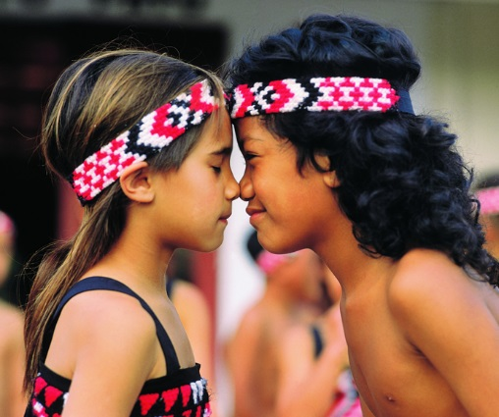
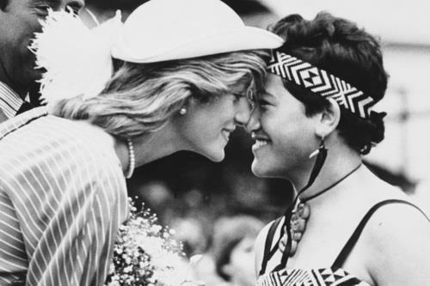
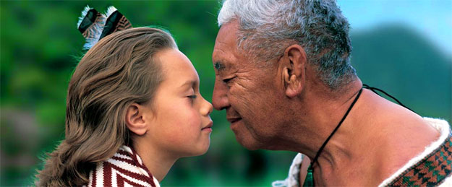
A HONGI

Slide 27
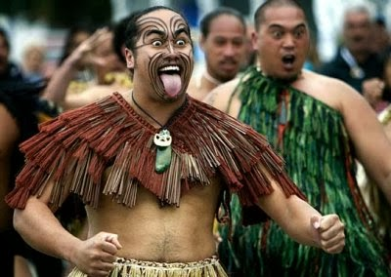
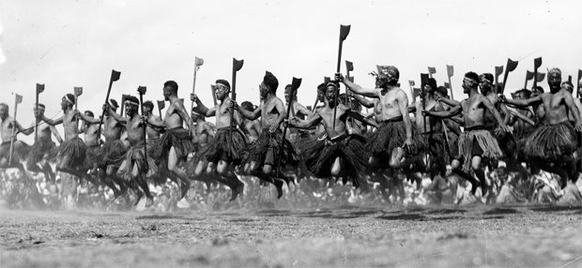
THE HAKA DANCE
a war dance
loud and fierce shouts
challenging their opponents

Slide 28
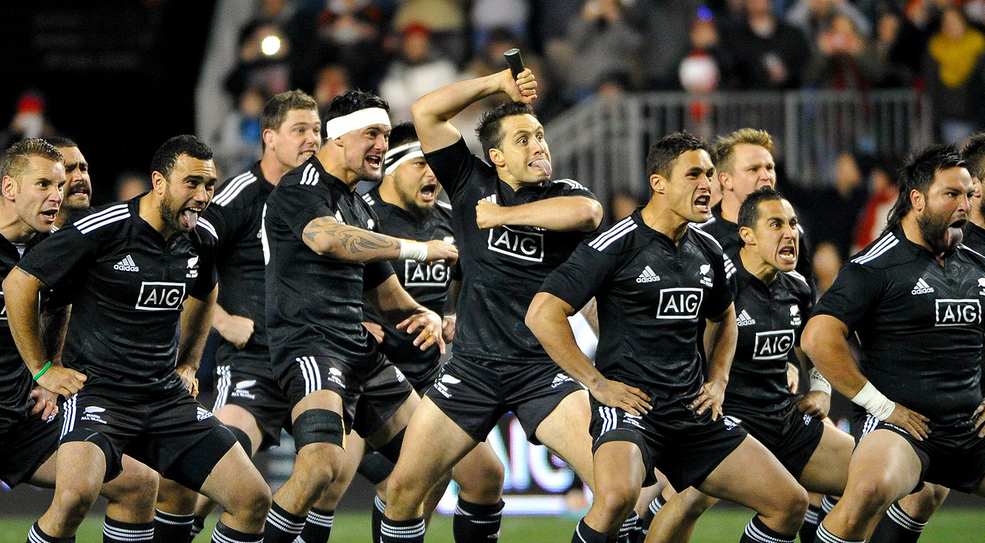
THE HAKA TODAY
https://www.youtube.com/watch?v=yiKFYTFJ_kw

Slide 29
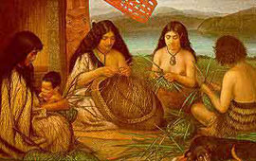
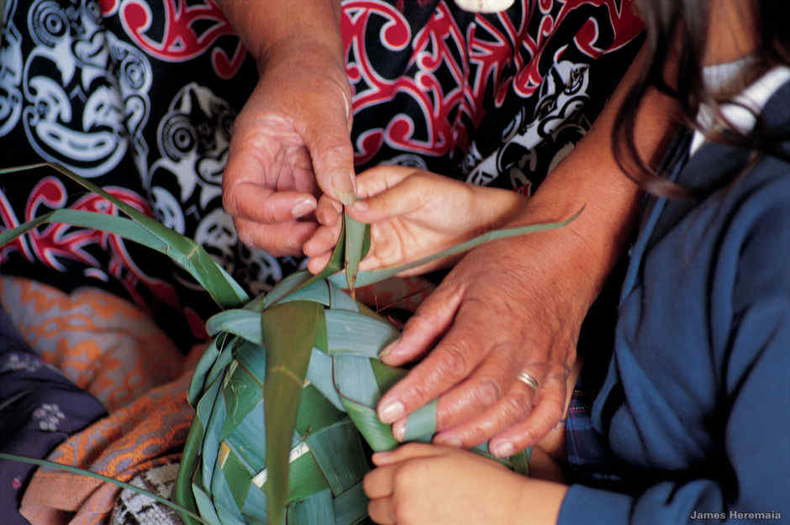
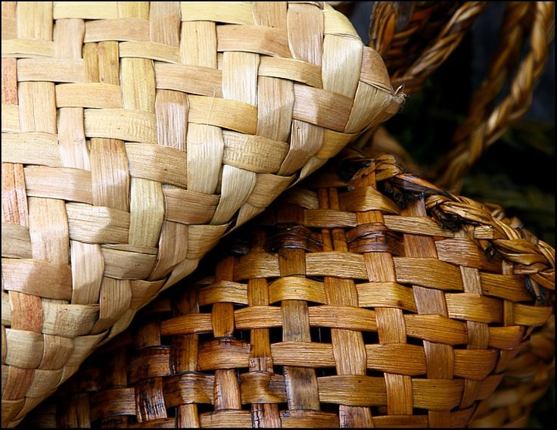
TOI - MĀORI ARTS
Raranga – the art of weaving
'Aitia te wahine o te pā harakeke'

Slide 30
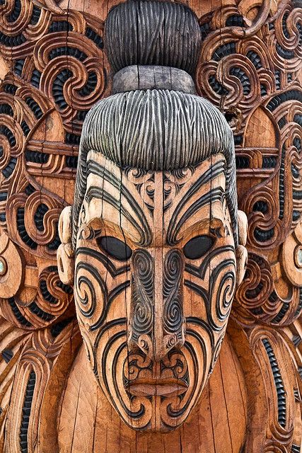
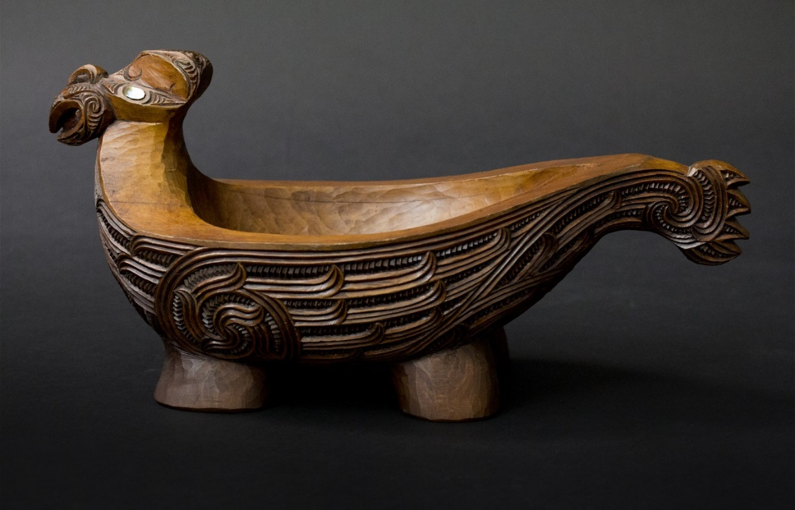
TOI - MĀORI ARTS
Whakairo – the art of carving
rich in symbolism

Slide 31

TE REO MĀORI - THE MĀORI LANGUAGE
witnessing a revival
useful phrases:
  Kia ora - Hello
  Kia ora tātou - Hello everyone
  Nau mai, haere mai - Welcome
  Kei te pēhea koe? - How’s it going?
  Kei te pai - Good
  Tino pai - Really good
  Ka kite anō - See you again

Slide 32

TE REO MĀORI - THE MĀORI LANGUAGE
The national anthem: https://www.youtube.com/watch?v=Z2ToGR1Sb98
Learn animals: http://www.digitaldialects.com/Maori/Animals.htm

Slide 33

NEW ZEALAND SLANG
https://www.youtube.com/watch?v=tgWnQVfY3mE&nohtml5=False

Slide 34
POPULAR KIWI WORDS
Can refer to either a New Zealander, or the country’s national bird.
For the fruit, we say kiwifruit.
= Kiwi
Flip flops, e.g. Havaianas
= Jandals
A convenience store, corner store, or mini supermarket.
= Dairy
A cooler bin, used for keeping drinks cold.
= Chilly bin

Slide 35
Really far away, the middle of nowhere. e.g. she lives far away, out in ...
= The wops
McDonald’s
= Macca’s
Swimsuit
= Togs
Hood & trunk (of a car)
= Bonnet & boot
To drink a usually alcoholic drink in one go without stopping.
= Scull
Very tired
= Buggered

Slide 36
Soda
= Fizzy drink
Ground beef
= Mince
French fries
= Hot chips
Maori word for food
= Kai
Crowded/busy
= Chocka Block
Drunk
= Pissed
A hot drink, usually short for “cup of coffee” or “cup of tea”
= Cuppa
A jersey or sweatshirt
= Jumper
Someone with an anger problem
= Angus
Someone who eats too much
= Hungus

Slide 37

STEREOTYPES ABOUT NEW ZEALAND
https://www.youtube.com/watch?v=gkEe2sOFpZg&nohtml5=False

Slide 38

COMMON MISCONCEPTIONS ABOUT NEW ZEALAND

Slide 39

COMMON MISCONCEPTIONS ABOUT NEW ZEALAND

Slide 40

COMMON MISCONCEPTIONS ABOUT NEW ZEALAND

Slide 41

COMMON MISCONCEPTIONS ABOUT NEW ZEALAND

Slide 42

COMMON MISCONCEPTIONS ABOUT NEW ZEALAND

Slide 43

COMMON MISCONCEPTIONS ABOUT NEW ZEALAND

Slide 44

COMMON MISCONCEPTIONS ABOUT NEW ZEALAND

Slide 45

COMMON MISCONCEPTIONS ABOUT NEW ZEALAND

Slide 46

COMMON MISCONCEPTIONS ABOUT NEW ZEALAND

Slide 47

COMMON MISCONCEPTIONS ABOUT NEW ZEALAND

Slide 48

COMMON MISCONCEPTIONS ABOUT NEW ZEALAND

Slide 49

COMMON MISCONCEPTIONS ABOUT NEW ZEALAND

