Slide 1
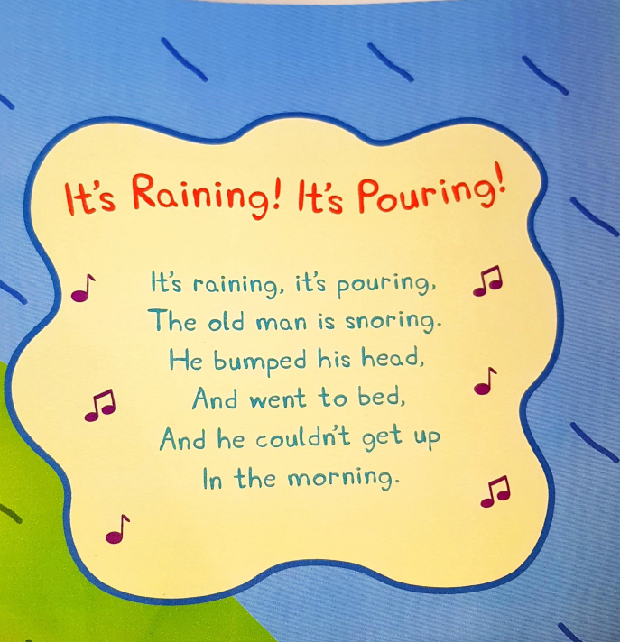

Slide 2

Students: Katja Jerman, Ela Juhart, Sara Kaiser

Slide 3

PRESENTATION
THEME: WEATHER
AGE: 4-6
DAILY TOPIC OF CONVERSATION

Slide 4


SUNNY
HOW’S THE WEATHER?

Slide 5
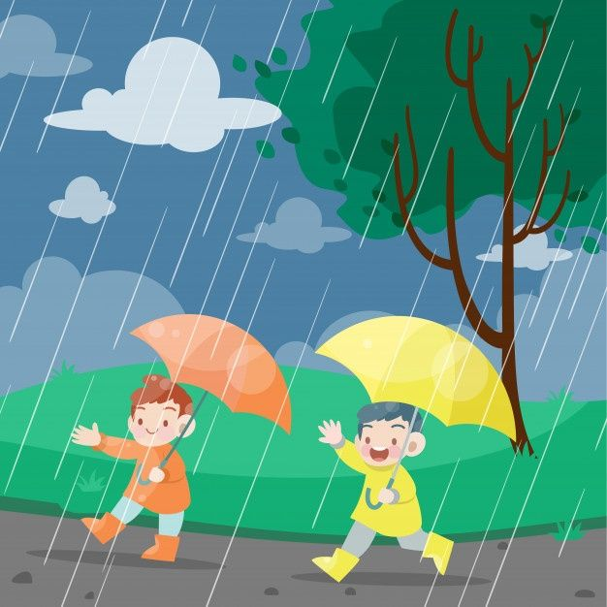

RAINY
HOW’S THE WEATHER?

Slide 6




CLOUDY
HOW’S THE WEATHER?

Slide 7


WINDY
HOW’S THE WEATHER?

Slide 8


SNOWY
HOW’S THE WEATHER?

Slide 9



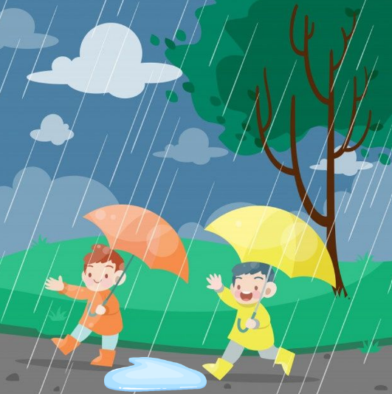
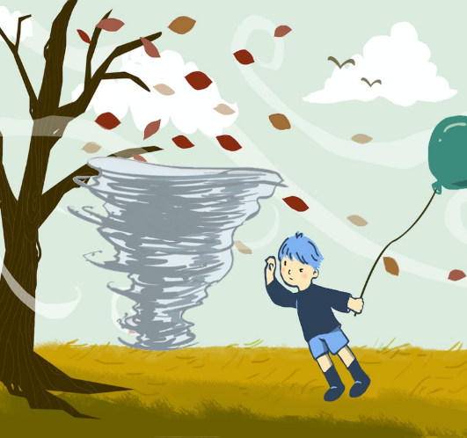
WORD RECAP
RAINY
SUNNY
WINDY
CLOUDY
SNOWY

Slide 10
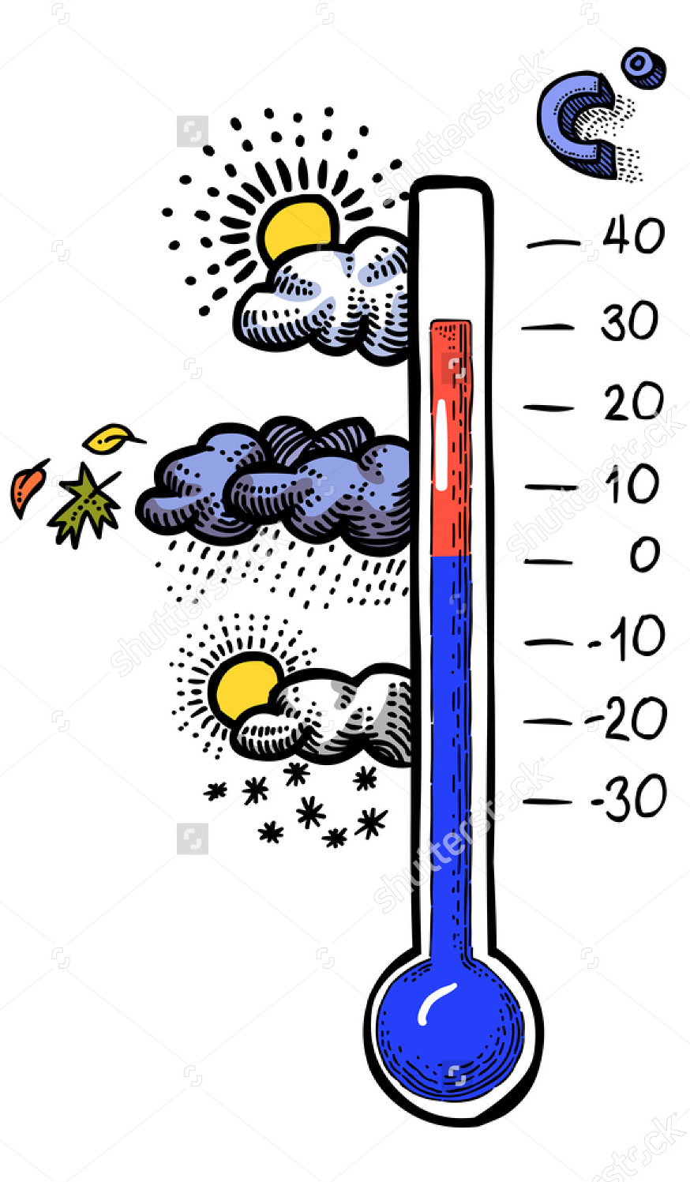
Look outside the window
HOW’S THE WEATHER?

Slide 11

Game of Telephone

Slide 12

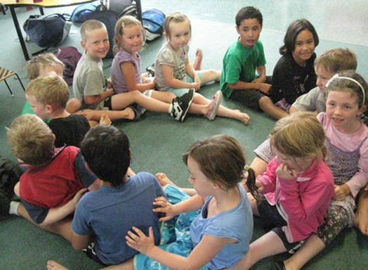
Weather Massage
Morning – Edward Grieg https://www.youtube.com/watch?v=vntAKXIuRUI

Slide 13
Weather Massage
One day the sun came up. It was SUNNY and the sun was caressing the children (stroke their backs) who were lying on the lawn. Then it became WINDY and the children were twisted a little by the wind (twist your partner). Fortunately, the wind soon calmed down, but the sky suddenly became CLOUDY (gently massage their backs with your fists). Then suddenly the rain started to fall and the weather was RAINY (fingers tapping gently on the back). Then it started to rain harder (tapping harder). And harder still (tapping with open palms). Suddenly, the rain turned to snow. So the weather was SNOWY (snowflakes running down their back).

Slide 14

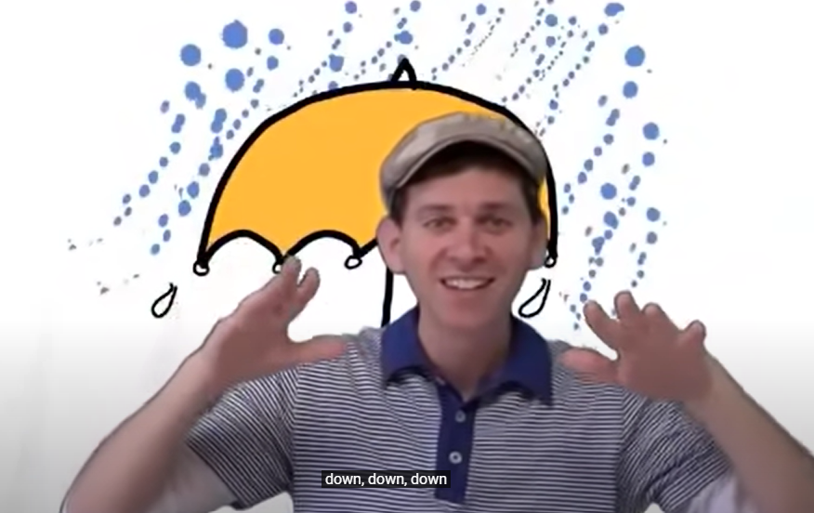
Songs
How’s The Weather: https://www.youtube.com/watch?v=rD6FRDd9Hew
Weather Song For Kids: https://www.youtube.com/watch?v=XcW9Ct000yY
How’s the Weather?: https://www.youtube.com/watch?v=KBL5aXSJTlE

Slide 15
Videos for Learning Vocabulary
The Weather for Kids: https://www.youtube.com/watch?v=sn6GLgaTY0M
How’s the Weather: https://www.youtube.com/watch?v=CXKj7bm4Ops

Slide 16



Books
Sharratt N. (2015). Shark in the park on a windy day. London: Picture Corgi. https://www.youtube.com/watch?v=AD4mwxaSTzI
Cousins, L. (2011). Maisy’s wonderful weather book. London: Walker books. https://www.youtube.com/watch?v=FK2IlbyUPOo
McKee, D. (2014). Elmer’s weather. Chicago: Milet.
https://www.youtube.com/watch?v=DuvooLLGJms

Slide 17
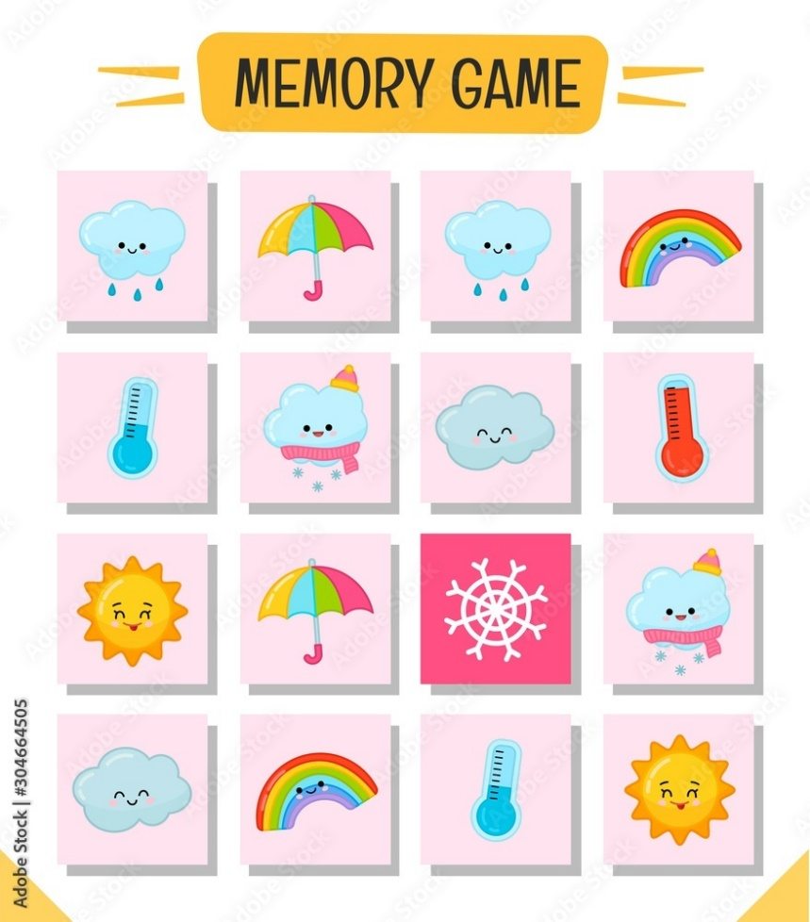
Activities
Memory game
Games with flashcards: What's Missing?, Policeman, hide and seek …
Pantomime
Day/Night (Sun/Moon)

Slide 18
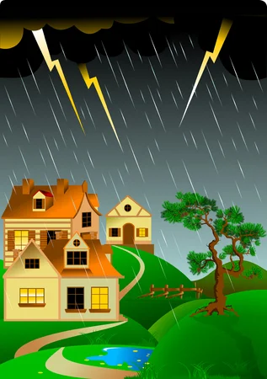


RAINBOW
FOGGY
STORMY

Slide 19
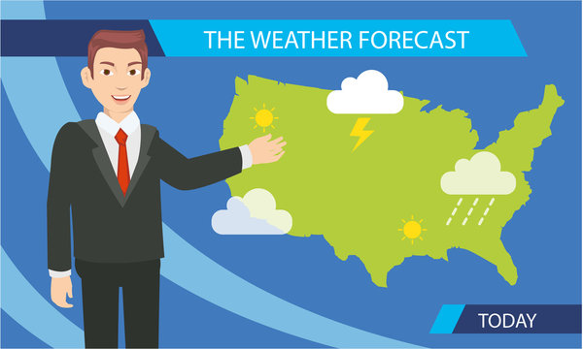
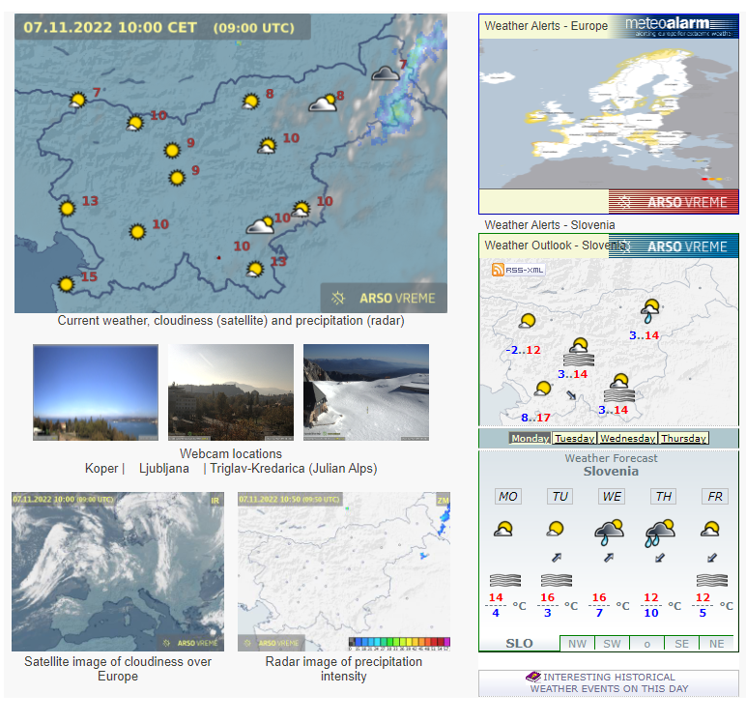
Types of weather forecasts
WEATHERMAN
Radarska slika padavin:
https://meteo.arso.gov.si/met/sl/weather/observ/radar/
Forecast for CLOUDINESS
Forecast of PRECIPITATION

Slide 20
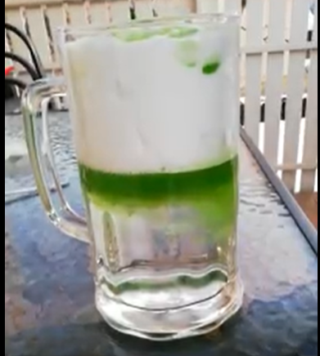
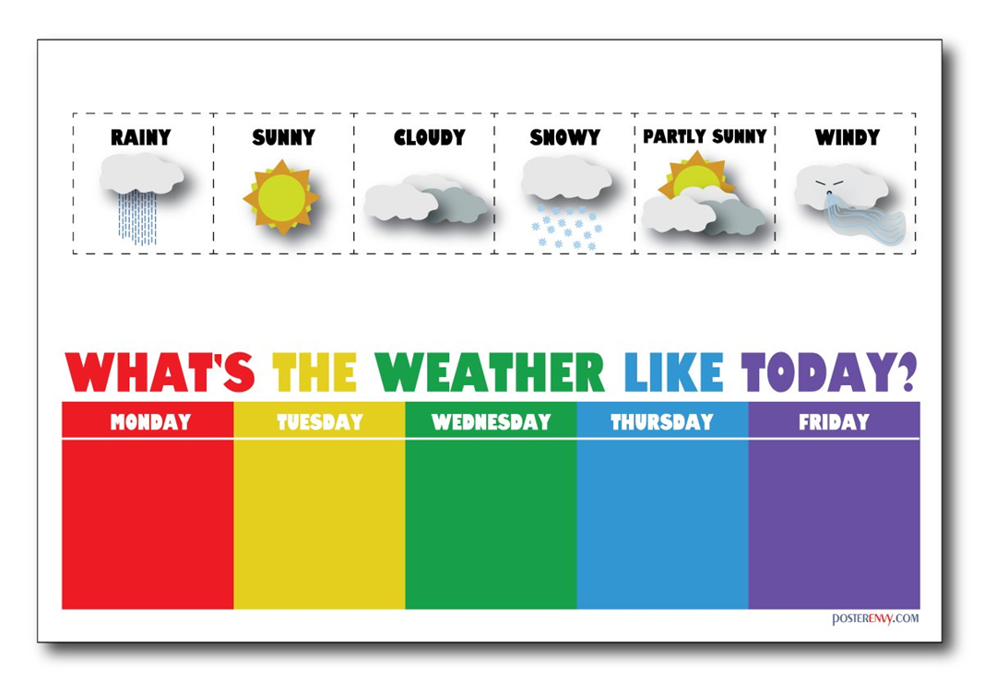
Cross-curricular
The storm glass experiment
Related vocabulary: clothes, seasons …
Weekly project – documenting the weather throught the week

Slide 21


