Slide 1
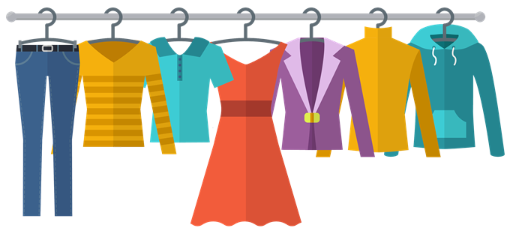
CLOTHES
Hana Abdić and Maja Zajc

Slide 2
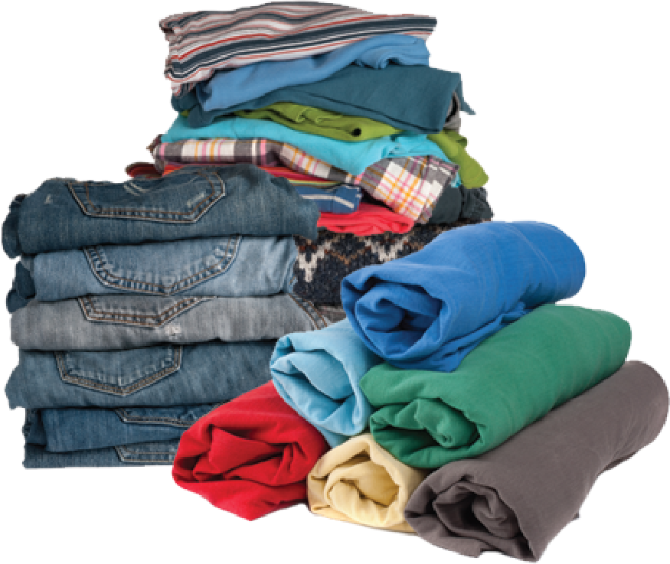
VOCABULARY
Summer | Winter
T-shirt | Pants
Shorts | Socks
Dress | Jumper
Sandals | Coat/Jacket
Swimsuit | Shoes
Sunglasses | Hat

Slide 3
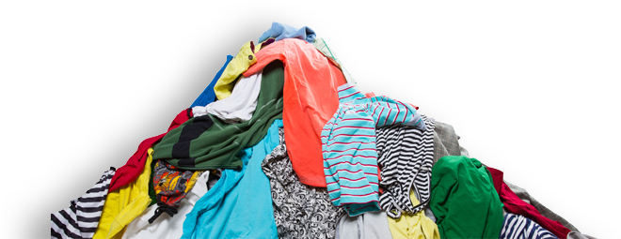
FIRST ACTIVITY
Name the clothes your teacher or you pull out of the bag.

Slide 4
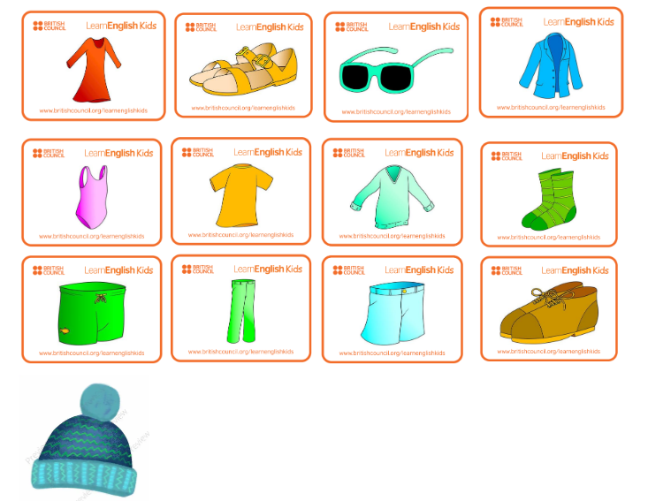
CLOTHES FLASHCARDS

Slide 5
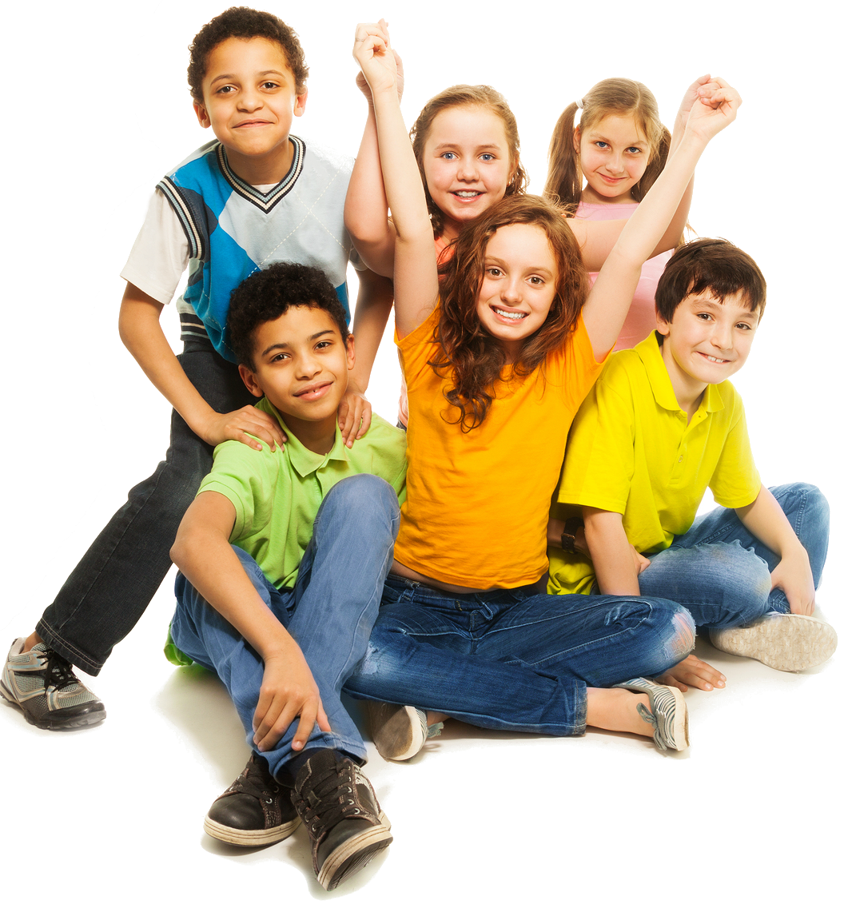
THIRD ACTIVITY
Everyone gets one flashcard and we form a circle. Choose an item of clothing and tell it to your friends out loud. They can help you or they can repeat the word after you. Then we play a game of “switching”. The teacher will tell you who will switch places with whom. For example: someone who is holding a jacket and someone who is holding sunglasses switch places.

Slide 6
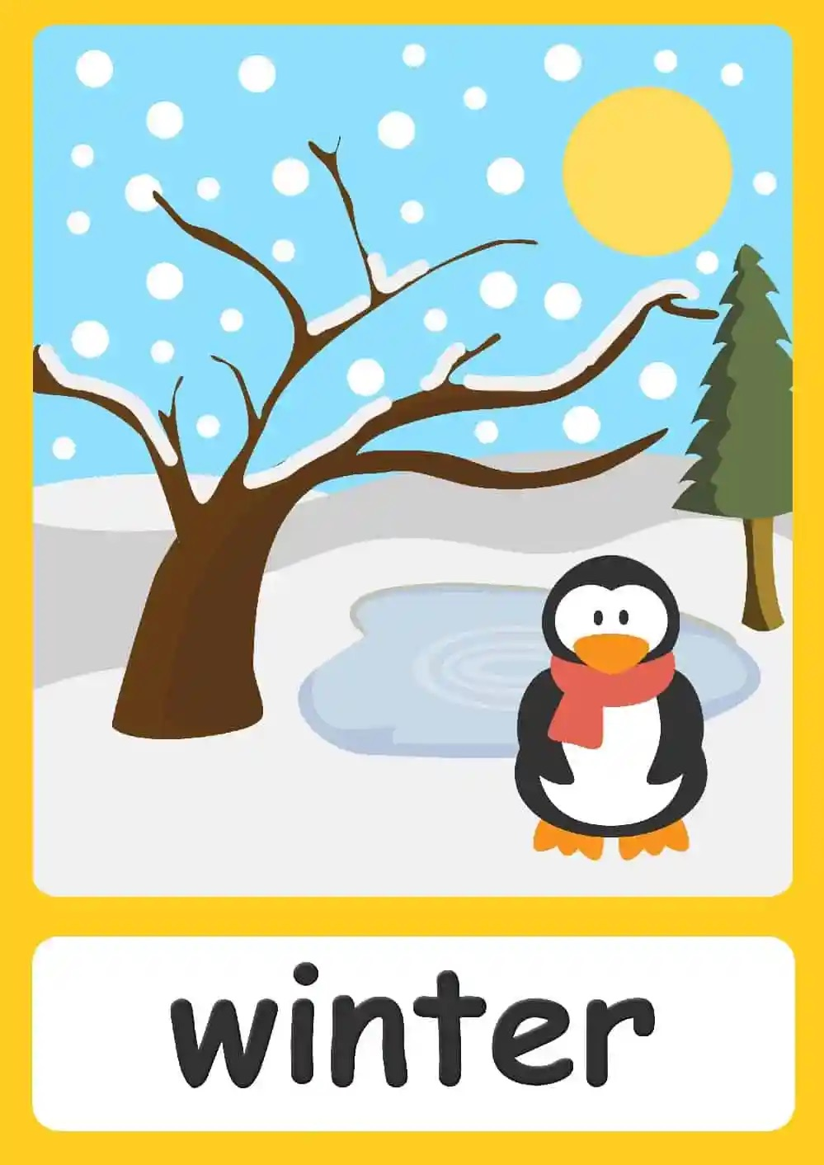
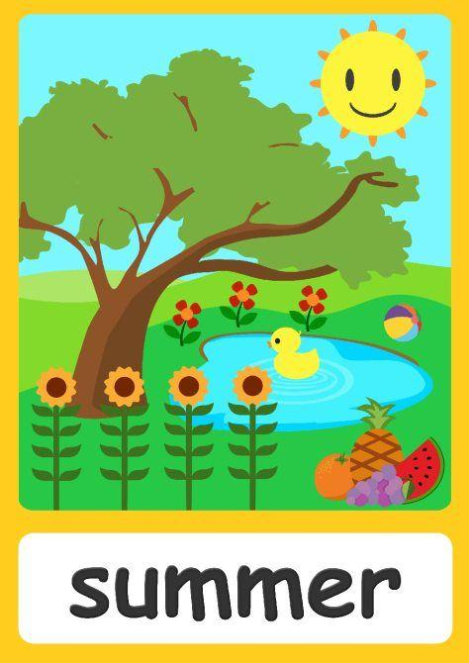
SEASONS

Slide 7
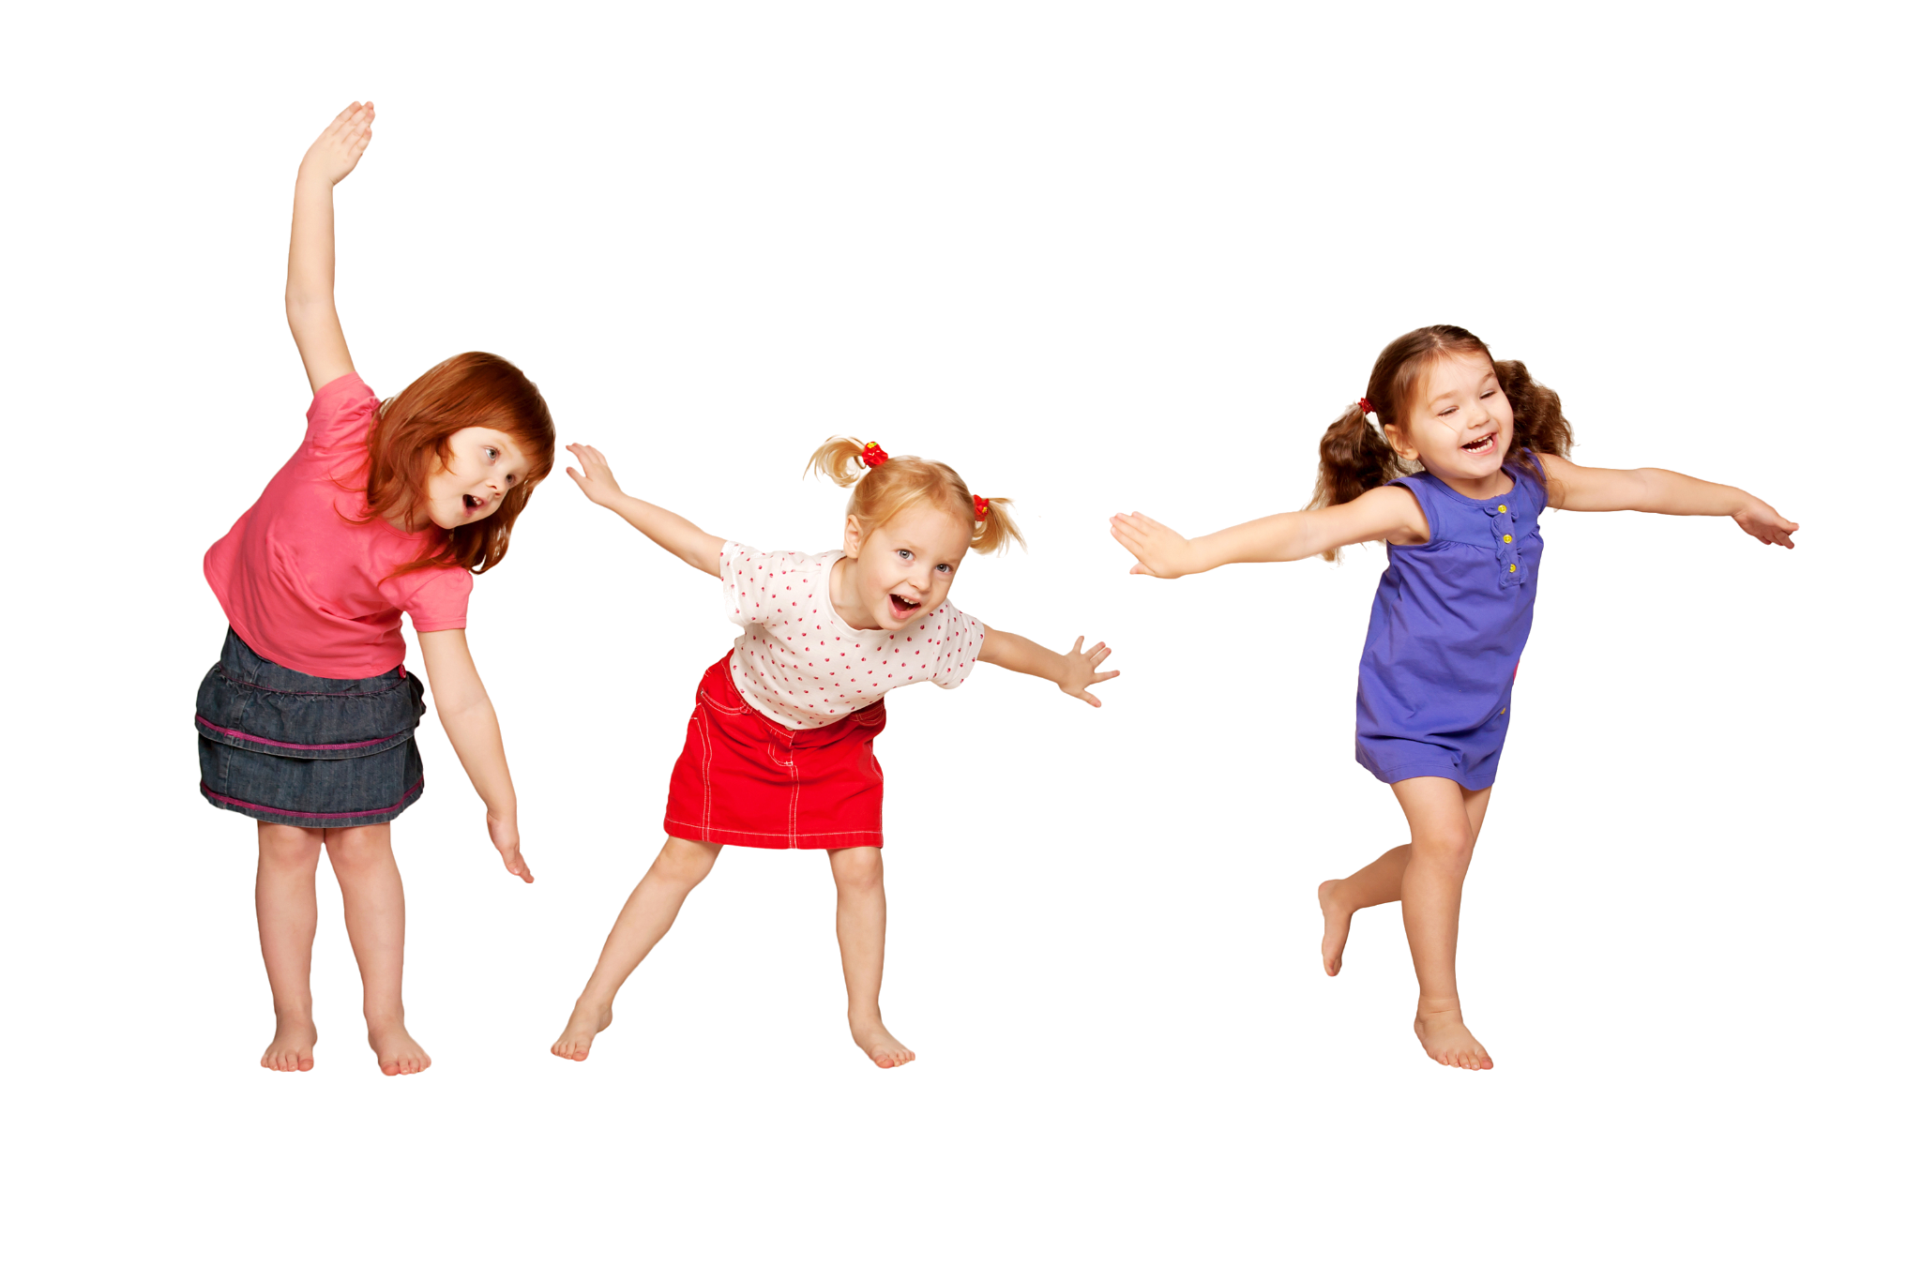
FOURTH ACTIVITY
Let’s play pantomime together!
You draw an item of clothing and your friends guess which item you put on or represent. Be careful, you can’t make a sound!

Slide 8
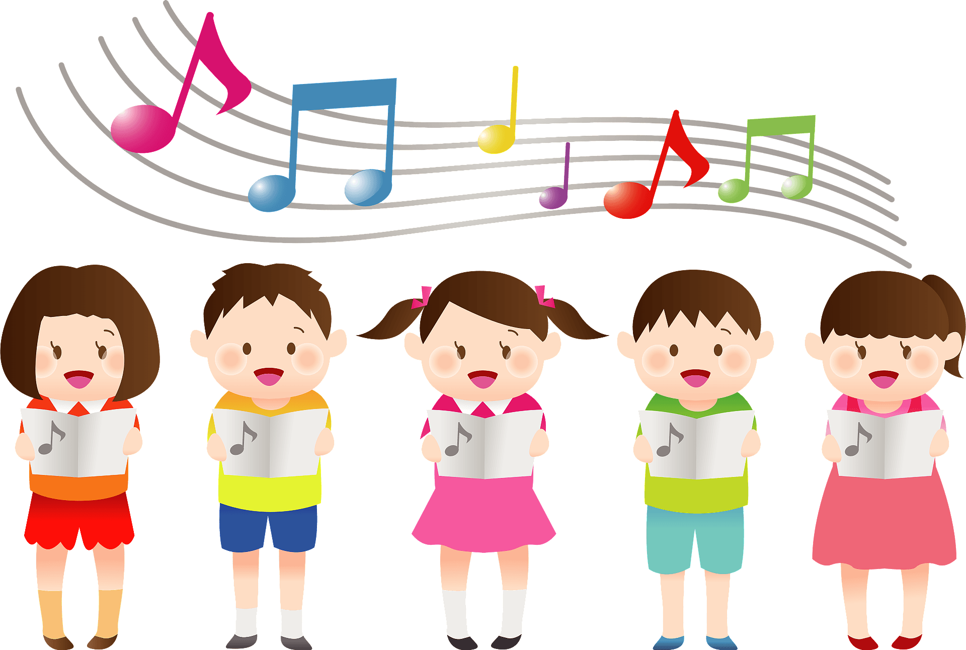
ADDITIONAL ACTIVITY
Let's Get Dressed - The Kiboomers Preschool Songs & Nursery Rhymes about Clothes
Listen to the song and try to sing along!

Slide 9
Maybe the real treasure was the tips we learnt along the way
Flashcards:
https://www.flashcardsforkindergarten.com/
Flashcards, activities and worksheets:
https://learnenglishkids.britishcouncil.org/
Learn some new/old nursery rhymes/songs:
https://www.thegarden.fr/en/our-top-10-english-songs-for-children/
https://www.fluentu.com/blog/educator-english/esl-songs-for-kids/

Slide 10

THANK YOU FOR LISTENING AND PLAYING ALONG

