Slide 1
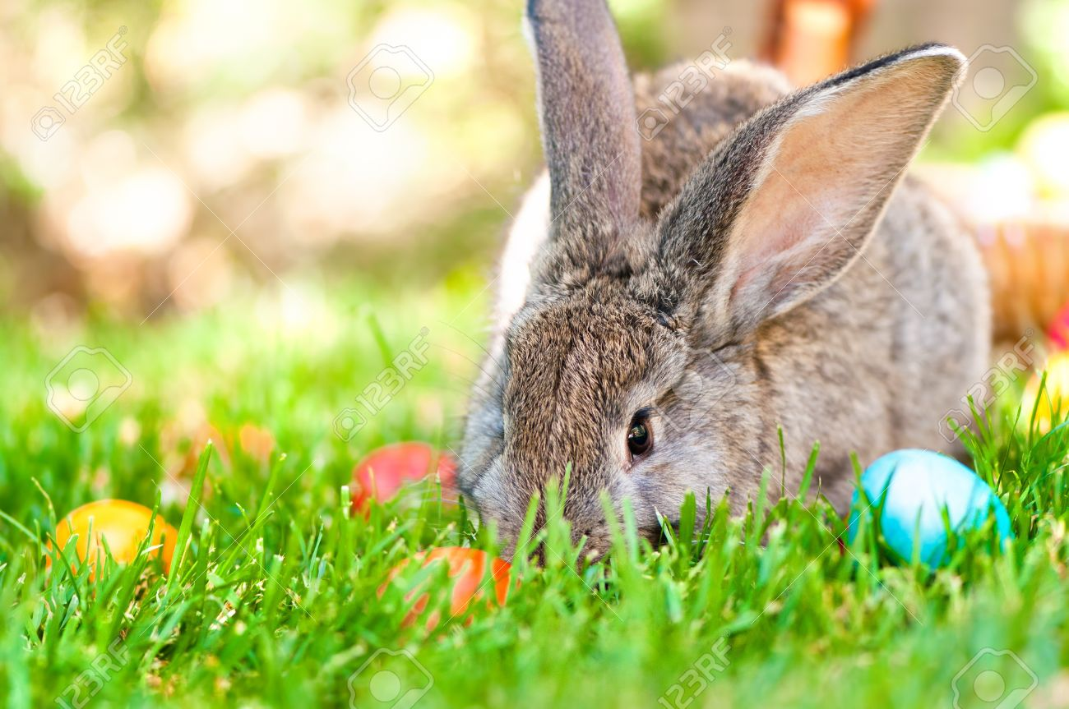
Have you ever appeared on television?
Have you ever spoken to a famous person?
Can you count to ten in Spanish?
Do you go to bed late?
Are you left-handed?
Have you ever been to a summer camp wtih children?
Have you ever changed a baby‘s diaper?
What is your dream job?
What kind of sports do you like?
Do you have a pet?
What kind of a super power would you like to have?
What would you do if you won the lottery?
What kind of an animal would you like to be?
What‘s your favourite TV series?
What‘s your favourite cartoon?
What do you dislike the most?
What‘s your favourite song?
What was your favourite toy when you were a child?
Which places would you like to visit?
What‘s your favourite ice cream flavour?

