Slide 1
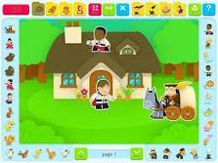
Storytelling
Mateja Dagarin Fojkar

Slide 2
Flap books: Spot, What colour are your knickers
‚Interactive‘ books: Press Here by Herve Tullet
https://www.youtube.com/watch?v=QArdr96aZTw
Brown Bear, Brown Bear by Bill Martin Jr.

Slide 3
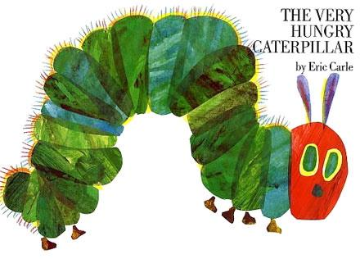
The very hungry caterpillar
What kind of activities can you think of based on the book?

Slide 4
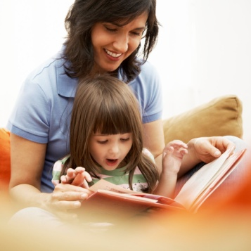
"If you want your children to be brilliant, tell them fairy tales.
If you want them to be very brilliant, tell them even more fairy tales.” (Albert Einstein)
»Now, I'm going to tell you a story I heard when I was a boy, and every time I've thought of it since, it struck me as being much nicer, for it's the same with stories as with many people: they grow nicer and nicer with age, and that's so delightful!«
(H. C. Andersen in What Papa Does Is Always Right)

Slide 5
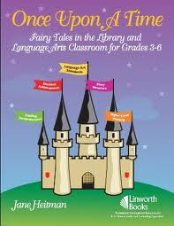
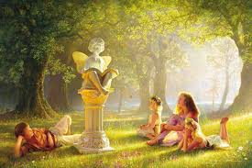
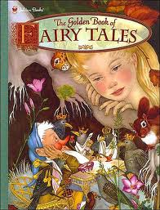
Your favourite childhood stories

Slide 6
Guess the stories
''When the Princess is fifteen years old, she shall prick her finger on a spindle and fall down dead.'‘
''I too shall die and float as foam upon the sea, not hear the music of the waves or see the lovely flowers, and the red sun. Isn't there anything at all I can do to win an immortal soul?'‘
''Those are pretty children the mother has. They are all pretty except that one; he didn't turn out right. I do wish she could make him over again.'‘
''Nibble, nibble, gnaw, who is nibbling at my little house?'‘
''…., …., Let down your hair.'‘
''Oh, just miserably! I've hardly closed my eyes all night! Heaven knows what was in my bed! I've been lying on something so hard that I'm black and blue all over! It's simply dreadful!''

Slide 7
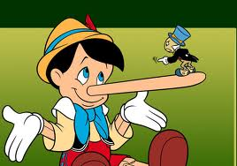
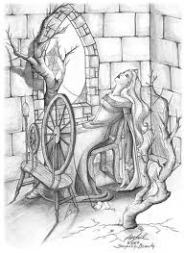
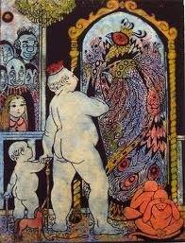
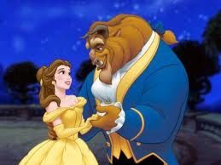
Guess the stories

Slide 8
Fill in the titles
Slovene | English | Other
Motovilčica
Janko in Metka
 | Cinderella
Trnuljčica
 | The Snow-White
Rdeča Kapica
 | Puss in Boots
 | Gingerbread man
Zlatolaska in trije medvedki
 | Thumbelina
Jakec in Fižolček

Slide 9
WHY?
Motivation (it's natural, interesting, children become involved)
Imagination (children live in their imaginary world, identification with characters)
Contextualization, not just separate words
Meaningful repetition, natural rhythm of language
Cultural information
Many ways of using them:
a) revision or introduction of new vocabulary and structures
b) topic work (you can base them on a certain theme of the unit, e.g., animals)
c) cross-curricular work (you can do art, craft, music activities conn. to stories)
Develop all four skills
Develop creative skills
Encourage social and emotional development
Develop listening and concentration skills (their knowledge, experience, visual clues)

Slide 10
TYPES OF STORIES
Fairy tales (most well known Grimm and Andersen)(security for children in a FL)
Traditional stories from our or other cultures http://www.worldstories.org.uk/
Comics
Authentic storybooks
Picture stories with no text, picture books without pictures https://www.youtube.com/watch?v=EZwY5BeYcyo
Rhyming stories
Adapted stories for learners
Fables
Shape: flap-books (Spot), zigzag books, window books, pop-up books, big books,
Children's own stories, everyday events
Contemporary fiction
Adaptations of traditional stories (e.g. R. Dahl or A. Ahlberg)
Stories on YT (e.g. Winnie – adapted, The very hungry caterpillar)
3 basic types:
a linear story (e.g. The Goldilocks and the Three Bears)
a repetitive story (e.g. The Goldilocks and the Three Bears, The Three Little Pigs)
a cumulative story (e.g. Chicken Licken)

Slide 11
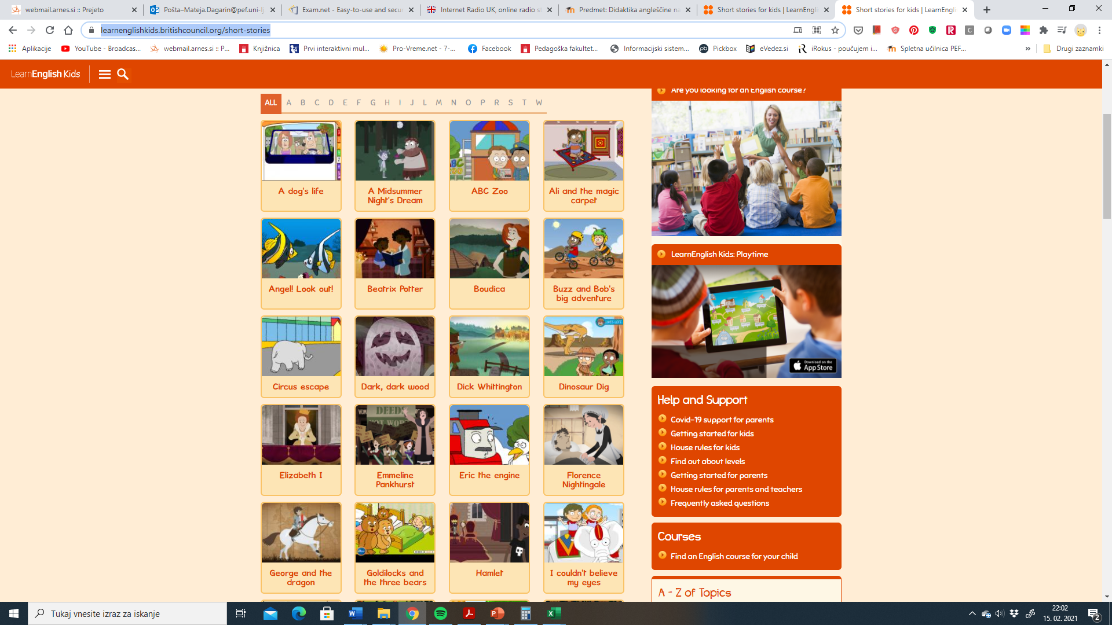
Learnenglish kids stories
https://learnenglishkids.britishcouncil.org/short-stories

Slide 12
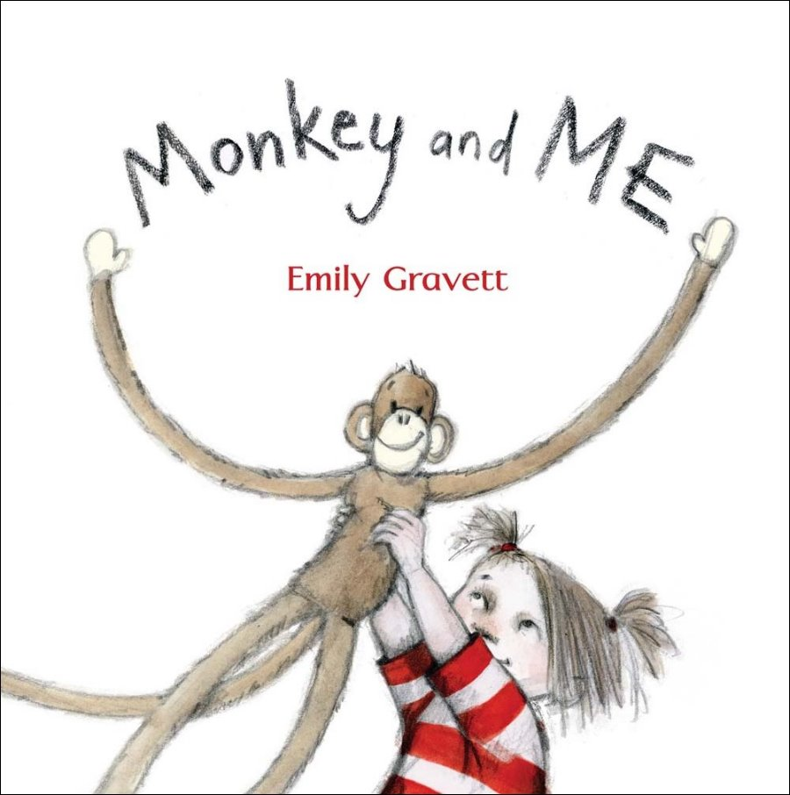
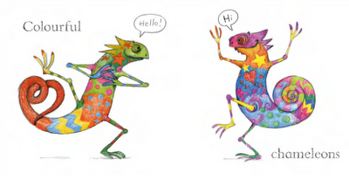
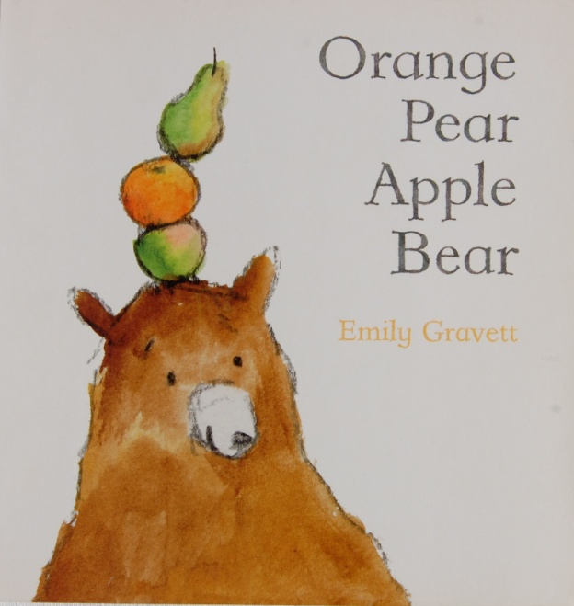
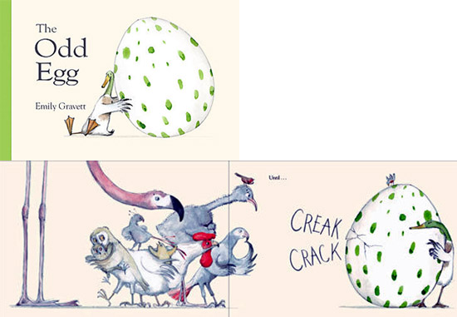
Emily Gravett
https://www.youtube.com/watch?v=oxoX7MkRsC0

Slide 13
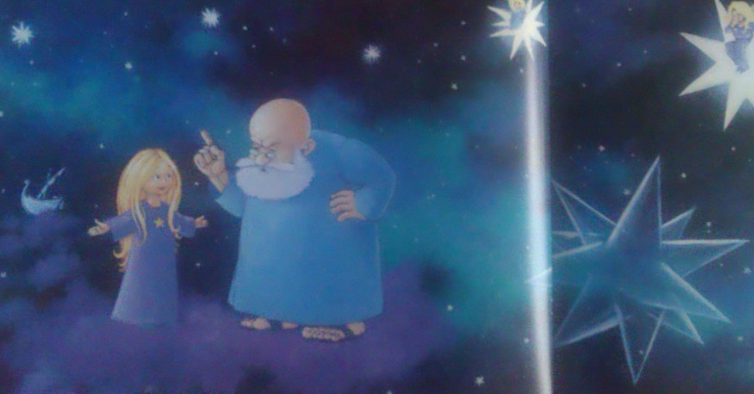
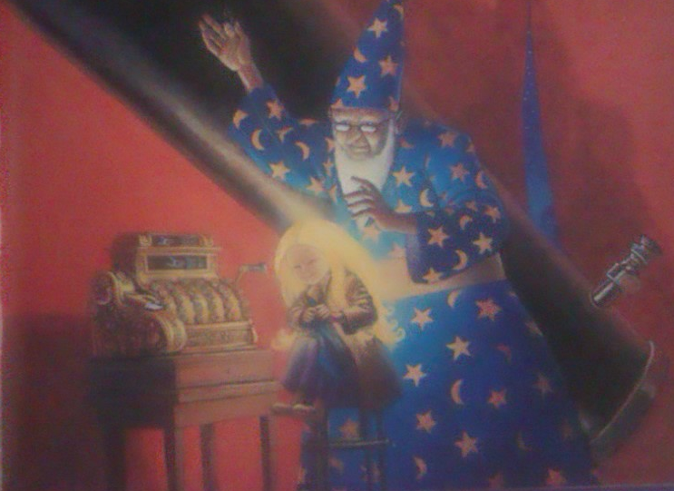
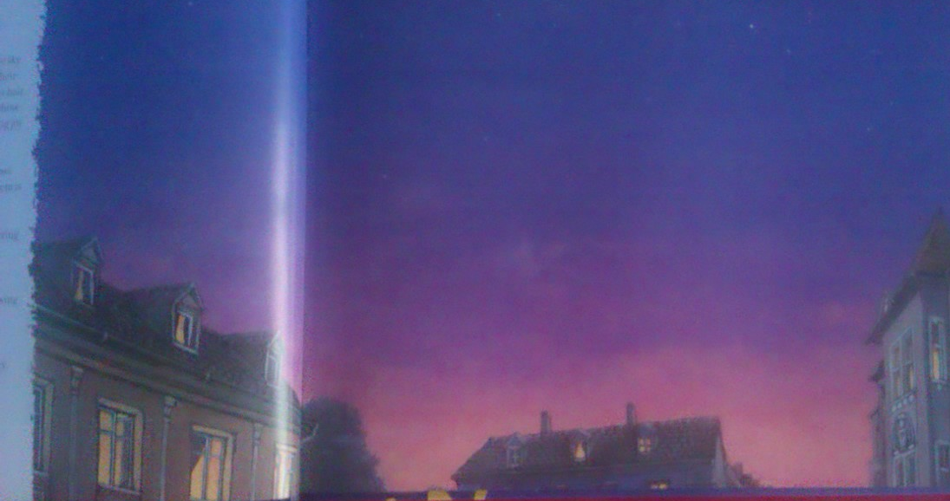
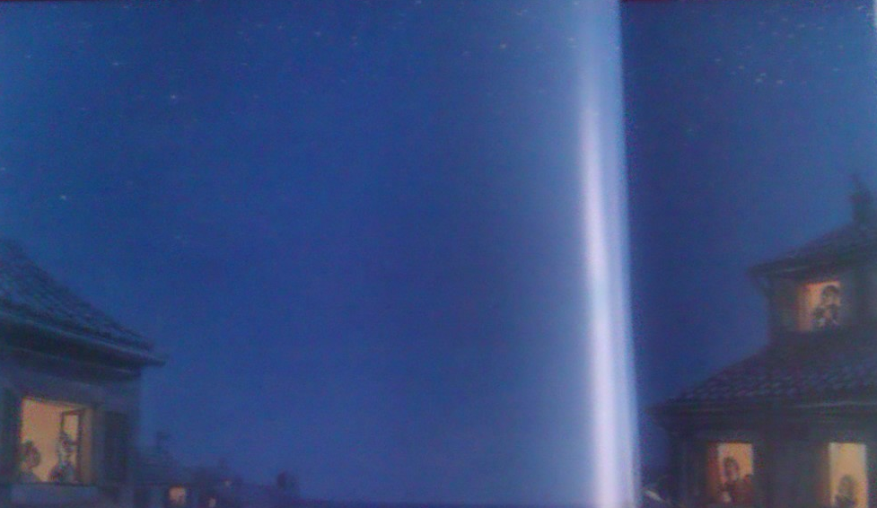
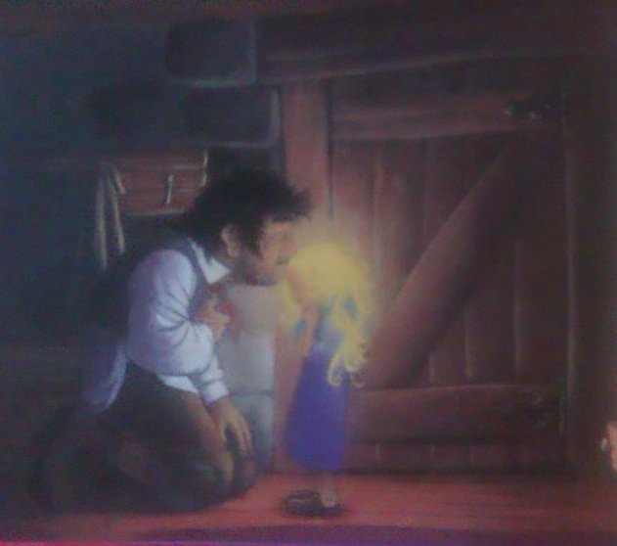
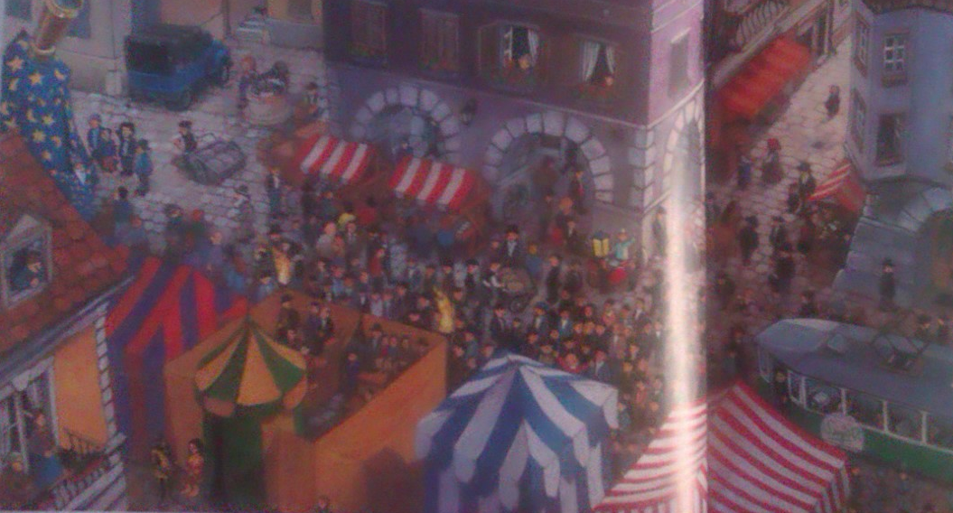
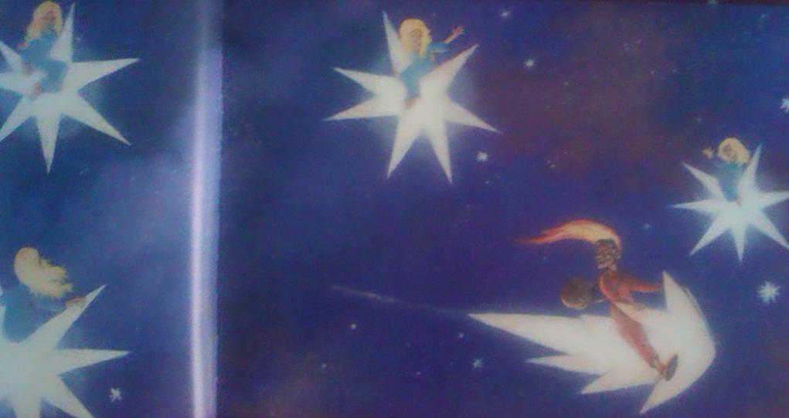
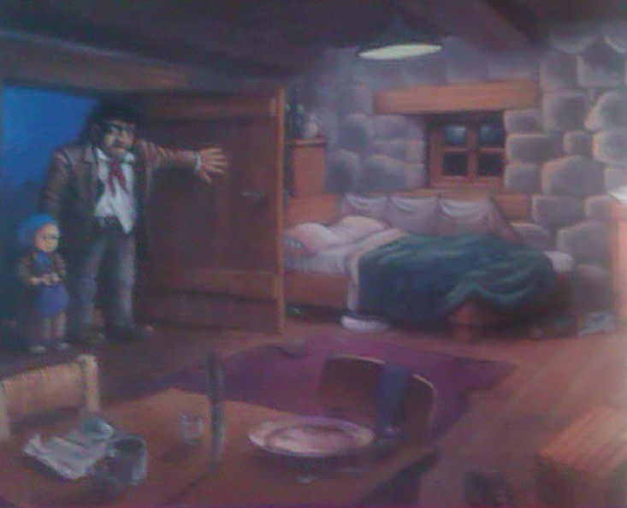
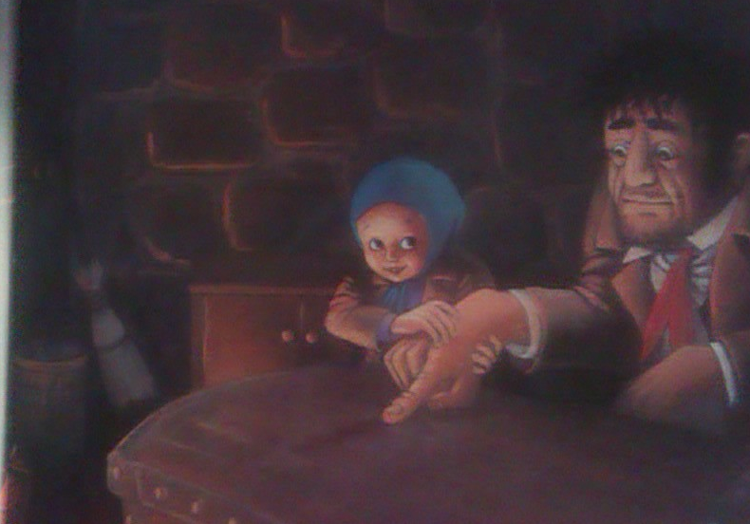
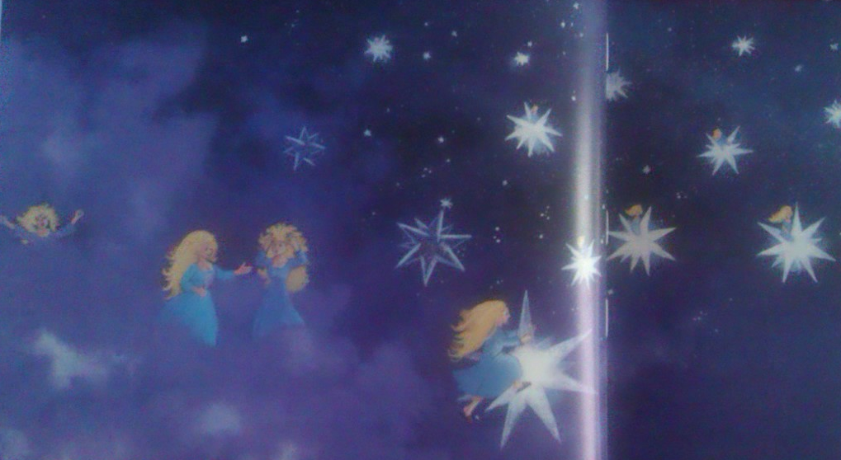
LITTLE SLEEPY STAR

Slide 14
A dice game – Little Sleepy star

Slide 15
Choosing a story
  Does it engage your students?
  Do you like it?
  Is the level appropriate for your students? (a balance between new and already acquired language)
  Is the story interesting?
  Are the illustrations appealing to your students?
  Is there any opportunity for prediction and follow up activities?
  (+ see Ellis, Brewster and Girard, p. 190, 191)

Slide 16
Reading or telling it?
A) Reading it

Slide 17
Reading or telling it?
B) Telling it

Slide 18
The storyteller
Remembering the story
  read the story a few times and tell it to a friend
  don't learn the details, memorize the gist of the story
  making skeletons = a bare frame of the story for the teller to work from and must not be referred to during a telling (a plot outline, background inf., character detail)
  check the meaning of words and the pronunciation
  adapt the story if necessary (grammar – e.g., shorter sent., but not from past to present, vocabulary – unfamiliar words, idioms)

Slide 19
Before telling the story
  get the children nearer to you (around your feet, in a circle)
  Entering phrase (Are you sitting comfortably?/ writing on BB, music)
  A story bag (coat, shirt, hat, realia, pictures, etc.) – A. Wright

Slide 20
While telling the story
  adopt a different voice for each character
  Pause at key moments (listeners absorb the already told and predict what follows)
  Make sound effects when possible
  Use your body and face (gestures, movement LRRH)
  Don't tell from your notes
  When reading it: read slowly and make comments about illustrations, encourage Ss to participate

Slide 21
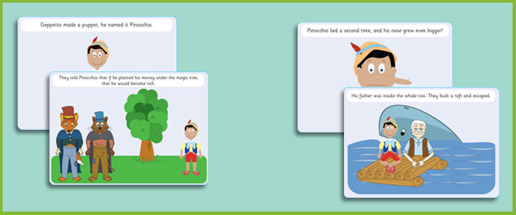
Stories with flashcards
Tell a story with the help of the flashcards
https://www.youtube.com/watch?v=ImchVnBo4ss

Slide 22
Stages in storytelling
http://www.teachingenglish.org.uk/try/tips/telling-a-story
https://www.futurelearn.com/courses/english-language-teaching/2/steps/62872 (stages in storytelling)

Slide 23
Activities based on the three-part skills model
1. pre-listening
practising new words from story (flashcards, games, e.g.; pelmanism, bingo, dominoes, etc.)
guessing/predicting a story (pictures, a cover, first sentence, title given)
brainstorming (what ch. already know about that topic, country, characters, events of a well-known story) (or/and making a mind map)

Slide 24
Activities based on the three-part skills model
1. while-listening
miming a story (S. Phillips. Enormous elephant – Drama with children)
predicting what happens next; predicting the ending
building a story together (pictures, initials, sent. on strips (Do and Understand)
describing what they see, feel, etc. (their pictures in mind)
intensive listening (searching for words, phrases, or gap fill, mistakes (e.g. traditional fairy tales)

Slide 25
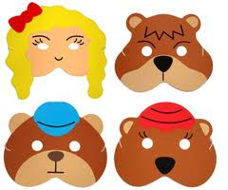
Goldilocks
Once upon a time there were bears: a big Father a Mother bear and a bear. The bears lived in a in the middle of the . .
One morning they made porridge for
breakfast. Father bear poured the hot into the three …

Slide 26
Adapted versions
The True Story of the Three Little Pigs
https://www.youtube.com/watch?v=vB07RfntTvw
The Paper Bag Princess by Robert Munsch
https://www.youtube.com/watch?v=P0lNFZtpq7APrincPrincess Smartypants by Babette Cole
https://www.youtube.com/watch?v=Hl6jIUz0e4o
Prince Cinders by Babette Cole
https://www.youtube.com/watch?v=SOaEIiHT4tI
https://www.youtube.com/watch?v=jPCobrg78Yc&t=645s

Slide 27
Activities based on the three-part skills model
1. post-listening
Retelling a story (questions, key words, sentences, pictures, puppets, etc.)
Changing a story (a medium, a point of view, a setting, characters, a modern version, change the ending, combining two stories, imagining what happened before the story)
Drawing/ miming/ acting out a story
Making a book
Making a puppet, a mobile of the main characters in the story
Creating / playing a game based on a story (dominoes, pelmanism, snap)
Singing a song based on a story
Interview with the characters
Identifying or imitating the characters
Evaluating the story (best part, worst part, most interesting event, most exciting part)
Personalizing a story (Imagine being there, what does it look like? What would you do? OR Have you ever experienced anything like the character in the story?)

Slide 28
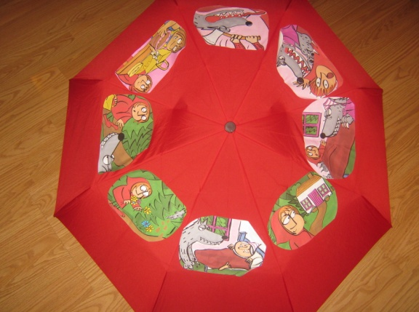
‘storytelling umbrella’

Slide 29
A post listening activity Who am I?
Who am I? I have grey hair and a big nose and huge feet. I‘m very strong. I know the woods very well as I work in there all day long. I can use an axe very well. I don‘t like wolves but I do like Grandma. I rescued Grandma.
Answer: the woodcutter

Slide 30
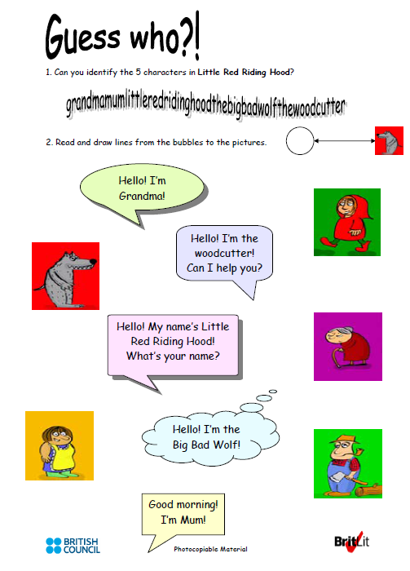
Guessing the charasters
http://www.teachingenglish.org.uk/article/little-red-riding-hood

Slide 31
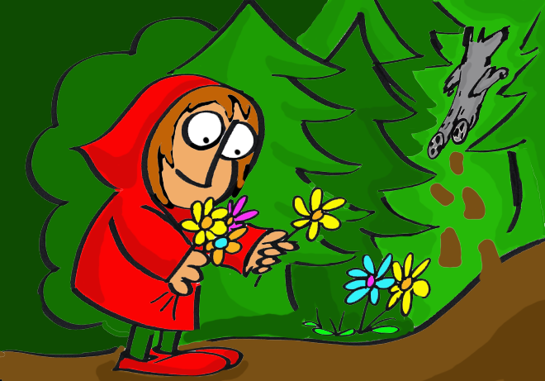
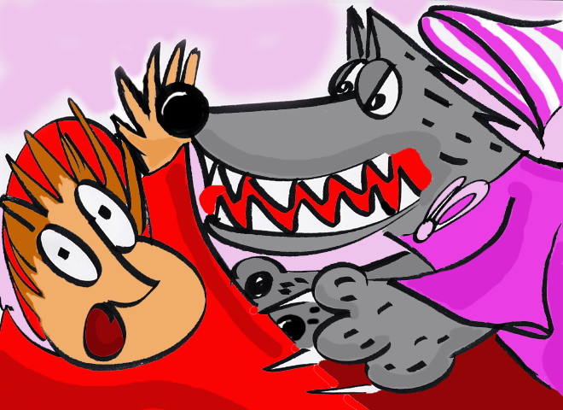
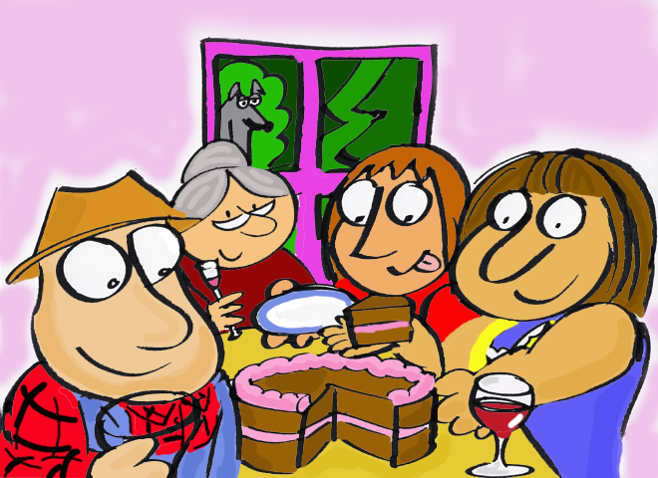
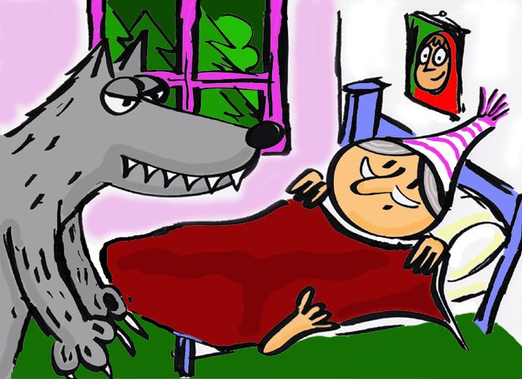
Story flashcards – putting them in order

Slide 32
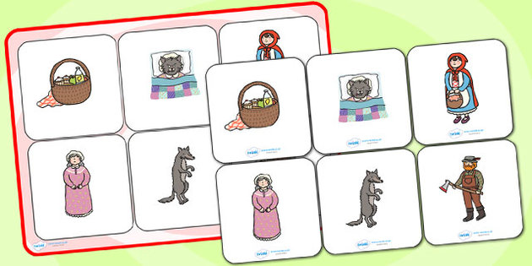
Bingo cards

Slide 33
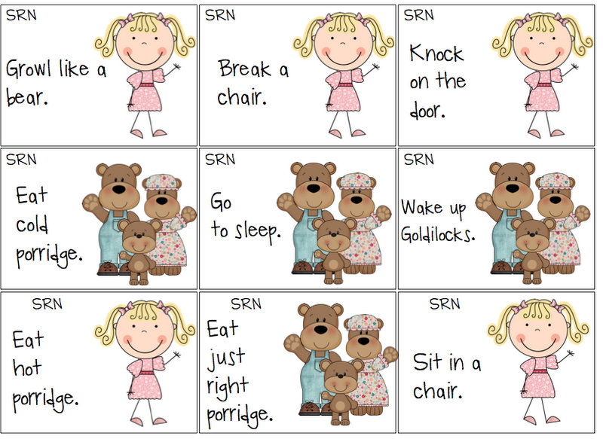
TPR STORY ACTIVITY

Slide 34
Story mat

Slide 35
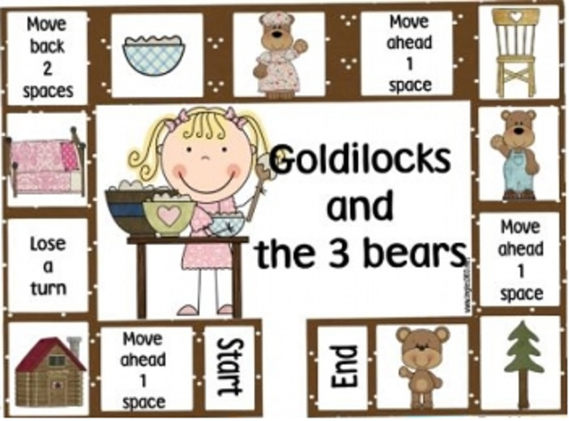
Storytelling boardgame

Slide 36
Making mini and pop-up books
Mini books
https://www.youtube.com/watch?v=bHa6kR2SZok
Mini books templates
http://www.dltk-teach.com/minibooks/index.htm
MAKING POP OUT BOOKS
https://www.youtube.com/watch?v=2mFxlbqUb0g

Slide 37
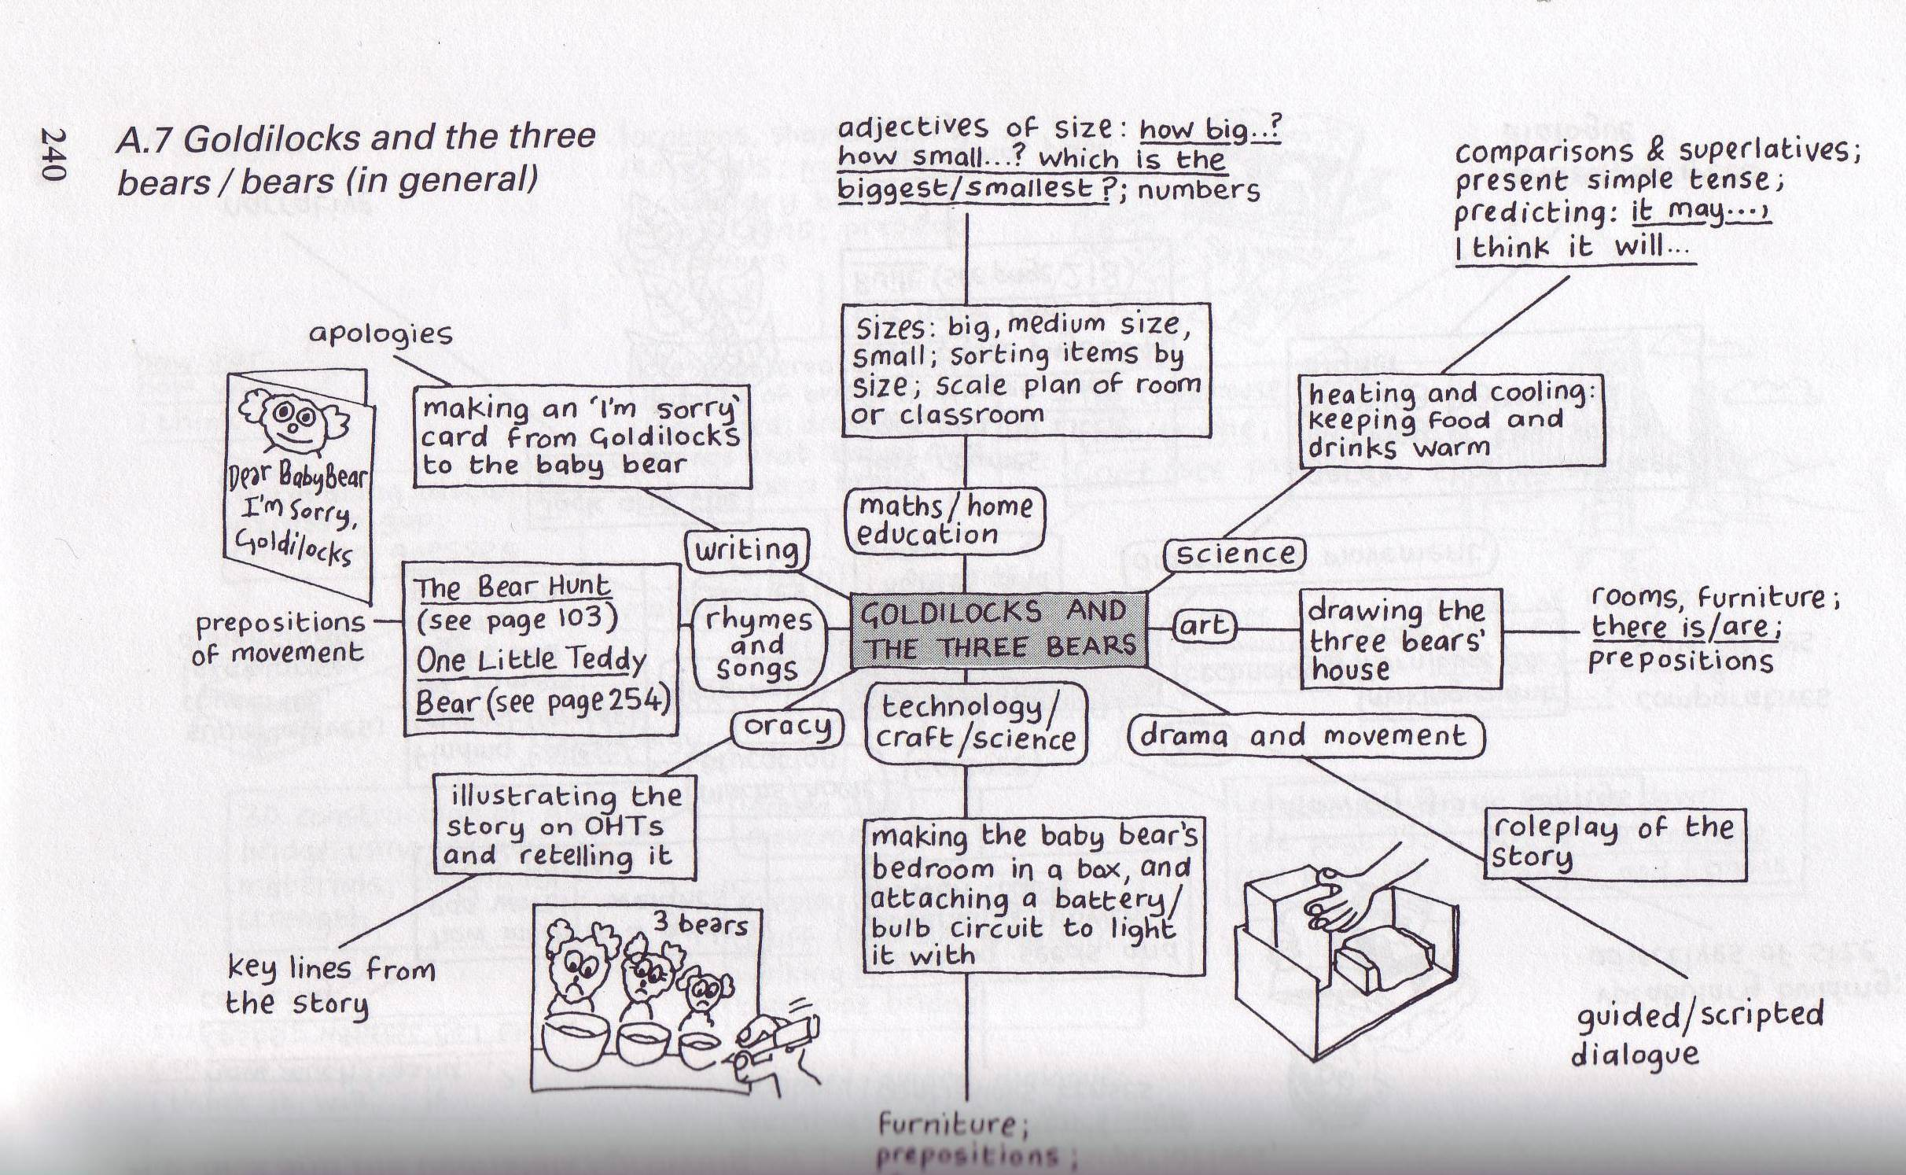
Activities based on different cross-curricular areas

Slide 38
Creating stories
''Stories can be 'mothers' to new stories''. (Wright 1997: 56)
Activities:
Making a story from one sentence
Making a story from a set of pictures
Passing a story
Fairy tales with holes
Question stories
http://learnenglishkids.britishcouncil.org/games/story-maker-1

Slide 39
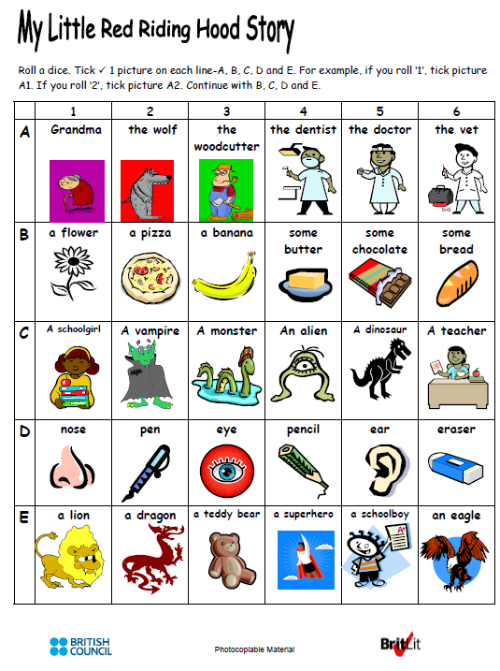
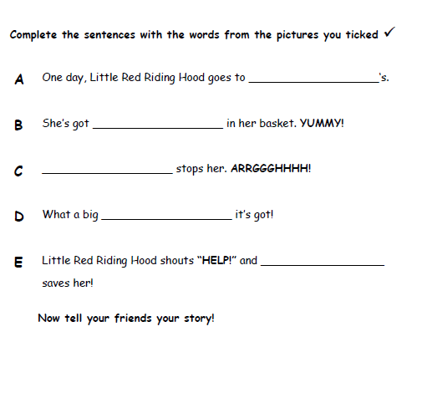
Creating a story
http://www.teachingenglish.org.uk/article/little-red-riding-hood
http://www.teachingenglish.org.uk/article/little-red-riding-hood

Slide 40
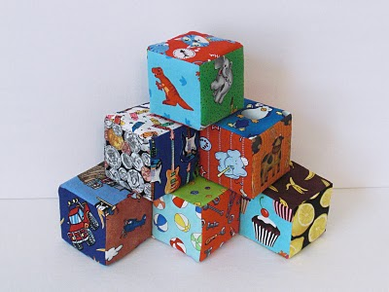
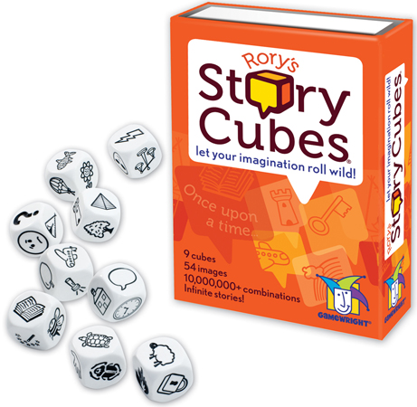
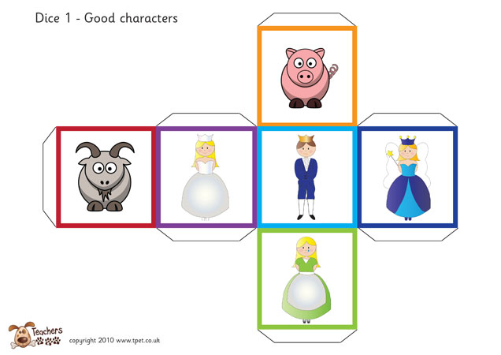
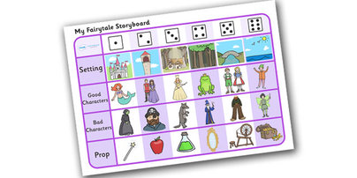
Storytelling dice
https://davebirss.com/storydice/

Slide 41
STORYTELLING WEBSITES
https://www.oxfordowl.co.uk/
http://www.penguinreaders.com/pyr/resources/
http://www.magickeys.com/books/index.html
http://www.teachingenglish.org.uk/try/teaching-kids/goldilocks-three-bears
https://learnenglishkids.britishcouncil.org/short-stories
http://www.bbc.co.uk/cbeebies/stories/
http://schoolexpress.com/fws/cat.php?id=2333
http://www.primaryhomeworkhelp.co.uk/interactive/onlinestory.htm
https://worldstories.org.uk/

Slide 42
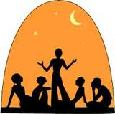
Happy storytelling!

