Slide 1

STORY BASED APPROACH
& CLIL
SCIENCE
MATHS
LANGUAGE
GEOGRAPHY
MUSIC
P.E.
ART &
CRAFT

Slide 2

THE VERY HUNGRY CATERPILLAR
Written by Eric Carle
Narration: http://www.youtube.com/watch?v=_4HI7q38VmQ
Activities and lesson plans: http://fabulousclassroom.com/2011/06/hungry-caterpillar-activities-lesson-plans/

Slide 3
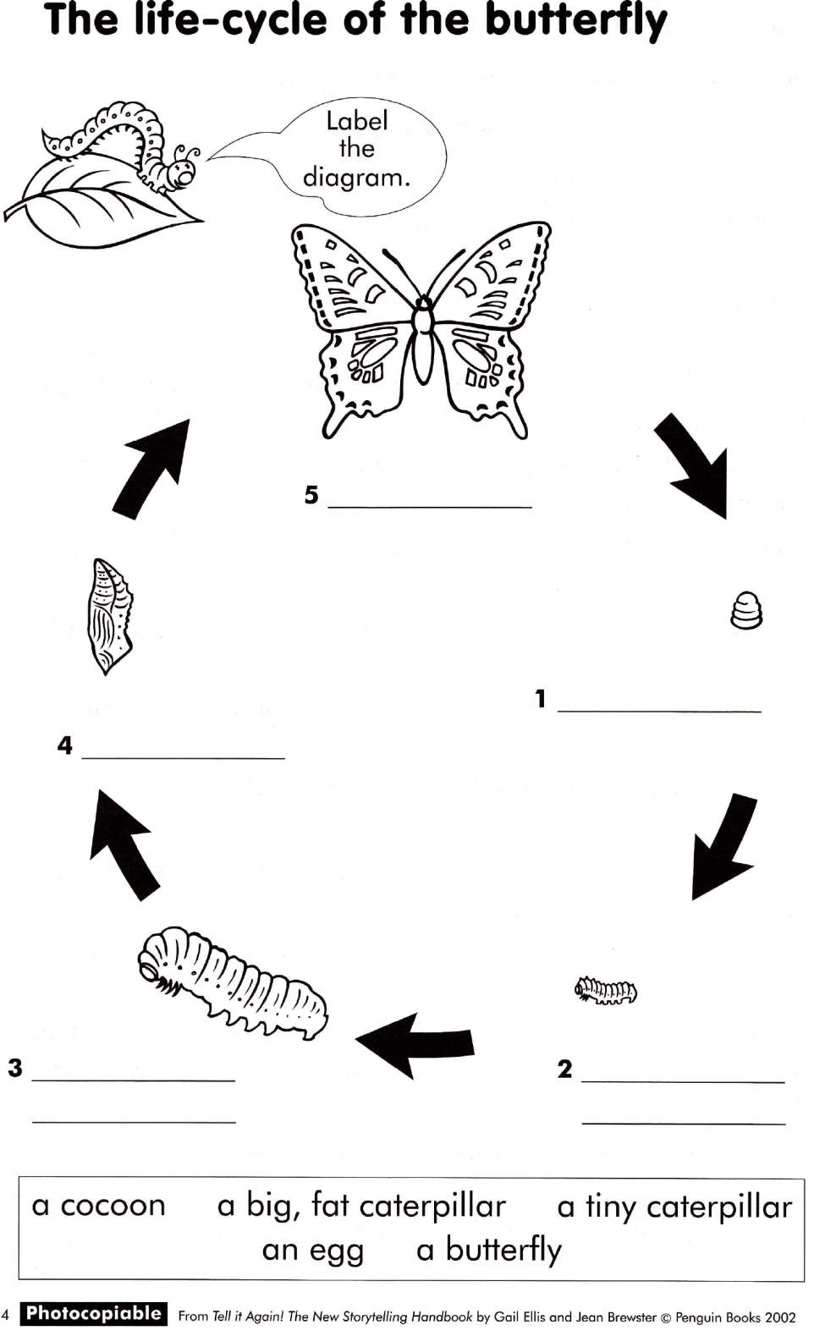
Science

Slide 4
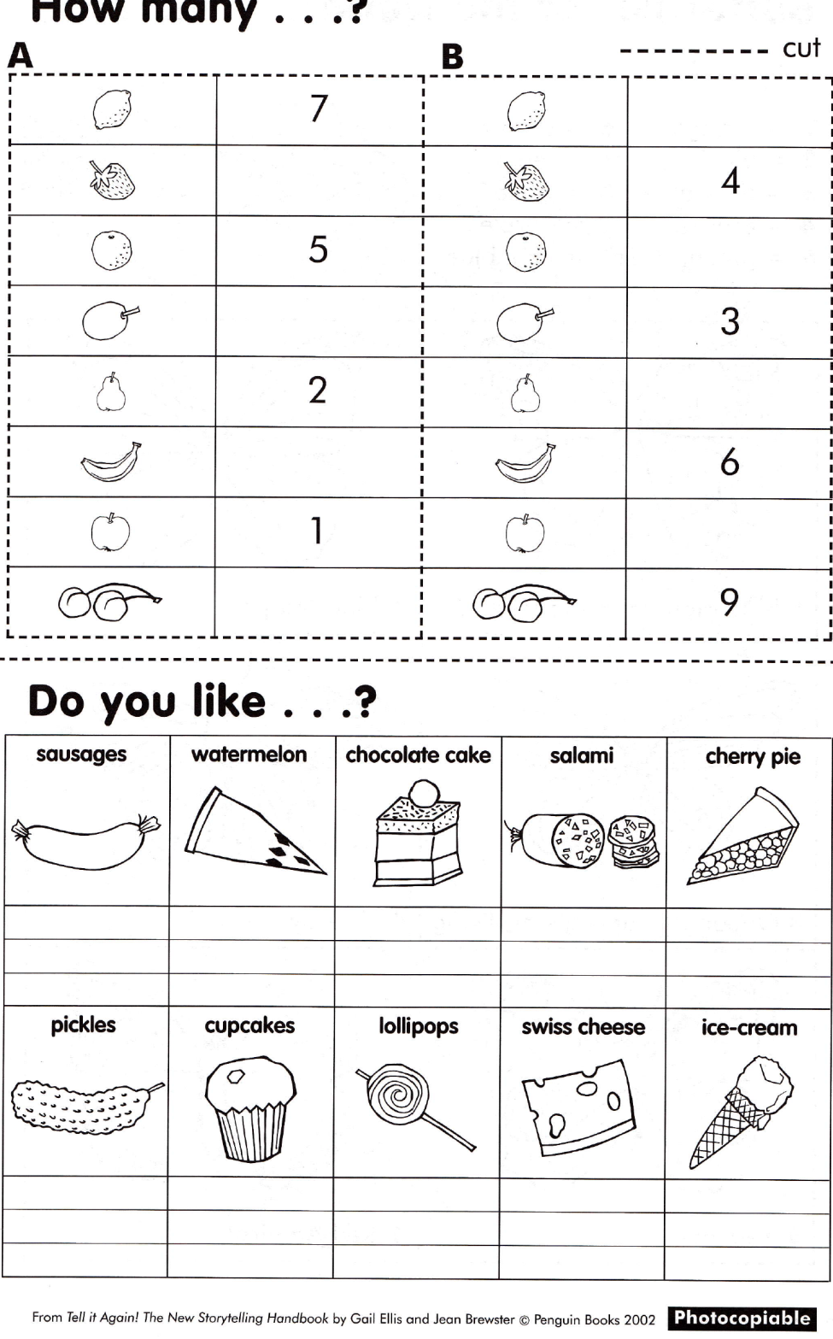
Maths

Slide 5
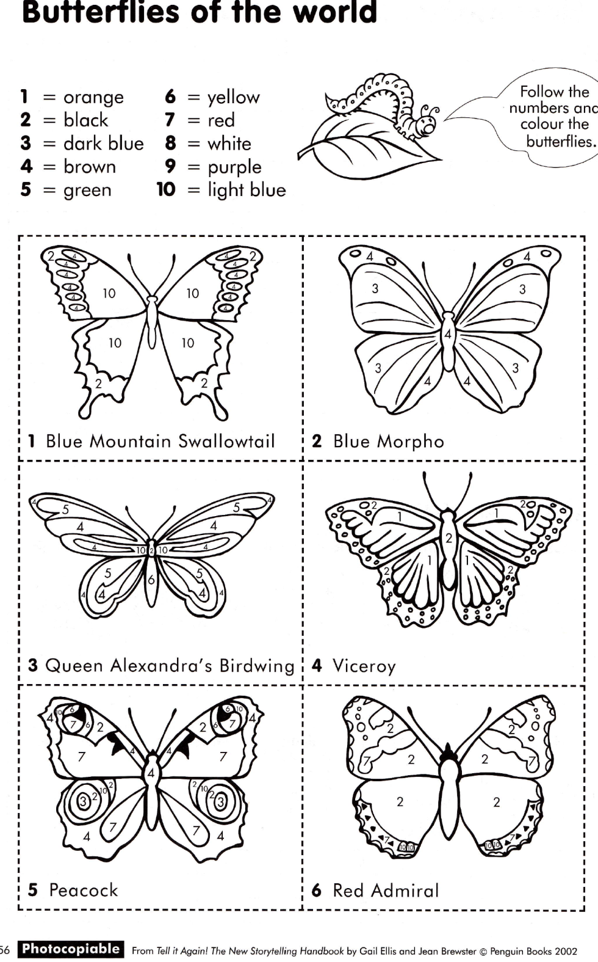
Art

Slide 6
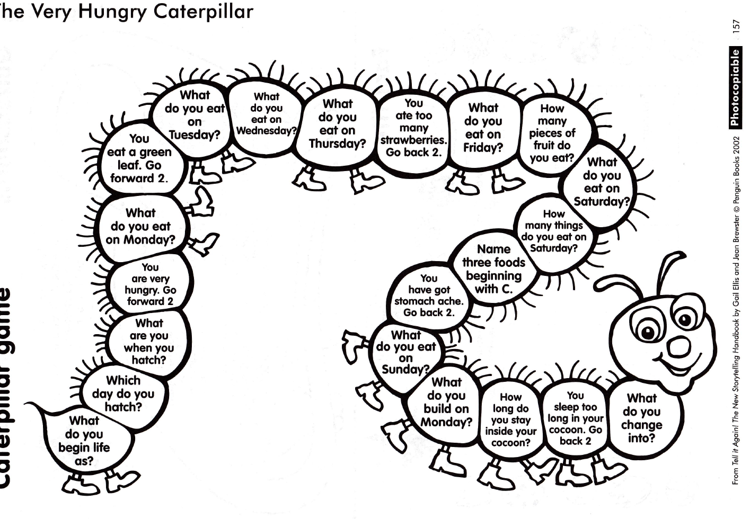

Slide 7
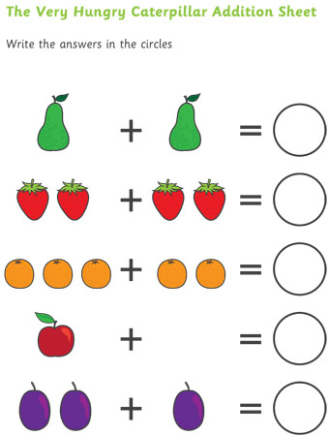
Maths

Slide 8
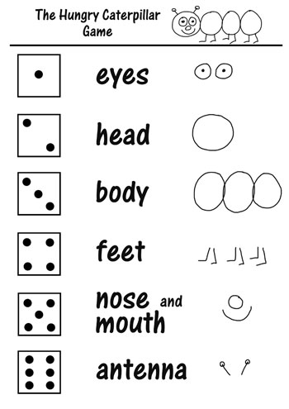
Maths

Slide 9
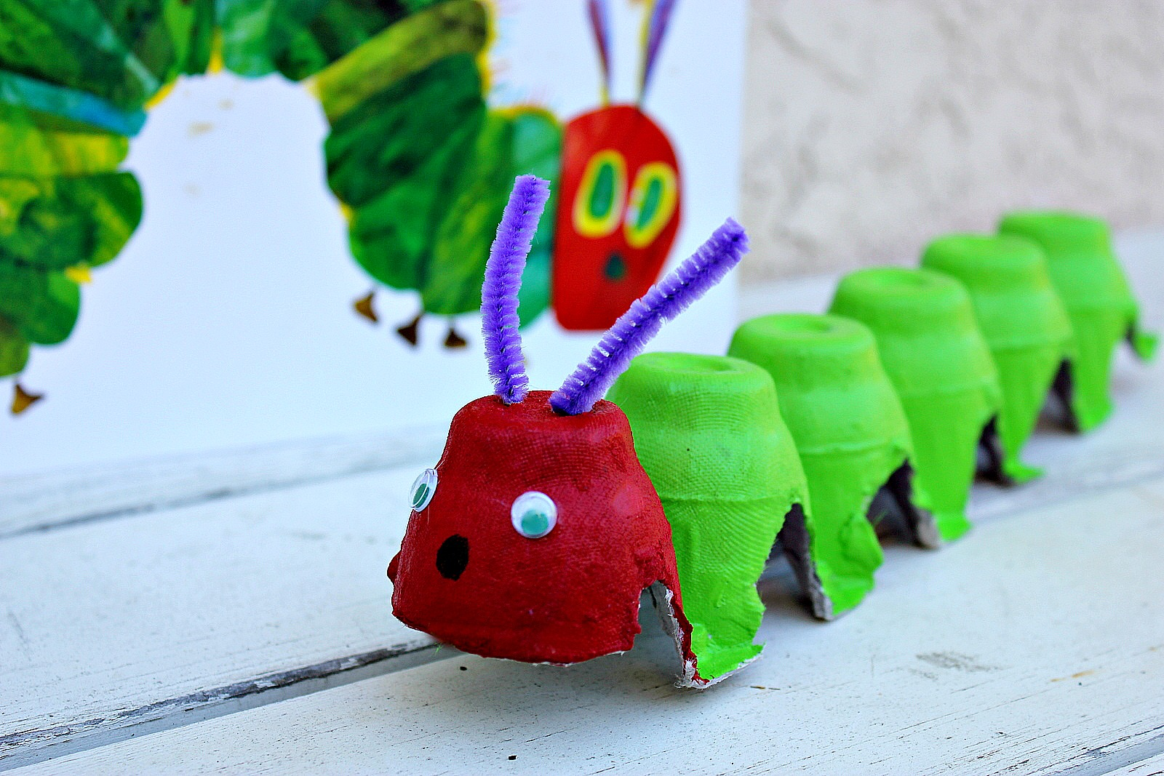
Art activity

Slide 10
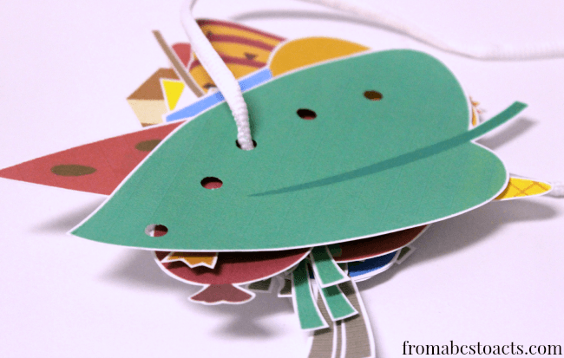
Art activity

Slide 11
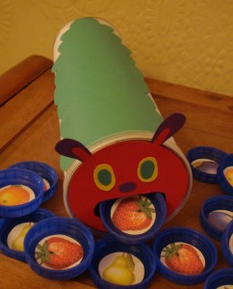
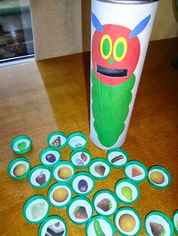
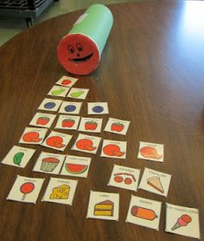
Art – feeding the caterpillar

