Slide 1
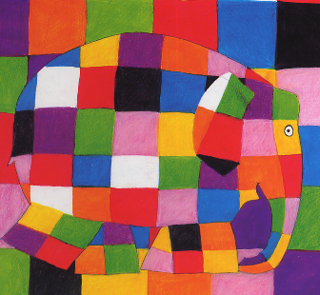
Elmer
By David McKee

Slide 2
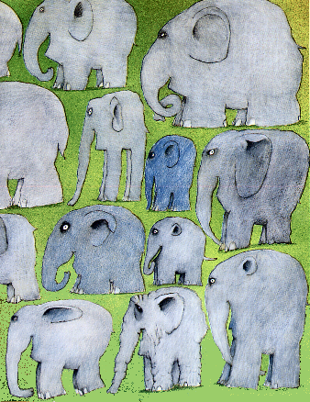
There was once a herd of elephants.
Elephants young, elephants old, elephants tall or fat or thin.
Elephants like this, that or the other, all different but all happy and all the same colour.
All, that is, except Elmer.

Slide 3
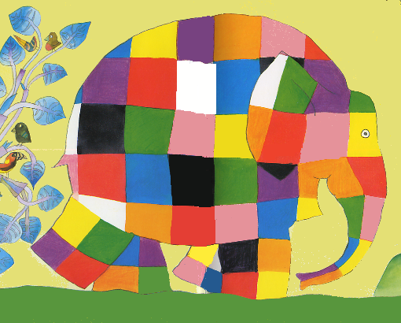
Elmer was different.
Elmer was yellow and orange and red and pink and purple and blue and green and black and white
Elmer was patchwork.
Elmer was not elephant colour.

Slide 4
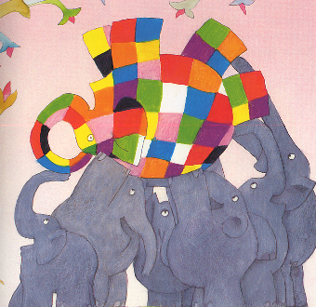
It was Elmer who kept the elephants happy.
Sometimes he joked with the other elephants, sometimes they joked with him.
But if there was even a little smile, it was usually Elmer who started it.

Slide 5
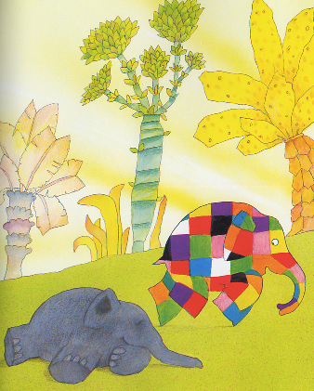
One night Elmer couldn’t sleep for thinking, and the think he was thinking was that he was tired of being different.
No wonder they laugh at me.
Whoever heard of a patchwork elephant?
he thought
In the morning before the others were really awake, Elmer slipped quietly away, unnoticed.

Slide 6
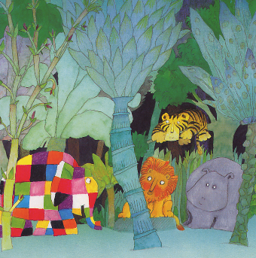
As he walked through the jungle, Elmer met other animals
They always said: “ Good Morning, Elmer”
Each time Elmer smiled and said: “ Good Morning.”

Slide 7
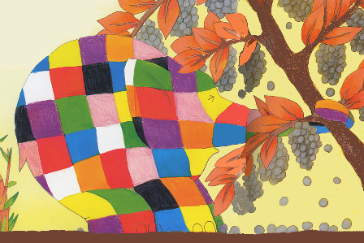
After a long walk Elmer found what he was after – a large bush
A large bush covered with berries, a large bush covered with elephant-coloured berries
Elmer caught hold of the bush and shook it and shook it so that the berries fell on the ground.

Slide 8
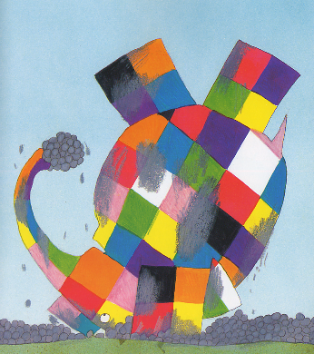
Once the ground was covered in berries, Elmer lay down and rolled over and over – this way and that way and back again.
Then he picked up a bunch of berries and rubbed himself all over, covering himself with berry juice until there wasn’t a sign of any yellow, or orange, or red, or pink, or purple, or blue, or green, or black, or white.
When he had finished, Elmer looked like any other elephant.

Slide 9
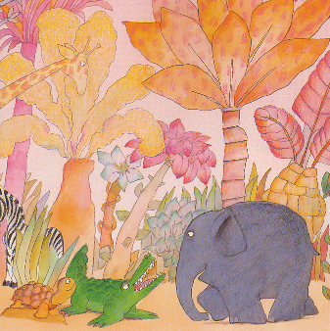
After that Elmer set off back to the herd. On the way he passed the other animals again.
This time each one said to him: “ Good Morning, elephant”
Each time Elmer smiled and said: “ Good Morning,” pleased he wasn’t recognised

Slide 10
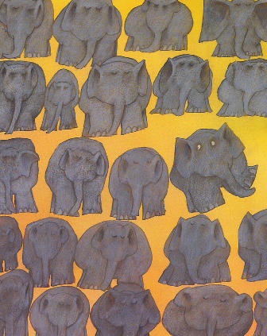
When Elmer rejoined the other elephants they were all standing quietly.
None of them noticed Elmer as he made his way to the middle of the herd.

Slide 11
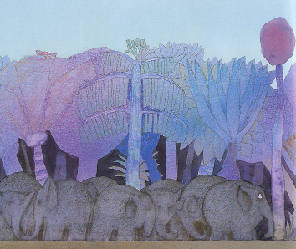
After a while Elmer felt that something was wrong. But What? He looked around: same old jungle, same old bright sky, same old rain cloud that came over from time to time and lastly same old elephants.
Elmer looked at them.

Slide 12
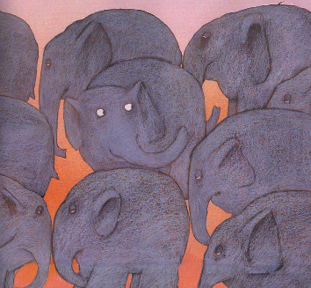
The elephants were standing absolutely still. Elmer had never seen them so serious before.
The more he looked at the serious, silent, still standing elephants, the more he wanted to laugh.
Finally he could bear it no longer. He lifted up his trunk and at the top of his voice shouted:

Slide 13

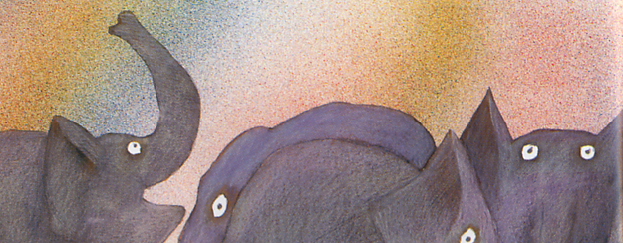
BOOO!

Slide 14
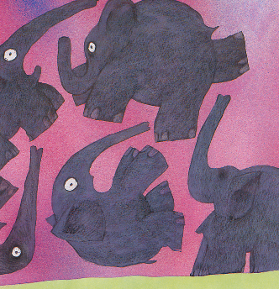
The Elephants jumped and fell all ways in surprise.
“Oh my gosh and golly!” they said – and then saw Elmer helpless with laughter
“Elmer,” they said. “It must be Elmer.” Then they other elephants laughed too, as they had never laughed before.

Slide 15
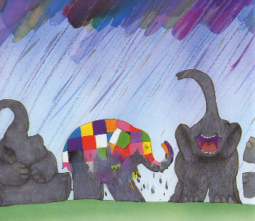
As they laughed the rain cloud burst and when the rain fell on Elmer his patchwork started to show again.
The elephants still laughed as Elmer was washed back to normal. “Oh Elmer,” gasped an old elephant. “you’ve played some good jokes, but this has been the biggest laugh of all. It didn’t take you long to show your true colours.”
“We must celebrate this day every year,” said another. All the elephants must decorate themselves and Elmer will decorate himself elephant colour.”

Slide 16
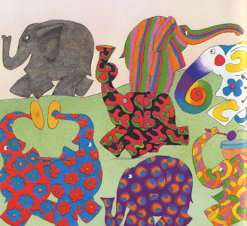
That is exactly what the elephants do.
On one day a year they decorate themselves and parade. On that day if you happen to see an elephant ordinary elephant colour you will know it must be Elmer.

Slide 17
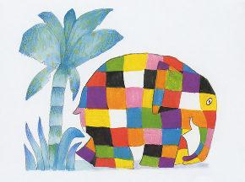
Images and words ©Andersen Press, London

