Slide 1
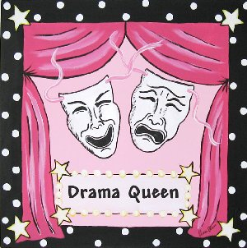

Role plays and drama
Mateja Dagarin Fojkar
Faculty of Education
Ljubljana

Slide 2
ROLE-PLAYS
In role plays you pretend to be in a particular situation, especially to help you learn a language.
Role plays improve students’ fluency in a FL and provide learners with a rehearsal for ‘real life’.
All role plays are simulations, but not all simulations are role plays.
Students can imagine a role, a situation or both.
There should be a balance between realistic and unrealistic situations (fantasy, imagination), but familiar situations are easier to act out.
Sarah Phillips: Drama with children
http://books.google.com/books?id=XiPqzmyWzjMC&printsec=frontcover
Notes:
Role – plays
What?
Simulation? – you are yourself, the situation is different
Practise real-life situations

Slide 3
Ways of role-playing
Just miming
Using words and simple sentences
Using sentences
Usign puppets and other props
Based on comics, songs, chants, stories…
Short plays based on books (scripts)
Whole class in two groups

Slide 4
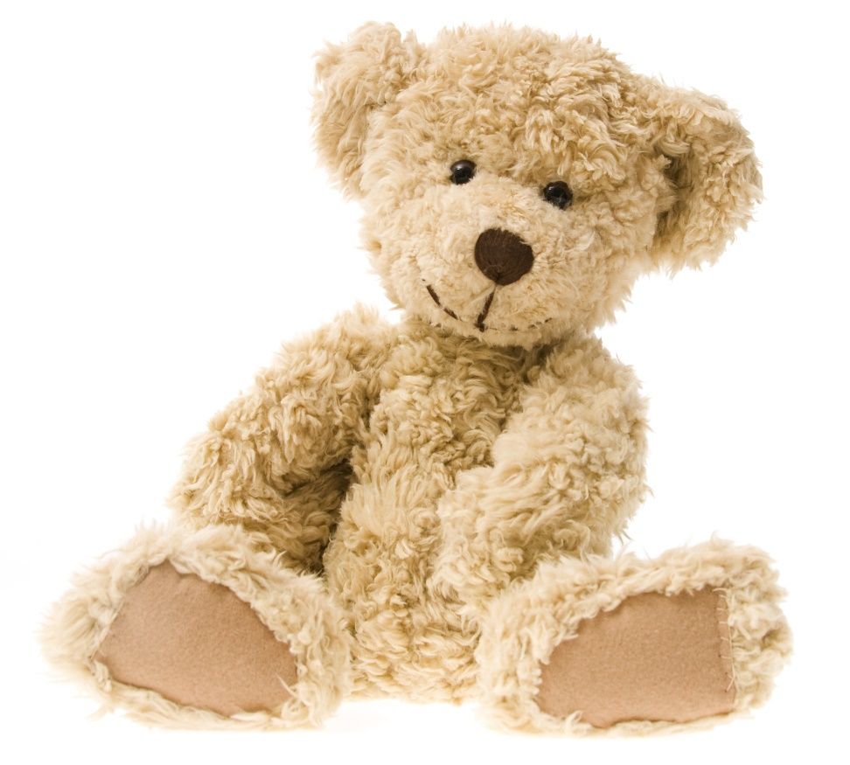
Using Teddy
Teddy bear or other soft toys
Plastic food
Cutlery, kitchen utensils, food containers
Play money, plastic cash register
Clothes, toy bed, toy cars
Maps, postcards, photos
Blanket, pillow

Slide 5
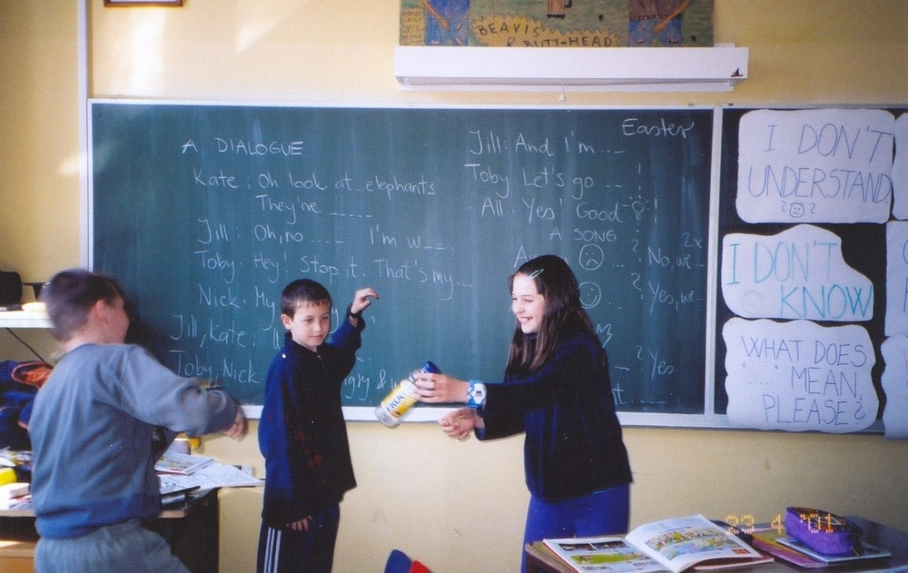
Types of role-plays
A story / a dialogue
An interview
A fashion show
Shopping
At a restaurant
A quiz show
…

Slide 6
Writing a dialogue
In pairs choose a situation to role play, e.g. in a (clothes/food…) shop, in a restaurant, at a fashion show, on a street, at a party, at an interview…
Write down the dialogue the students would need to know and all the props you can use in the role play.
https://www.youtube.com/watch?v=u1-5__upsXw

Slide 7
A ROLE PLAY ON A CHANT
Two tall daddies
Walking down the lane
Waved to each other
And then they waved again.
How are you?
How are you?
Lovely day again!
(Sarah Phillips, Drama with Children)

Slide 8

A ROLE PLAY ON A CHANT
The Bear Hunt
We’re going on a bear hunt
We’re going to catch a big one
We’re not scared
Oh no, grass, long green grass
We can’t go over it
We can’t go under it
We can’t go round it
We must go through it
Swish, swish swish…
Oh, no water, cold wet water (splash, splash, splash)
Oh no, mud, black sticky mud (Squelch, squelch)
Oh look, a cave, a big dark cave (shh, shh, shh)
Oh no, a bear, a big brown bear
Quick, run – out of the cave (shh, shh), through the mud (squelch, squelch), through the water (splash, splash), through the grass (swish, swish) And back home (Phew)
http://www.youtube.com/watch?v=BAJc6sLTOPw

Slide 9
Ten in the bed
There were ten in the bed [Hold up 10 fingers.]
and the little one said, [Hold your hands close together, indicating 'small.']
"Roll over, roll over" [Roll hands around each other, or each student turns to the right and says, "Roll over! Roll over!"]
So they all rolled over and one fell out. [Everyone rolls to the right and the student in the first chair 'falls out' of the bed.]
http://www.youtube.com/watch?v=a2bxC_TovZ4
http://supersimplelearning.com/songs/original-series/one/ten-in-the-bed/

Slide 10
A role-play on a rhyme

Slide 11
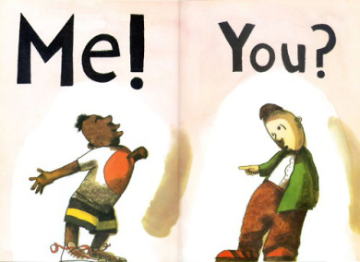

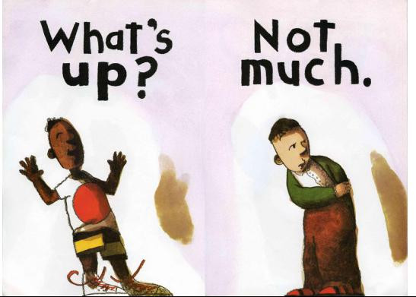
A role play with whole class

Slide 12
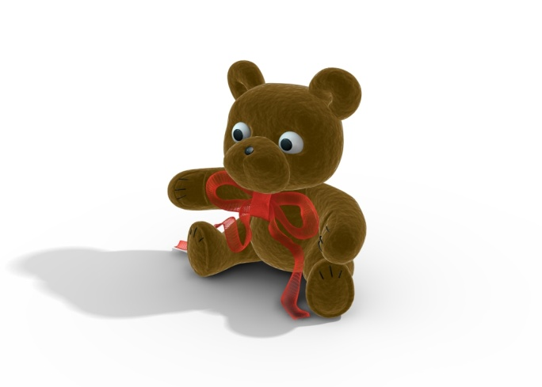
A role-play on a story
Watching children’s performance
Little Red Riding Hood
(Teaching with bear – Mary Slattery (6.4))

Slide 13
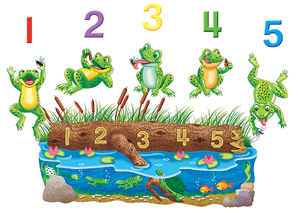
Five little speckled frogs
Five little speckled frogs
Sat on a speckled log
Eating the most delicious bugs
One jumped into the pool
Where it was nice and cool
Then there were four green speckled frogs.
http://www.youtube.com/watch?v=6wM0AIb3BTE
http://www.youtube.com/watch?v=SVPmtaHmL4g

Slide 14
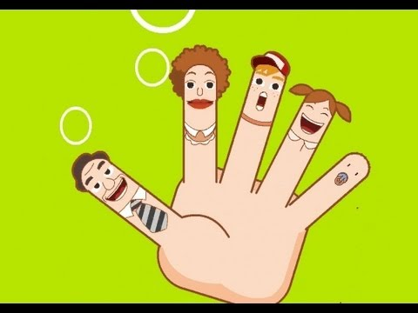
The finger family song
https://www.youtube.com/watch?v=YJyNoFkud6g
Daddy finger, daddy finger, where are you?
Here I am, here I am. How do you do?
Mommy finger, Mommy finger, where are you?
Here I am, here I am. How do you do?
Brother finger, Brother finger, where are you?
Here I am, here I am. How do you do?
Sister finger, Sister finger, where are you?
Here I am, here I am. How do you do?
Baby finger, Baby finger, where are you?
Here I am, here I am. How do you do?

Slide 15
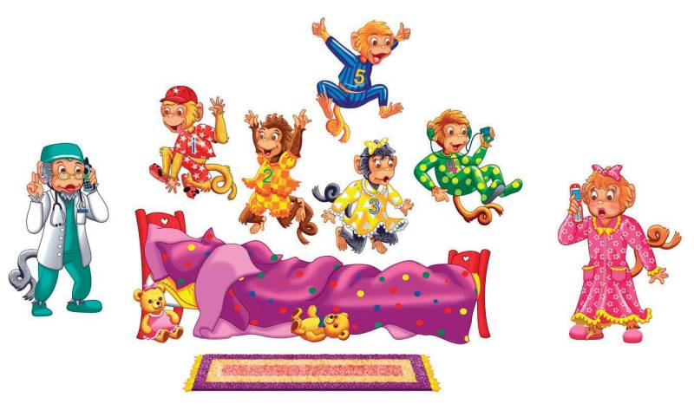
Five little monkeys
Five little monkeys jumping on the bed
One fell off and bumped his head
Mama called the doctor,
And the doctor said
No more monkeys jumping on the bed
http://supersimplelearning.com/songs/original-series/one/five-little-monkeys/

Slide 16
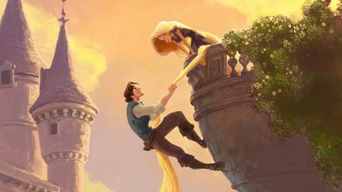
A ROLE PLAY ON A SONG and STORY
There was a princess long ago…
http://downloads.bbc.co.uk/cbeebies/tikkabilla/swf/princess.swf
https://www.youtube.com/watch?v=vjw2PFjXj7s

Slide 17
Group work
Prepare a role-play for the following stories and perform it in the classroom:
Goldilocks
The Mitten
The Very Clumpsy Centipede
The Little Red Hen
The Gruffalo
The Frog Family
The Three Little Pigs
Little Red Riding Hood

Slide 18
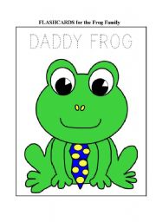
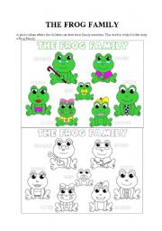
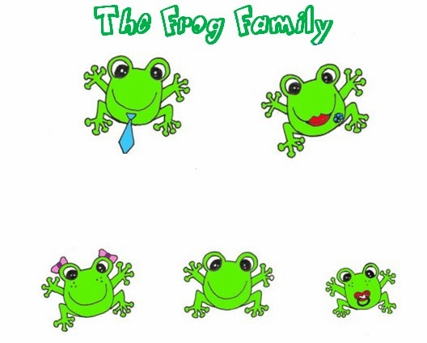
The Frog family
https://www.youtube.com/watch?v=sBCdI_K_zi8

Slide 19
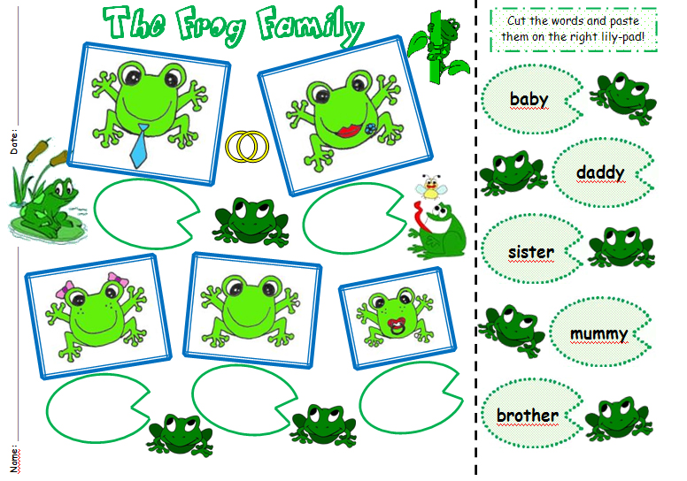

Slide 20
ROLE PLAYS -WEBSITES
http://shellyterrell.com/2010/11/29/animating-your-lessons-with-some-drama-20-resources/
http://www.teachingenglishgames.com/eslplays.htm
http://iteslj.org/Techniques/Huang-RolePlay.html
http://www.kidsinco.com/role-plays/
https://elt.oup.com/parents-hubs-resources/games?cc=cz&selLanguage=cs&mode=hub

Slide 21
DRAMATIZATION OF THE GRUFFALO
FOX: Where are you going to little brown mouse?
Come and have tea in my underground house.
MOUSE: It’s terribly kind of you, but no.
I’m going to have lunch with a gruffalo.
FOX: A gruffalo? What’s a gruffalo?
MOUSE: A gruffalo? Why, didn’t you know?
He has terrible tusks and terrible claws
And terrible teeth in his terrible jaws.
FOZ: Where are you meeting him?
MOUSE: Right here by these rocks
And his favourite food is roasted fox!
FOX: Roasted fox? Oh no. Oh no.
Goodbye, little mouse. I have to go.
MOUSE. Silly fox. Doesn’t he know?
There’s no such thing as a gruffalo.
OWL: Where are you going to, little brown mouse?
Come and have tea in my treetop house.
MOUSE: It’s terribly nice of you, but no.
I’m going to have tea with a gruffalo.
OWL: A gruffalo? What’s a gruffalo?
MOUSE: A gruffalo? Why, didn’t you know?
He has knobbly knees and turned-out toes
And a poisonous wart at the end of his nose.
OWL: Where are you meeting him?
MOUSE: Here by this stream
And his favourite food is owl ice-cream.
OWL: Owl ice-cream? Oh no. Oh no.
Goodbye, little mouse, I have to go.
MOUSE: Silly old owl. Doesn’t he know?
There’s no such thing as a gruffalo.
SNAKE: Where are you going to, little brown mouse?
Come for a feast in my log-pile house.
MOUSE: It’s terribly nice of you, but no.
I’m having a feast with a gruffalo.
SNAKE: A gruffalo? What’s a gruffalo?
MOUSE: A gruffalo? Why. Didn’t you know?
His eyes are orange, his tongue is black.
He has purple prickles all over his back.
SNAKE: Where are you meeting him?
MOUSE: Here by this lake
And his favourite food is scrambled snake.
SNAKE: Scrambled snake? Oh no. Oh no.
Goodbye, little mouse. I have to go.
MOUSE: Silly old snake. Doesn’t he know?
There’s no such thing as a gruffalo.
(The gruffalo appears.)
OH, HELP! OH NO! IT’S A GRUFFALO!

Slide 22
GOLDILOCKS AND THE THREE BEARS - A PLAY
NARRATOR: Once upon a time there were three bears, a
mummy bear, a daddy bear and a baby
bear. They lived in a little house in the
forest.
.
MUMMY BEAR: Hello, I'm Mummy Bear.
DADDY BEAR: Hello, I'm Daddy Bear.
BABY BEAR: Hello, I'm Baby Bear.
.
NARRATOR: Mummy Bear made some soup but it was
too hot.
BABY BEAR: Oooooh! It's very hot!
NARRATOR: They decided to go for a walk.
DADDY BEAR: Let's go for a walk.
BABY BEAR: Yes, let's go for a walk.
NARRATOR: While the Three Bears were out, Goldilocks
came. She saw the soup.
GOLDILOCKS: Mmmmmmm! Soup! Lovely!
NARRATOR: She tried Daddy Bear's soup but she didn't
like it.

Slide 23
GOLDILOCKS: Yuk! Horrible!
NARRATOR: Then she tried Mummy Bear's soup but she
didn't like it.
GOLDILOCKS: Yuk! Horrible!
NARRATOR: Then she tried Baby Bear's soup and it was
lovely so she ate it all.
GOLDILOCKS: Mmmmmm! Lovely!
NARRATOR: Goldilocks was tired so she sat on Daddy
Bear’s chair.
GOLDILOCKS: Oh, it's too hard!
NARRATOR: Then she sat on Mummy Bear's chair.
GOLDILOCKS: Oh, it's too soft!
NARRATOR: Then she sat on Baby Bear's chair and broke
it.
GOLDILOCKS: This is OK. Ooooooo! Help!
NARRATOR: Goldilocks went upstairs to see what was
there. She saw the beds.
GOLDILOCKS: Oooooo! I'm tired.
NARRATOR: She lay down on Daddy Bear's bed.

Slide 24
GOLDILOCKS: It's too hard.
NARRATOR: Then she lay down on Mummy Bear's bed.
GOLDILOCKS: It's too soft.
NARRATOR: Then she lay down on Baby Bear's bed and
fell asleep.
GOLDILOCKS: Mmmmm. Good night.
NARRATOR: When the three bears came back they were
very angry.
BABY BEAR: Where's my soup? Look at my chair! Boo
hoo!
NARRATOR: The three bears went upstairs.
MUMMY BEAR: Look at my bed!
DADDY BEAR: Look at my bed!
BABY BEAR: Look! A girl! Aaaaaaah!
NARRATOR: Goldilocks woke up and screamed.
GOLDILOCKS: Aaaaaaaaa! Bears!
NARRATOR: Goldilocks jumped out of the bed and ran
down the stairs and out of the house. She
never went in the forest again.
© Sheila Margaret Ward

Slide 25
Group work – role plays
Write a script for a role-play (based on a situation/story/ song) – use simple language.
Think about the characters and the props.
Act out the role-play.

