Slide 1
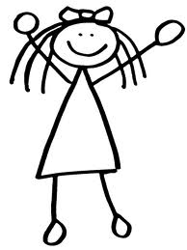
MY FACE AND BODY
Appropriate for 3rd grade
Jelka Čadež
Ema Šmid
Barbara Tavčar September 2012

Slide 2
Body parts
Body
A head
An eye / eyes
An ear/ ears
A nose
A mouth
A face
Shoulders
An arm
A leg
Fingers
toes

Slide 3
Structures and phrases
Have you got a / an … ?
Who’s got…?
I’ve got… / We’ve got…
Articles a / an

Slide 4
Vocabulary
Colours
numbers

Slide 5
GAME
Instructions:
Names of the body parts are on the floor.
Body is on the blackboard.
Choose one body part
You can take only one body part at a time.
Take it to the blackboard
The rest of the group sticks it to the right place on the body.
The group who finishes first and gets all the answers right is the winner.
Body pictures
Body parts words

Slide 6
A CHANT – Touch your head
TOUCH YOUR HEAD,
TOUCH YOUR TOES,
TOUCH YOUR KNEES,
TOUCH YOUR NOSE.
STAND UP STRAIGHT,
COUNT TO TEN
AND TOUCH YOUR NOSE AGAIN.
HEAD, TOES, KNEES, NOSE. (4X)
TOUCH YOUR HEAD…

