Slide 1

Angleščina skozi osnovnošolski kurikul
ENGLISH THROUGH PRIMARY SCHOOL CURRICULUM
PRACTICAL CLASSES 2022/23

Slide 2




Class Teacher
&
English Teacher

Slide 3
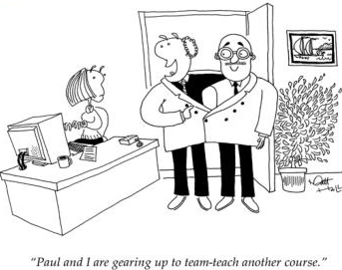
Team work

Slide 4
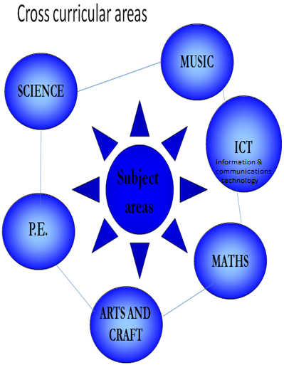
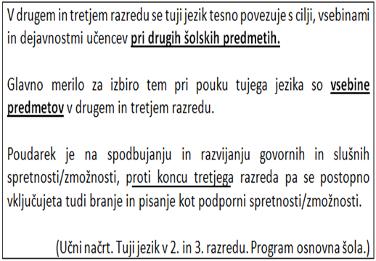
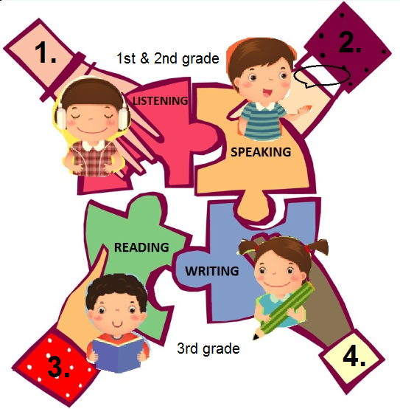
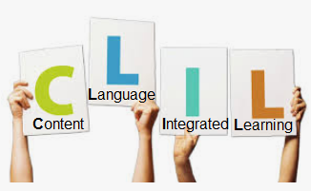

Slide 5
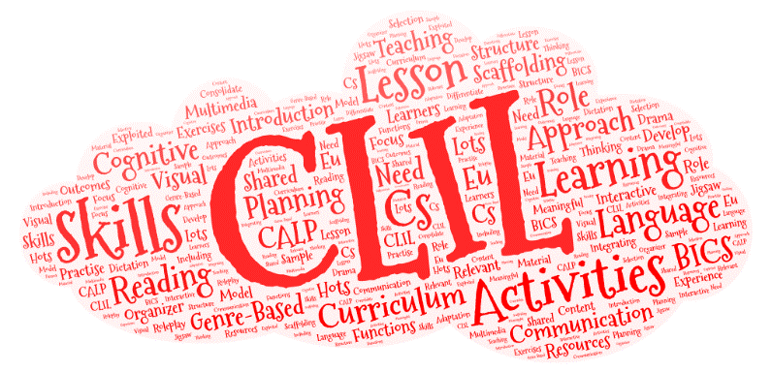
CLIL
Content and Language Integrated Learning
CLIL is a special approach to teaching in which a foreign language is used for learning and teaching of both content and language the focus is on both (content and language).
Language learning is much more effective when linked to meaningful content.
Lerners gain a foreign language and subject knowledge simultaneously.
CLIL: https://www.youtube.com/watch?v=kR6OnEqq1Fc
5 senses: https://www.youtube.com/watch?v=IoBjcnmLmpE

Slide 6



Slide 7
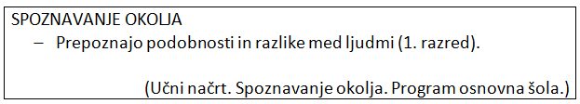
SCIENCE

Slide 8
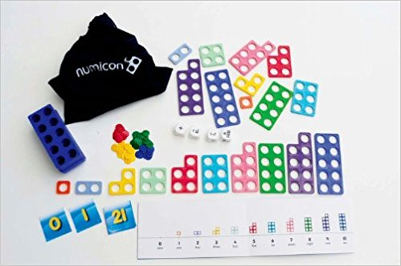
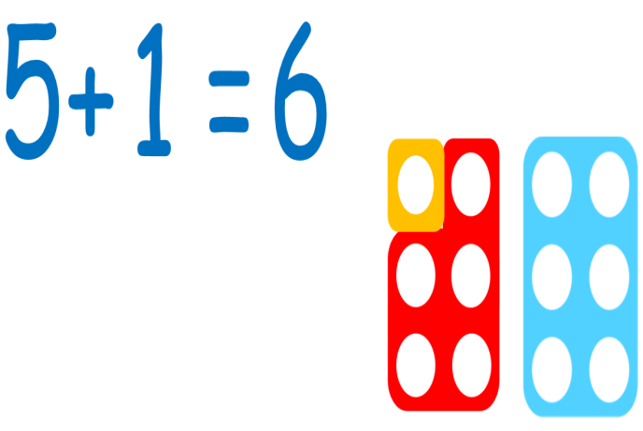

Slide 9
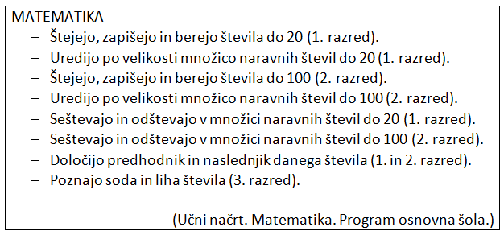
MATHS

Slide 10
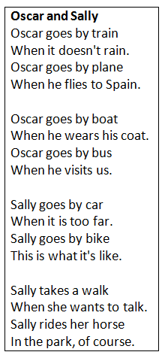
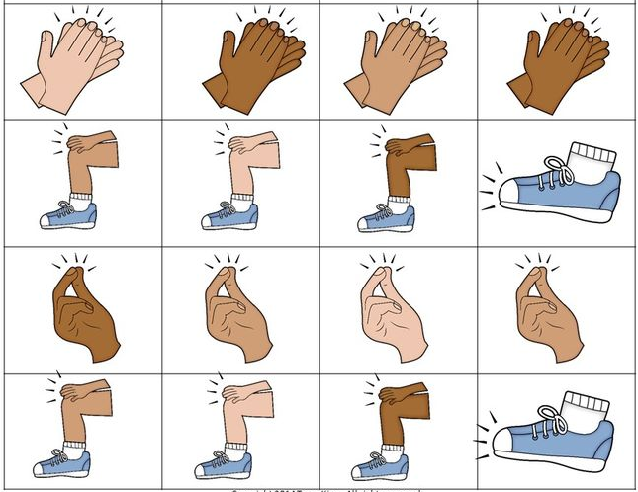

Slide 11
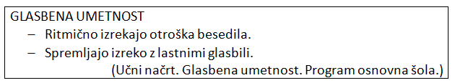
MUSIC

Slide 12


Slide 13
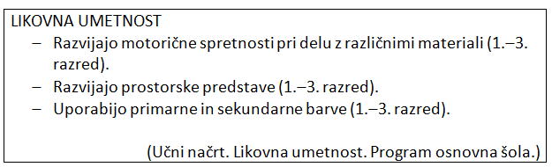
ART AND CRAFTS

Slide 14
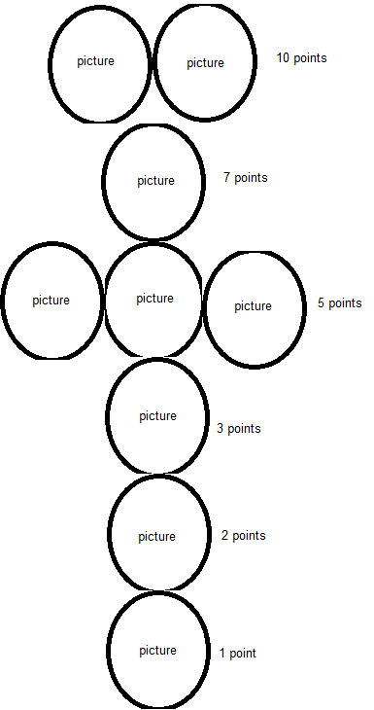


Slide 15
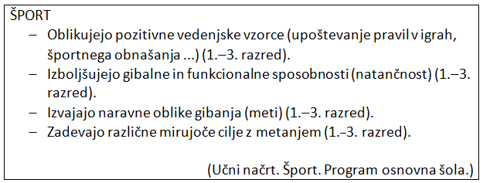
P. E.

Slide 16

Language learning is much more effective when linked to meaningful content.
Learners gain a foreign language and subject knowledge simultaneously.

Slide 17
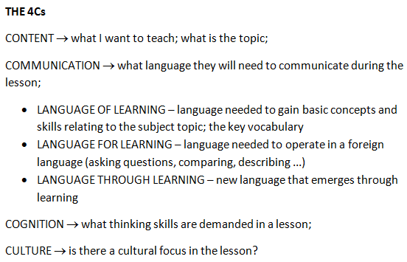
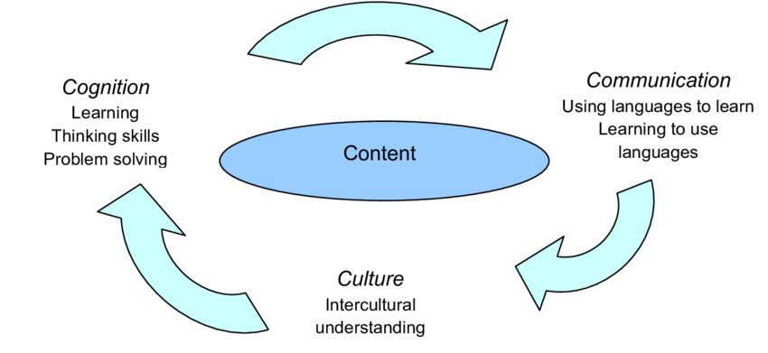
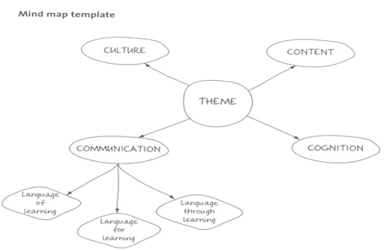

Slide 18
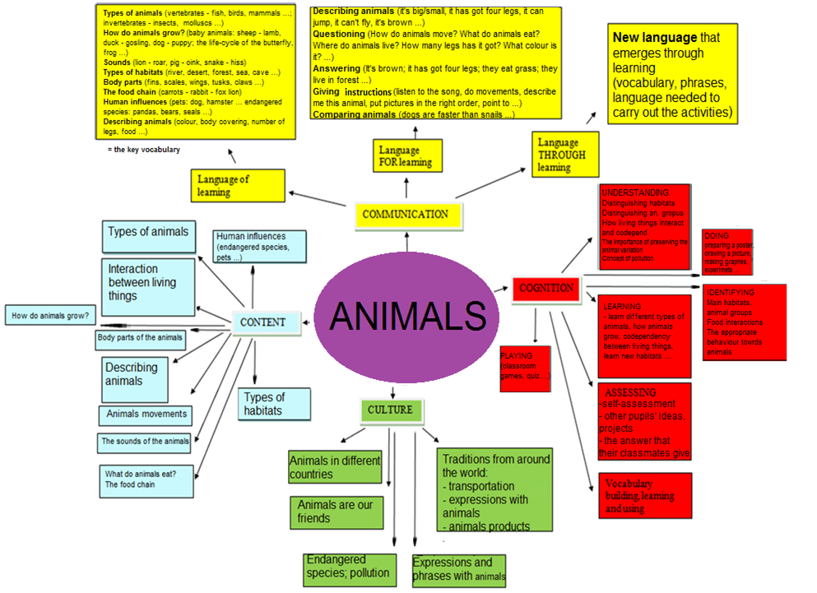
Animals can be used as a topic within the
subject of Natural Sciences, 4th grade.

Slide 19
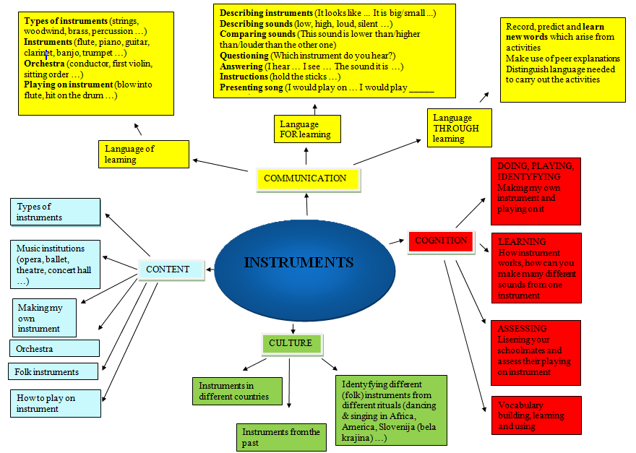
The topic „Instruments“ is a part of the music curriculum (Glasbena umetnost; 3rd grade, 4th grade).

Slide 20
E-classroom:
Angleščina skozi osnovnošolski kurikul
Key: CLIL_matters2023

Slide 21


