Slide 1
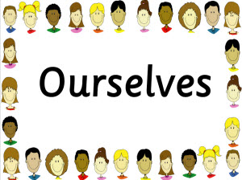
SCIENCE

Slide 2
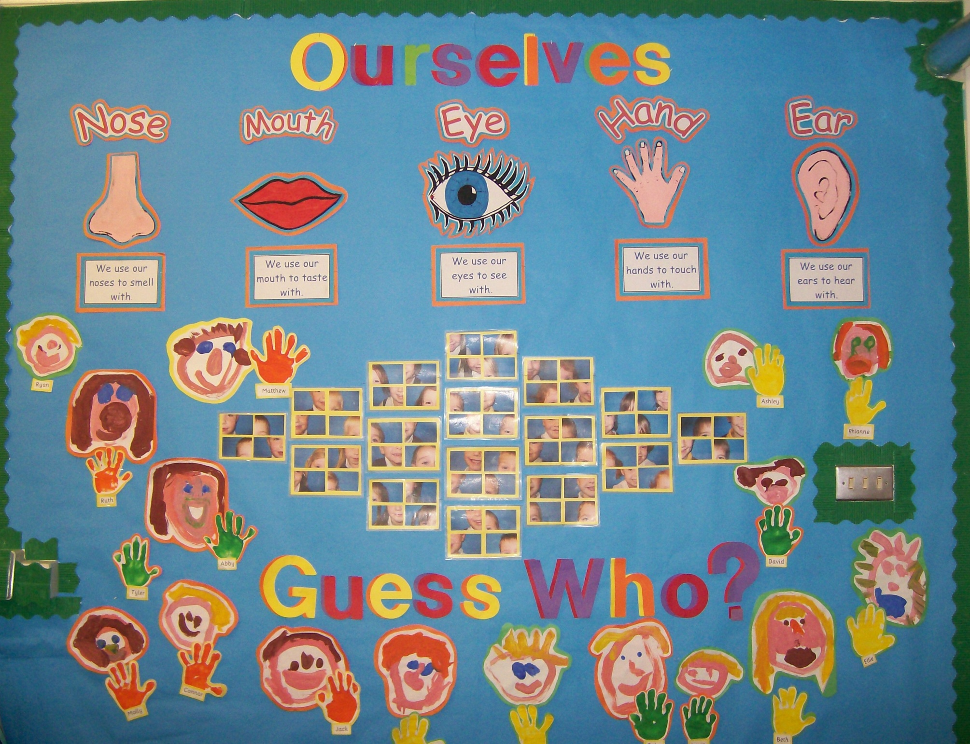

Slide 3
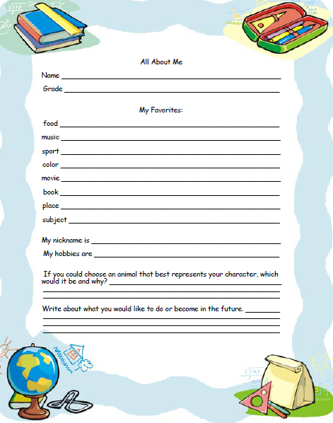

Slide 4
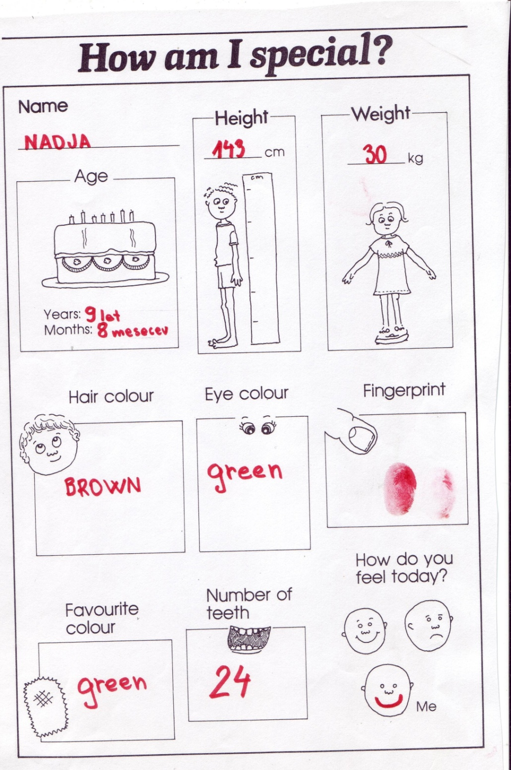

Slide 5
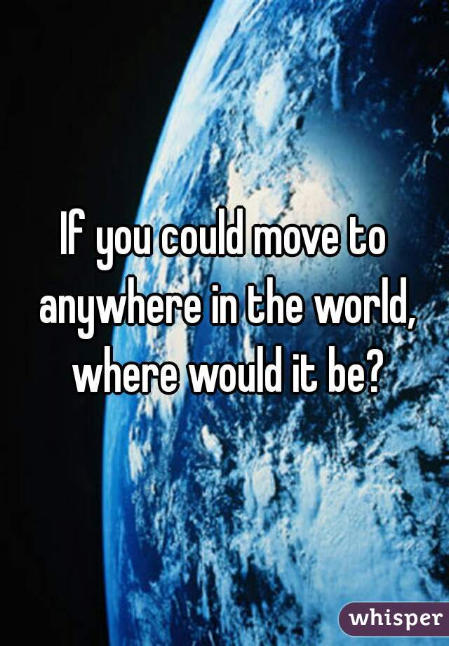

Slide 6
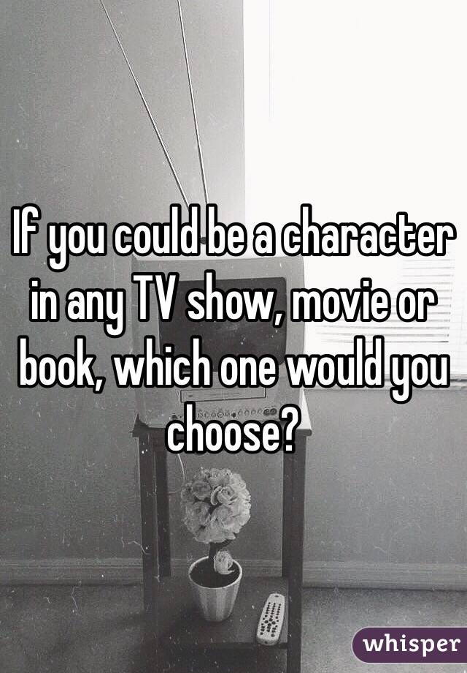

Slide 7


Slide 8
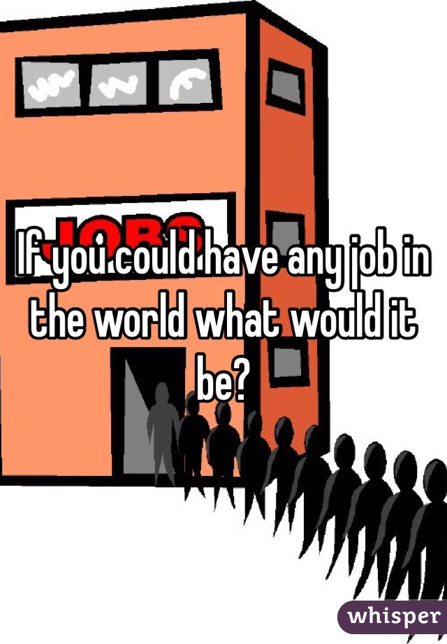

Slide 9
A GLOSSARY OF FACE AND
BODY PARTS – ELEMENTARY
(Slovenian – English)
hrbet | back
jezik | tongue
koleno | knee
lasje | hair
lice | cheek
noga | leg
noga (stopalo) | foot, feet (pl)
nos | nose
obraz | face
oko | eye
palec | thumb
prst na nogi | toe
prst na roki | finger
rama | shoulder

Slide 10
A GLOSSARY OF FACE AND
BODY PARTS – ELEMENTARY
(Slovenian – English)
roka | hand
roka (laket) | arm
telo | body
trebuh | belly
uho | ear
usta | mouth
vrat | neck
zob | tooth, teeth (pl)
želodec | stomach

Slide 11
A GLOSSARY OF FACE AND
BODY PARTS –ADVANCED
(Slovenian – English)
aorta | aorta
arterija | artery
beločnica | white
brada | chin
celica | cell
čeljust | jaw
črevesje | intestine
dlaka | hair
dlan | palm
dlesen | gum
dvanajsternik | duodenum
gleženj | ankle
grlo | throat
hrbtenica | spine
hrbtenjača | spinal cord

Slide 12
A GLOSSARY OF FACE AND
BODY PARTS –ADVANCED
(Slovenian – English)
jetra | liver
kapilara | capillary
kita | ligament
ključnica | collarbone
kolk | hip
komolec | elbow
kost | bone
koža | skin
kri | blood
leča | lens
ledvica | kidney
limfa | lymph
lobanja | skull
lojnica | sebaceous gland
maternica | uterus, womb

Slide 13
A GLOSSARY OF FACE AND
BODY PARTS –ADVANCED
(Slovenian – English)
rebro | rib
roženica | cornea
sapnik | trachea, tracheae (pl)
skelet | skeleton
sklep | joint
slepa pega | blind spot
slepič | appendix
slina | saliva
srce | heart
stegno | thigh
šarenica | iris
trebušna slinavka | pancreas
trepalnica | eyelash

Slide 14
A GLOSSARY OF FACE AND
BODY PARTS –ADVANCED
(Slovenian – English)
vena | vein
zapestje | wrist
zenica | pupil
žila | vein
živec | nerve
žolč | gall bladder

Slide 15
IDIOMS, PHRASES,
SAYINGS & EXPRESSIONS
Marvin Terban: Scholastic Dictionary of Idioms
Achilles' Heel
I'm an A student in math and science, but English is my Achilles' heel.
Meaning: the one weakness, fault, flaw, or hurtful spot in one's otherwise strong character.
Albatross around Your Neck
"Everywhere I go, my mother makes me take my little bratty sister. She's an albatross around my neck."
Meaning: a very difficult burden that you can't get rid of or a reminder of something you did that was wrong.
All Ears
"You said you had something important to tell me. I'm all ears!"Meaning: eager to listen; sharply attentive; curious.
All Thumbs
"Marco can't build the model of the atom for the science project. He's all thumbs."
Meaning: awkward and clumsy, especially with the hands.
Apple of Your Eye
"Nejc is the apple of my eye."
Meaning: a person or thing that is greatly loved, treasured and adored.

Slide 16
IDIOMS, PHRASES,
SAYINGS & EXPRESSIONS
Bite the Hand that Feeds You
"Eve just insulted the girl who is teaching her to ice-skate. That's biting the hand that feeds you."
Meaning: to turn against someone who helps you; to do harm to someone who does good things for you.
Bite Your Tongue
"Don't you dare say that to me! Bite your tongue, young man!"
Meaning: take back or be ashamed of what you have said; struggle not to say something you want to say.
Bleeding Heart
"Rob is such a bleeding heart. He'll donate to any charity that asks him for money!"
Meaning: an extremely soft-hearted person who feels compassion or pity towards all people, including those who may not deserve sympathy.

Slide 17
IDIOMS, PHRASES,
SAYINGS & EXPRESSIONS
Butterflies in My Stomach
"I can't sing a solo without getting butterflies in my stomach."
Meaning: a fluttery feeling in the stomach, usually caused by nervousness.
Button Your Lip
"Renee talked about her vacation so much that we finally told her to button her lip.
Meaning: to stop talking, be quiet.
Cat Got Your Tongue
"Why don't you answer me? Cat got your Tongue?"
Meaning: Is there a reason that you're not speaking?
Lead you by the nose (to dominate), Let your hair down (to behave freely), Little pitchers have big ears (listen to the conversation to the olders), Long in the tooth (old), Look down your nose at someone (to disrespect),
Make no bones abouth sth (to speak directly, honestly), Make your mouth water (to have a great desire), More than one way to skin a cat (several different ways to reach the goal),

Slide 18
IDIOMS, PHRASES,
SAYINGS & EXPRESSIONS
Catch Someone Red-Handed "Ashley's brother was caught red-handed at the scene of the crime."
Meaning: to catch someone in the act of doing something wrong.
Cold Feet
"Jerry wanted to ask Lynette to the dance, but he got cold feet."
Meaning: a fear of doing sth, a loss of nerve confidence.
Cool Your Heels
"Poor Jerry. I just saw him cooling his heels outside the principal's office!"
Meaning: to be kept waiting for a long time, usually by someone in power or authority.
Cost an Arm and a Leg
"It cost him an arm and a leg to go to Hawaii, but Mr Wrong really needed the vacation."
Meaning: very expensive, high priced, though possibly not worth the cost.
Green Thumb
"My uncle has a green thumb. You should see his roses."
Meaning: having a special talent for making flowers and green plants grow well.

Slide 19
IDIOMS, PHRASES,
SAYINGS & EXPRESSIONS
Off the Top Of Your Head
"Right off the top of your head he listed all the state capitals in alphabetical order."
Meaning: stating sth quickly and without thinking hard about it.
Penny for Your Thoughts
"You seem so serious. A penny for your thoughts."
Meaning: Tell me what is on your mind?
Rub Elbows with Someone
"On her last vacation Samantha went to Hollwood, where she said she rubbed elbows with a lot of stars."
Meaning: to associate with people.
Scarce as Hen's Teeth
"During the holidays, seats on any flight were as scarce as hen's teeth."
Meaning: very rare or totally nonexistent.
Sweet Tooth
"With his sweet tooth, it will be nearly impossible for Jim to stay on a diet."
Meaning: a great desire to eat sweet foods.

Slide 20
IDIOMS, PHRASES,
SAYINGS & EXPRESSIONS
Tongue-in-Cheek
"Don't be insulted by what Roz said. She meant it tongue-in-cheek."
Meaning: not serious, intended as a joke.
Wet Behind the Ears
"Lisa wouldn't hire him as a manager because he was too wet behind the ears."
Meaning: young, inexperienced.
Word of Mouth
"The movie got bad reviews, but it became popular by word of mouth."
Meaning: by one person telling another.
There are many others idioms including words of body or face
Have Your Heart in Your Mouth, Head in the clouds, Have a bone to pick with you, Heart's in the right place, Keep a straight face (to keep from laughing), Keep body and soul together (to keep alive), Keep you ear to the ground (to pay attention), Keep your fingers crossed (to wish for good luck), Keep your head above water ( to avoid financial ruin), Keep your nose to the grindstone (to always keep busy), Kick up his heels (to celebrate)

Slide 21
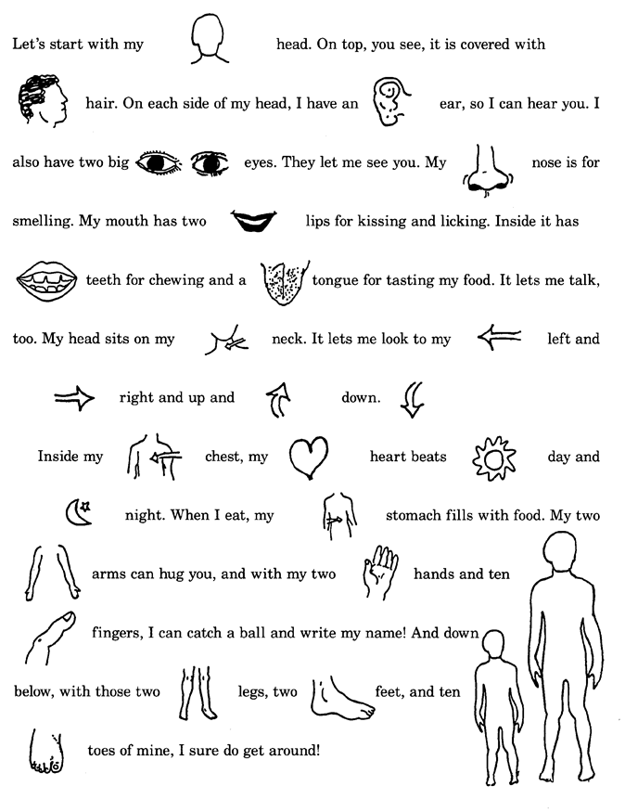

Slide 22
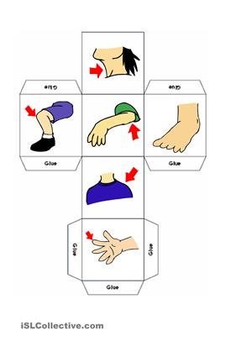
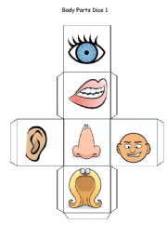
Body parts dice

Slide 23
Videos for children – body parts
Teeth: http://www.youtube.com/watch?v=lYlLycYf7Pk
Skeleton: http://www.youtube.com/watch?v=gmV8z0G2pv4
Lungs: http://www.youtube.com/watch?v=SejXhR6kEvg
Stomach: http://www.youtube.com/watch?v=w0LlqOaxsGU
Kidney: http://www.youtube.com/watch?v=qdP3zBaDCv0

Slide 24
Interactive activities
Hangman: Parts of the Body English Hangman Vocabulary Game
Wordsearch: English ESL body wordsearch worksheets - Most downloaded (16 Results) (islcollective.com)
Labelling: http://www.ego4u.com/en/cram-up/vocabulary/body-parts
Body pictures: http://www.mes-english.com/flashcards/files/body_flash.pdf
Quiz: http://iteslj.org/v/ei/body.html
Neuroscience for kids: http://faculty.washington.edu/chudler/introb.html

Slide 25
BODY QUIZ – NERVOUS SYSTEM, SKELETON
1. Which part of the brain is good at language and Maths?
2. Which part of the brain is good at art and music?
3. What’s the name of the bone that protects the spinal cord?
4. How many bones are there in your skeleton?
5. What’s the biggest bone?
6. How many bones are there in each hand?
7. Where is the smallest bone?

Slide 26
BODY QUIZ – NERVOUS SYSTEM, SKELETON - answers
Left.
Right.
Backbone.
About 206.
Femur.
27.
In your ear.

Slide 27
BODY QUIZ – MUSCULAR AND CIRCULATORY SYSTEM
1. How many muscles are there in your body?
2. How many muscles do you use for a single step?
3. How are muscles attached to the bones?
4. How do muscles work?
5. How many muscles in your face move when you smile?
6. How many litres of blood does a seven-year old child have?
7. How many litres of blood does an adult have?
8. How fast does a child’s heart beat?

Slide 28
BODY QUIZ – MUSCULAR AND CIRCULATORY SYSTEM - answers
620.
200.
By tendons.
In pairs; when one contracts the other one relaxes.
30.
3 litres.
5 litres.
About 100 times a minute.

Slide 29
BODY QUIZ – RESPIRATORY AND DIGESTIVE SYSTEM
How many litres of air can an adult’s lung hold?
How many times a minute do adults breathe and how many times per day?
How long does the whole process of digestion last?
How long does food stay in stomach?
How long is the small intestine?

Slide 30
BODY QUIZ – RESPIRATORY AND DIGESTIVE SYSTEM - answers
Five litres.
18 times a minute and more than 25,000 times a day.
18 hrs.
About 3 hours.
5 metres.

