Slide 1
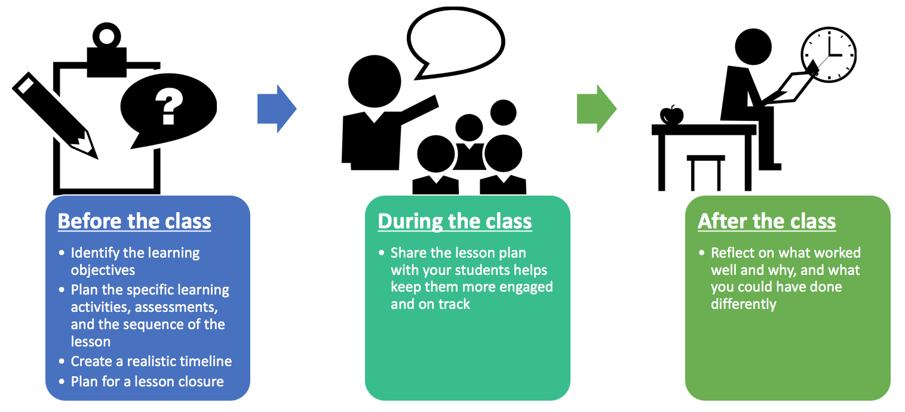
LESSON PLANNING AND TEACHING

Slide 2

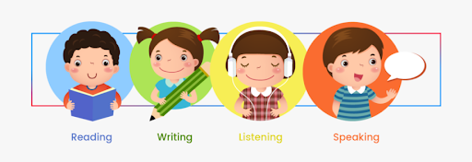
CLIL lesson planning
1. Choose a topic.
The topic needs to be taken from Slovene curriculum (SPO; MAT; GUM; LUM; ŠPO).
Think of the cross-curricular links.
2. Decide what vocabulary and phrases you would practise with that topic.
you’ll assess the language, not the subject knowledge
3. Define aims:
Aims need to be taken from Slovene curriculum (SPO; MAT; GUM; LUM; ŠPO) and from Language curriculum.
4. Don’t forget:
1st−3rd grade: listening, speaking
3rd grade: listening, speaking, reading, (writing)
5. Classroom language: give short and simple instructions, give examples, use gestures and movements (write classroom language next to each activity)
a foreign language is used for teaching
6. Activities: plan a lot of shorter activities keep the pupils engaged

Slide 3
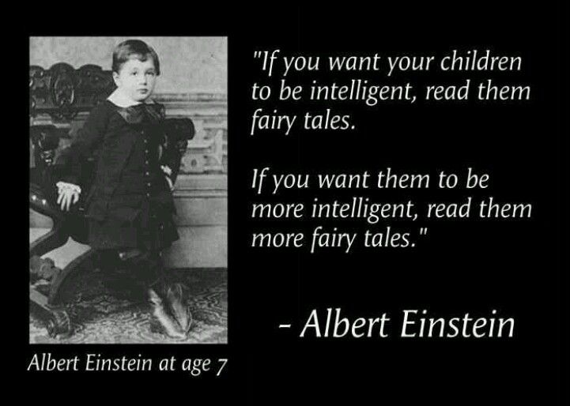

Lesson structure
1. Questions
2. Movements according to teacher’s instructions
3. Story
4. Activities for development of phonological awareness (long – short words; rhymes; syllables; differences in the sound and writing system between first and foreign language ...)
5. Revision or introduction of a new topic – through games
Teaching new vocabulary and phrases: activities for repetition
6. What have I learned today?

Slide 4
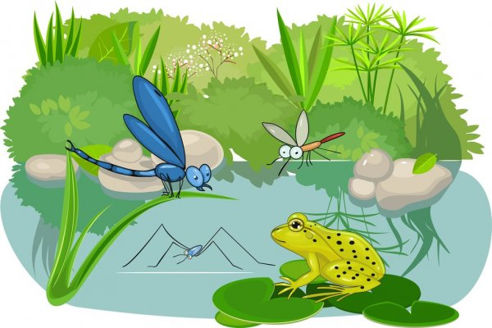
Lesson – example
Topic: Animal habitats
Grade: 3rd
Subject: social sciences
Aims:
SPO: They know different habitats and animals within those habitats.
MAT: They name and add numbers to 100.
ŠPO: They perform locomotor movements (running, walking, jumping ...).
TJA: They understand the instructions/they recognize the main topic of the story/they use the vocabulary and phrases within discussed topics;
Vocabulary and phrases:
Vocabulary: animals (bear, giraffe, snake ...); habitats (jungle, mountains, ocean, river, desert, forest, garden, farm, sea ... ), numbers to 100, colours ...
Phrases: What do you see? I see a ... This is a/an, Where do animals live ...

Slide 5
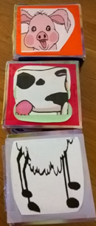
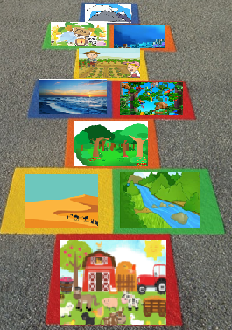
Lesson structure:
1. Questions: (what’s your name/how old are you/what day is today/what’s the time/what’s the weather like today/what season is it/when’s your birthday/what’s your favourite animal ...?)
2. Movements: (swim, touch your toes, climb, turn around, jump and count to 12, show me the alphabet, show me the months, touch something blue ...)
3. Revision:
50 animals game (revision of animals and numbers to 50)
Funny animals
Build the longest road (activity for development of phonological awareness); adding the numbers, naming the colours
4. Teaching a new topic:
Story: Walking through the jungle (video) https://www.youtube.com/watch?v=plvY0quSyJg
Questions about the story: What do you see/What colour is it/How many do you see/Is it big/Where can you see a wolf ...?
Where do animals live (I live in Ljubljana/I live in a house; Where do animals live? Where can I see bears?)
Teaching new words: jungle, mountains, ocean, river, desert, forest, garden, farm, sea ...
1. I say, you say
2. Guessing game
3. Which habitat is number four?
4. Movements – swim like a fish to the river, fly like a bird to the mountains ...
5. Hitting the right picture
6. Where do bears/monkeys ... live? - placing the pictures of animals next to their habitats
7. Fill the habitat game
5. What have I learned today? Game: hopscotch (ristanc)

Slide 6

Giving instructions
Give short and simple instructions, give examples, use gestures and movements (write classroom language next to each activity).
Pupils are not able to read the instructions. You need to explain them.
Example: game Build the longest road
Let’s play a game. Make a circle and sit down.
We need two groups – boys on this side (point to one side) and girls on this side (point to the other).
Take one picture without looking (cover your eyes and take one picture).
Name the animal and clap – how many syllables are there (counting on fingers)?
For example: frog (clap) – how many are there? One (show one finger). You get the white stick (take it) and put it on the floor (put it on the floor).
or e (clap)- le (clap) – phant (clap) – how many are there? Three (show three fingers). You get the green stick (take it) and put it on the floor (put it on the floor).
The group with the longest road (put your arm apart and show long) wins the game.

Slide 7
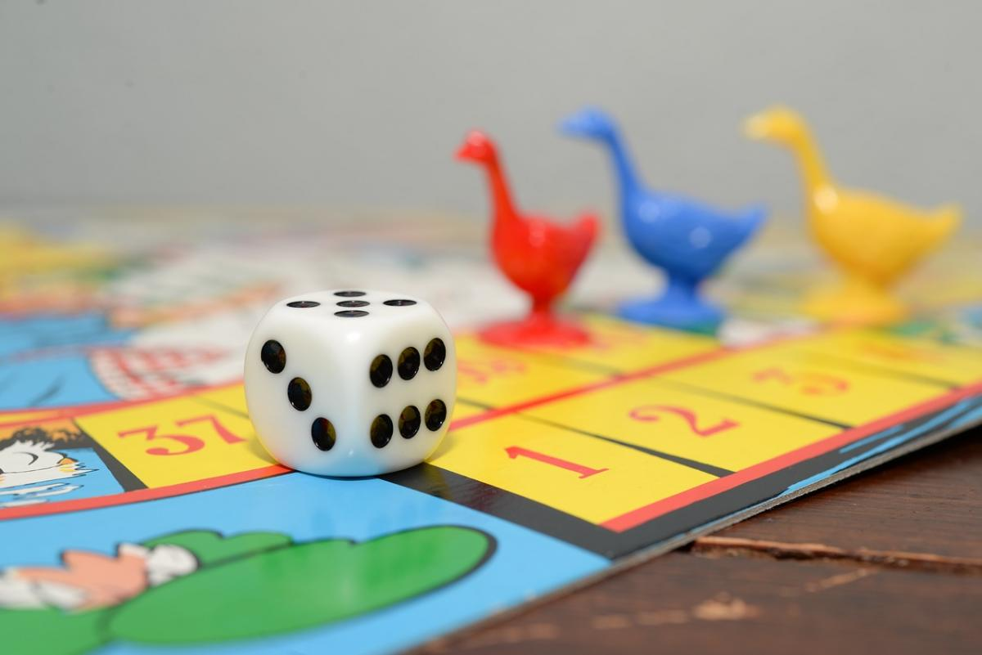
Giving instructions – exercise
In groups choose a game.
Read the instructions.
Pretend you are a teacher and give other students (pupils) the instructions. Explain them with movements, gestures, examples. Give short and simple instructions.

Slide 8
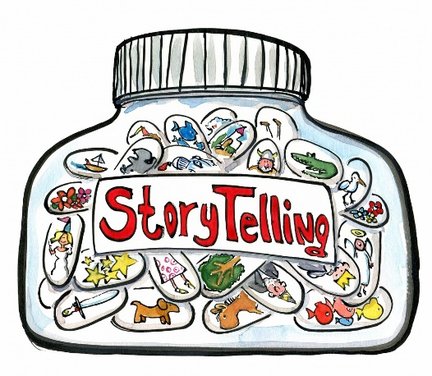
Reading or telling a story
Many ways of using them:
a) revision or introduction of new vocabulary and structures
b) topic work (you can base them on a certain topic)
c) cross-curricular work (you can do art, craft, music activities connected to stories)
  Is the level appropriate for your students?
  → you can adapt the story
While telling or reading the story
  adopt a different voice for each character
  make sound effects
  use your body and face (gestures, movements)
  when reading it: read slowly, point to illustrations, encourage pupils to participate

Slide 9


Including a story – example
Define the topic and the subject.
Define the vocabulary and phrases.
Plan 5 after reading activities

Slide 10

Including a story – example
Topics and subjects:
SPO – animals
ART – colours
Vocabulary and phrases:
Colours: brown, red, yellow, blue, green, purple, white, black, gold
Animals: bear, bird, duck, horse, frog, cat, dog, sheep, goldfish
Other words: teacher, children
Phrases: What do you see? I see ...
5 after reading activities:
Introduction of new vocabulary and structures
Learning colours/animals
Learning structures: What do you see? I see a/an ...
Revision of vocabulary and structures
Ordering pictures of animals
Matching animals and colours (I see a brown bear)
Mixing the colours (red bird + blue horse = purple cat)
Making puppets and acting out the story
Changing the story (different animals and colours)

Slide 11
CLIL lesson planning and teaching
1. Teaching vocabulary, dialogues, language structures – practise, practise, practise!
Include different activities for repetition → to prepare pupils to work in groups later on.
2. Don’t let videos substitute you as a teacher.
3. Teaching songs, dances, movements: teacher should be a role model (use gestures, encourage them to participate, smile, be energetic)
4. Storytelling: use your body and face, point to pictures, make sound effects ...
5. Don’t forget:
1st−3rd grade: listening, speaking
3rd grade: listening, speaking, reading (only well known words, phrases)

