Slide 1

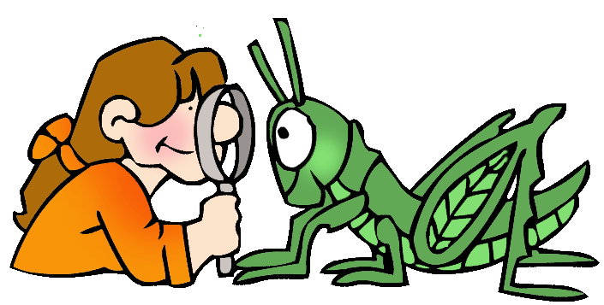
CLIL
Mateja Dagarin Fojkar, Ana Ilić, Tina Rozmanič

Slide 2

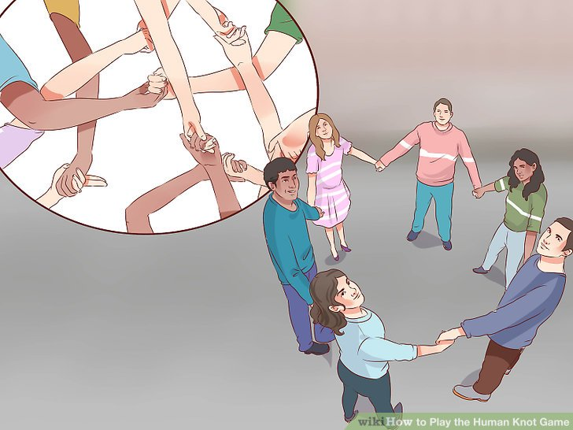
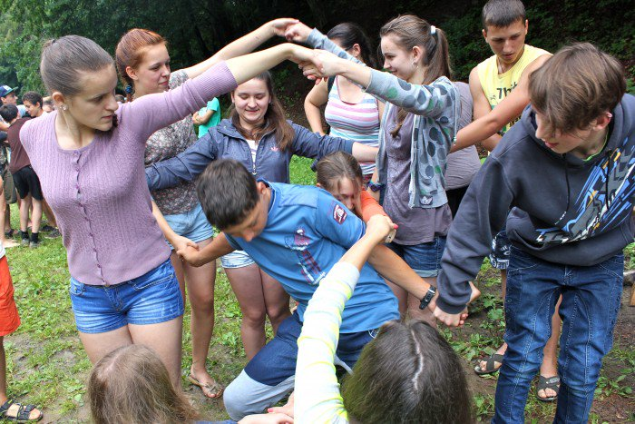
GAME:
HUMAN KNOT GAME
Make a circle.
Extend your left hand and reach across the circle and grab someone else’s hand.
Extend your right hand and reach across the circle and grab someone else’s hand.
You must not be holding the hands of the people next to you.
Try to untangle yourselves without letting go of hands.
You should end up in a circle.

Slide 3
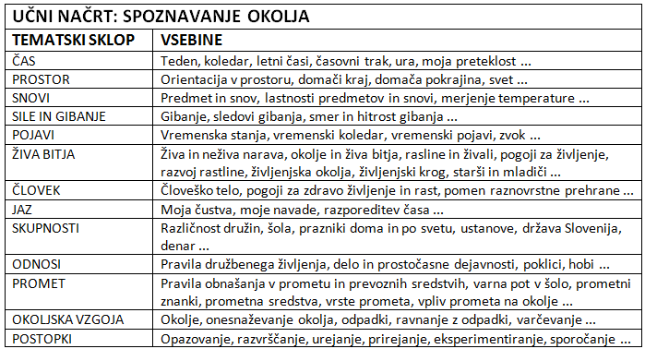
SCIENCE: Content areas
TIME (seasons, days of the week, months of the year, telling the time)
ORIENTATION IN SPACE (left, right, up, down, open, close, under, on top of ...)
WEATHER
ANIMALS
PLANTS
PEOPLE (human body, health ...)
SOCIETY
TRAFFIC
ENVIRONMENT
PROCEDURES
...

Slide 4


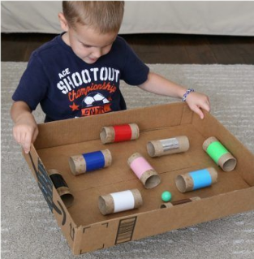
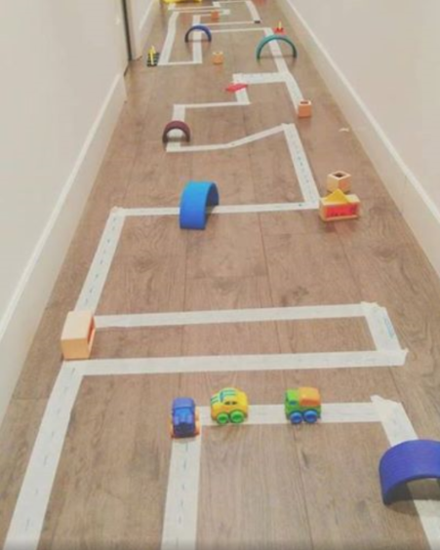
1. ORIENTATION IN SPACE
Left, right
Move and freeze: https://www.youtube.com/watch?v=388Q44ReOWE

Slide 5
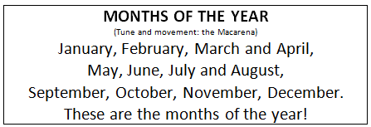
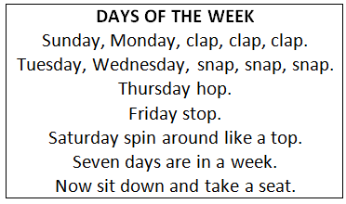

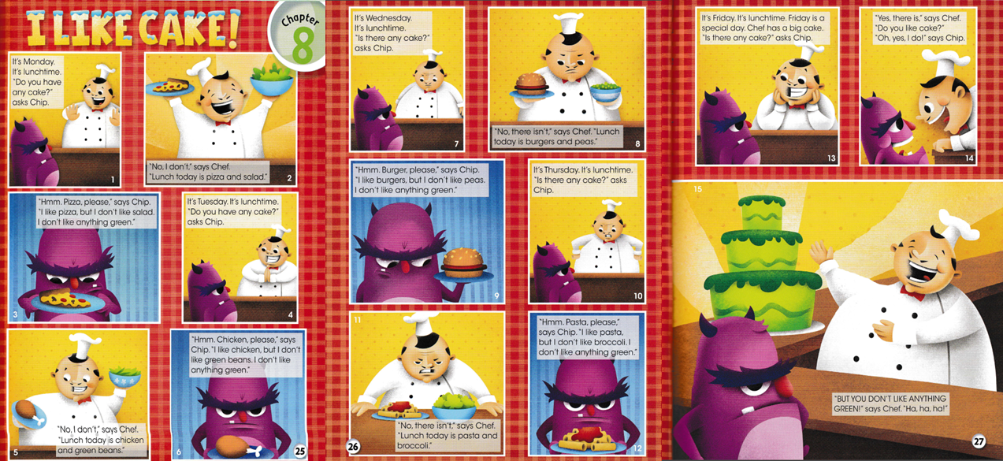
2. TIME
Days of the week
Months of the year
Telling the time
Seasons
Macarena Months – YouTube
Days of the Week Song | The Singing Walrus - YouTube

Slide 6
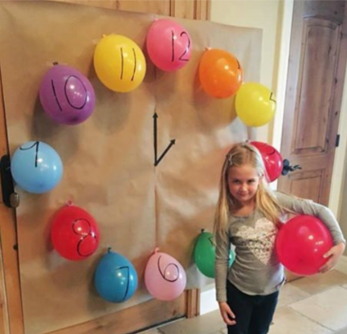


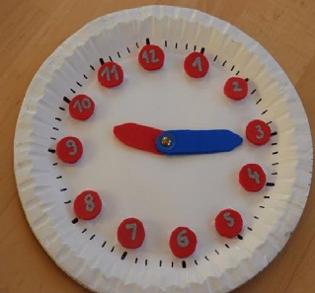

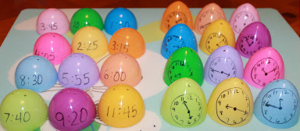
Telling the time
Learn to Tell Time #1 | Telling the Time Practice for Children | What's the Time? | Fun Kids English - YouTube

Slide 7


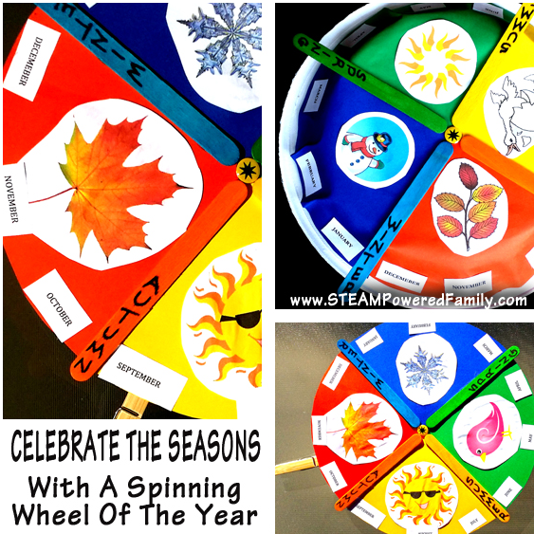
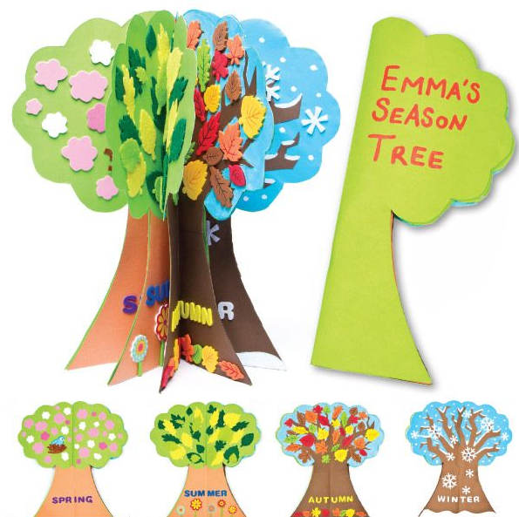
3. SEASONS
If You Know All the Seasons | Four Seasons Song for Kids | The Kiboomers - YouTube

Slide 8
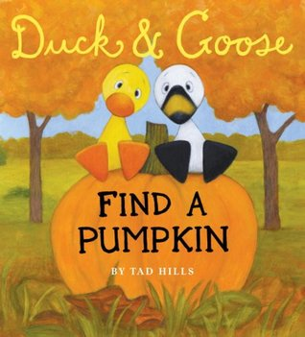







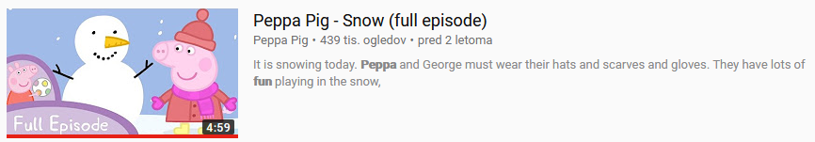

Autumn:
Winter:
Peppa Pig - Snow (full episode) - YouTube

Slide 9
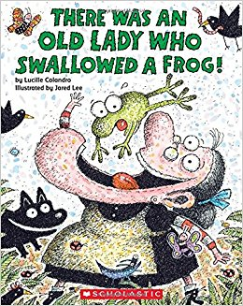



Spring:
Summer:

Slide 10


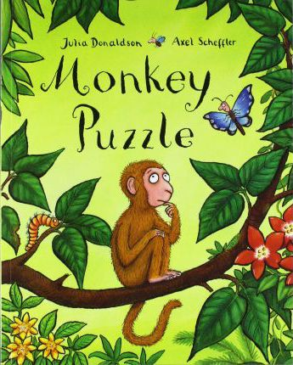
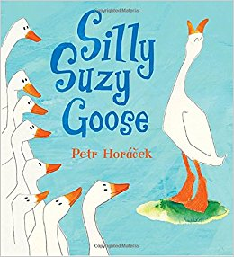
3. ANIMALS
Group work: write animals from A to Z.

Slide 11
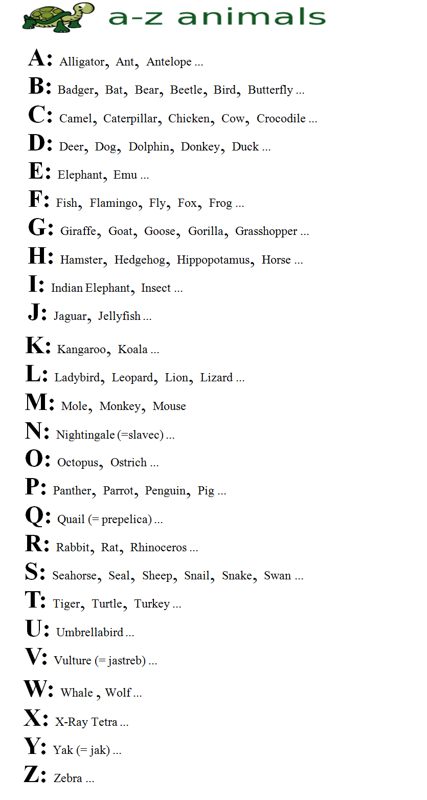
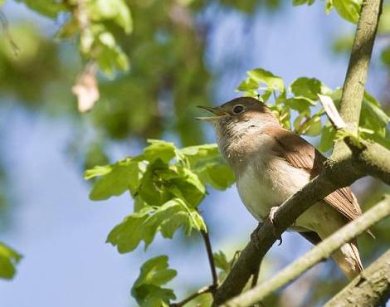
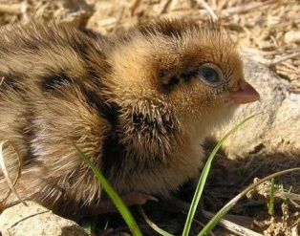
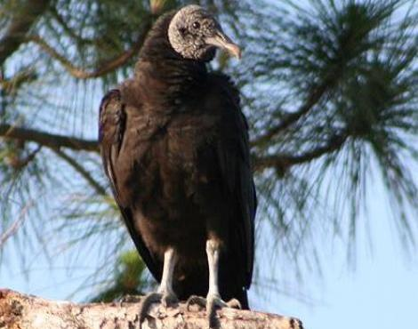
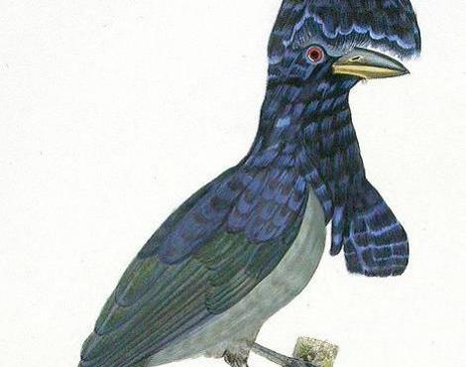
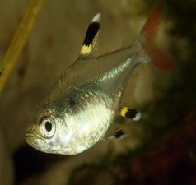
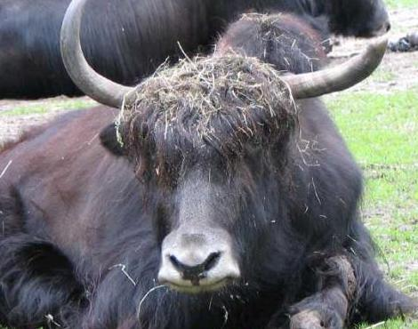

Slide 12
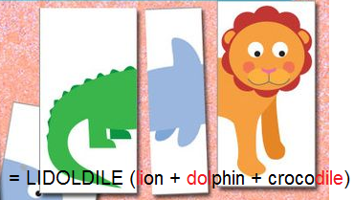
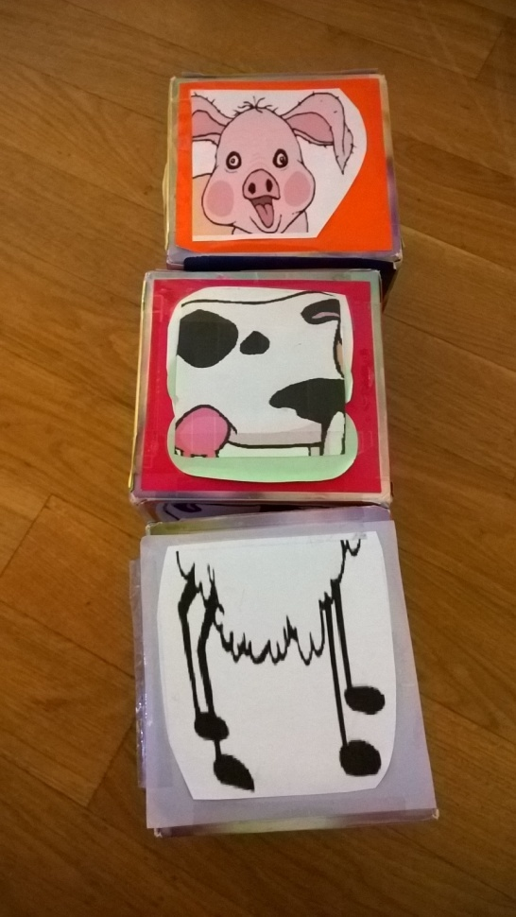
Content areas
(Science: animals)
Types of animals
Body parts of the animals
Describing animals ...
How do animals move?
How do animals grow?
The sounds of the animals
What do animals eat?
Where do animals live?

Slide 13
Animal groups
VERTEBRATES
INVERTEBRATES

Slide 14
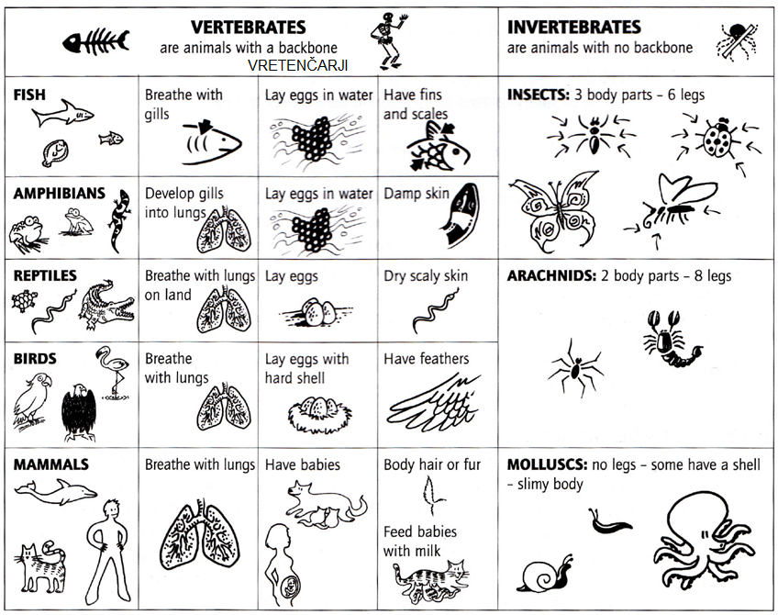
Calabrese, Rampone: Cross-curricular resources, 2007, OUP

Slide 15
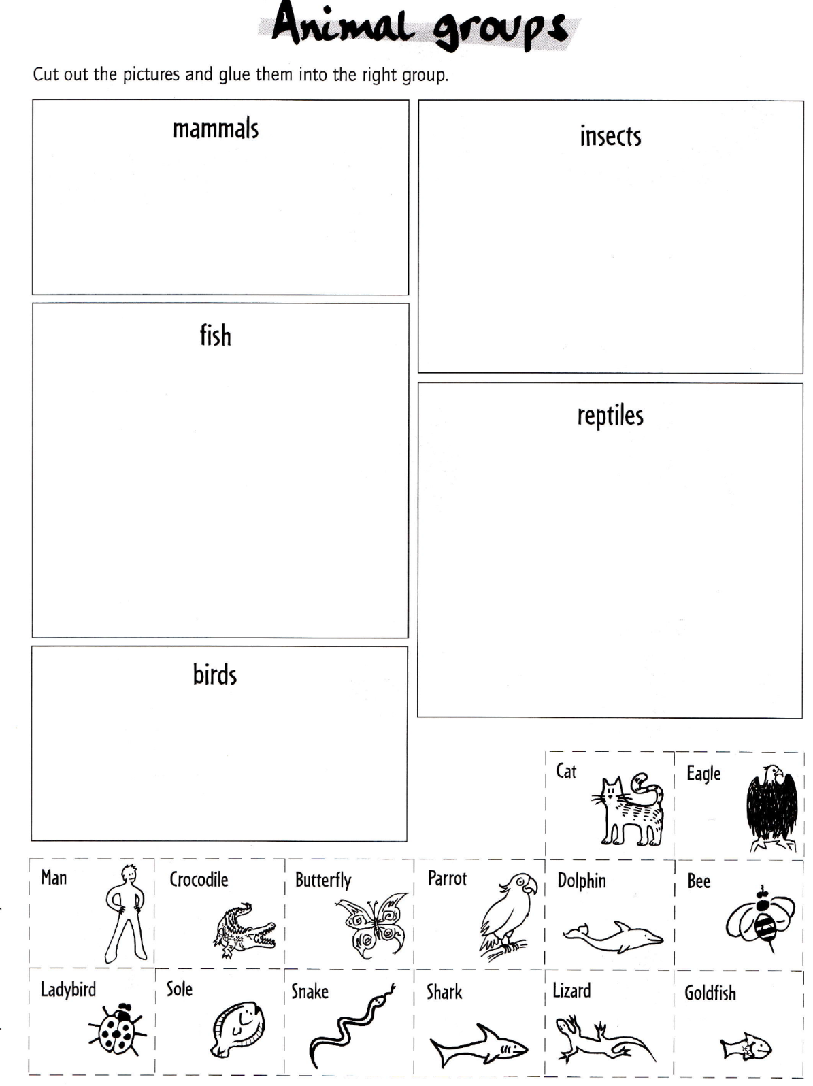
Calabrese, Rampone: Cross-curricular resources, 2007, OUP

Slide 16
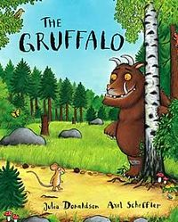
Animal body parts
Written by: Julia Donaldson
Narration:
The Gruffalo - Narrated by Pad (the full, proper, unadulterated version) - YouTube

Slide 18
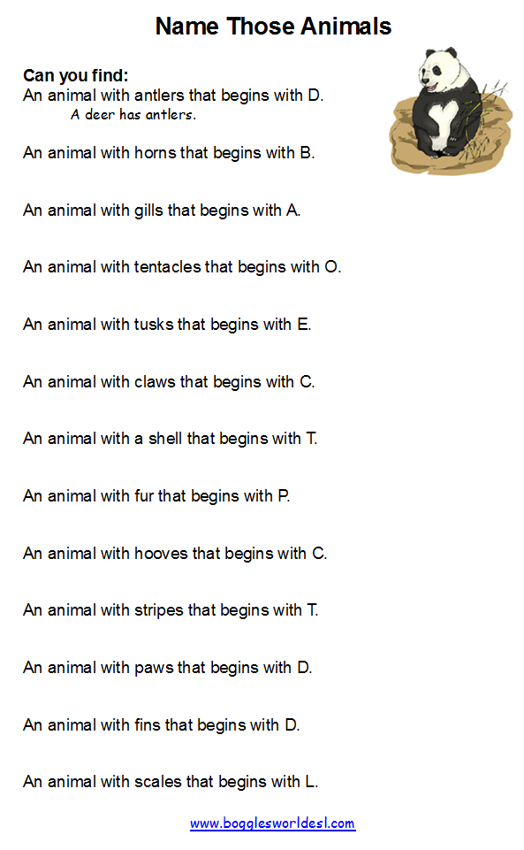
http://bogglesworldesl.com/animal_body_parts.htm (pictures)
http://www.infovisual.info/02/pano_en.html (visual dictionary of animal body parts)
http://www.englishexercises.org/makeagame/viewgame.asp?id=5591 (an exercise)
http://www.switchzoo.com/ (switch body parts of animals)

Slide 19
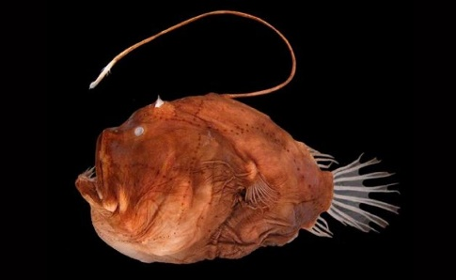
Animals:
deer
bull, buffalo
angler fish (morske spake ali rokoplute)
octopus
elephant
cat
turtle
panda
cow
tiger
dog
dolphin
lizard

Slide 20
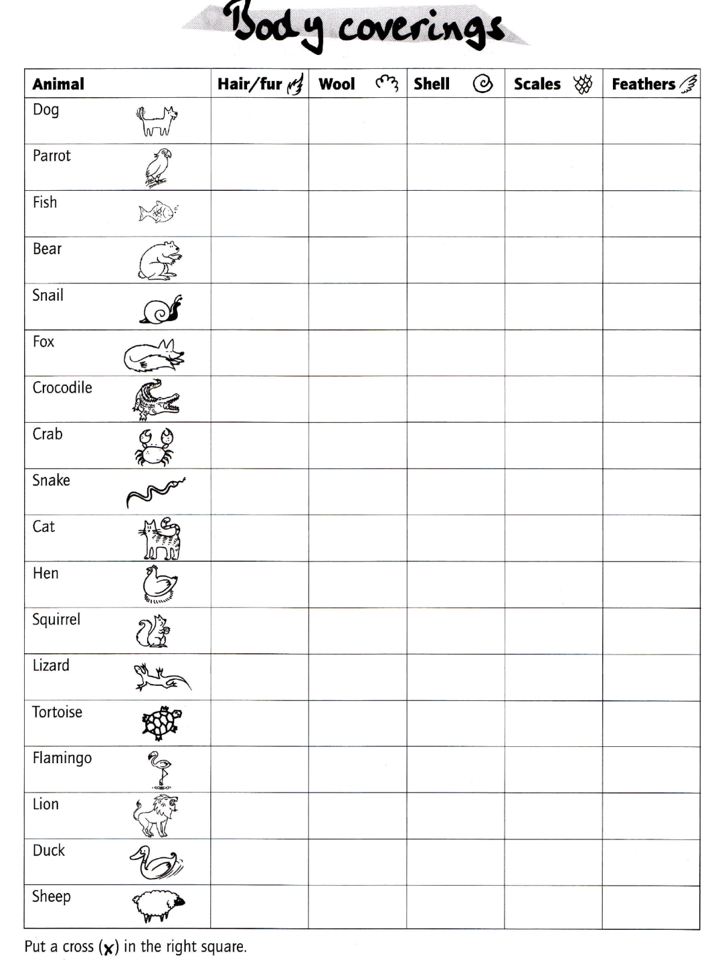
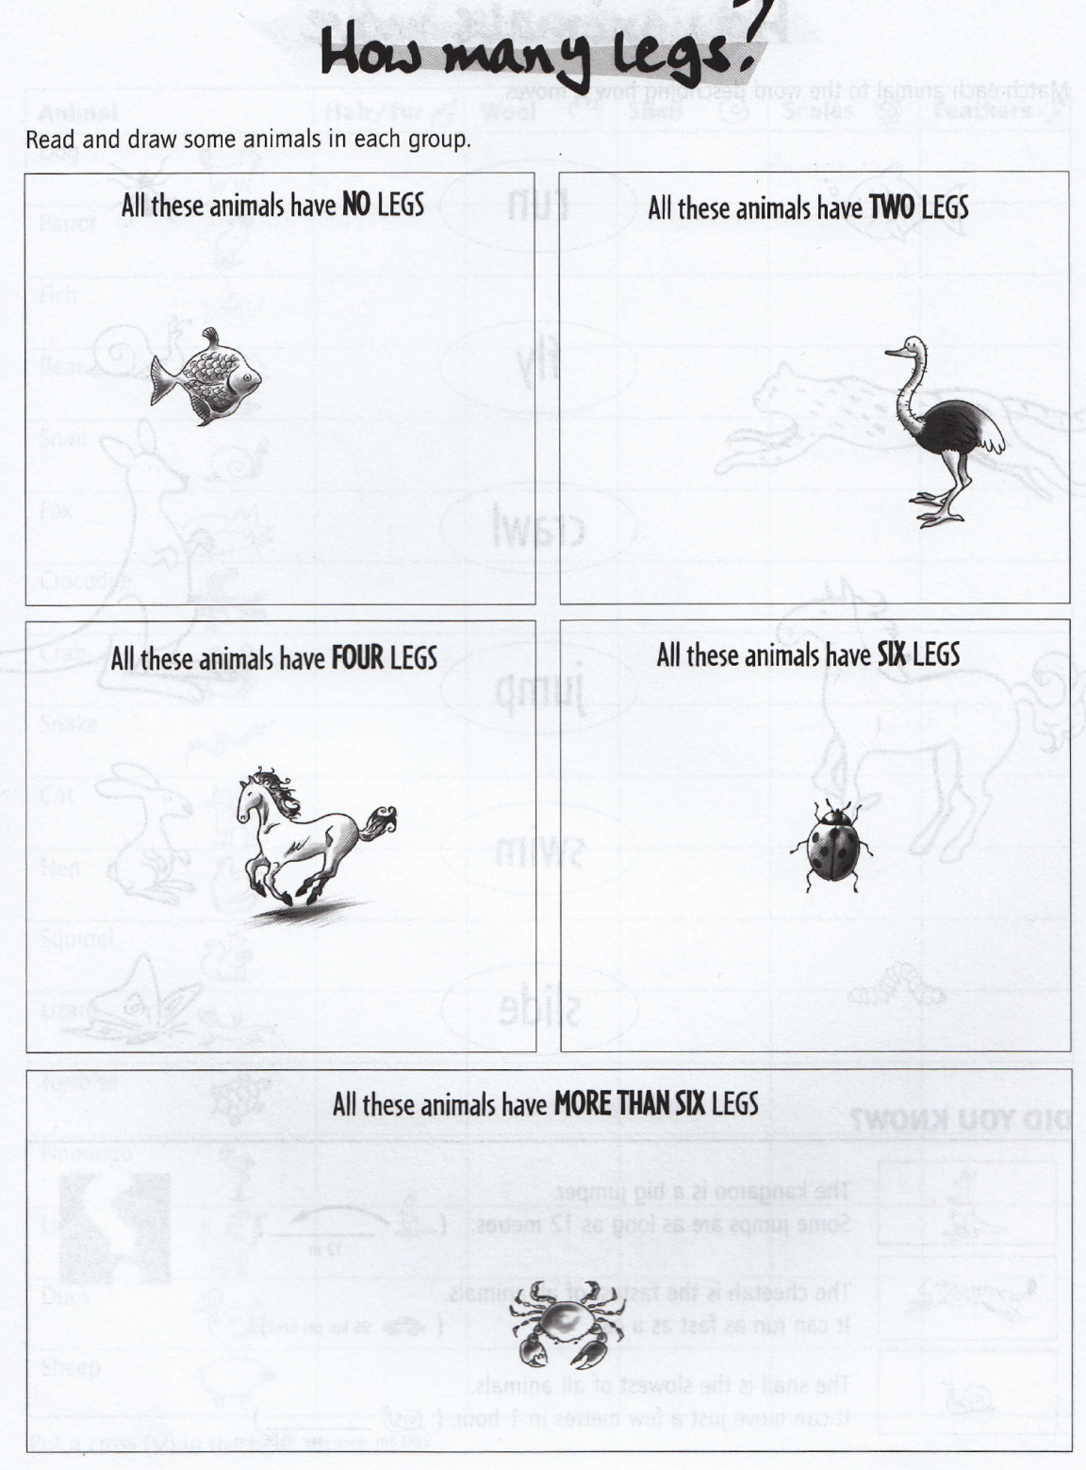
Calabrese, Rampone: Cross-curricular resources, 2007, OUP

Slide 21
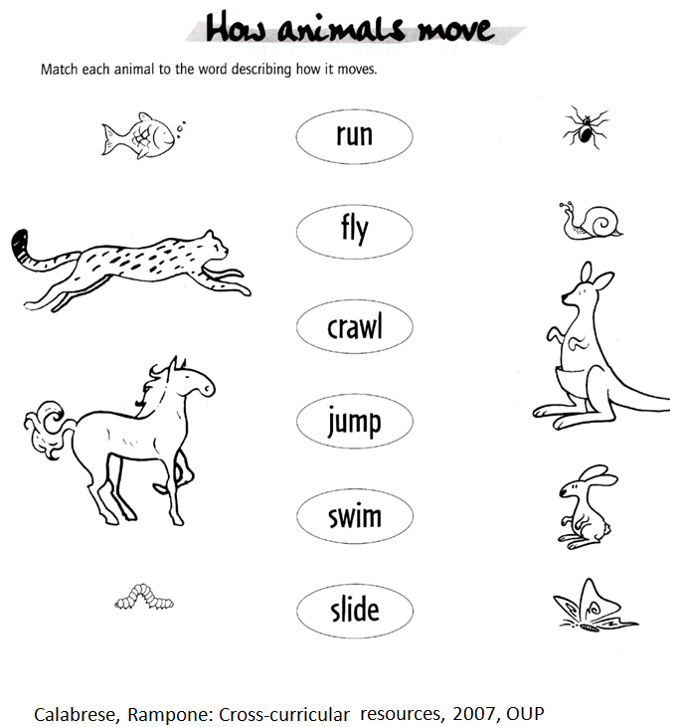
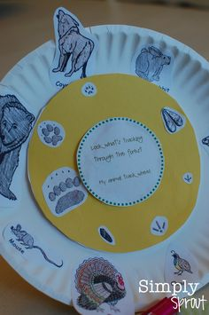
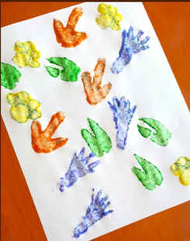

Slide 22
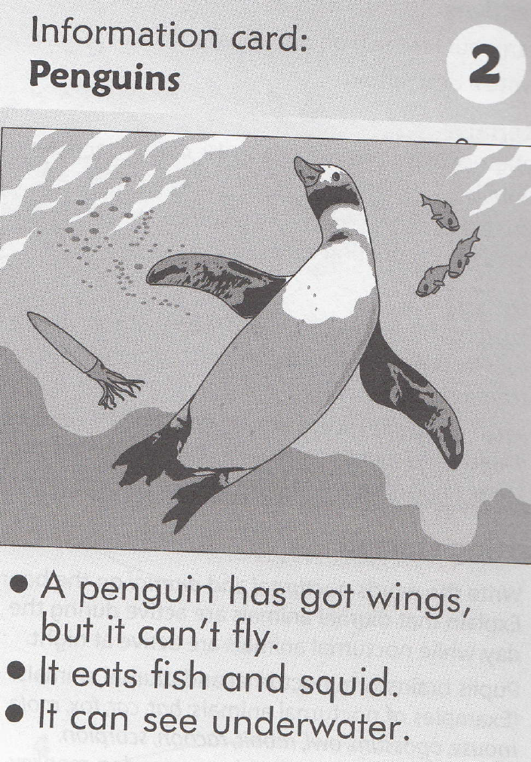
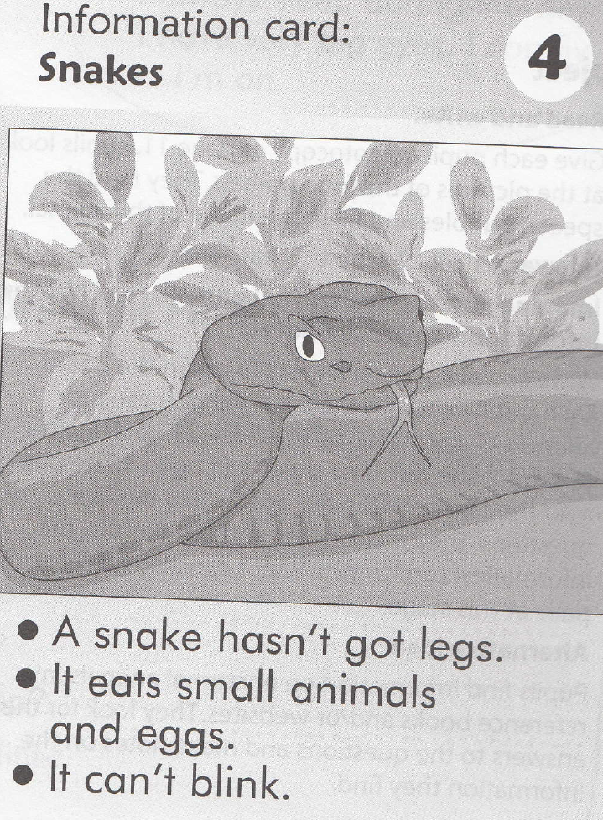

Describing animals
Animal group: | mammal
Food: | Grass - herbivore
Colour: | Black and white stripes
Body covering: | hair
Number of legs: | 4
It can: | Walk, run
It can’t: | Climb, swim, fly
This is an elephant. It’s grey. It has got four legs and two eyes.
It’s big and dangerous. It can walk. It can’t climb.

Slide 23
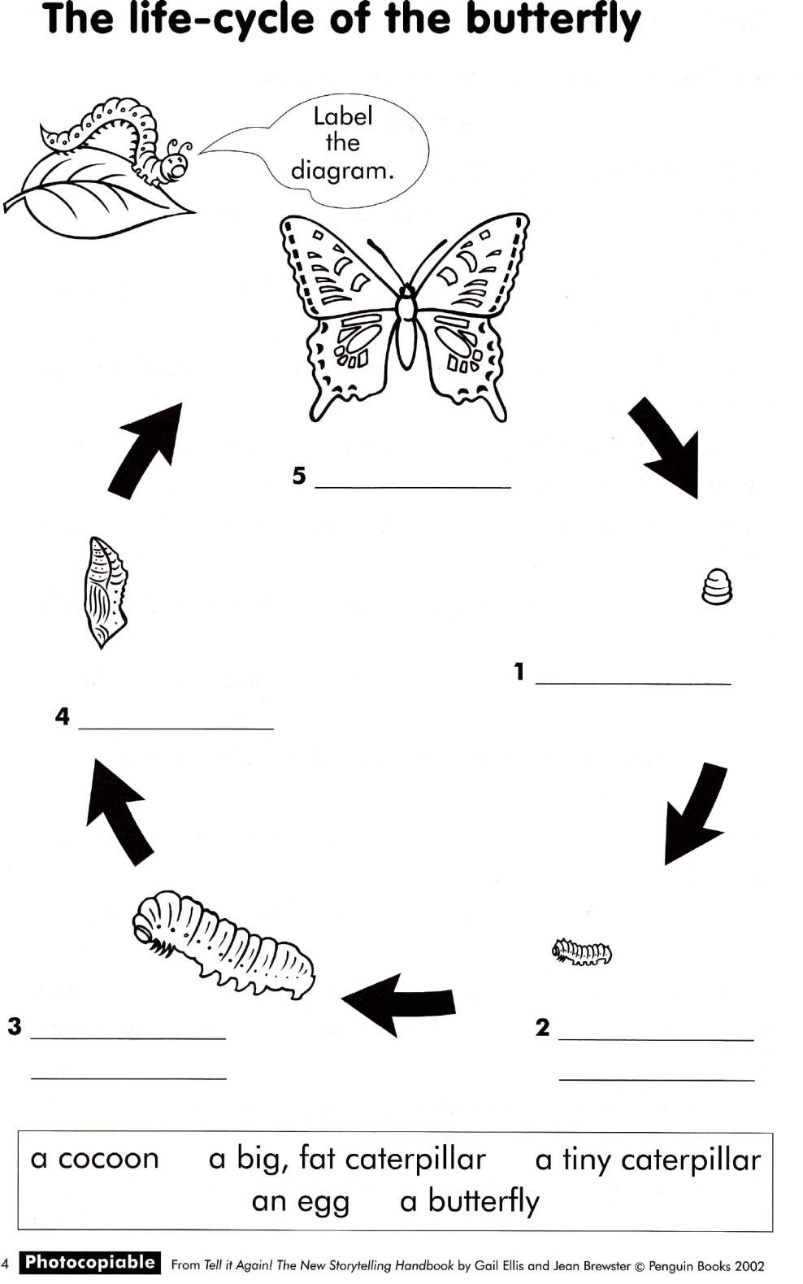

How do animals grow?
THE VERY HUNGRY CATERPILLAR
Written by Eric Carle
Narration:
The Very Hungry Caterpillar - Animated Film – YouTube
Activities and lesson plans:
The Very Hungry Caterpillar Activities and Lesson Plan | Woo! Jr. Kids Activities

Slide 24
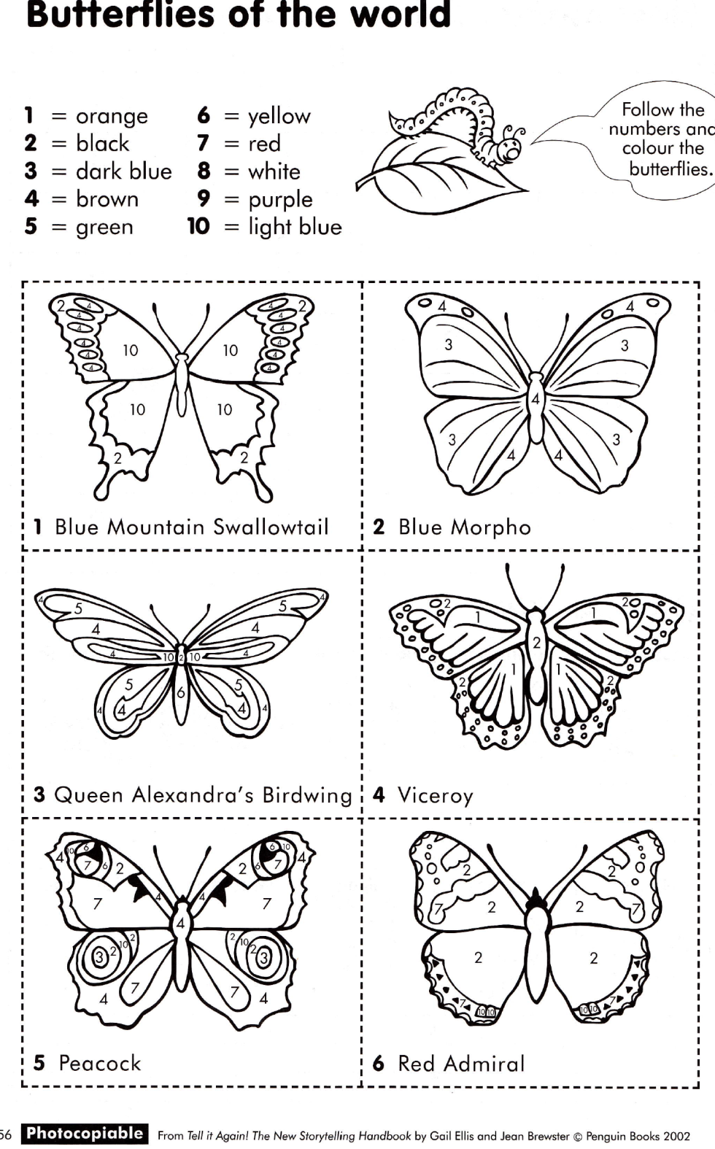
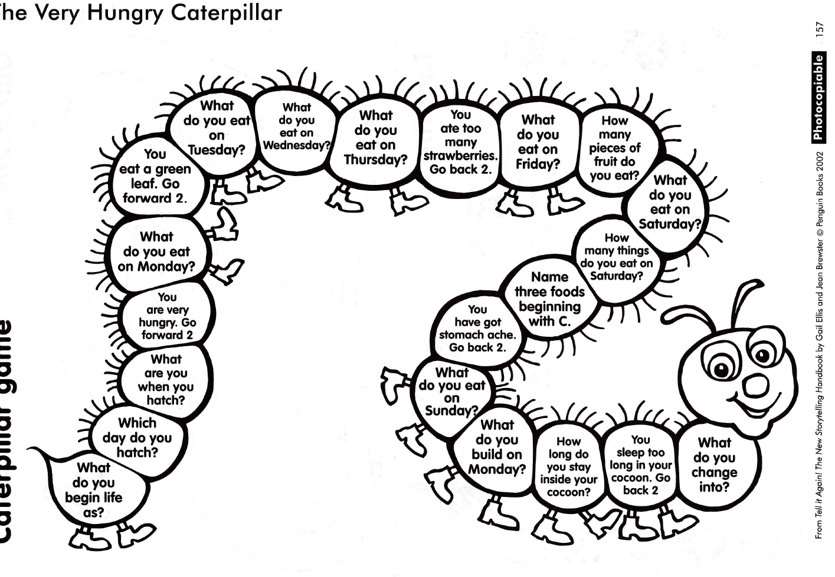

Slide 25
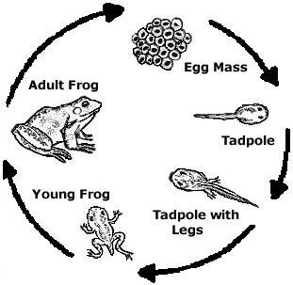
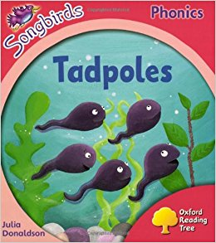
How do animals grow?
Life cycle of a frog

Slide 26
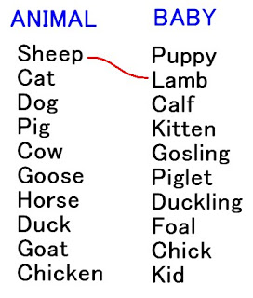
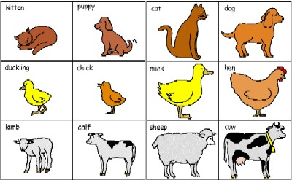
Baby animals

Slide 28

Animal sounds
What the ladybird heard (by Julia Donaldson)
Julia Donaldson reads What The Ladybird Heard – YouTube
Activities on the book:
What The Ladybird Heard | Teaching Ideas
Animal sounds quiz
Animal Sounds Picture Quiz | EnglishClub
The Animals On The Farm (song)
The Animals On The Farm | Super Simple Songs - YouTube

Slide 29
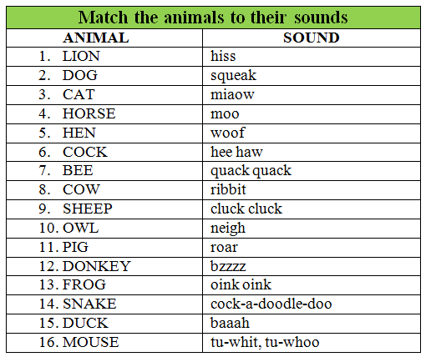

Slide 30
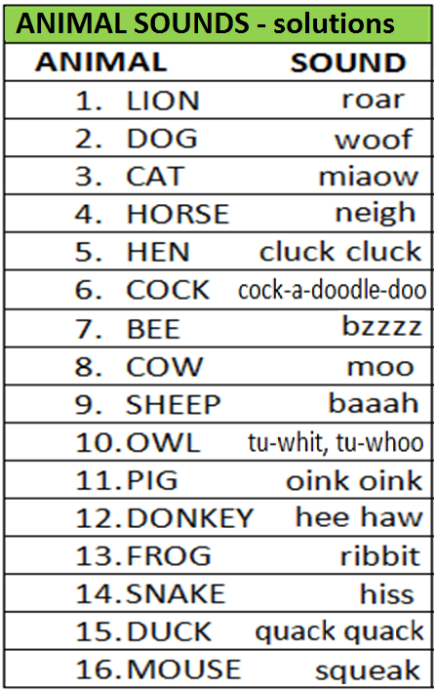
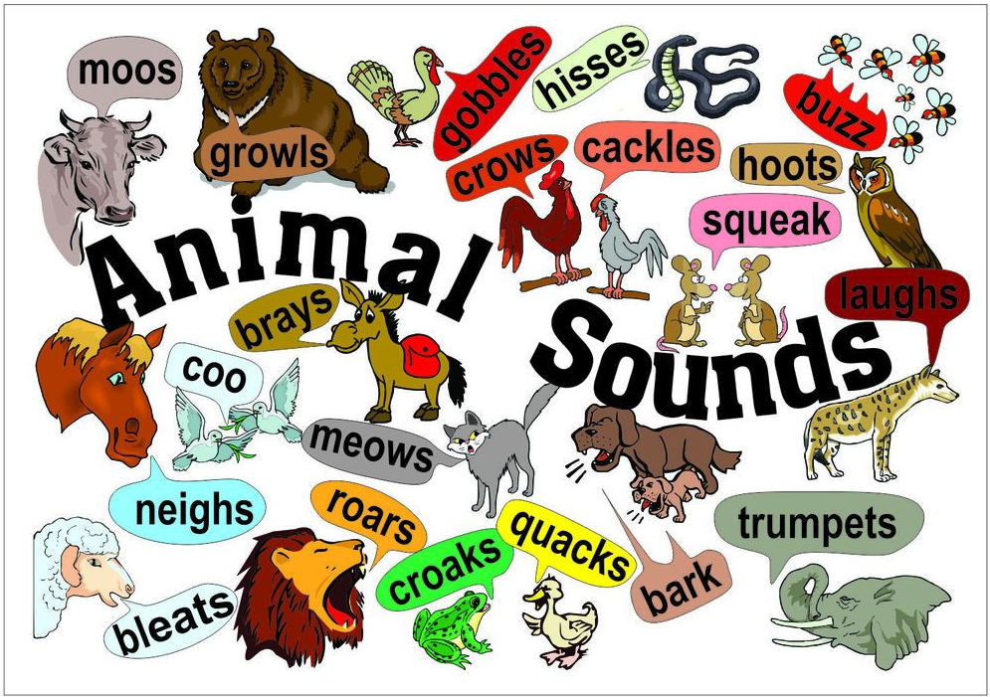

Slide 31



What do animals eat?

Slide 32




Where do animals live?
Walking Through the Jungle | Barefoot Books Singalong - YouTube

Slide 33

Group work:
1. Each group gets different letters.
2. One student is a teacher.
3. The teacher says one letter, whoever says a name of the animal on a certain letter first, gets one point.

Slide 34





Group work: Fill in some animal worksheets. When you finish check the solutions – see the animal worksheets key.
→ Aim: develop students’/teachers’ vocabulary

Slide 35




4. PLANTS

Slide 36






5. WEATHER
How's The Weather? | Super Simple Songs - YouTube

Slide 37


Observing and describing weather

Slide 38


Slide 39


Slide 40



6. OURSELVES
Me and society (all about me, feelings, family, school, rules, good manners, festivals ...)
Human body
Health
Food
The world around us

Slide 41


All about me

Slide 42


Slide 43





Slide 44






Human body

Slide 45




Human body: songs, chants and rhymes

Slide 46


Slide 47


Slide 48




Slide 49

In pairs:
1. describe a body part in 3 sentences (e.g. shape, texture, weight, length, its function)
2. exchange with other pairs pieces of paper and write down the body part.

Slide 50

In groups:
Names of the body parts are on the floor next to the blackboard.
Body is on your desk.
Take a body part and place it on the body.
You can take only one body part a time.
Take it to the desk and put it to the right place on the body.
The group who finishes first and gets all the answers right is the winner.

Slide 51
In groups:
Names of the body parts are hidden in the classroom.
Body is on your desk.
Find different body parts.
Take them to the desk and put them to the right place on the body.
The group who finishes first and gets all the answers right is the winner.

Slide 52







Food
Group work: Fill in some food worksheets. When you finish check the solutions – see the food worksheets key.
→ Aim: develop students’/teachers’ vocabulary

Slide 53





Good manners

Slide 54







HOLIDAYS AND FESTIVALS
Halloween
Room on the broom

Slide 55









Christmas

Slide 56





Easter
Thanksgiving

Slide 57






Valentine
Mother’s Day

Slide 58


The world around us

Slide 59


Design your ideal neighbourhood

Slide 60


Slide 61


Slide 62

Flags:
Flags | LearnEnglish Kids | British Council
Quiz European countries: Europe: Countries - Map Quiz Game (seterra.com)

Slide 63


Slide 64

Group work:
Each group gets pieces of paper with capital cities.
One student is Ljubljana.
You have to stand where these cities are according to Ljubljana.

Slide 65




Slide 66
CLIL lesson planning - exercise
Topic: Garden
Grade: 2nd
Aims
(SPO): Spoznajo vrt kot življenjsko okolje.
(TJA): They name animals and plants in the garden./They understand the instructions./They recognize the main topic of the story.
Write step by step lesson plan. Include a warm-up activity, different activities for introduction of the topic and repetition, revision!

Slide 67

Choose a story.
Define the topic and the subject.
Define the aims.
Define the vocabulary and phrases.
Plan 5 after-reading activities.

Slide 68
Group work
Work in 6 groups. Each group chooses one SCIENCE topic and brainstorms vocabulary and facts.
1. Write down/draw vocabulary and facts about the chosen topic.
2. Create a crossword on the topic.
3. Create a quiz on the topic.
4. Create activities for children on the topic. Write simple instructions.
Afterwards, you will present your work to others + ask them one question related to your topic.

Slide 69
Group work: MIND MAP
Instructions:
1. Work in 6 groups.
2. Each group chooses one SCIENCE topic and brainstorms vocabulary and facts they know.
3. Prepare a mind map in which you classify the vocabulary according to the 4 Cs (content, culture, cognition and communication; language of/for/through learning). Provide example words and phrases you would practise with that topic.
4. Afterwards, you will present your work to other.

Slide 70


The 4 Cs Framework
CONTENT
What is the science topic?
E.g.plants, human body, animal habitats, classification of animals, the world around us ...
COMMUNICATION
What science language will learners communicate during the lesson?
E.g. comparing and contrasting animals in order to analyse similarities and differences ...
CULTURE
Is there a cultural focus in the lesson?
E.g.plants in your country, plants specific for certain areas, animals living in specific areas ...
COGNITION
What thinking skills are demanded of learners in a science lesson?
E.g. classifying leaves, classifying animals, thinking about advantages and disadvantages of animal coverings ...

Slide 71



Language OF learning The language needed for learners to access basic concepts and skills relating to the subject topic. | Language FOR learning The kind of language needed to operate in a foreign language environment. | Language THROUGH learning New language will emerge through learning.
The Language Triptych or how to integrate cognitively demanding content with language learning and using

Slide 72


Slide 73

CLIL mind map

Slide 74


Učni načrt: Spoznavanje okolja

Slide 75


Slide 76



Slide 77


Slide 78



Slide 79


Slide 80


Slide 81



Slide 82


