Slide 1

Teaching Maths through English
Mateja Dagarin Fojkar, Ana Ilić, Tina Rozmanič

Slide 2
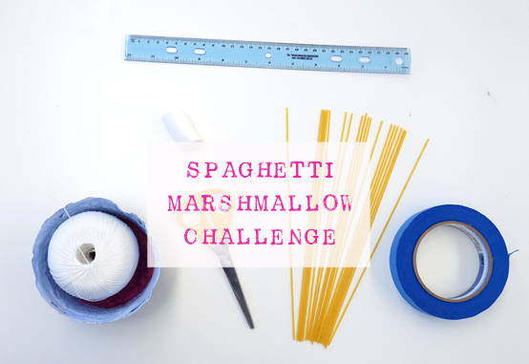

Slide 3
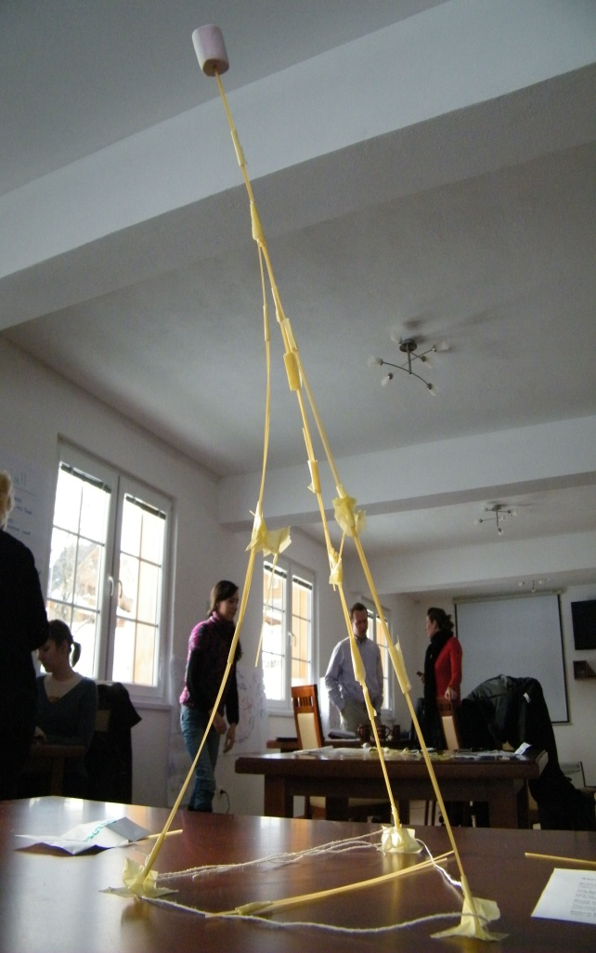
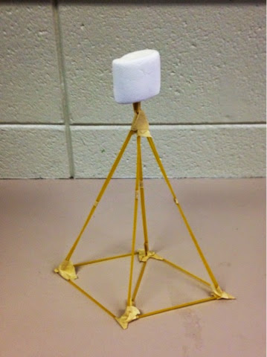
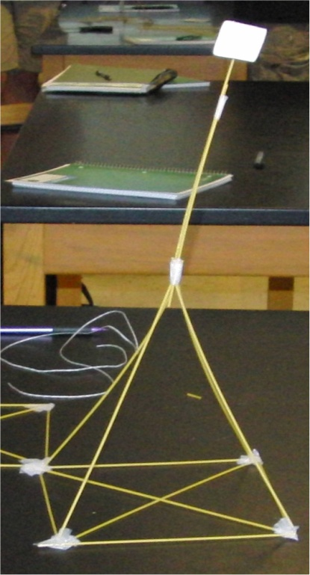
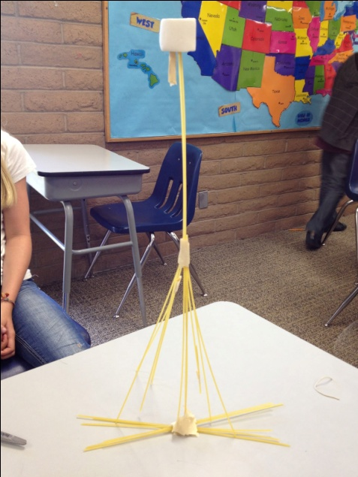
team work
problem solving
(mistake → try again)
creativity
cooperation
Spaghetti Tower Marshmallow Challenge | TinkerLab

Slide 4
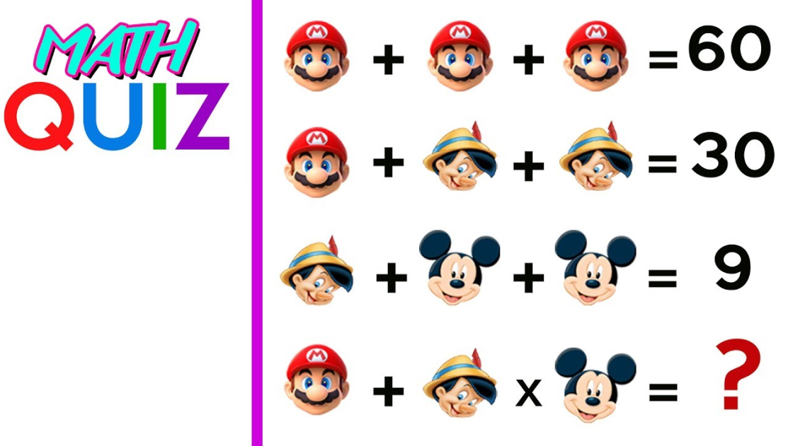
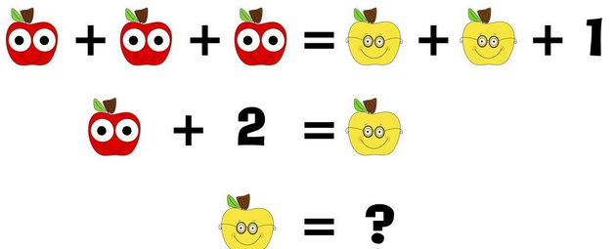
Speed math quiz
https://www.sporcle.com/games/Answer/speed-math-2

Slide 5
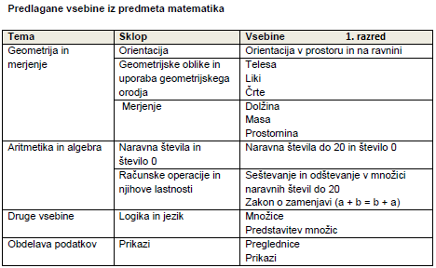
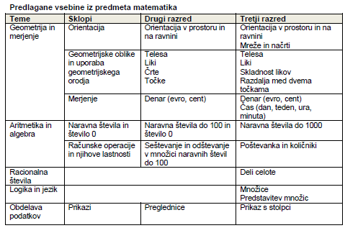
MATHS: Content areas

Slide 6
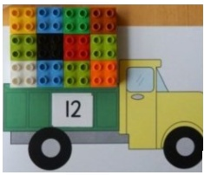
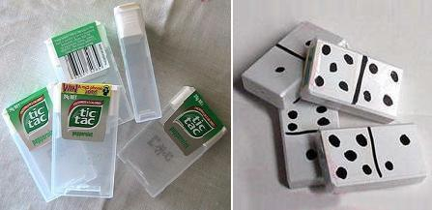

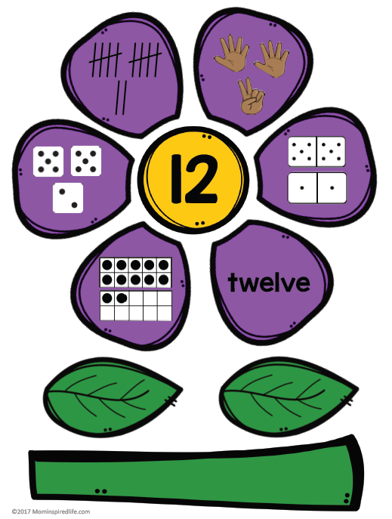
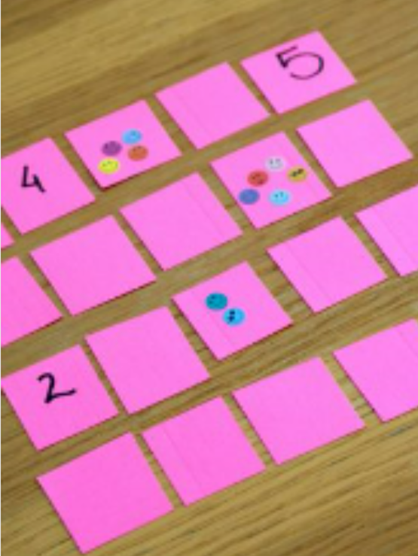
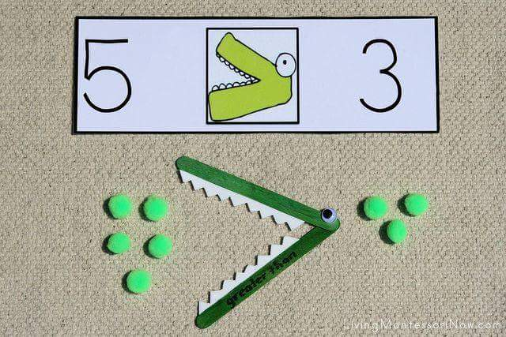
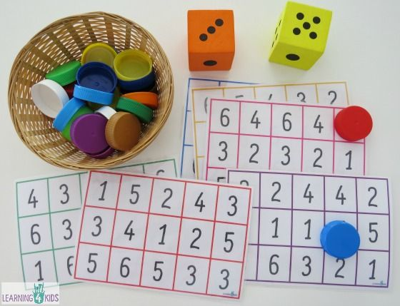

NUMBERS
https://www.youtube.com/watch?v=SxgCA1qOW20

Slide 7
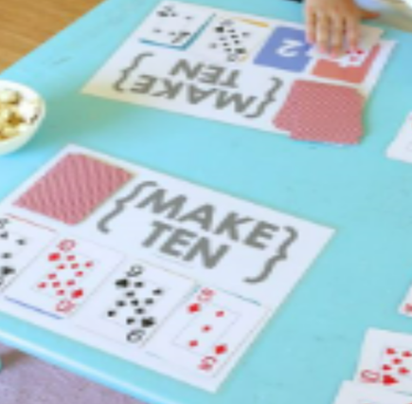
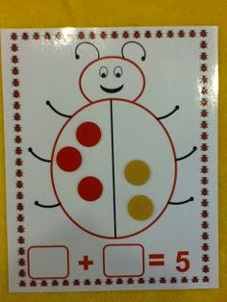
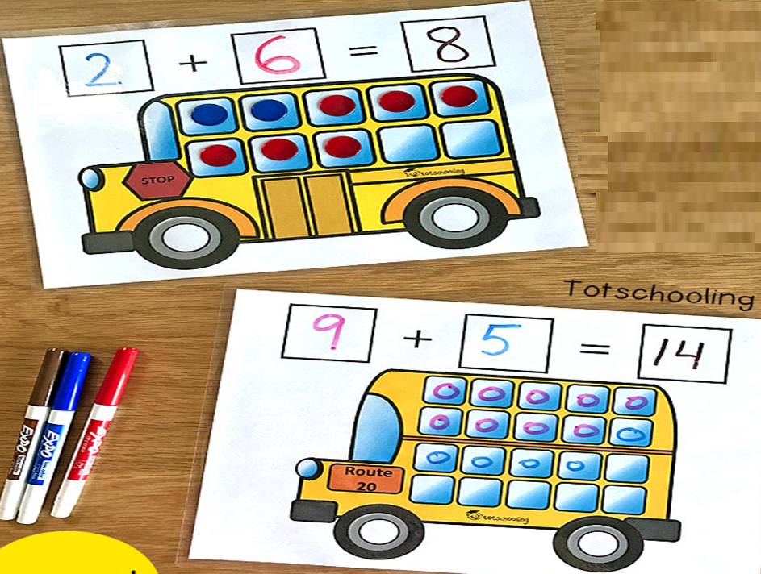
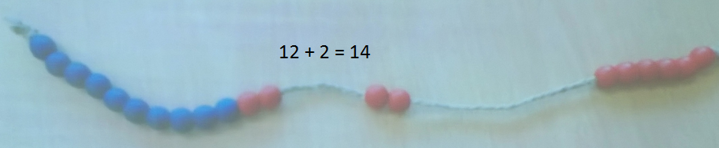
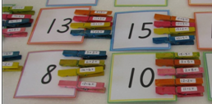
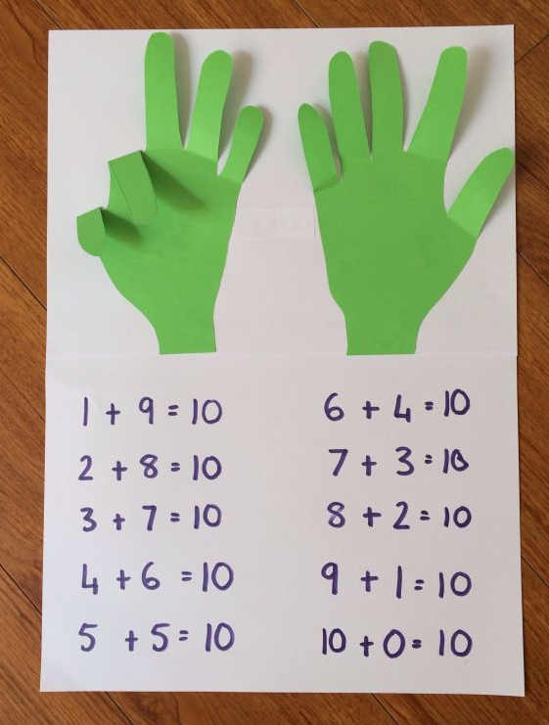
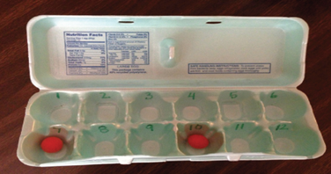
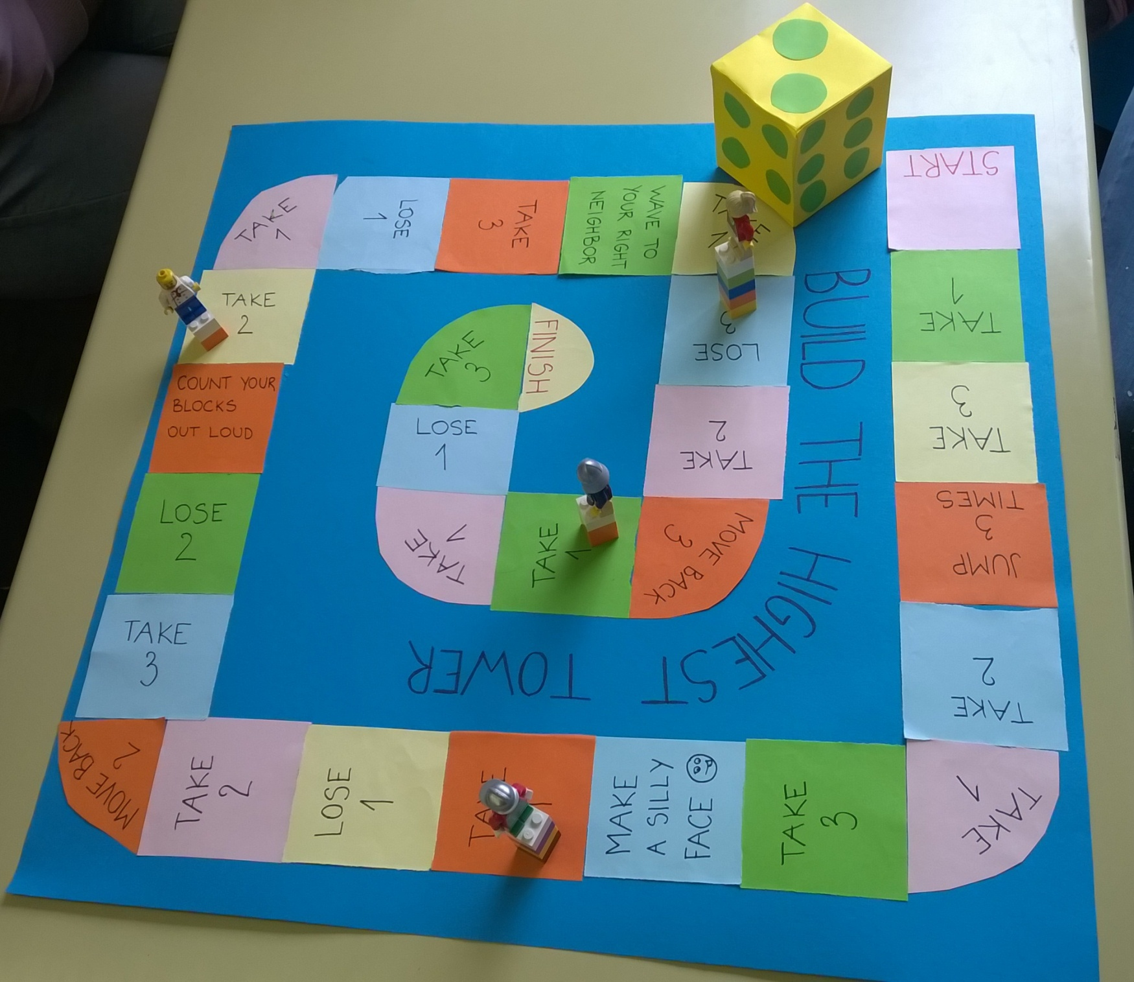
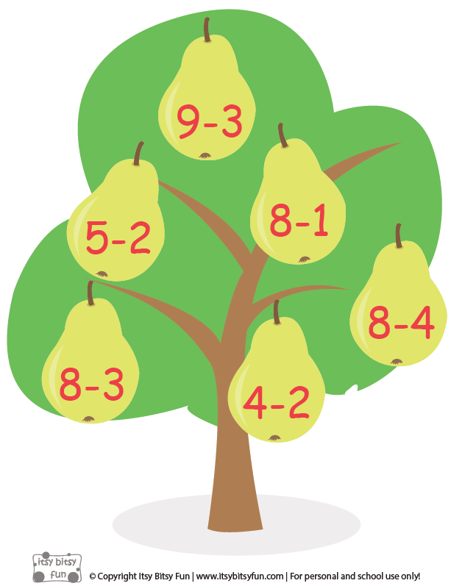
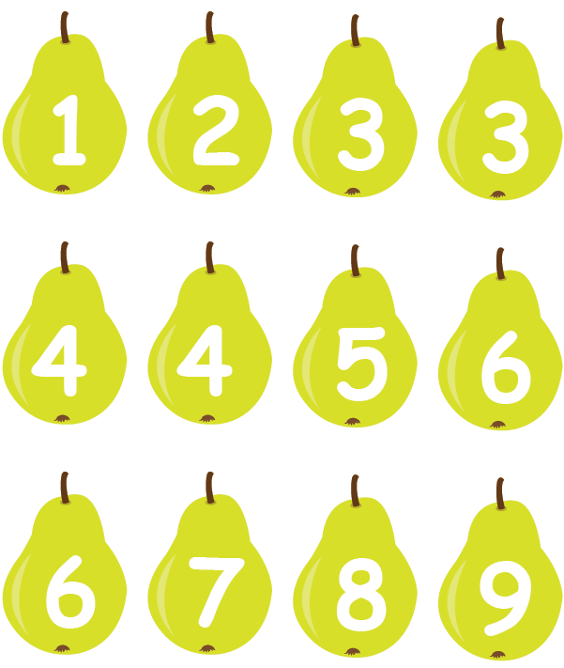
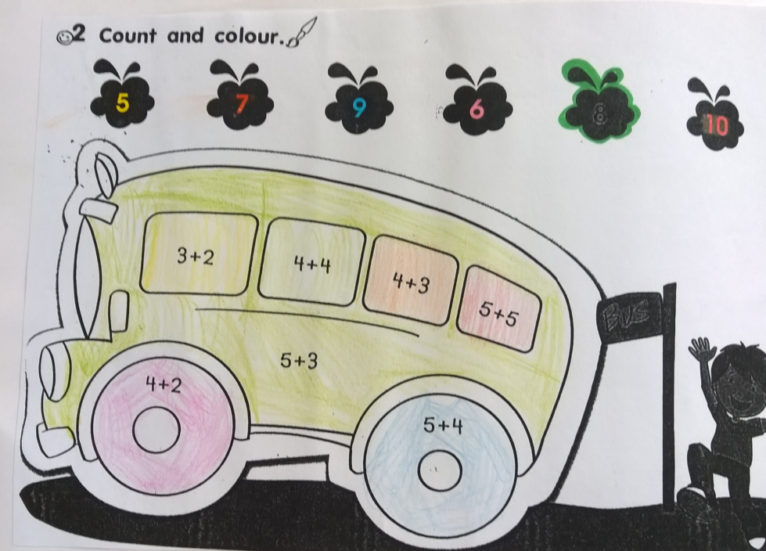
MATHEMATICAL OPERATIONS: addition, subtraction, multiplication, division
Basic Math For Kids: Addition and Subtraction, Science games, Preschool and Kindergarten Activities - YouTube

Slide 8
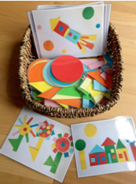

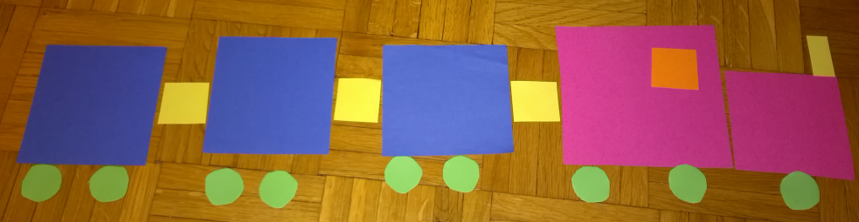

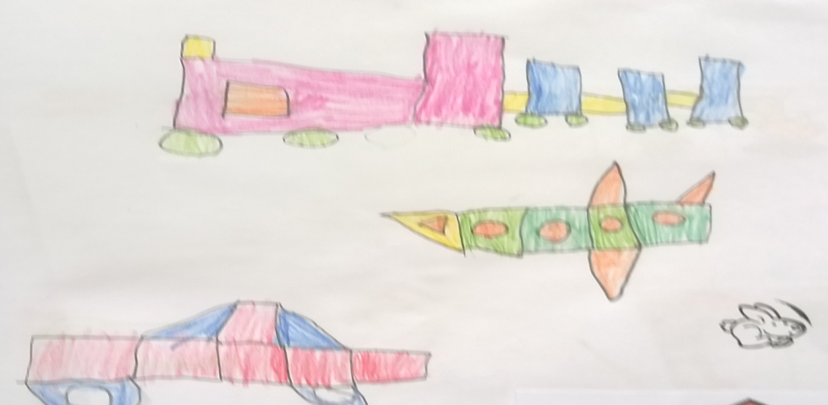
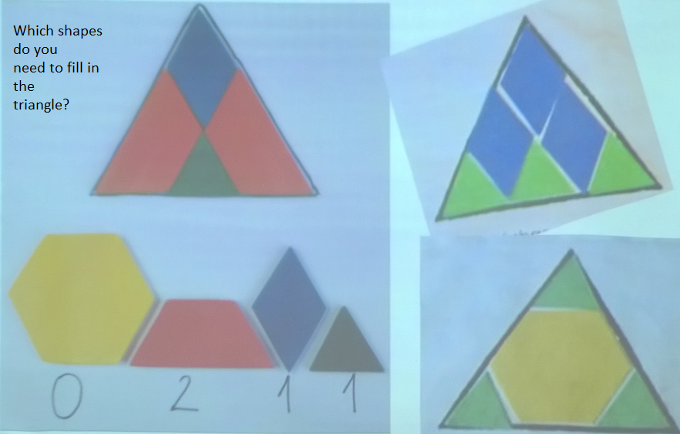
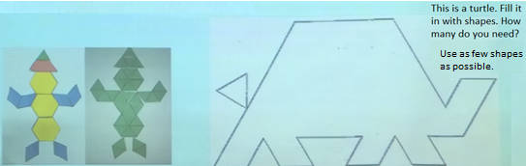
SHAPES
https://www.youtube.com/watch?v=JsWOS575gxk

Slide 9
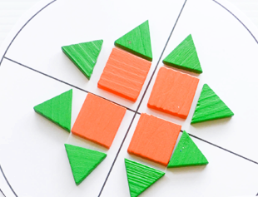
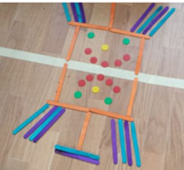
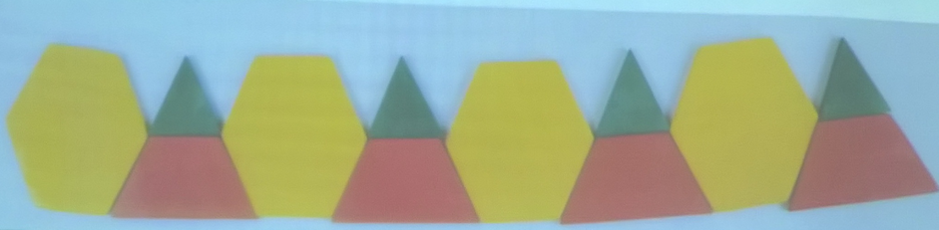
SYMMETRY
PATTERNS

Slide 10


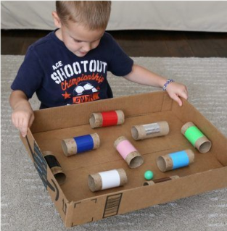
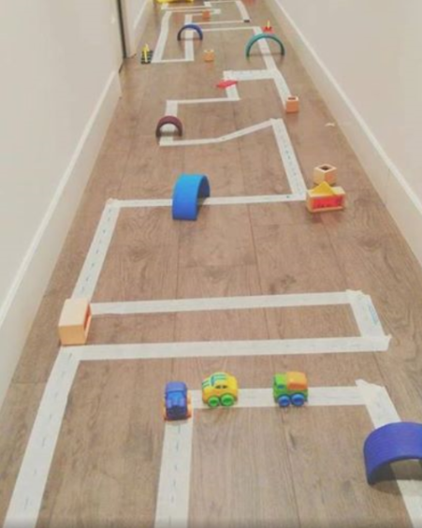
ORIENTATION IN SPACE
Left, right
Move and freeze: https://www.youtube.com/watch?v=388Q44ReOWE

Slide 11
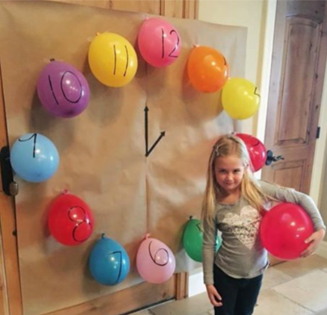



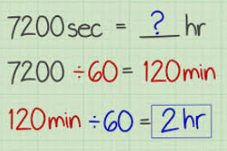

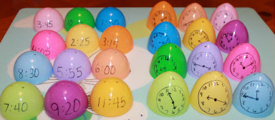
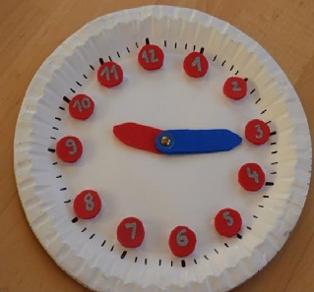
TELLING THE TIME
Learn to Tell Time #1 | Telling the Time Practice for Children | What's the Time? | Fun Kids English - YouTube

Slide 12
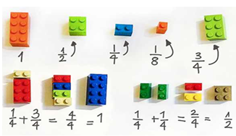
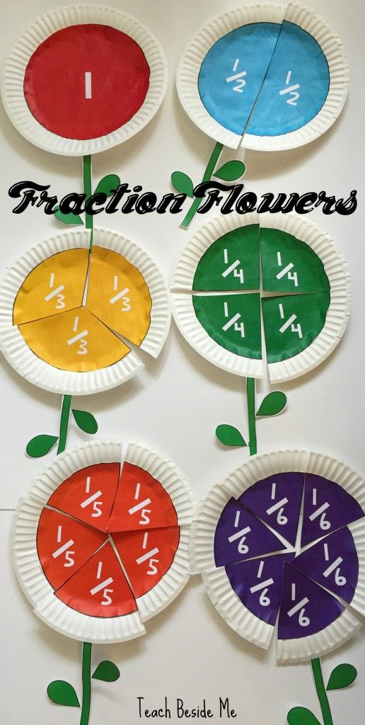
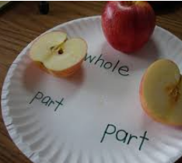
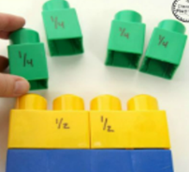
WHOLE TO PART LEARNING
FRACTIONS

Slide 13
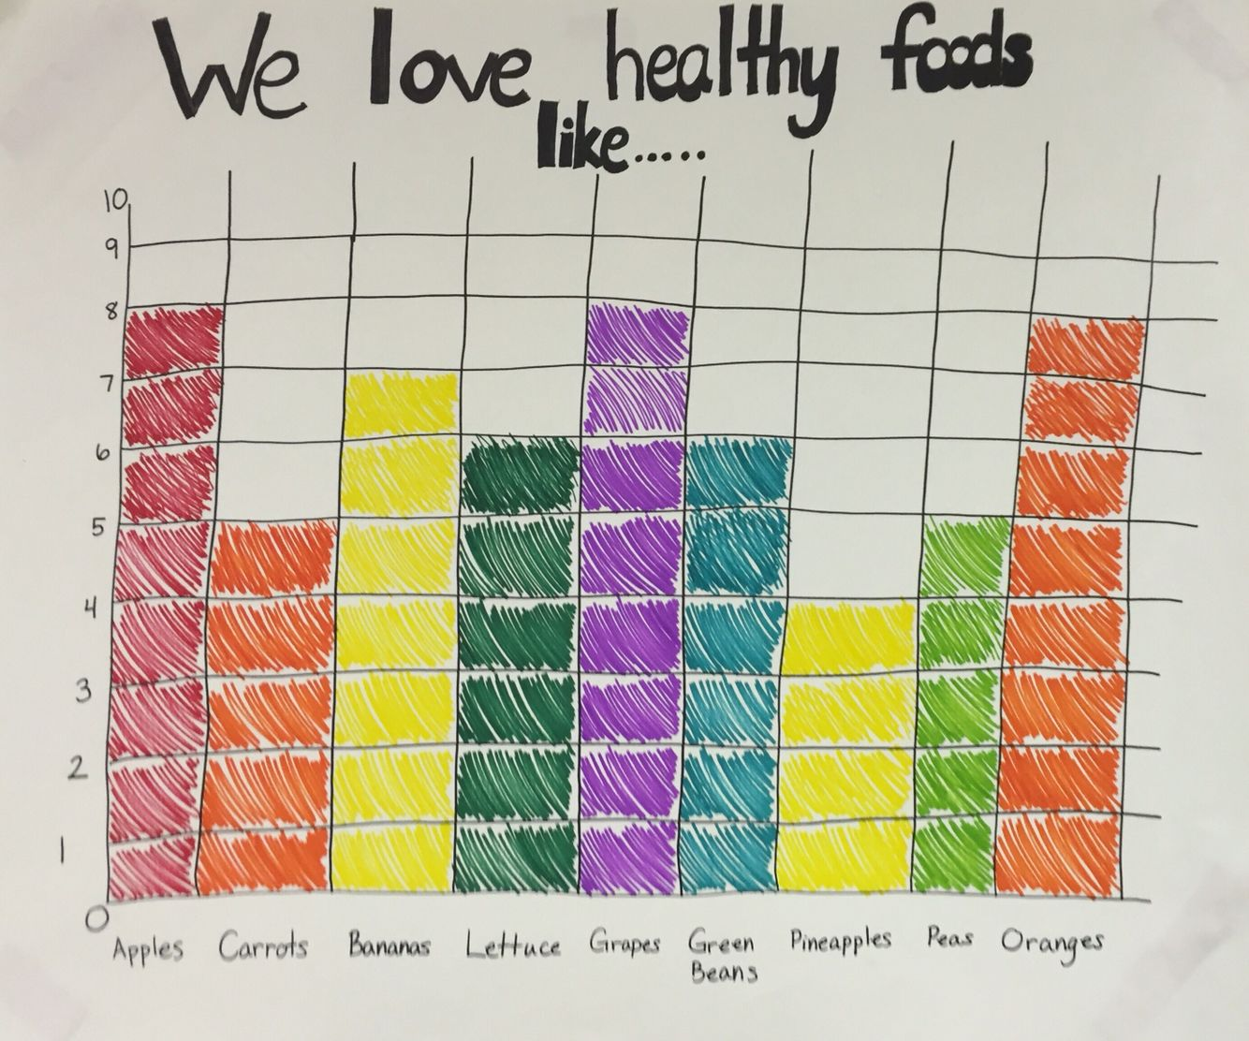
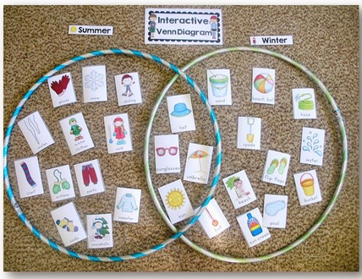
ORGANIZATION, ANALYSIS AND STORAGE OF DATA – HANDLING DATA

Slide 14










MATHS THROUGH STORIES
NUMBERS
SHAPES TELLING THE TIME
https://www.youtube.com/watch?v=fWUcfNvdrZs

Slide 15
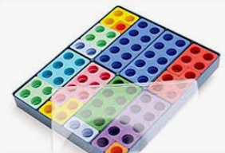
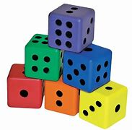
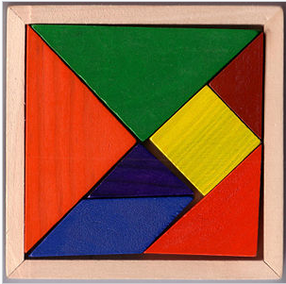
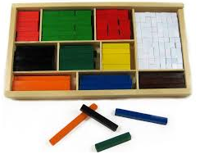



Mathematical materials and activities
NUMICON
CUISENAIRE RODS
LEGO BLOCKS
PLAYING CARDS
DICE
TANGRAM
LINK BLOCKS

Slide 16






NUMICON

Slide 17








CUISENAIRE RODS
Changing cuisenaire rods
with rods for smaller numbers

Slide 18





LEGO blocks

Slide 19



DICE GAMES

Slide 20

TANGRAM
The tangram is a puzzle consisting of seven flat
shapes, which are put together to form shapes.
The objective of the puzzle is to form a specific
shape using all seven pieces, which can not
overlap.
The seven pieces are:
2 large right triangles (=pravokotna trikotnika)
1 medium right triangle
2 small right triangles
1 square
1 parallelogram

Slide 21








MATHS AND ART

Slide 22





MATHS AND MUSIC

Slide 23





Mathematical activities - making didactic games
Work in groups.
Choose a topic.
Design a didactic game.
Define a school subject, a topic and aims (taken from Slovene curriculum − MAT + Language curriculum), describe your game.
Provide example words and phrases you would practise with that game.

Slide 24
PLANNING LESSONS
Work in 2 groups.
Choose a story book and read it.
Define a grade, a school subject, a topic and aims (MAT+ Language curriculum).
Design 5 activities (pre-/while-/post-). Write descriptions of activities.
Provide example words and phrases you would practise with that story.
PRESENTATION
Afterwards, you will present your work:
read the story to us;
define a grade, a school subject, a topic and aims;
define language loading;
describe 5 activities.

Slide 25






