Slide 1

ENGLISH ACROSS THE CURRICULUM
Mateja Dagarin Fojkar, Ana Ilić, Tina Rozmanič

Slide 2

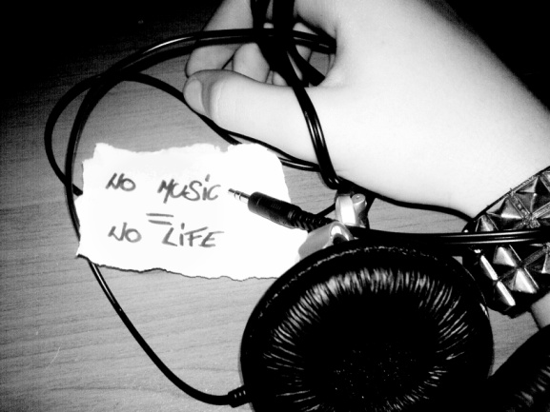
Music produces a kind of pleasure
which human nature cannot do without. (Confucius 551-479 BC)
Without music, life would be a mistake. (Nietzsche 1889)
Music is the stuff dreams grow on.
(Tanak Akay 1900)
We learnt more from a three-minute record, than we ever learnt in school.
(Bruce Springsteen 1983)

Slide 3
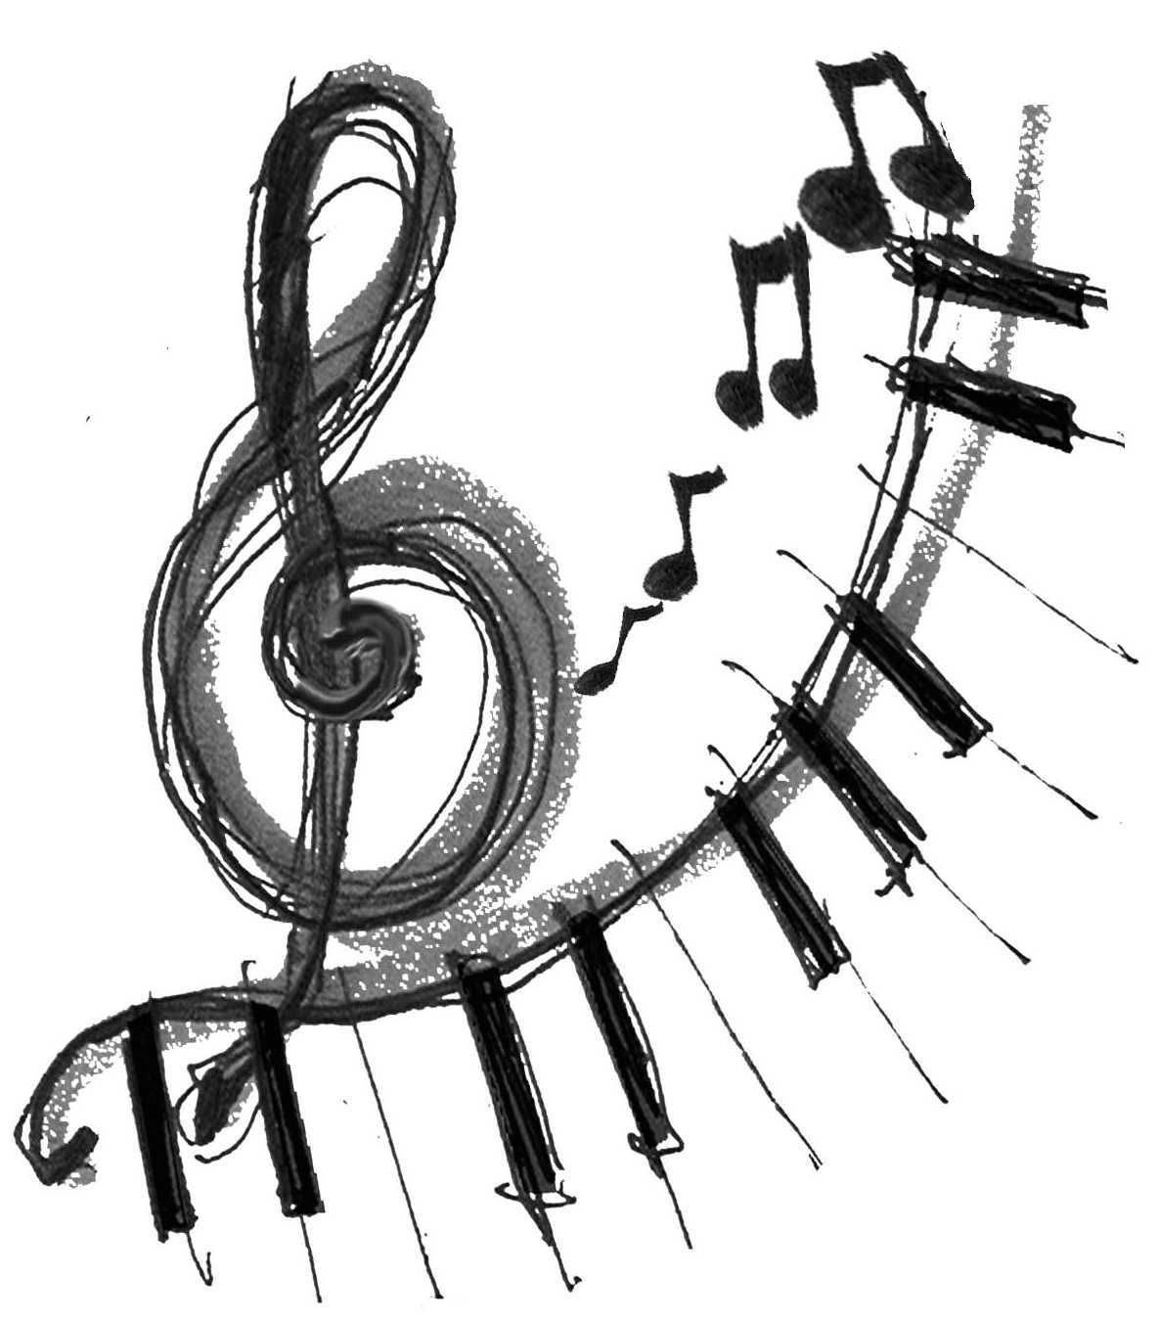

Test your musical knowledge
http://www.funtrivia.com/playquiz/quiz17977314961a0.html
In groups brainstorm 4 Cs for music.

Slide 4
4Cs:
COMMUNICATION
What music language will learners communicate during the lesson?
e.g.
Describing and comparing sounds, instruments
Analysing music
Answering, presenting
CONTENT
What is the music topic?
e.g.
genres of music
musical instruments
dance
music institutions
sounds
musicians
etc.
CULTURE
Is there a cultural focus in the lesson?
e.g.
Music from your country
Music around the world
The origin of the instruments
Instruments from the past
Music in different rituals
COGNITION
What thinking skills are demanded of learners in a music lesson?
e.g.
Playing, identifying,
Classifying
Evaluating

Slide 5
MUSIC VOCABULARY
Match the verb in the column on the left with the correct noun from the column on the right
VERB NOUN
compose tune
conduct drum
write horn
play instrument
blow piece of music
tap orchestra
improvise lyrics
sing song
hum solo
beat foot

Slide 6
MUSIC VOCABULARY KEY
compose - piece of music
conduct - orchestra
write - lyrics
play - instrument
blow - horn
tap - foot
improvise – solo
sing - song
hum - tune
beat - drum

Slide 7
MUSIC VOCABULARY 2
Fill in the blanks with a word from the exercise above.
Don't you think the Maestro ___________ the orchestra well?
He beat the _________ like a madman!
John Lennon _________ the lyrics to many of the Beatles's best songs.
You can tell when Peter is in a good mood, he ________ one of his favorite tunes.
The most famous opera __________ by Mascagni was "Cavelleria Rusticana".
Jazz musicians almost always ___________ their solos.
The ___________ always tune their instruments before they begin the concert.
I can remember the time when President Clinton got up on MTV to _______ his horn - the saxophone.
Would you please not tap your _______ in time to the music?
Some of the best rock singers don't _________ their songs, they shout them!

Slide 8
MUSIC VOCABULARY 2 - KEY
Don't you think the Maestro conducted the orchestra well?
He beat the drums like a madman!
John Lennon wrote the lyrics to many of the Beatles's best songs.
You can tell when Peter is in a good mood, he hums one of his favorite tunes.
The most famous opera composed by Mascagni was "Cavelleria Rusticana".
Jazz musicians almost always improvise their solos.
Most professional musicians play their instruments up to five hours a day!
I can remember the time when President Clinton appeared on MTV to blow his horn - the saxophone.
Would you please not tap your foot in time to the music?
Some of the best rock singers don't sing their songs, they shout them!

Slide 9
MUSIC VOCABULARY 3
a public performance
a collection of songs
the words of a song
one song from a collection
a classification of the most popular songs
work on a project
not recorded
a song with no words
number of times a radio station plays a song
most recent
the singing in a song
easy to remember and sing
the music of a song
recorded music at a concert
the music for a film
copy music to disc or cassette
the most popular song in a classification
album single top ten number one lyrics vocals melody catchy record | live concert backing track collaborate soundtrack latest airplay instrumental

Slide 10
MUSIC VOCABULARY 3 - KEY
a public performance = CONCERT
a collection of songs = ALBUM
the words of a song = LYRICS
one song from a collection = SINGLE
a classification of the most popular songs = TOP TEN
work on a project = COLLABORATE
not recorded = LIVE
a song with no words = INSTRUMENTAL
number of times a radio station plays a song = AIRPLAY
most recent = LATEST
the singing in a song = VOCALS
easy to remember and sing = CATCHY
the music of a song = MELODY
recorded music at a concert = BACKING TRACK
the music for a film = SOUNDTRACK
copy music to disc or cassette = RECORD
the most popular song in a classification = NUMBER ONE

Slide 11
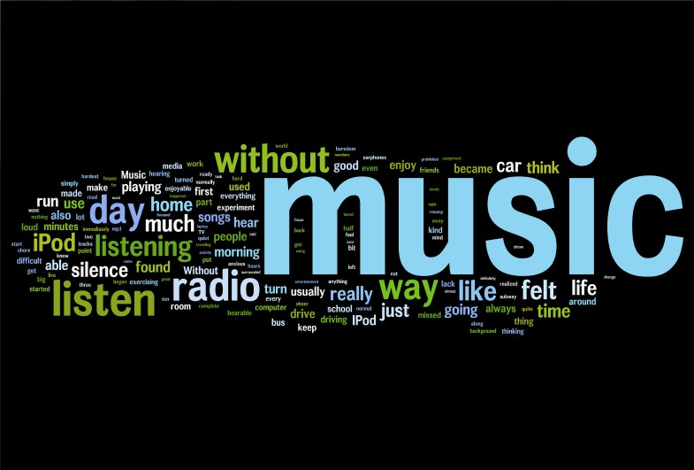
MUSIC VOCABULARY
http://quizlet.com/20061355/4th-grade-music-vocabulary-quiz-flash-cards/

Slide 12
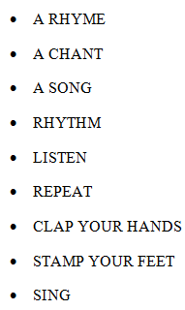

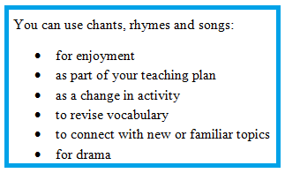
CLASSROOM LANGUAGE – MUSIC EXPRESSIONS

Slide 13
MUSIC ACTIVITIES IN PRIMARY CURRICULUM
Listen to different genres of music or music from different cultures
Learn about musical instruments
Learn about characteristics of different music genres
Make your own music instruments (e.g. shakers, drums, a guitar…)
Create your own music
Play different instruments and record yourself
Organise and perform in a school musical
Learn about the rhythm with tapping, clapping, clicking fingers…
Dance and move to the music
Observe (and imitate) the sounds in the nature (e.g. waves, stream…)
Musical chairs
Role play a story with instruments (e.g. a triangle for a mouse, a drum for a bear…)
…
http://pinterest.com/debchitwood/kids-music-activities/
http://www.dltk-kids.com/crafts/music/index.htm
http://www.teachervision.fen.com/music/lesson-plan/54321.html
http://www.biglearning.org/treasure-music.htm

Slide 14
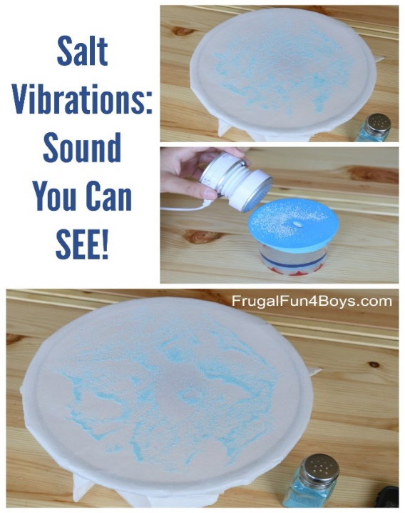
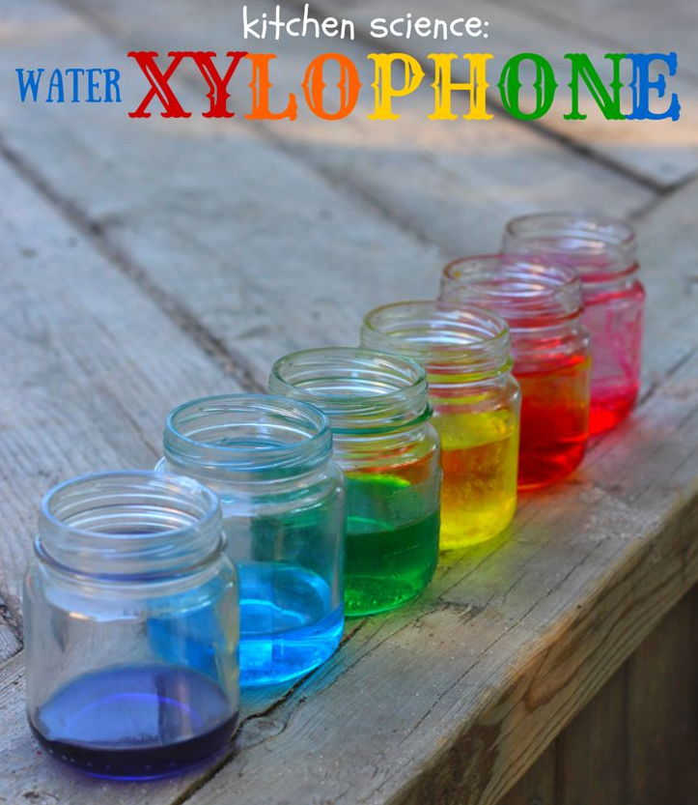
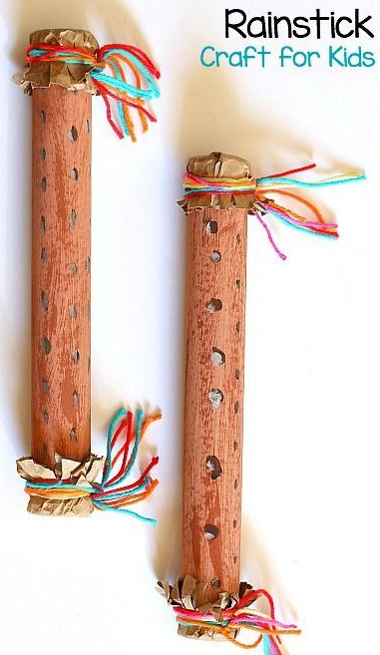
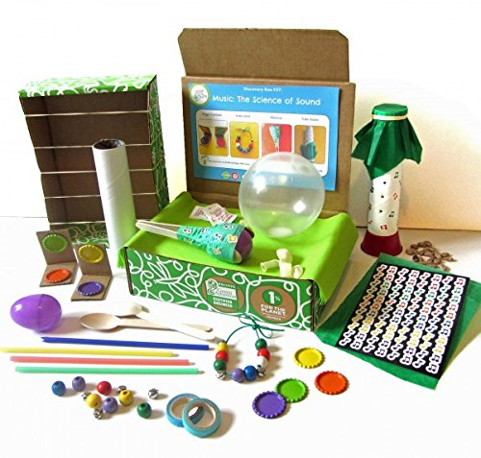
MUSIC AND SCIENCE

Slide 15
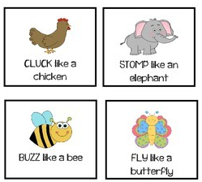
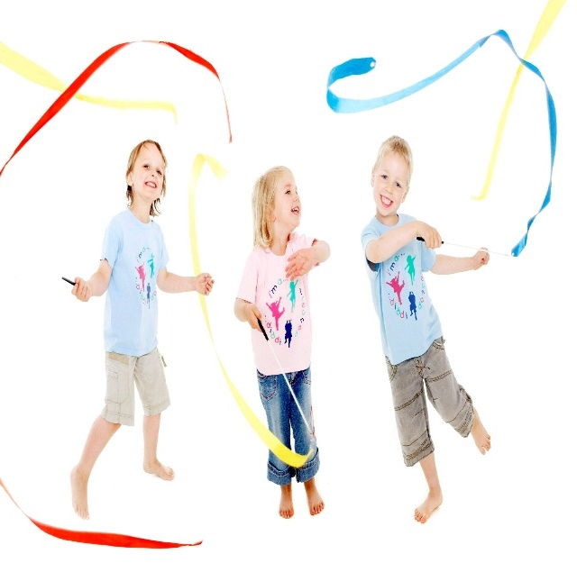
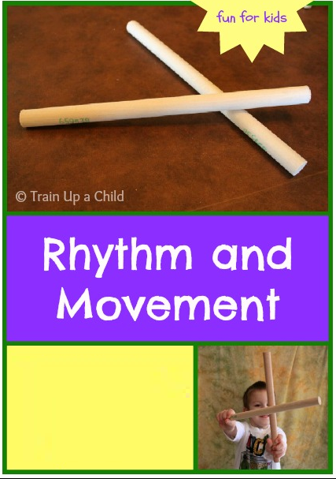


MUSIC AND P. E.

Slide 16
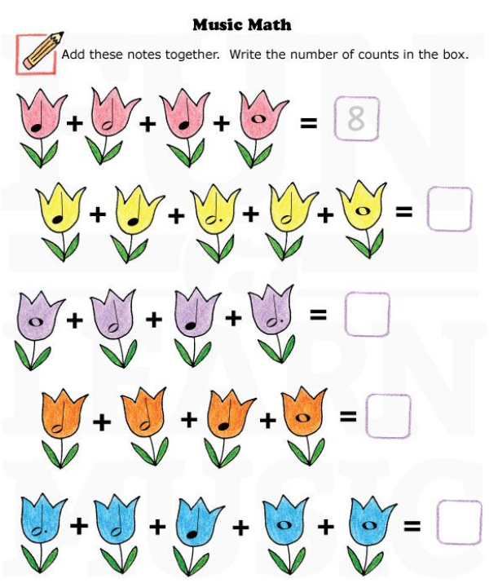
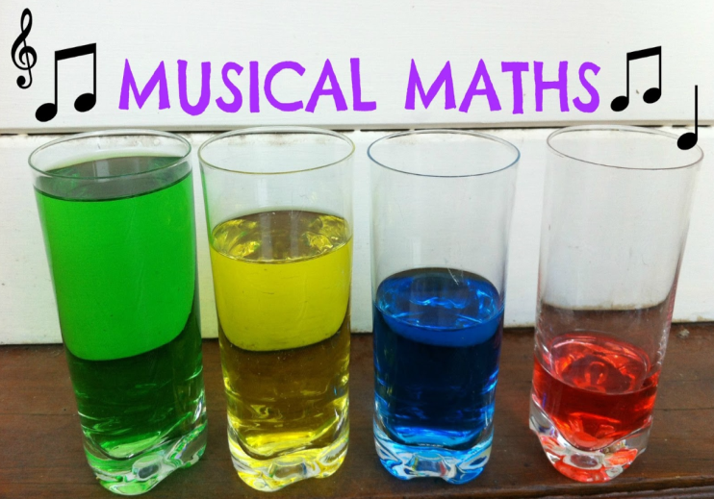
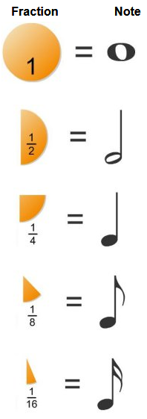
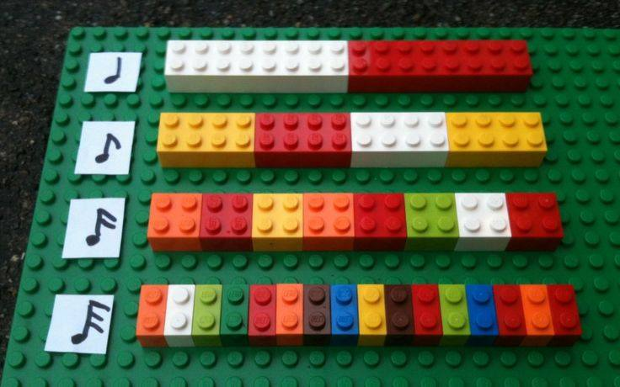
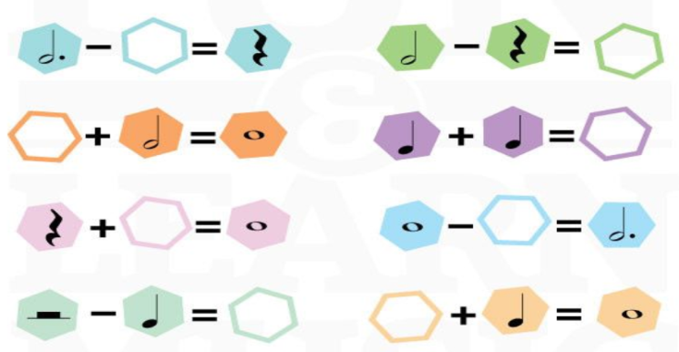
MUSIC AND MATHS

Slide 17
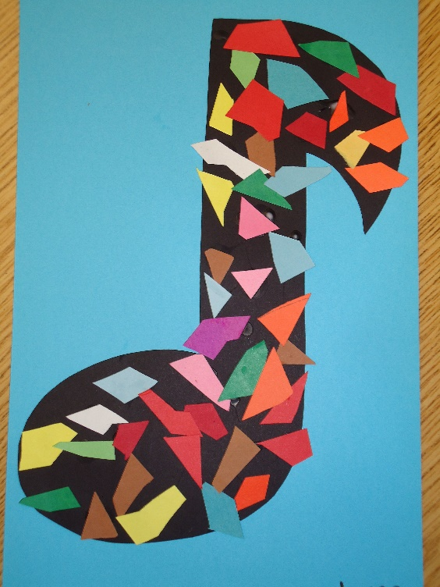
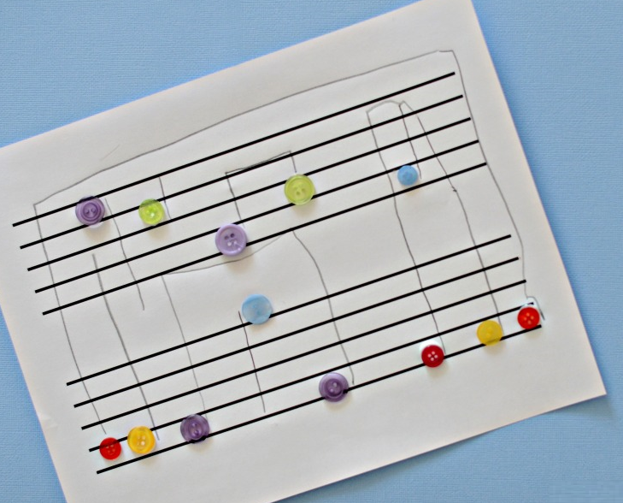
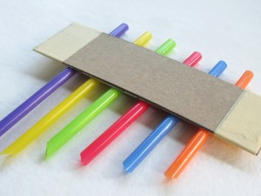
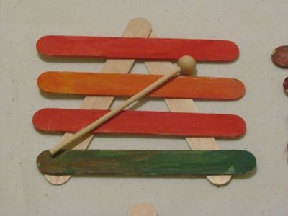
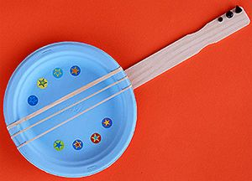
MUSIC AND ART

Slide 18
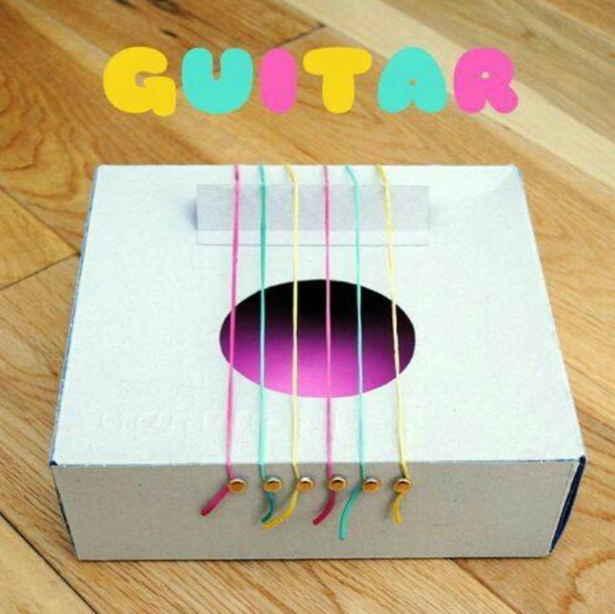
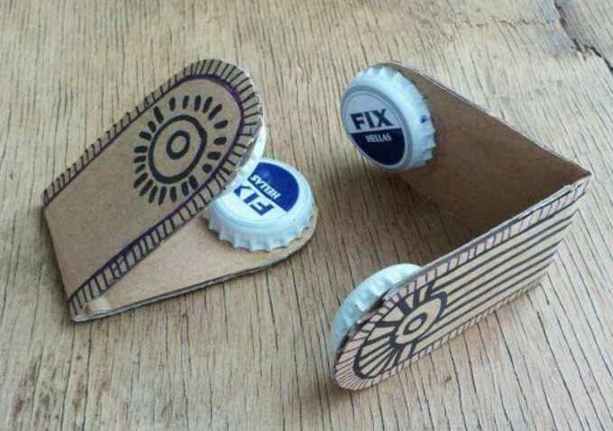
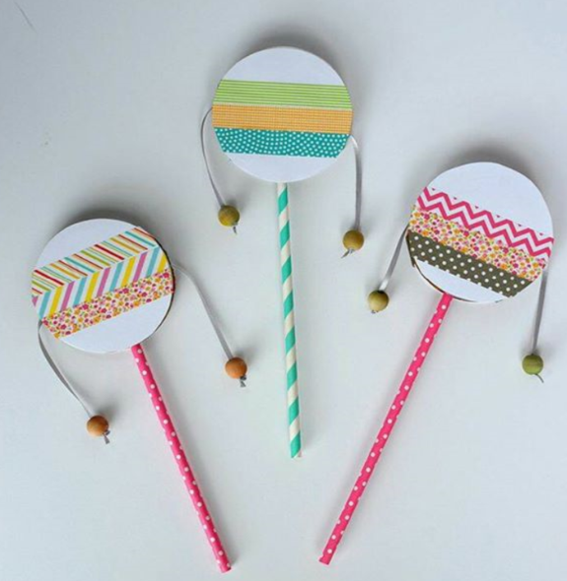
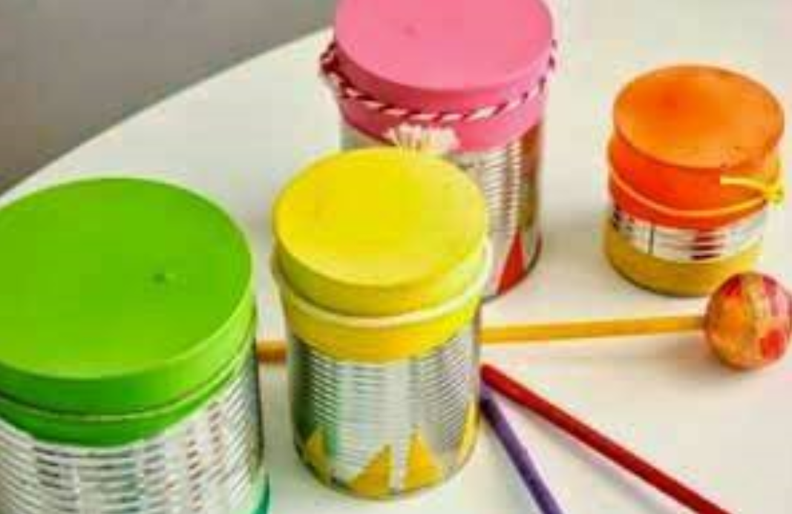
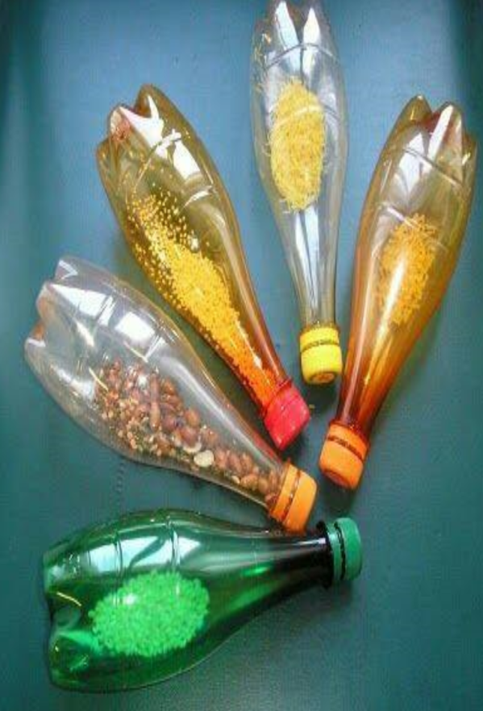
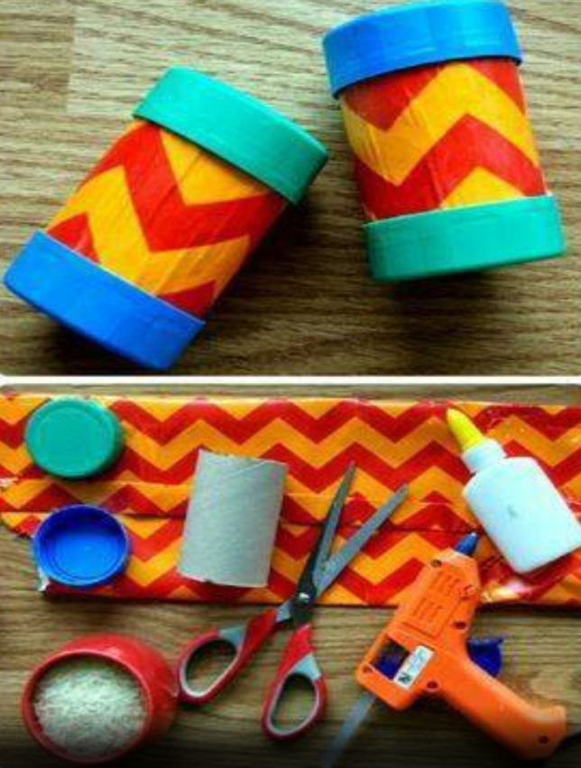
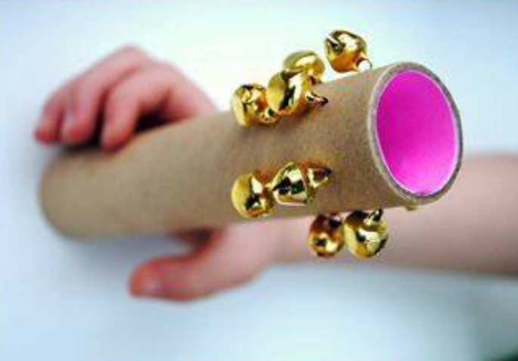

Slide 19
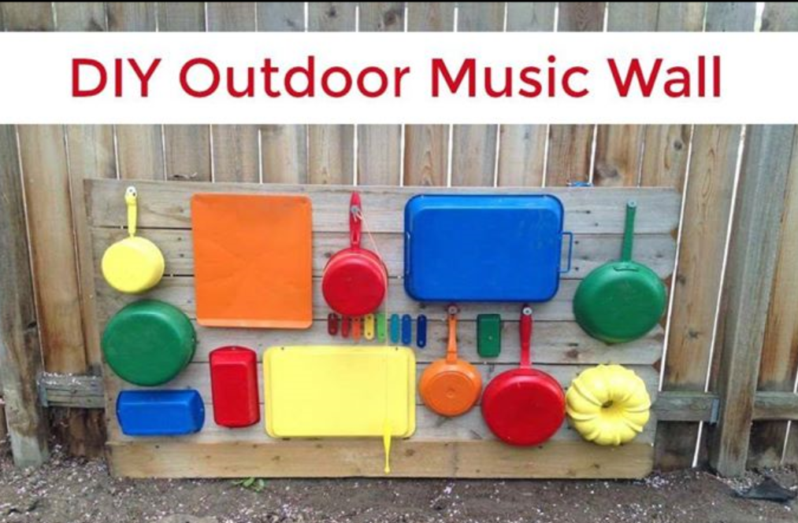
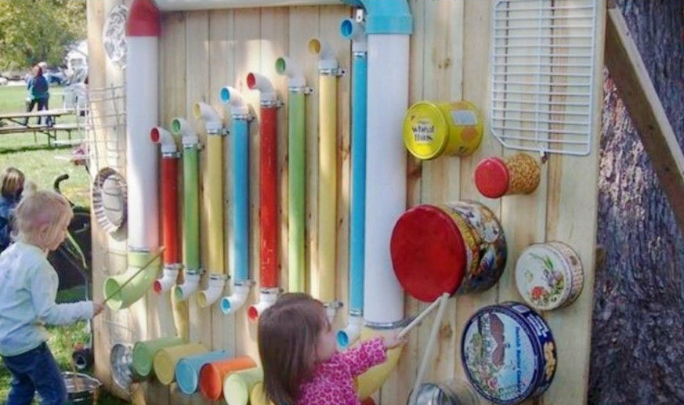
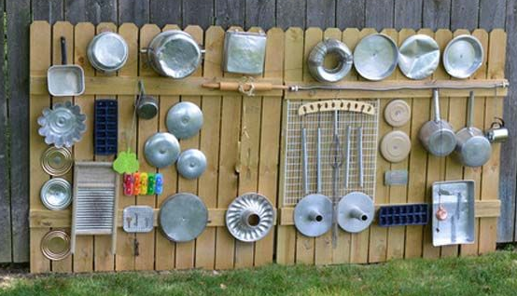

Slide 20


MUSIC THROUGH STORIES
Baby Loves To Rock by Wednesday Kirwan, book read aloud. – YouTube
Dogs Don't Do Ballet - Bedtime Story Read Aloud - YouTube

Slide 21
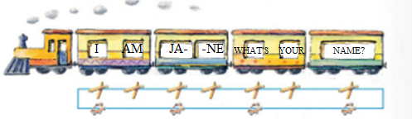
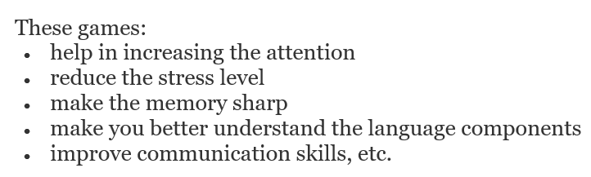
RHYTHMIC GAMES
I am Jane. What‘s your name?
L knee, R knee, snap (2x)

Slide 22
CREATING A CHANT
CHANT = to keep saying or singing a word or phrase many times
Work in 5 groups.
Select a topic.
Write down words associated with the topic.
No. of syllables: the same number of syllables in a line, otherwise a break.
Write down rhyming words.
Write down adjectives – no. of syllables.
Create a chant.
Create the rhythm with tapping, clapping, clicking fingers …
Chants - Playway teacher training film no.5 – YouTube
(Herbert Puchta – chants)
Notes:
Creating your own rhymes –
e.g. what’s this? What’s this? A cat, a cat
((Combining items into a chant, adding lang.
Vocabulary topic: 2/3/1
Fruit: apple/banana/pear
Animasl: tiger/elephant/cat
Ruler, eraser, chair:
Purple ruler, pink eraser
Yellow chair, yellow char
lots of repetition! ))
Making up a chant - topic – weather
Pattern: the same number of syllables in a line, otherwise a break

Slide 23


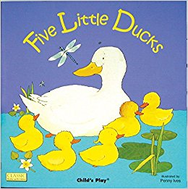


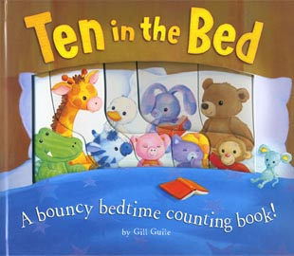


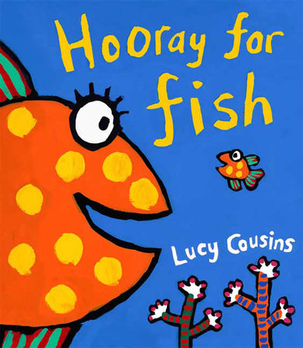
Let's Sing with Eric Carle's Book ~ : "From Head To Toe Song" - YouTube

Slide 24
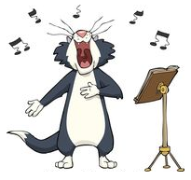
CREATING A SONG
Work in 5 groups.
Select a story book and read it.
Create a song (on a well known tune) - summarize the story or read the whole story.
Define aims (MUSIC + Language).

Slide 25












MATCH THE WORD WITH THE SYMBOL.
TREBLE CLEF
BASS CLEF
TIME SIGNATURE
REPEAT SIGN
BAR LINE
BAR
END
PLAY MUSIC LOUDLY
PLAY MUSIC SOFTLY
HALF NOTE
QUARTER NOTE
WHOLE NOTE
EIGHTH NOTE
DOTTED HALF NOTE
STAFF
FIRST LINE
FOURTH SPACE

Slide 26

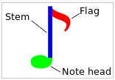
MATCH THE WORD WITH THE SYMBOL – KEY.
TREBLE CLEF
BASS CLEF
TIME SIGNATURE
REPEAT SIGN
BAR LINE = taktnica
BAR = takt
END = končaj
PLAY MUSIC LOUDLY
PLAY MUSIC SOFTLY
HALF NOTE
QUARTER NOTE
WHOLE NOTE
EIGHTH NOTE
DOTTED HALF NOTE
STAFF
FIRST LINE
FOURTH SPACE

Slide 27
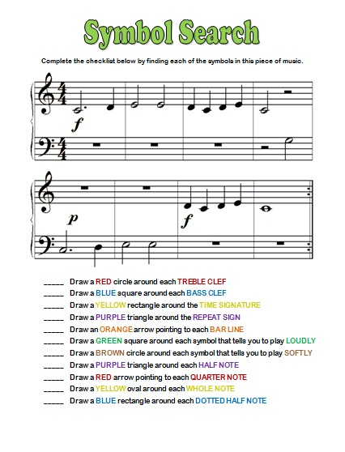

Slide 28
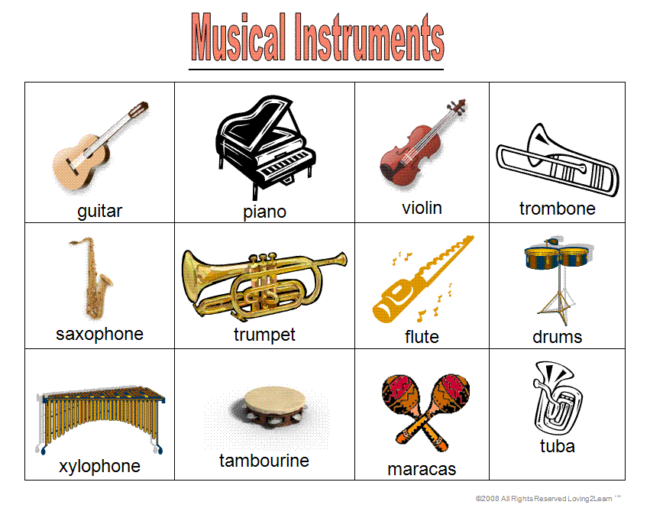
MUSICAL INSTRUMENTS
http://www.eflnet.com/vocab/music_vocabulary.php

Slide 29
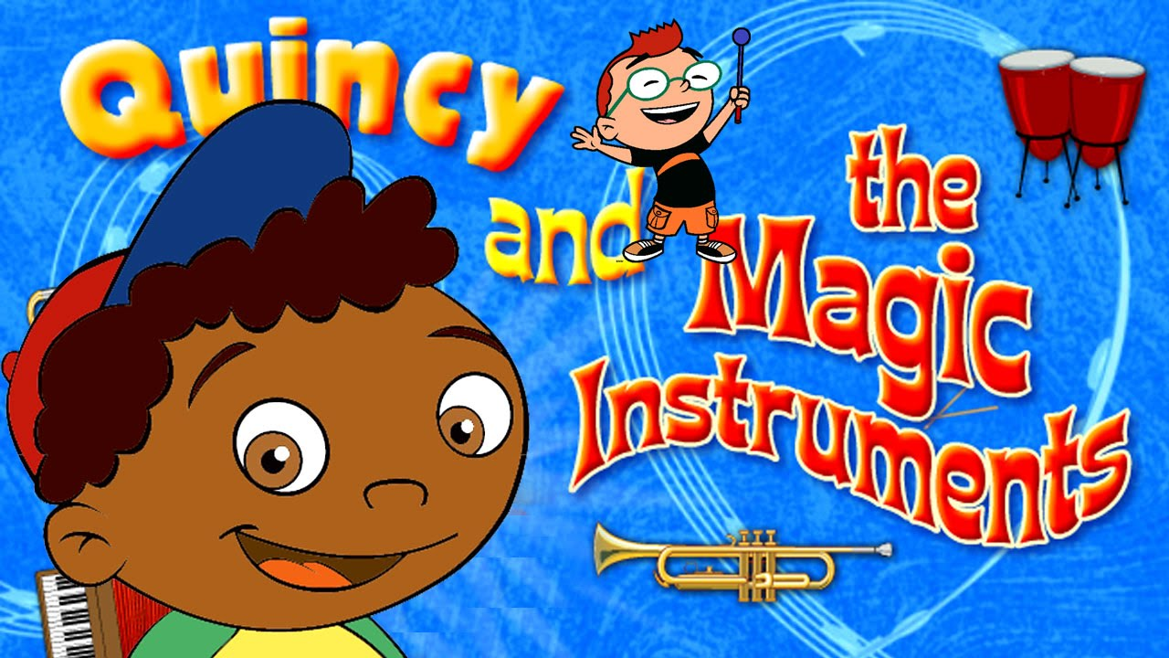
LITTLE EINSTEINS
Quincy and the magic instruments
(Which instruments did you hear?)
HD Version - Quincy and the Magic Instruments - YouTube

Slide 30
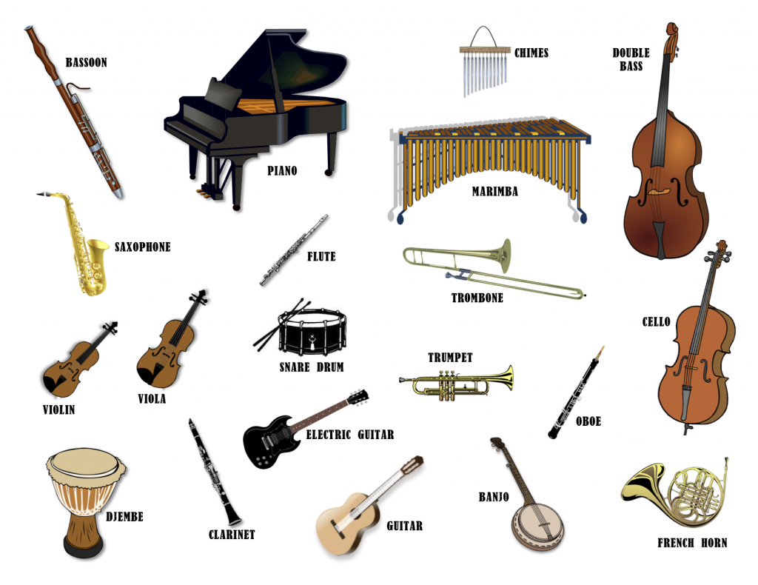

Slide 31
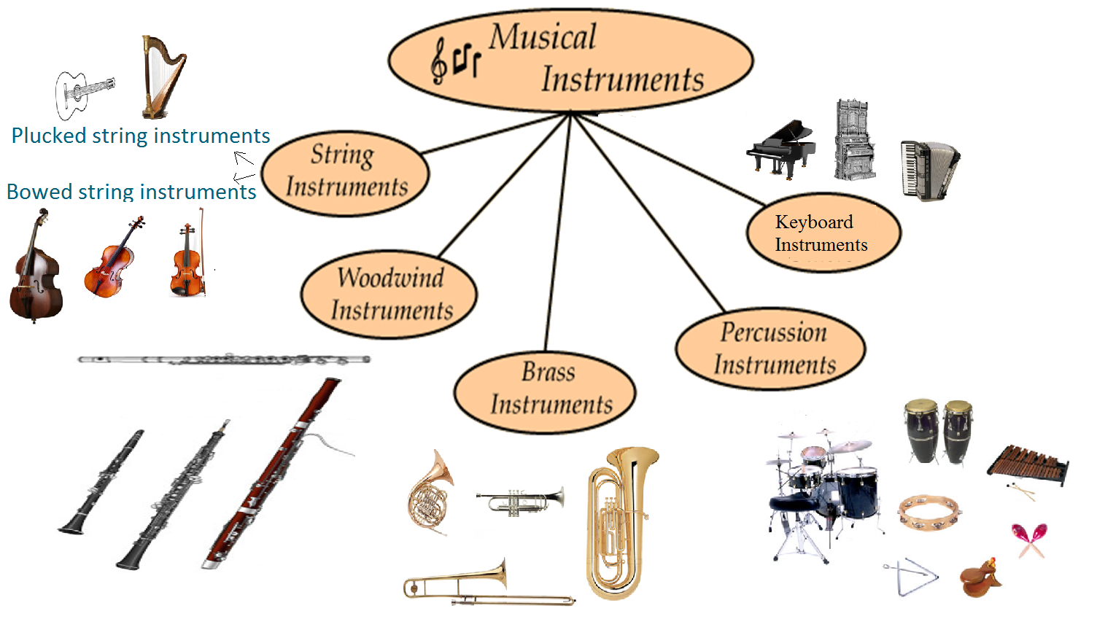
HORN, HARP, FLUTE, ORGAN, TRUMPET, XYLOPHONE, ACCORDION, TUBA, GUITAR, DRUM, CONGAS, VIOLIN, CLARINET, OBOE, TRIANGLE, TROMBONE, BASSOON, CELLO, MARACAS, BASS, PIANO, CASTANETS, TAMBOURINE

Slide 32
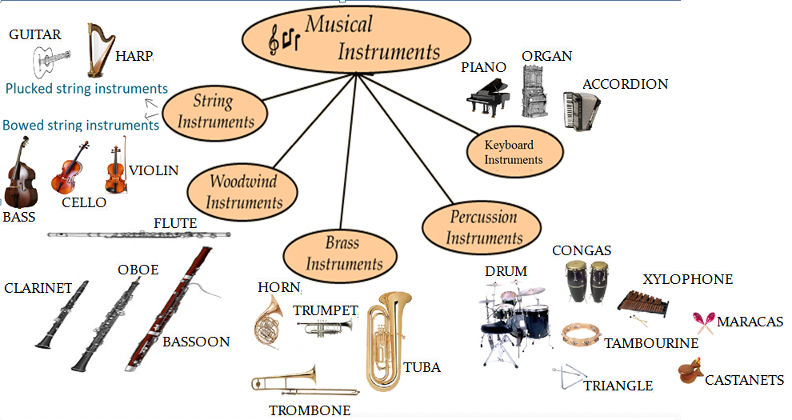

Slide 33
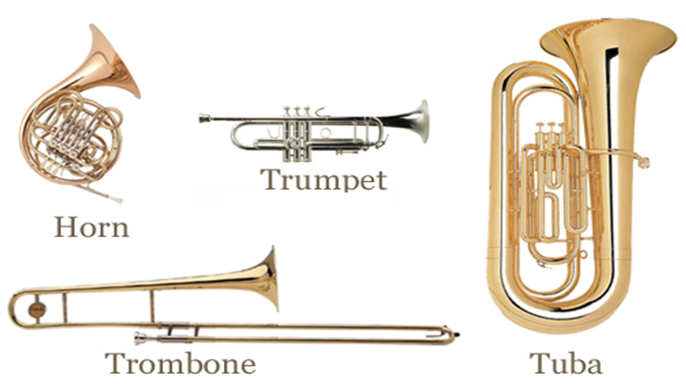
BRASS INSTRUMENTS

Slide 34
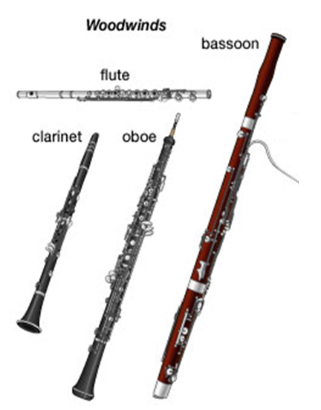

Slide 35
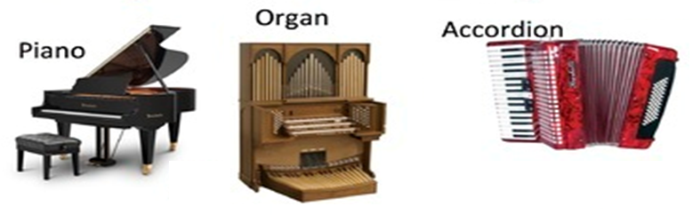
KEYBOARD INSTRUMENTS

Slide 36
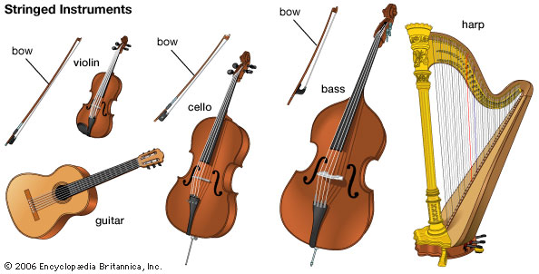
STRINGED INSTRUMENTS
1. Plucked string instruments – BRENKALA
2. Bowed string instruments – GODALA

Slide 37
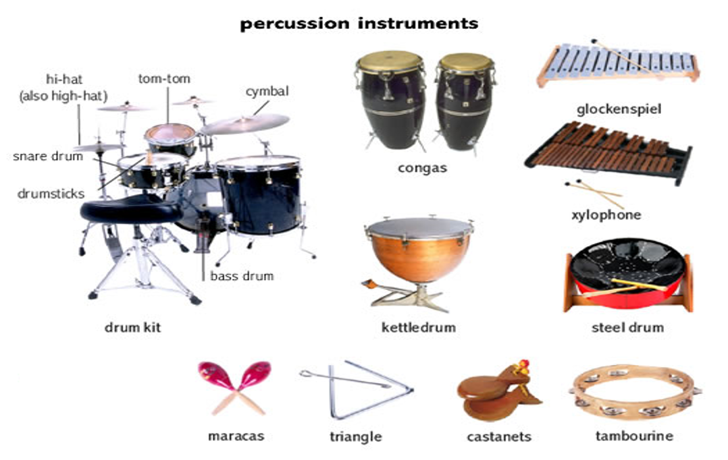

Slide 38

Boomwhackers Tuned Percussion Tubes are lightweight, hollow, color-coded, plastic tubes, tuned to musical pitches by length.
Boomwhackers:
https://www.youtube.com/watch?v=5qxPie5_cEU
https://www.youtube.com/watch?v=Vz_P6qQF-Yg

Slide 39
MUSICAL INSTRUMENTS: LANGUAGE LOADING
TOPIC: Musical instruments
Define language laoding (structures, vocabulary, classroom language) → language of/for/through learning.

Slide 40


Slide 41

MUSICAL INSTRUMENTS QUIZ
Music sounds quiz:
Music Tech Teacher, Music Quizzes, Games, Pianos, Worksheets
http://www.sporcle.com/games/Scarpia/sound-of-musical-intruments

Slide 42
ONLINE MUSIC GAMES
http://www.brighthubeducation.com/teaching-elementary-school/108616-best-online-music-games/
http://www.learninggamesforkids.com/music_and_art_games/orchestra-jigsaw.html
Create music:
http://www.incredibox.com
Write the lyrics to songs:
http://lyricstraining.com/

Slide 43

SONGS:
Elephants Have Wrinkles
Elephants have wrinkles, wrinkles, wrinkles.
Elephants have wrinkles. Wrinkles everywhere!
On their toes. On their toes.
No one knows, No one knows
Why -y- y- y.
Repeat with knees, hips, ears, trunks, teeth.
http://www.youtube.com/watch?v=cRvMB9zJvsg
Elephant song: http://www.youtube.com/watch?v=yihq8BIhL9c

Slide 44

PLANNING LESSONS
Work in 5 groups.
Choose a song.
Define a grade, a school subject, a topic and aims (Music + Language).
Design 5 activities with the chosen song. Write descriptions of activities.
PRESENTATION
Afterwards, you will present your work:
define a grade, a school subject, a topic and aims;
describe 5 activities.

Slide 45
CLIL Lesson plan

Slide 46
High and low voices – lesson plan
Learning outcomes
Students will:
tell the difference in low, medium, and high pitches.
sing low, medium and high pitches.
hear and reproduce low, medium and high pitches using the tone bars.
Time required for lesson
45 minutes
Materials/resources
The Three Bears: story book or Silver, Burdett and Ginn Big Book from The Music Connection series.
3 Tone Bars: the lowest bar should be middle C, medium A, and highest pitch D, an octave above middle C.
Pre-activities
The students need to be comfortable singing in a group situation as well as solo. Basic knowledge of how to play the tone bars is helpful.
Activities
Introduction: Say Hello to the students in a high, medium, and then low voice. Ask the students to echo. Explain that the class will be learning about high and low.
Divide students into high baby bear voices, medium mama bear voices, and low papa bear voices (practice).
Tell the story of The Three Bears, using the Music Connection Big Book as a visual aid. Have each group say their character’s lines in the assigned voices; i.e., “somebody’s been sitting in my chair,” making sure each student in the group uses the appropriate voice. You may also have each group pantomime the actions as they say their lines.
Play tone bars slowly and have students tell high, medium, or low by making their bodies high (stretching), medium (sitting) or low (on the floor). Next, have students sing pitches of the tone bars, again in their assigned groups.
Retell the story, this time with the students using their singing voices on the assigned lines on the appropriate pitches with one student from each group playing the tone bars. The students may also be advanced enough to sing while moving their bodies high, medium, and low.
Conclude the lesson by saying goodbye to each child in a high, medium, or low singing voice and having them echo the same pitch back.
Assessment
Teacher observation, individual check at the end of lesson.
Supplemental information
Comments
I have found this lesson to be very useful in helping children differentiate pitch. Also, many young students confuse high and low for loud and soft, and this lesson helps to clarify exactly what high and low means in music.

Slide 47
CLASSROOM THUNDERSTORM
See explanation at:
http://ezinearticles.com/?Classroom-Thunder-Storm-%28Or-Rain-Dance%29---Another-Great-Game-For-Music-Lessons&id=1858591
Watch it at:
https://www.youtube.com/watch?v=DN-hso_voeI

Slide 48


Slide 49


