Slide 1
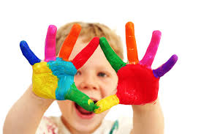
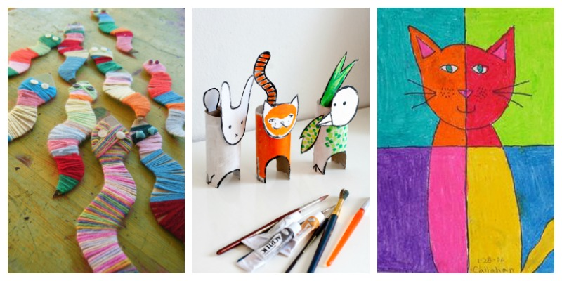

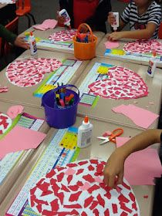
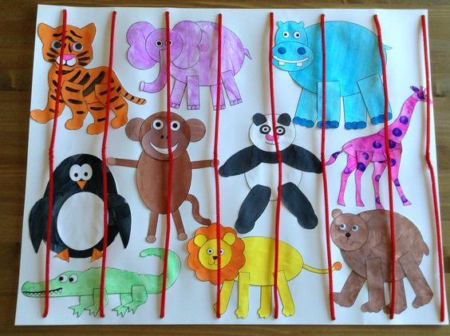
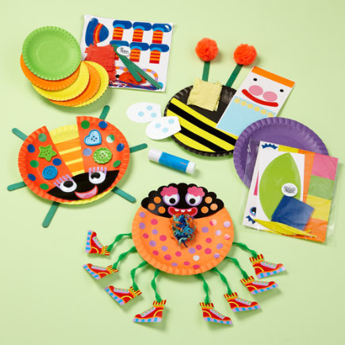
Mateja Dagarin Fojkar, Ana Ilić, Tina Rozmanič

Slide 2
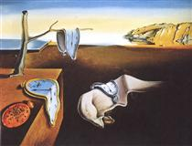

FAMOUS PAINTINGS QUIZ
https://www.goodnet.org/articles/you-match-these-famous-paintings-to-their-artists-quiz
Famous artists http://totallyhistory.com/art-history/famous-artists/
In groups brainstorm 4 Cs for art.

Slide 3
4Cs:
CONTENT
What is the art topic?
e.g.
shapes
colours
paintings
street art (e.g. graffiti)
sketches
sculptures
designs
art photography
installations
drawings
architecture
COMMUNICATION
What art language will learners communicate during the lesson?
e.g.
Comparing and contrasting paintings
Analysing art materials
CULTURE
Is there a cultural focus in the lesson?
e.g.
Architecture in your town
Paintings from your country
Street art in different countries
COGNITION
What thinking skills are demanded of learners in an art lesson?
e.g.
Classifying colours (primary, secondary)
Evaluating paintings
Thinking about advantages and disadvantages of street art

Slide 4
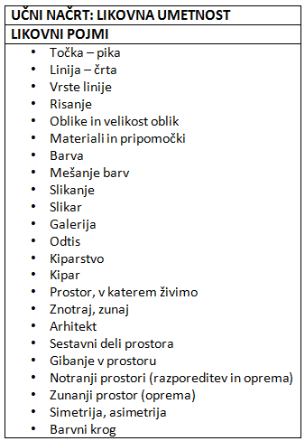


Slide 5
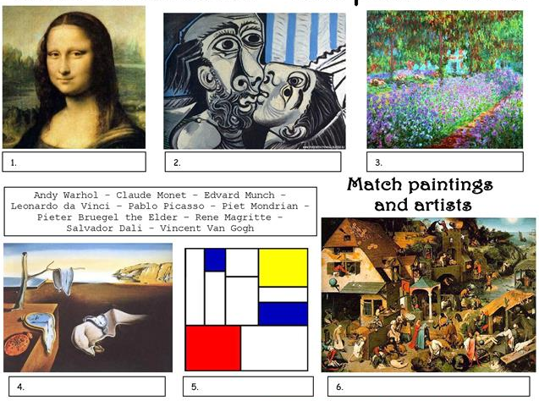
Group work:
Each group gets cut out famous photos, famous artists and names of photos.
They have to match the painting with the painter and the name of the painting.

Slide 6
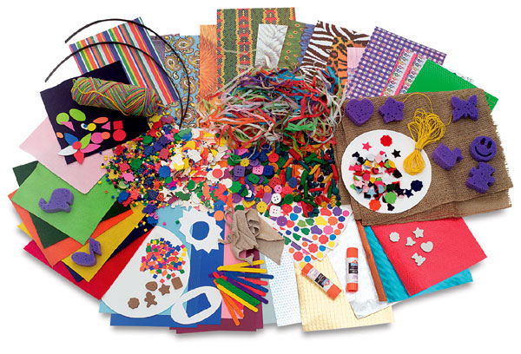
Art materials and activities
Fun foam
Lacing cards
Tweezers games
Play-dough
Using a hole punch
Clay
Eyedroppers
Pegboards
Cotton swabs
Clothespins
Paintbrush and water
Tearing paper
Stringing beads
Easel painting
Finger-painting
Making masks, puppets
Chalkboard drawing
Rubbings
Making (pop-up) books
Paper mache

Slide 7
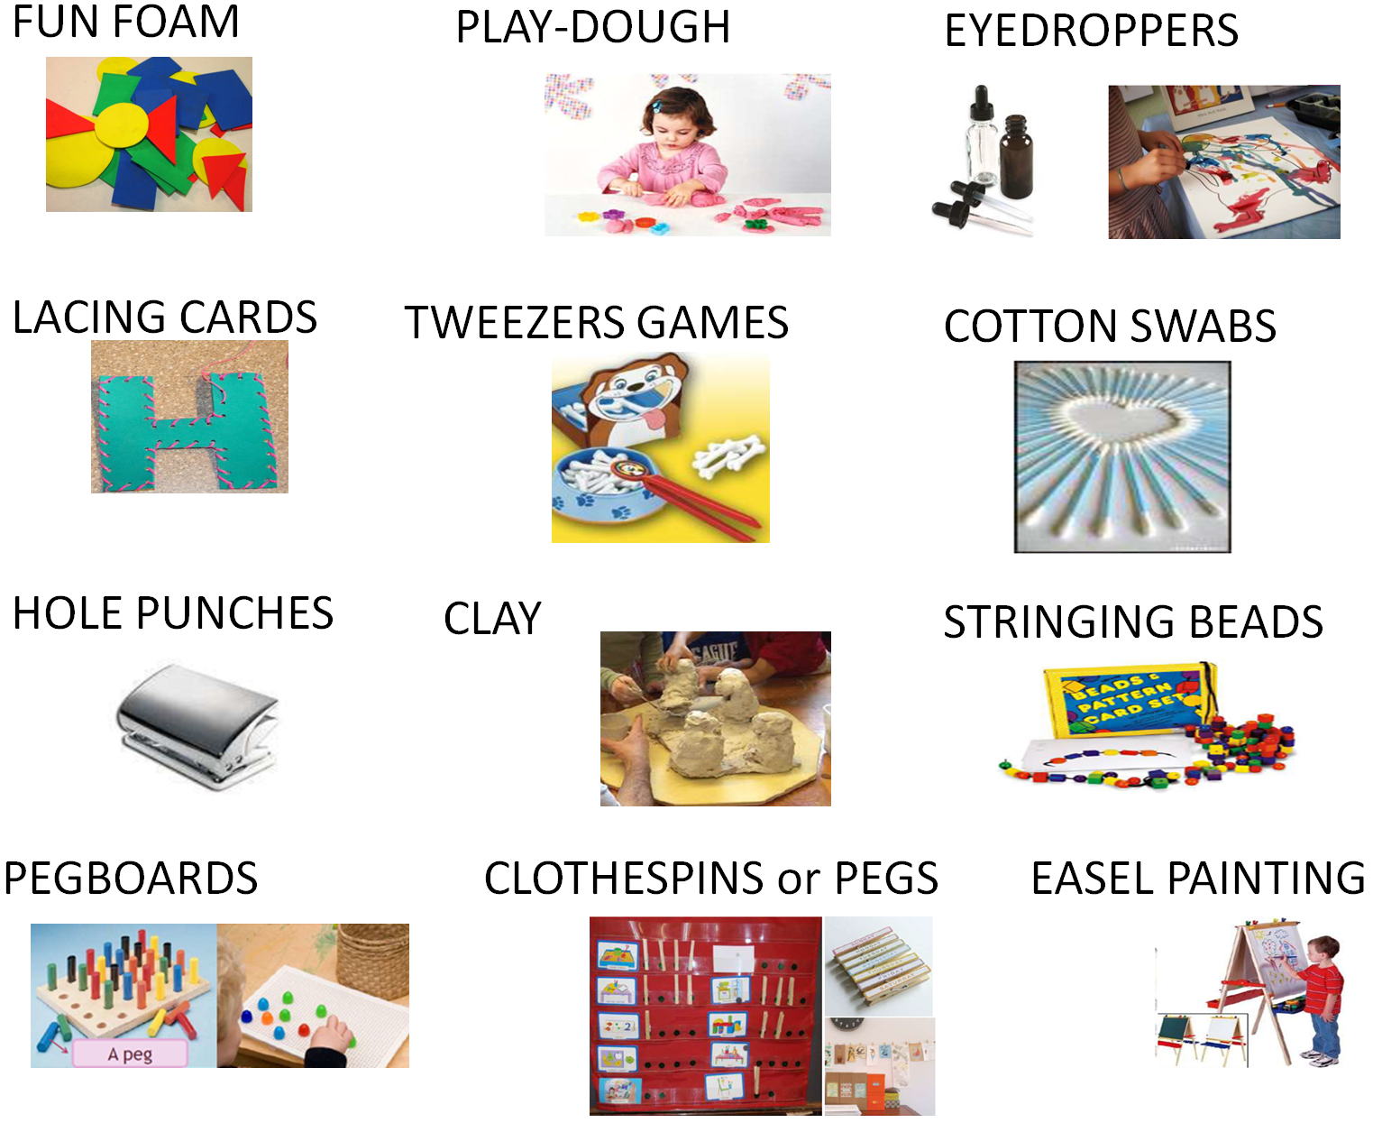

Slide 8
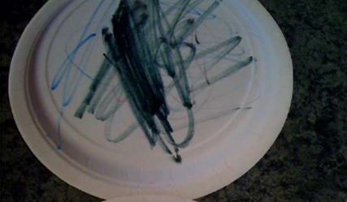
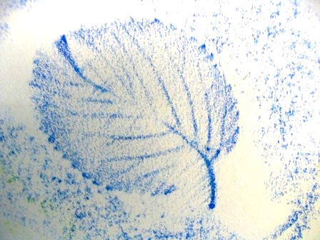
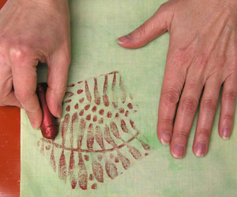
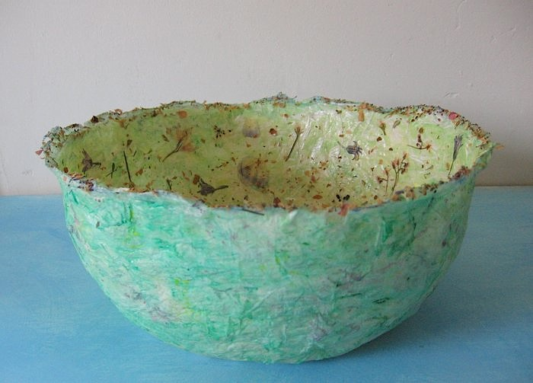
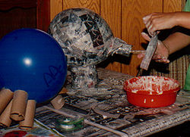
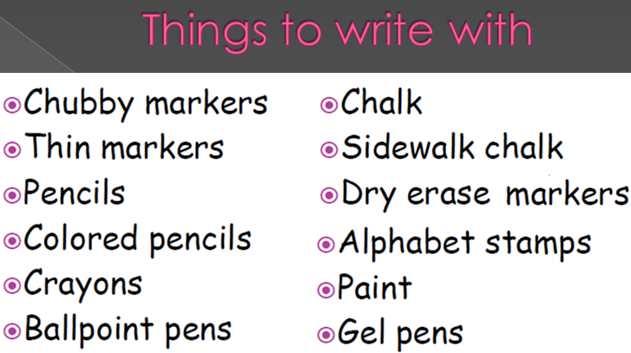
PAPER PLATES RUBBINGS
PAPER MACHE

Slide 9
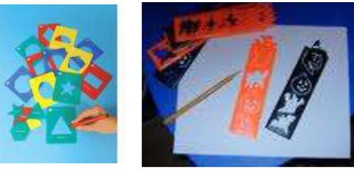
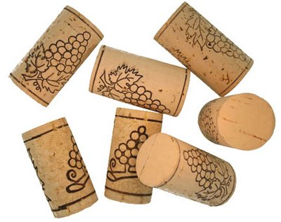
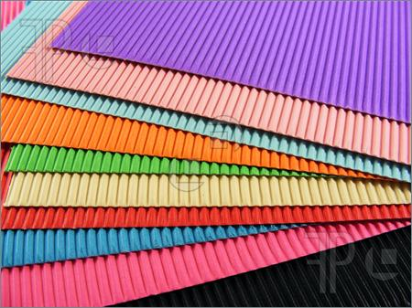
Accessories and tools
Marker stand
(Scotch) tape
Glue
Ruler
Stamps
Ink pad
Stencils
Yarn
Scissors
Paper, tissue paper, paper handkerchiefs
Cotton wool
Corks
Paper roll
Straw, string, elastic, sticks
Boxes, eggboxes
Silver kitchen foil
(Plastic) bottles, plastic cups, tins, yoghurt cups
Coloured cards, thin cardboard, corrugated card
Paper bags

Slide 10

Classroom language − art expressions
PROTECT your desk top with newspaper.
PREPARE your pencil, paintbrush, scissors.
POUR the water into the pot.
CUT the circle out of your sheet of paper.
FOLD the sheet of paper.
COLOUR the triangle red.
STICK
DRAW
PAINT

Slide 11
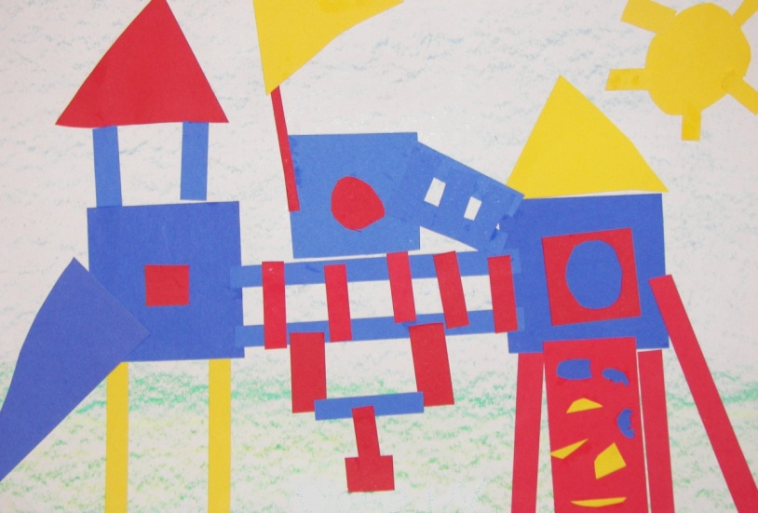
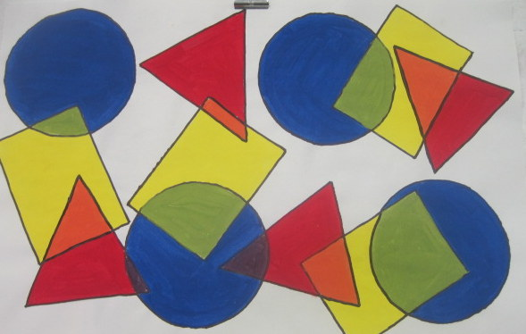
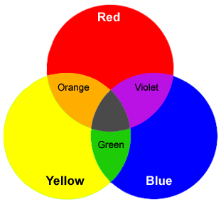
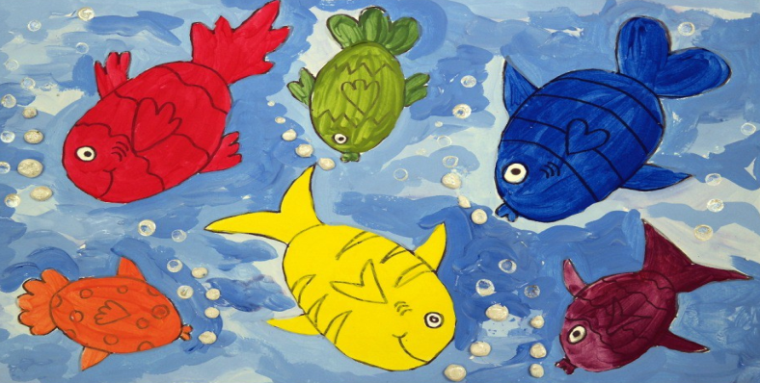
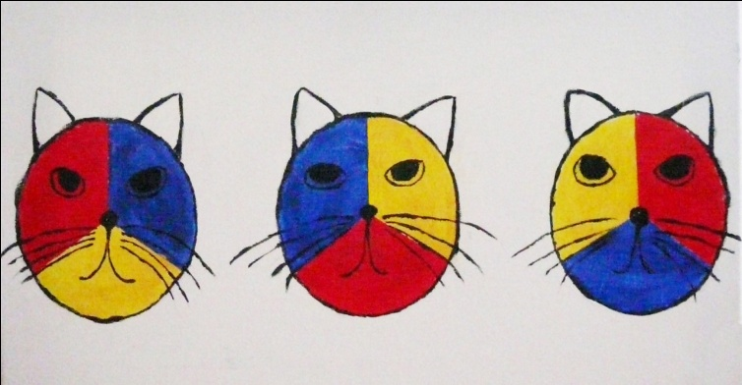
Primary and secondary colours

Slide 12
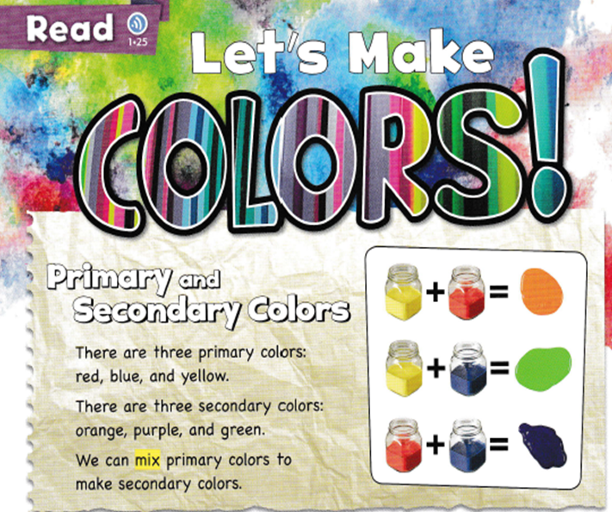
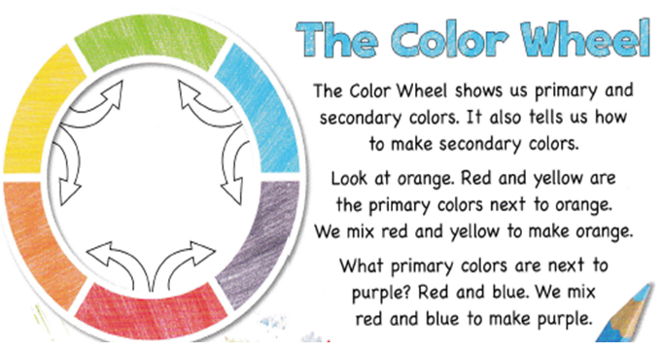

Slide 13





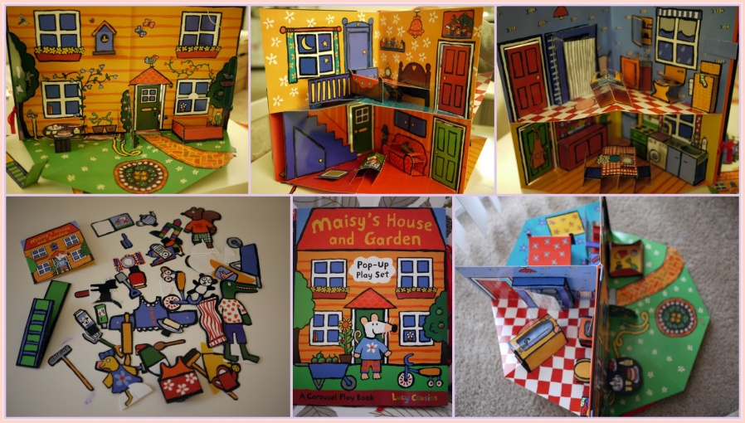
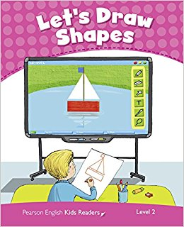
ART THROUGH STORIES
COLOURS
SHAPES AWARENESS OF SPACE AND INTERIOR DESIGN

Slide 14
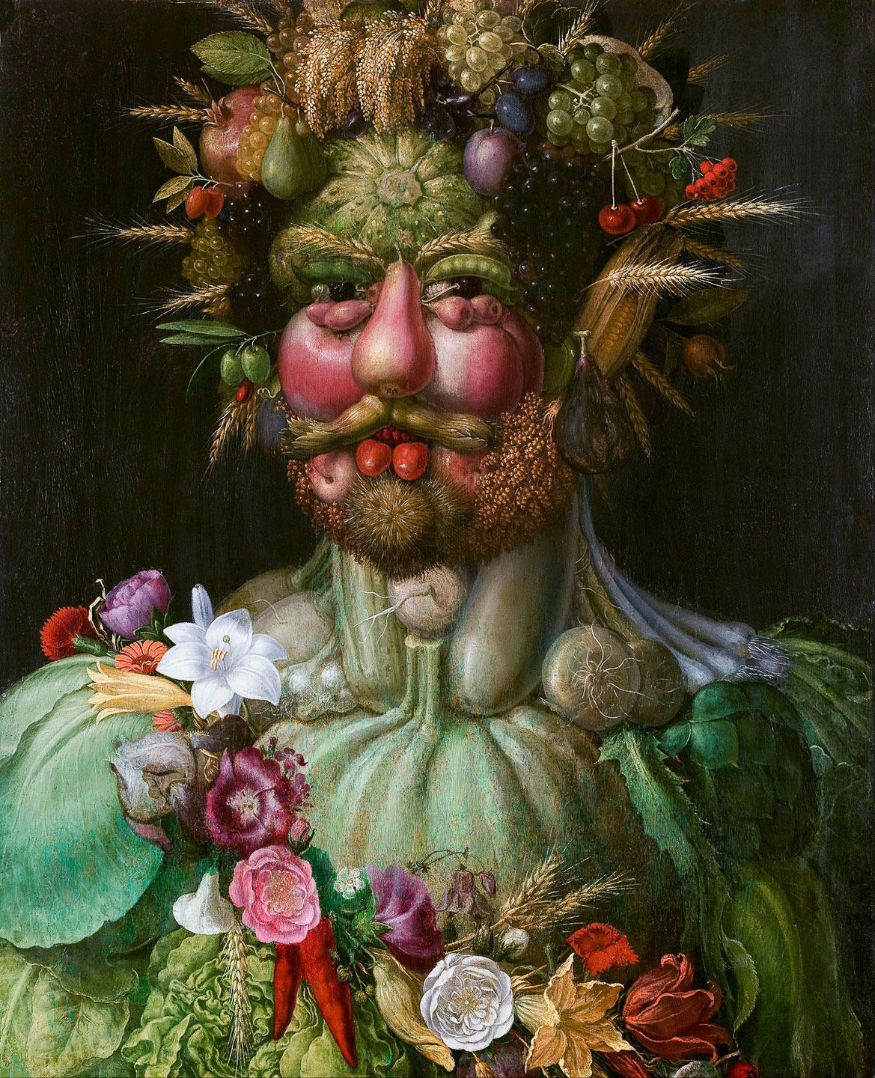
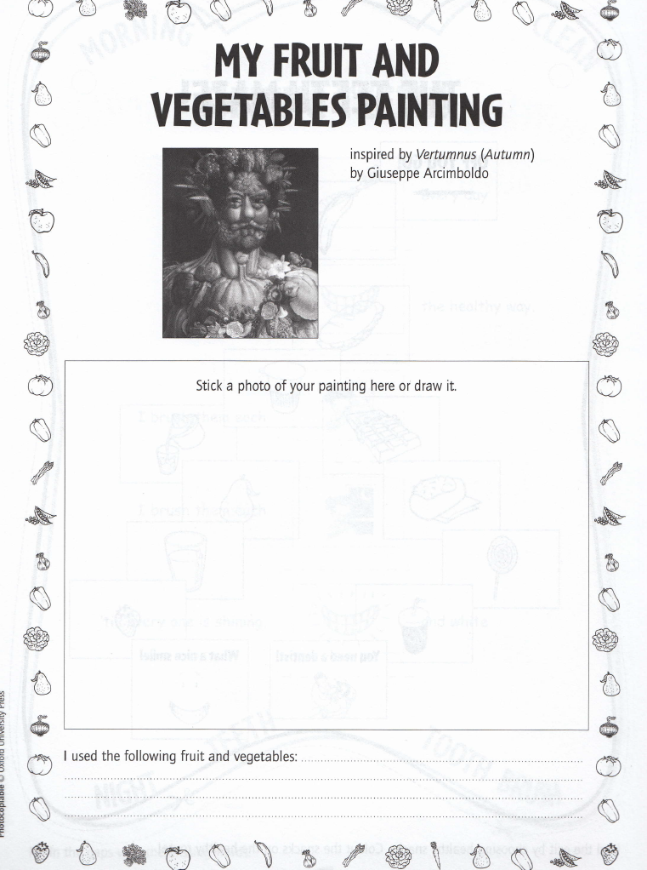
Art activities for children

Slide 15
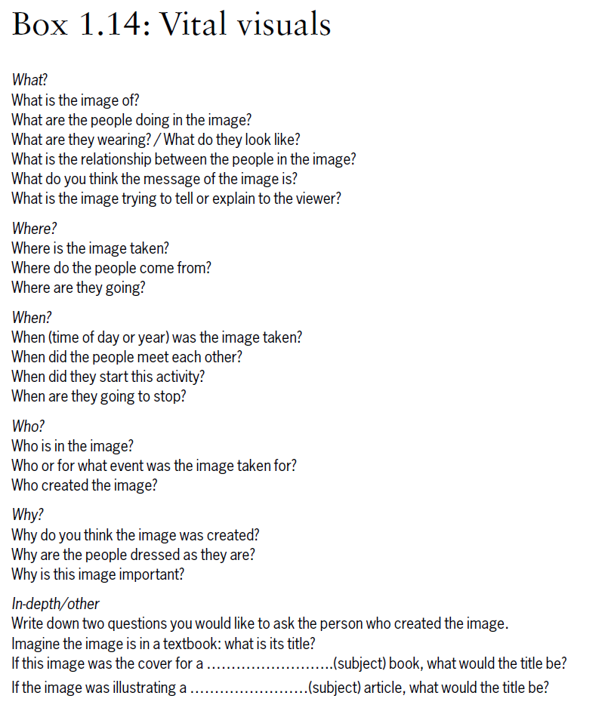
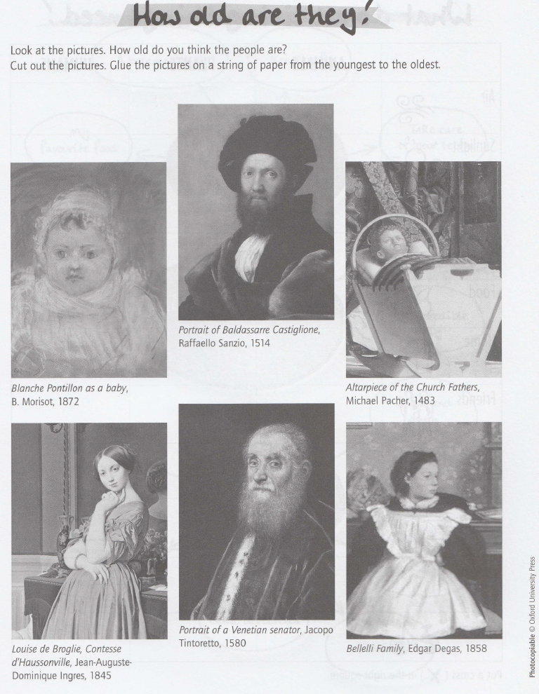
Art activities for children

Slide 16
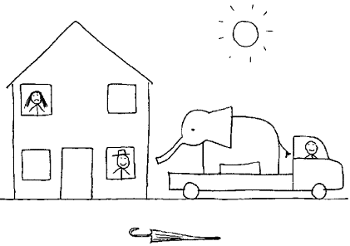
Drawing dictation
https://www.youtube.com/watch?v=vj4TLVuQ9aE

Slide 17
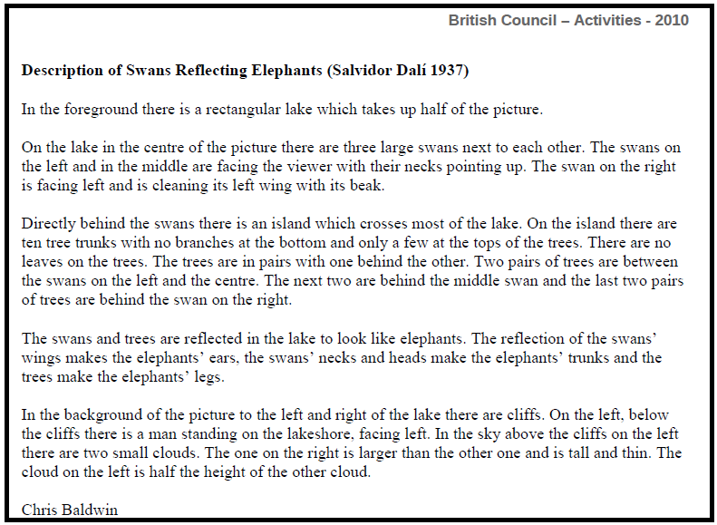
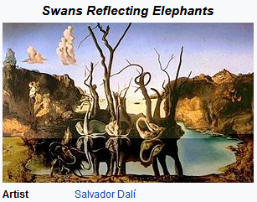
Painting dictation

Slide 18
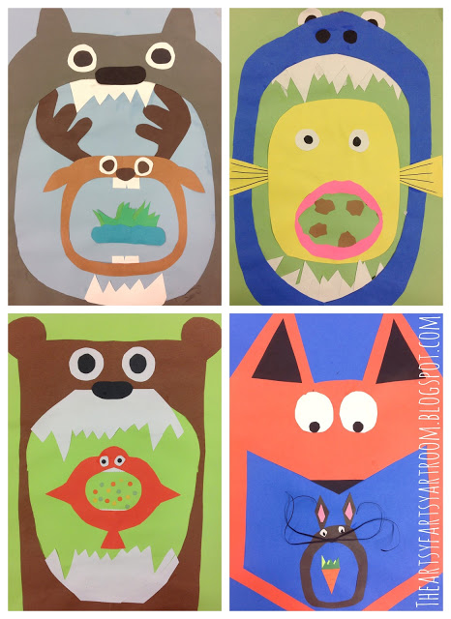
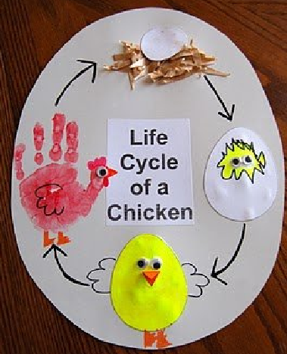
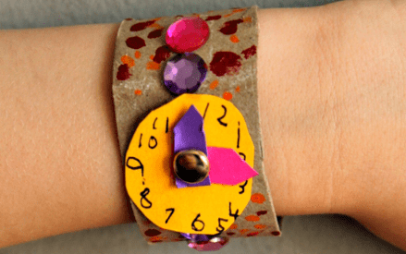
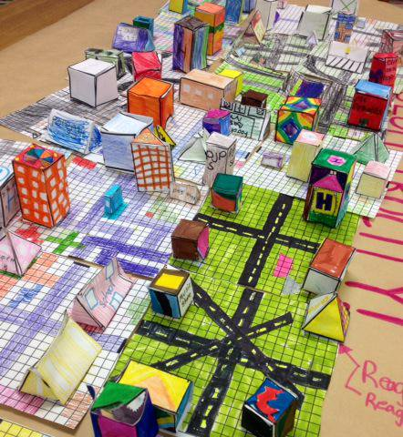
ART AND SCIENCE

Slide 19
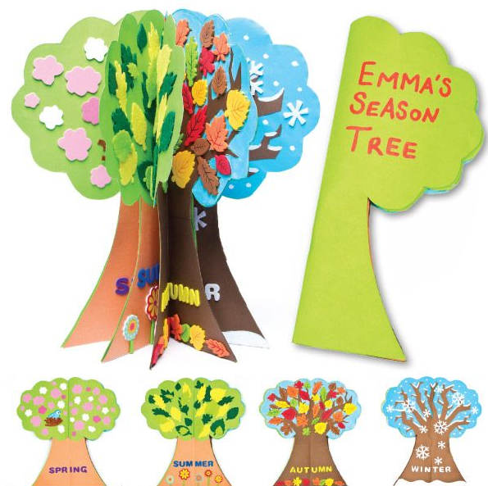
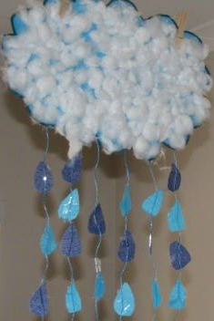
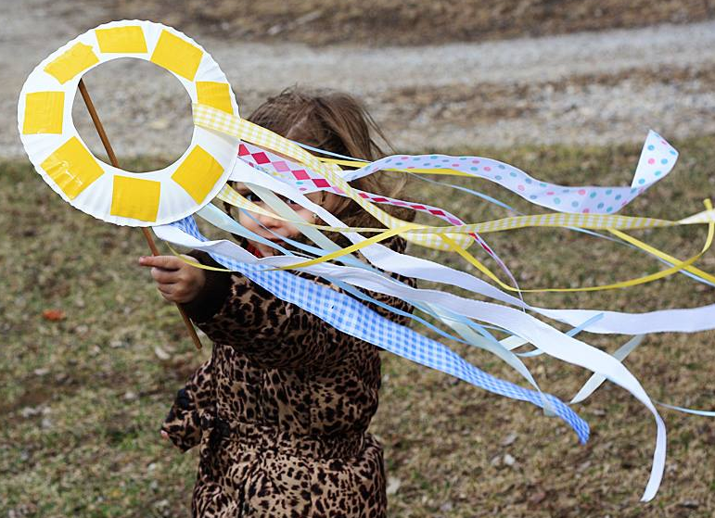
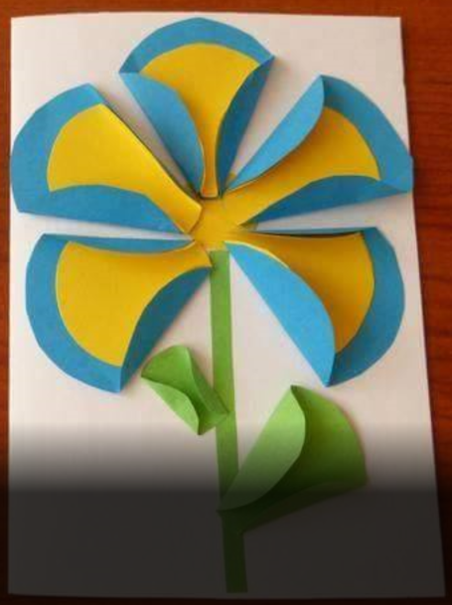
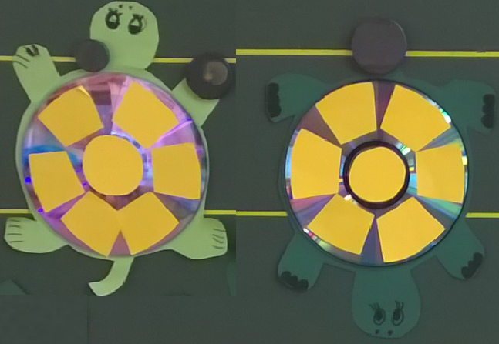
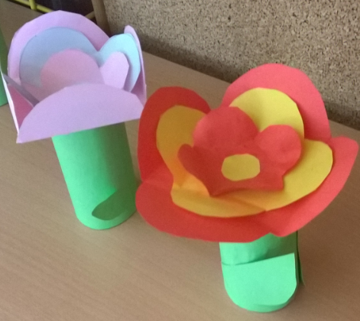
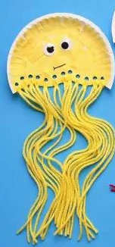
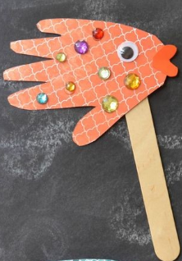
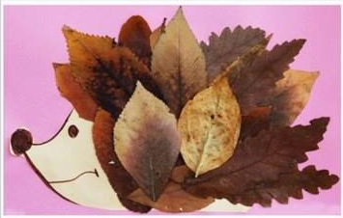
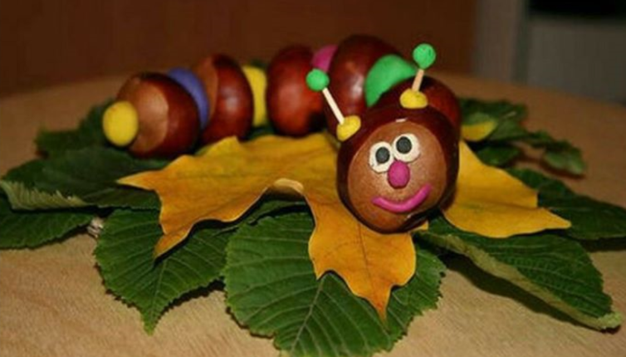

Slide 20
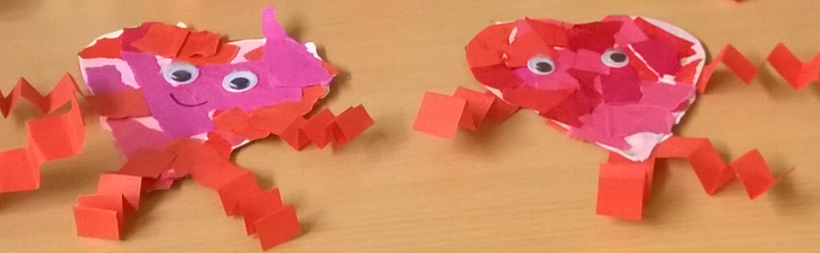














Slide 21








ART AND MATHS

Slide 22





ART AND P. E.

Slide 23




ART AND MUSIC
Group work: Fill in some art worksheets. When you finish check the solutions.
→ Aim: develop students’/teachers’ vocabulary

Slide 24



ART GAMES
Touch something brown/blue/green and red/white, black and purple ...
Drawing with eyes covered
Double Doodle Play

Slide 25





The Combination Man/Animal Drawing Game
Drawing/painting dictation
(for example: draw 2 cm long ...)
Draw with art dice and create your own picture/story

Slide 26







Lesson – example
Topic: Colours (revision)
Grade: 1st Subject: Art
Aims:
ART: They know different colours.
MAT: They recognize and continue patterns.
ŠPO: They perform locomotor movements (running, walking, jumping ...).
TJA: They understand the instructions/they recognize the main topic of the story/they use the vocabulary and phrases within discussed topics.
Vocabulary and phrases:
Vocabulary: colours (yellow, red, orange, green …), animals (bear, duck, cat, dog ...); ...
Phrases: What do you see? I see a ... What colour is it? It‘s … What comes next?
Lesson structure:
1. Questions (what’s your name/what’s the weather like today/do you like rabbits ...?)
2. Movements (swim, touch your toes, turn around, jump and count to 9, run to the door, touch three chairs ...)
3. Revision: Colours
I say, you say
Touch something red, yellow; green and pink
Colour scavenger hunt (in groups)
Story: Brown bear, brown bear, what do you see? (video) https://www.youtube.com/watch?v=WST-B8zQleM&t=2s
  Questions about the story: What do you see/What colour is it/How many do you see/What comes next…?
  Ordering pictures of animals/Matching animals and colours (I see a brown bear)
  Changing the story (different animals and colours)
4. Group work:
Kaboom
Patterns (link blocks)
Colourful cups tower challenge
Get your colours
5. What have I learned today? Pom Pom pick up with tweezers (fine motor skills)

Slide 27
Give short and simple instructions, give examples, use gestures and movements.
Pupils are not able to read the instructions. You need to explain them.
Giving instructions – exercise
In groups choose a game.
Read the instructions.
Pretend you are a teacher and give other students (pupils) the instructions. Explain them with movements, gestures, examples. Give short and simple instructions.

Slide 28

Art activities for children:
Activity: Making a fortune teller
Make a square from paper.
Fold the two opposite ends of the triangle together, forming a smaller triangle.
Open the paper up (unfolding all the folds).
Fold a corner into the central point. Repeat with the opposite corner. Repeat with the other 2 corners. You'll end up with a square.
Flip the paper over. Fold a corner over to the center. Repeat with the opposite corner.
Fold over the 2 remaining corners. You'll end up with a smaller square.
Fold the square in half. Unfold and fold in half the other way.
Unfold and pull the four ends together, making a diamond-like shape. Pick up each of the four square flaps, and put your fingers inside. You will be able to move the four parts around.

Slide 29



Art and crafts activities − instructions
Work in 6 groups.
Write step-by-step instructions for making something out of paper (e.g. a frog, a windmill, a flower…).
The instructions should be short and simple.
Afterwards, you will present your work (demonstrate).

Slide 30

Art and crafts activities - making pop-up books
Work in 6 groups.
Choose a story.
You can write your own story.
Make a pop-up book.
Afterwards, you will present your work (read the chosen story).

Slide 31





Art and crafts activities - making didactic games
Work in 6 groups.
Choose a school subject and a topic.
Make a didactic game.
Define a school subject, a topic and aims (taken from Slovene curriculum − SPO; MAT; GUM; LUM; ŠPO+ Language curriculum), describe your game, add a photo of the game.

Slide 32

PLANNING LESSONS
Work in 5 groups.
Choose a story book and read it.
Define a grade, a school subject, a topic and aims (LUM+ Language curriculum).
Define language laoding (structures, vocabulary, classroom language) → language of/for/through learning.
Design 5 activities (pre-/while-/post-). Write descriptions of activities.
PRESENTATION
Afterwards, you will present your work:
read or tell the story to us;
define a grade, a school subject, a topic and aims;
define language loading;
describe 5 activities.

Slide 33


Slide 34


Slide 35


Slide 36


