Slide 1


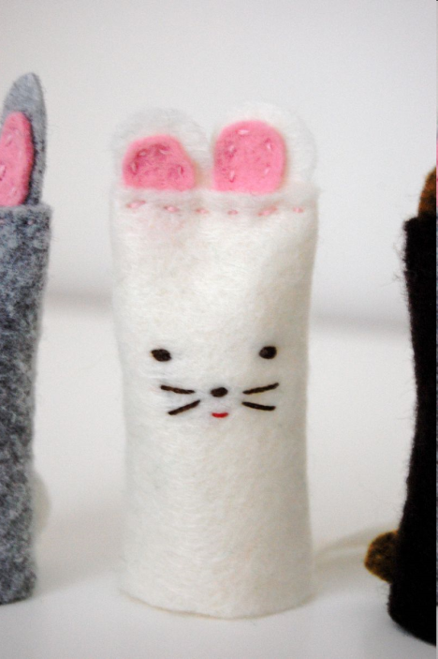
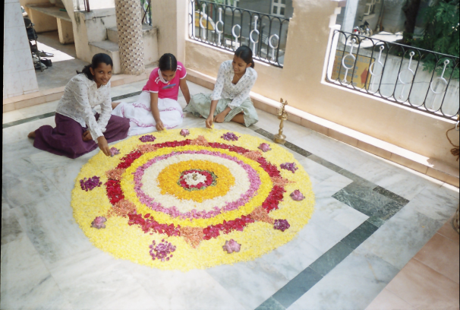
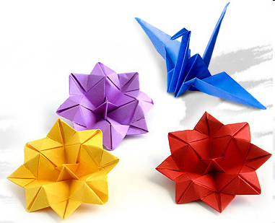
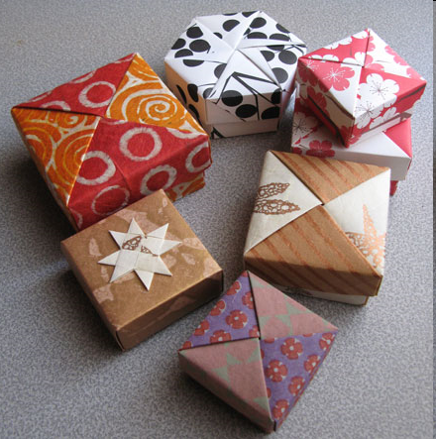
Instructions
for doing things
out of paper/clay ...
(art activities)

Slide 2
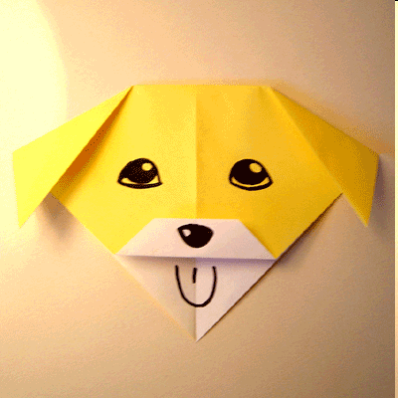
Origami Talking Dog
Start with your paper white side up.Fold in half then open.
Fold the top corner down to the bottom corner.
Fold the two top corners down to the points shown
Fold the uppermost layer of the bottom corner up a little way
Fold this layer up again, from the top of the triangle as shown
Instructions
http://www.origami-fun.com/origami-talking-dog.html

Slide 3
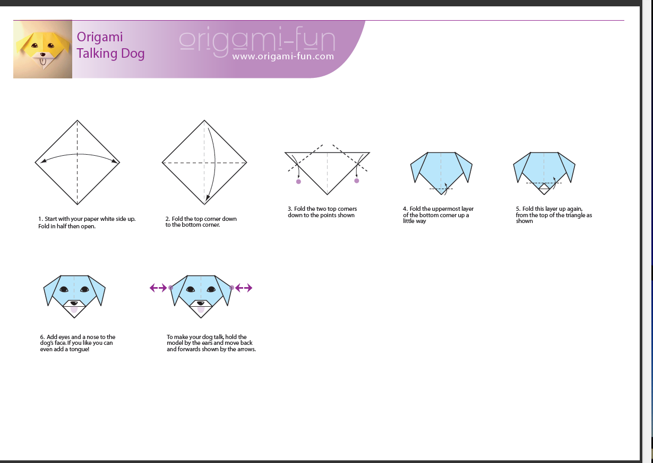
6. Add eyes and a nose to the dog’s face. If you like you can even add a tongue!
To make
your dog talk,
hold the model
by the ears
and move back
and forwards
shown by the
arrows.

Slide 4
Classroom language
PROTECT your desk top with newspaper.
PREPARE your pencil, paintbrush, scissors.
POUR the water into the pot.
CUT the circle out of your sheet of paper.
FOLD the sheet of paper.
COLOUR the triangle red.
STICK

Slide 5

Art expressions
MATERIALS
clay, plaster, paint, ink, paper,palette, colours, pastel (barvna kreda), charcoal (oglje), drawing paper, newspaper
REQUISITES
pencil, crayon, cartridge, paint box (vodene barvice), scissors, paper clip, acrylic paints, paint brush, glue, rolling pin
VERBS
paste up
cut out
fold
draw
paint

Slide 6
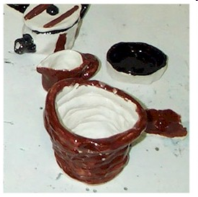
Working With Clay:
PINCH - Use your fingers to pinch and poke a single lump of clay into any shape.
SLAB - Roll the clay into flat sheets (like a pie crust) to cut apart and assemble.
COIL - Roll out long snakes of clay and twist them into coils and shapes.
WHEEL - Spin clay on a potter's wheel to form pots and vases.
Some Tools to Use When Working with Clay:
Your fingers
Rolling pins and canvas
Popsicle sticks and toothpicks
Cookie cutters
Plastic bags
A clay cutter (wire)
Sponges
Various carving tools, nuts and bolts, old toothbrushes and anything else you can get your hands on that will create texture in the clay
Kiln: This is a large, hot oven that is used to fire the clay
Glaze: This is used to decorate clay that will hold liquid.

Slide 7
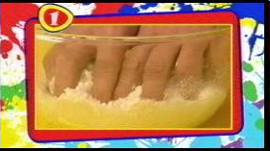
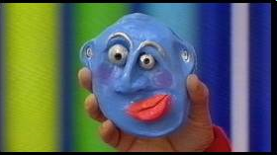
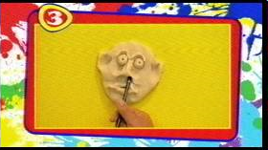
Dough faces
You'll need two cups of plain flour, one cup of salt and one cup of water to make it. Start by pouring these ingredients into a bowl.
Use your hands to knead the mixture together. This may take a little while.
Start to mould the face by poking two holes where the eyes should be, and one for the mouth.
Mould and sculpt with your fingers to make crazy expressions and funny shapes.

Slide 8
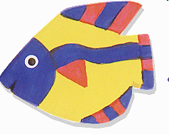
PAPERCLAY® FISH ORNAMENTS
Roll out the Paperclay® between two sheets of waxed paper or plastic from a sandwich bag with the rolling pin until it's 1/8" thick.
Place the fish patterns that have been drawn and cut out on top of the flattened Paperclay® and cut out Paperclay® fish with an knife or popsicle stick.
Smooth the rough edges with a wet finger or a paint brush and a drop of water.
Push a paper clip into the top of the moist Paperclay® fish. This is so you can hang your fish later on.
Let the paperclay dry a day or so. You can speed up the process by putting it in an oven for about 30 minutes at 250 degrees, or by placing them in direct sunlight.
Paint as desired.
After the paint dries, spray with an 80% water, 20% glue solution. You could also use a spray varnish but the glue and water mix is far less toxic.
What You Need:
Creative Paperclay®
Acrylic Paints
Rolling Pin
Glue and Water Mixture in a spray bottle (80% water 20% glue)
Paper Clip
Scissors
Sequins or other small found objects

Slide 9
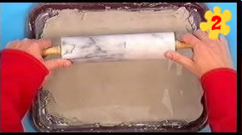
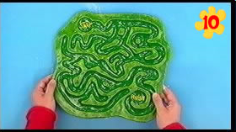
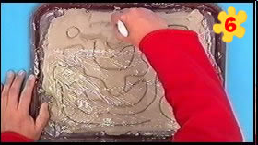
CLAY (Pencil, Cling film, bead, plastic spoon, paint)
Take a big ball and roll it out flat onto an old tray or board.
Take a pencil or paintbrush, and use the end to draw the design into the clay.
Next dig out the paths using the handle of a plastic spoon.
Leave your maze to dry and harden.
When dry, you can paint it.

Slide 10
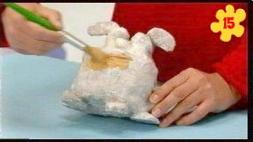
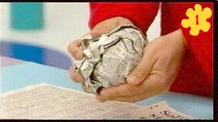
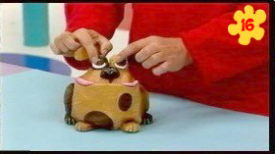
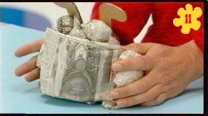
ANGRY GUARD DOG OF PAPER

Slide 11
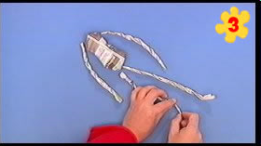
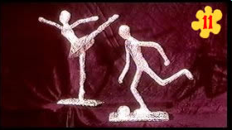
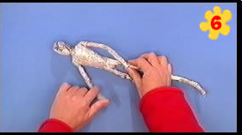
ALUMINIUM FIGURES
Start by scrunching up newspaper into a body shape.
Twist some strips of newspaper into arms and legs.
Bend the bottom of the legs to make feet.
Now that you have all the body parts made, tape them all together.
To create the effect of a priceless figurine, cover your creation in aluminium foil.
Put your sticky tape loops onto the back of your figurine's back, head, chest and so on, then simply cover with pieces of aluminium foil.

Slide 12
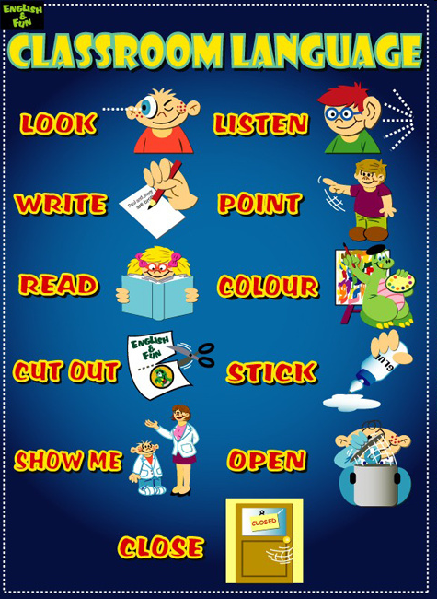

Slide 13
http://www.finchpark.com/courses/links/classroom.htm
http://www.cambridge.org/us/ESL/letstalk/support/language.htm

