Slide 1


Project SMILE too
Social Skills Make Inclusive Life Easier

Slide 2
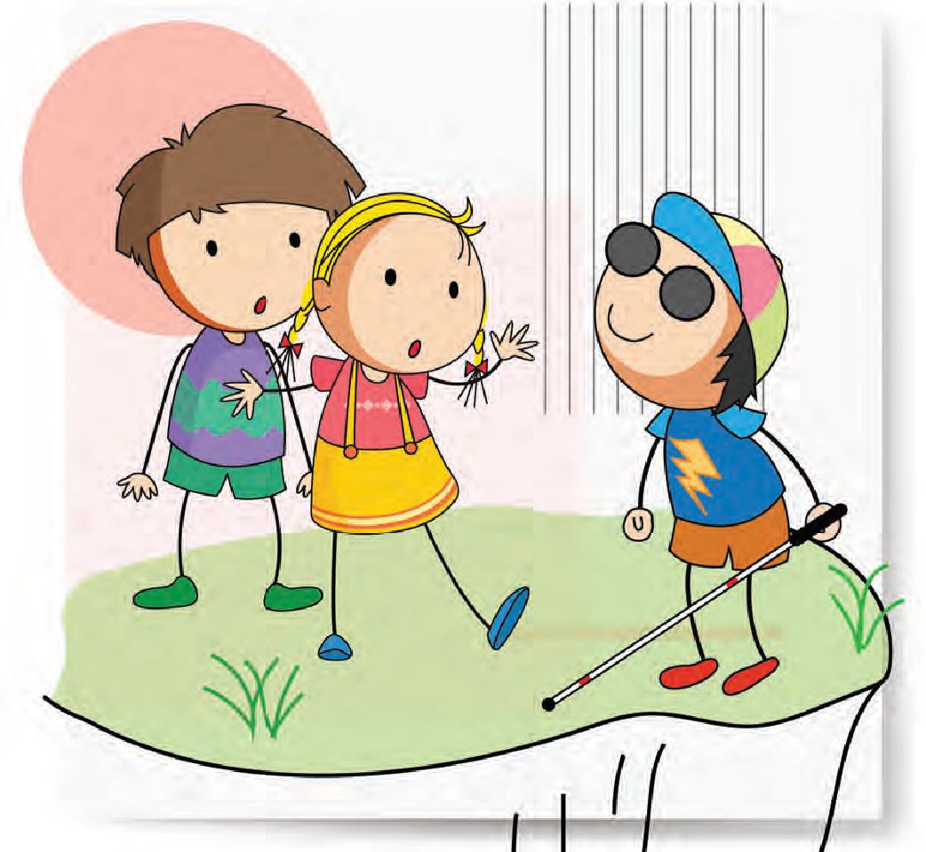
Who I am – Sight Description

Slide 3
Let´s talk about….
Knowledge of the unique visual impairment and its implications.
How modifications help.
The importance of sharing this information
Sight is not linked to your ability

Slide 4

Reflect
Do you talk about your child’s vision?
How much is understood?
Should they be able to explain it?
Do you think your attitude towards your child’s visual impairment affects your child’s self-interpretation?

Slide 5
Possible causes
Terminology
Talking to the individual
Acceptance/Guilt

Slide 6
Consequences
Placing themselves at a disadvantage
Low expectations
Stereotypes
Communication difficulties
Adaptive behaviour
Low motivation/self-esteem

Slide 7
How to support…
Empowerment
Self-advocacy
Understand why adaptations are made
Understand terminology
Awareness sessions for peers
Explain to family/peers
Have access to VI Role models

Slide 8
Video

Slide 9
Other tips
Simulation glasses activity
Be positive
Get involved with support groups

Slide 10
Thank you

Slide 11


"The European Commission's support for the production of this publication does not constitute an endorsement of the contents, which reflect the views only of the authors, and the Commission cannot be held responsible for any use which may be made of the information contained therein."

