Slide 1


Project SMILE too
Social Skills Make Inclusive Life Easier

Slide 2
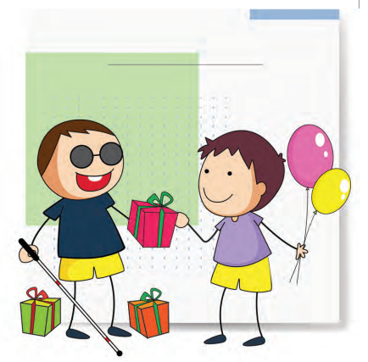
What is my social network
Family

Slide 3
Let´s talk about….
Family
Support groups

Slide 4
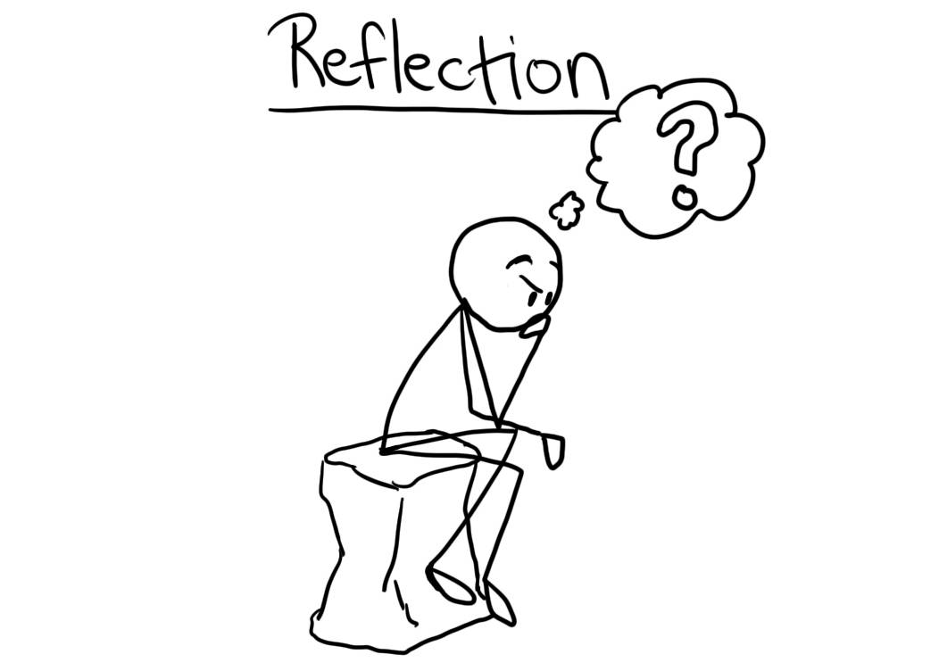
Reflect
How do you support relationships between your children?
How do siblings express their feelings about their brother/sister with a VI?
Do you talk about visual impairment in your family circle?
How often do you engage in social events? Family/Friends
Do you meet other people/ families (with children without a visual impairment)
Do you attend any support group events for children with a VI? Are you satisfied with the support?

Slide 5
Possible causes
Emotions
Over protection
Social Stigma
Opportunities

Slide 6
Consequences
Low self-esteem
Social isolation
Depression
Limited opportunities

Slide 7
How to support…
Do normal things – park, pool
Play adapted games to promote turntaking
Be inclusive – audio describe/ model
Encourage friendships with family/ VI/ non VI
Nurture interests and talents – individual and siblings
Develop a rich social life
Engage with support groups/ specialists
Attend summer schemes

Slide 8
Video

Slide 9
Other tips

Slide 10
Thank you

Slide 11


"The European Commission's support for the production of this publication does not constitute an endorsement of the contents, which reflect the views only of the authors, and the Commission cannot be held responsible for any use which may be made of the information contained therein."

