Slide 1
Halloween
ACTIVITIES FOR CHILDREN

Slide 2
Group work
Think of 5 Halloween activities.
What language expressions would you teach the children regarding Halloween (and their age)?
Which skills would you practise and how?

Slide 3
Vocabulary
carve pumpkins
wear costumes
go trick or treating
play pranks on others (soaping car windows, tipping over garbage cans)
eat sweets
have fun …
http://www.tolearnenglish.com/free/halloween.php (words presentation)

Slide 4
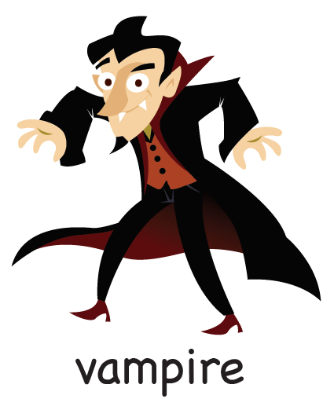

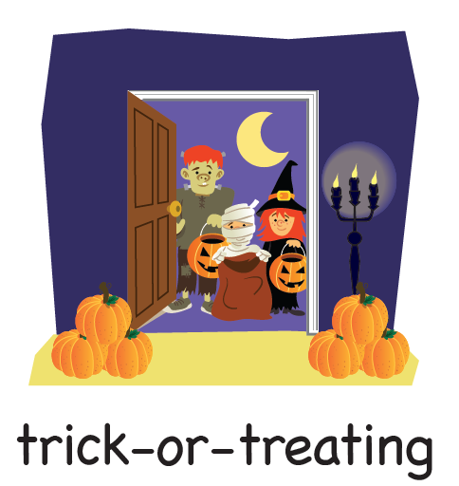
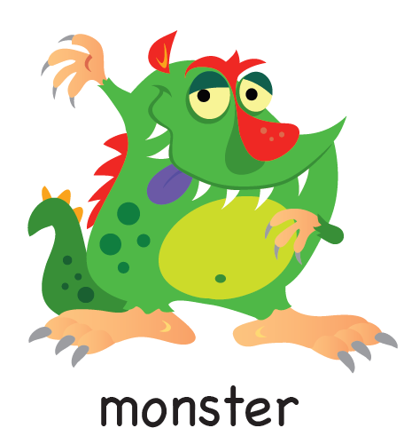

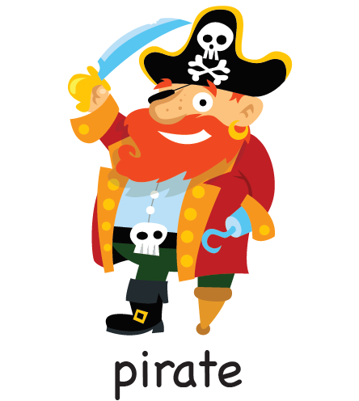
Card games

Slide 5
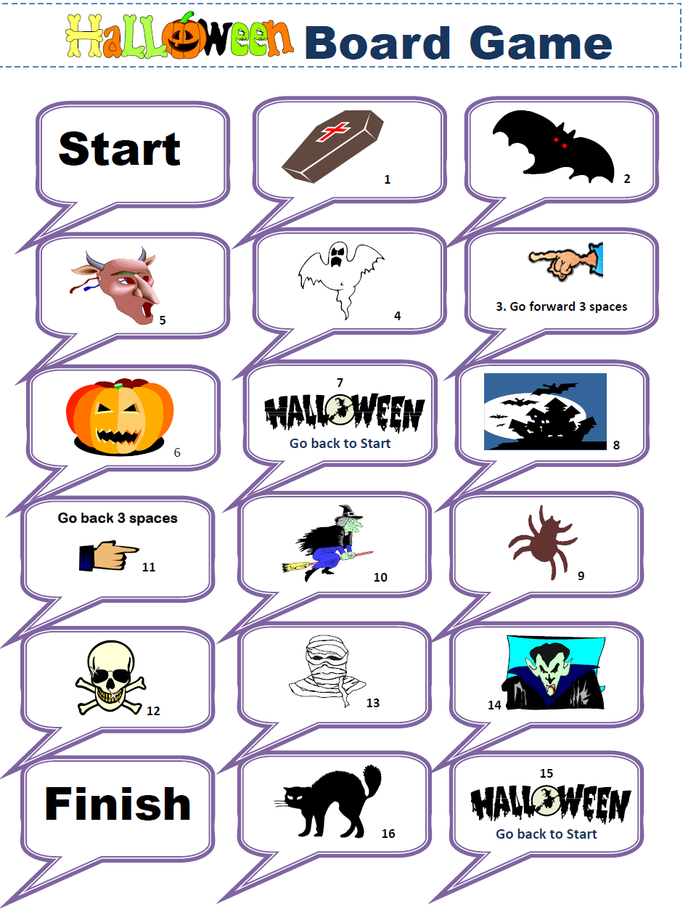
Halloween boardgame

Slide 6
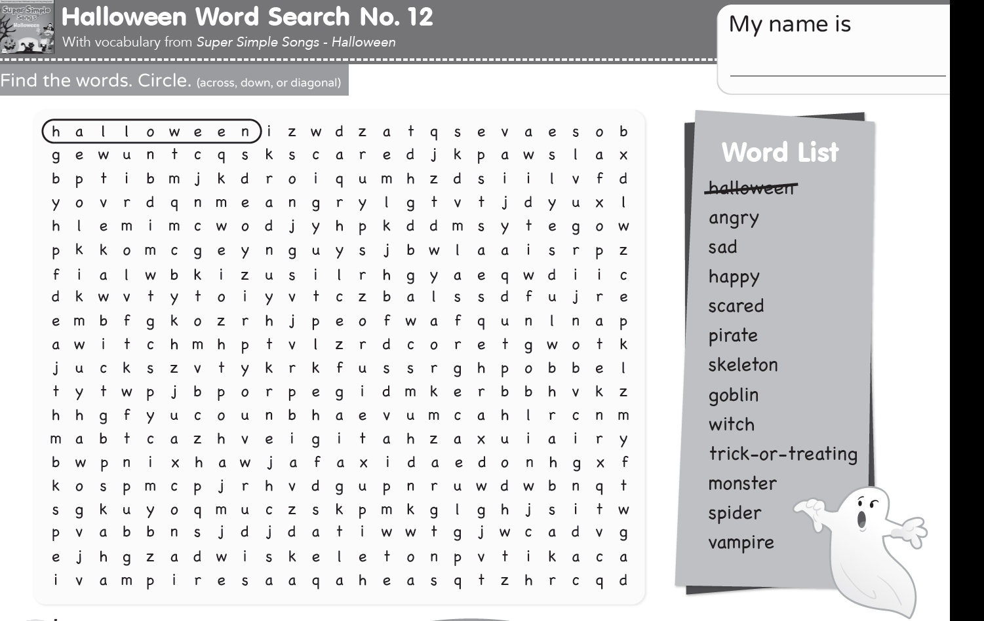
http://supersimplelearning.com/resource-center/halloween-word-search-11/

Slide 7
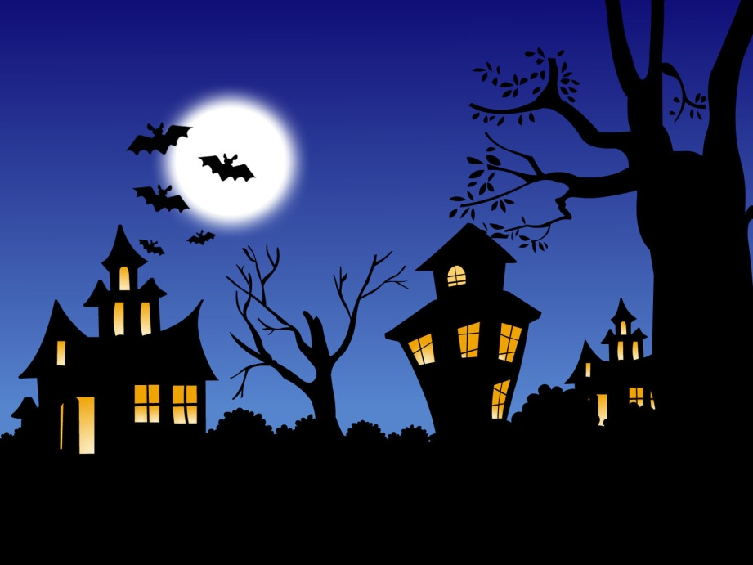
Halloween in the US - video
http://www.esolcourses.com/content/topics/autumn-festivals/halloween/halloween-in-the-usa-listening.html

Slide 8

Make up your own scary story
https://learnenglishkids.britishcouncil.org/games/story-maker-1

Slide 9
Match the Halloween jokes
Questions: | Answers:
What would you find on a haunted beach? | ...Napoleon bone-apart!
What kind of makeup do ghosts wear? | ...I Scream!
Who was the most famous French skeleton? | ...Dead ends!
What's it like to be kissed by a vampire? | ...A sand witch!
What do ghosts serve for dessert? | ...To improve his bite!
What kind of streets do zombies like the best? | ..."How do you boo, sir?"
What should you say when you meet a ghost? | Mas-scare-a!
Why did the vampire go to the orthodontist? | ...It's a pain in the neck!

Slide 10
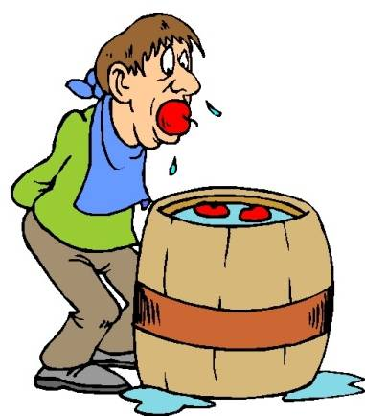
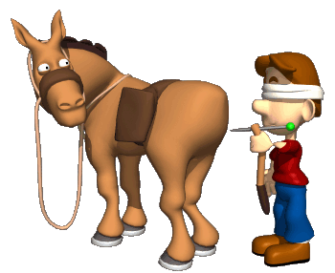
traditional gameS
Bobbing for apples is thought to have originated from the roman harvest festival that honors Pamona, the goddess of fruit trees.
Pin-the-tail-on-the-donkey

Slide 11

IN A DARK, DARK TOWN
In a dark, dark town,
There is a dark, dark road.
And in the dark, dark road
There is a dark, dark house.
And in the dark, dark house
There is a dark, dark door.
Go in the door.
There are some dark, dark stairs.
Go up and up and up
And up and up and up
The dark, dark stairs
Now...
There is a dark, dark room.
Go into the dark, dark room.
In the dark, dark room
There is a dark, dark cupboard.
Open the dark, dark cupboard.
What's in there?
http://learnenglishkids.britishcouncil.org/en/short-stories/dark-dark-wood

Slide 12
Tongue twister
If two witches were watching two watches, which witch would watch which watch?‘
Say it as fast as you can!

Slide 13
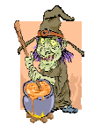

A Magic Spell
Two black cats
Three black bats
Four witches hats
Five white rats
Abracadabra tail of dog
You are turned into a FROG!
A CAULDRON
A MAGIC WAND
A MAGIC POTION

Slide 14

Your magic spell
Two…
Three…
Four…
Five…
Abracadabra..
You are turned into a…..

Slide 15
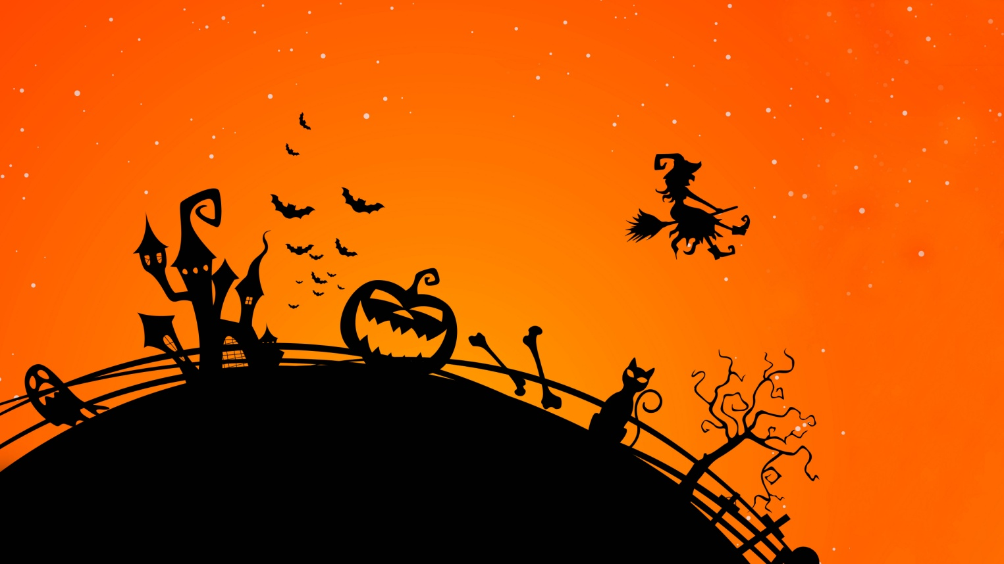
Halloween activities online
http://learnenglishkids.britishcouncil.org/en/category/topics/halloween

Slide 16
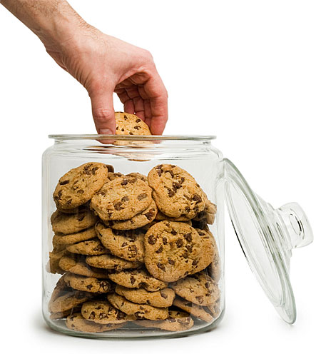
Who took the cookie?
1. All: Who took the cookie from the cookie jar?
[name/Halloween character] took the cookie from the cookie jar.
Child: Who me?
All: Yes, you.
Child: Not me.
All: Then who?
Child: [another child/another Halloween character]
2. All: Who took the cookie from the cookie jar?
[name/Halloween character] took the cookie from the cookie jar.
Child: Who me?
All: Yes, you.
Child: Not me.
All: Then who?
Child: [another child/another Halloween character] https://www.youtube.com/watch?v=N_hjFaITRB8

Slide 17
GO AWAY SCARY MONSTER
Go away scary monster…
Go away spooky vampire…
Go away scary witch…
Go away spooky ghost…
https://www.youtube.com/watch?v=Ec1cz_jHQM8

Slide 18
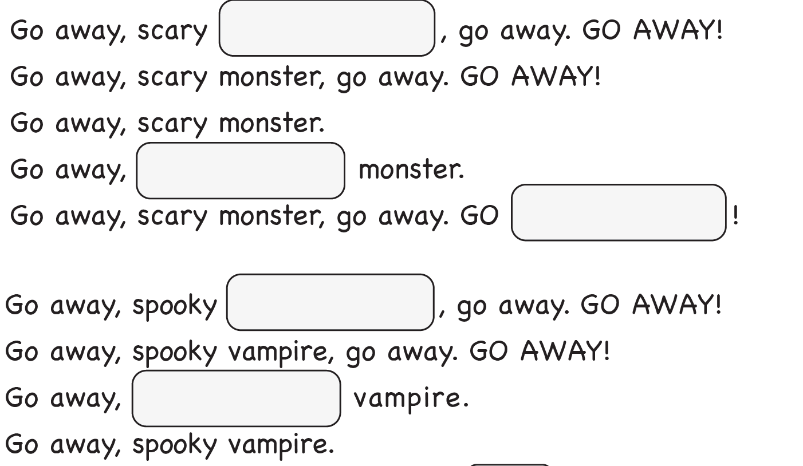
http://supersimplelearning.com/resource-center/go-away-worksheet-fill-in-the-blanks/

Slide 19
Knock knock trick or treat
https://www.youtube.com/watch?v=4jxcWlq3CBg
Knock knock
trick or treat?
Who are you?
I'm a ghost. I'm a little ghost.
Knock knock, trick or treat?
Who are you?
I'm a ghost. I'm a little ghost.
http://supersimplelearning.com/songs/themes-series/halloween/knock-knock-trick-or-treat/ (lyrics)

Slide 20
My Fairyland coursebook 1

Slide 21
If you’re a monster and you know it
If you’re a monster and you know it shake your head…
If you’re a monster and you know it blink your eyes…
If you’re a monster and you know it say ‘hello’…
If you’re a monster and you know it wiggle your nose…
If you’re a monster and you know it do the dance…
If you’re a monster and you know it kick your legs…
If you’re a monster and you know it go to sleep…
https://www.youtube.com/watch?v=Ti0N02OJv68

Slide 22
Your song: If you‘re …. and you know it
If you’re a … and you know it .…
If you’re a …. and you know it .…
If you’re a … and you know it …
If you’re a … and you know it …
If you’re a … and you know it …
If you’re a … and you know it …
If you’re a … and you know it …

Slide 23
Halloween stories
Winnie the witch
https://www.youtube.com/watch?v=NkwLOhFgXL0
Room on the broom
https://www.youtube.com/watch?v=A7CUCG6ijdE&list=PLHnIMMDvPyOOuwMv29H6AxCb01YDiJIhy
Jackie is ill (My Fairyland)

Slide 24
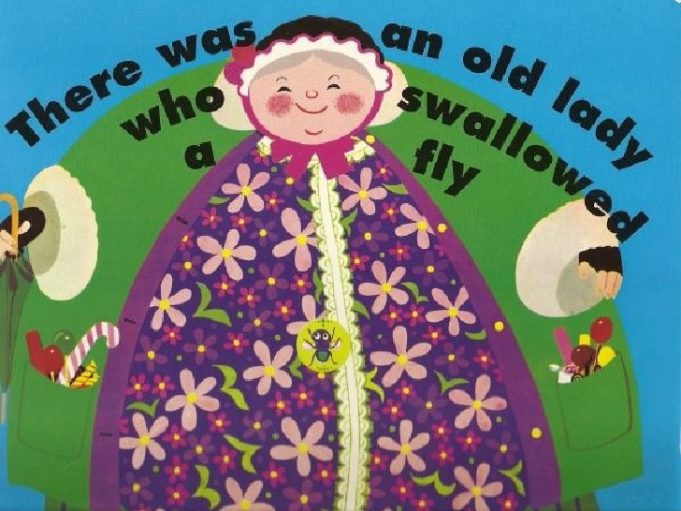
There was an old lady who swallowed a fly
https://www.youtube.com/watch?v=eXQPD6OcugY

Slide 25
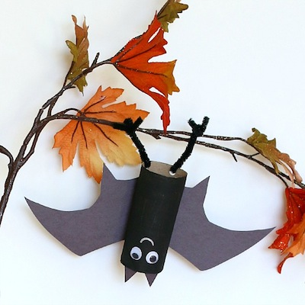
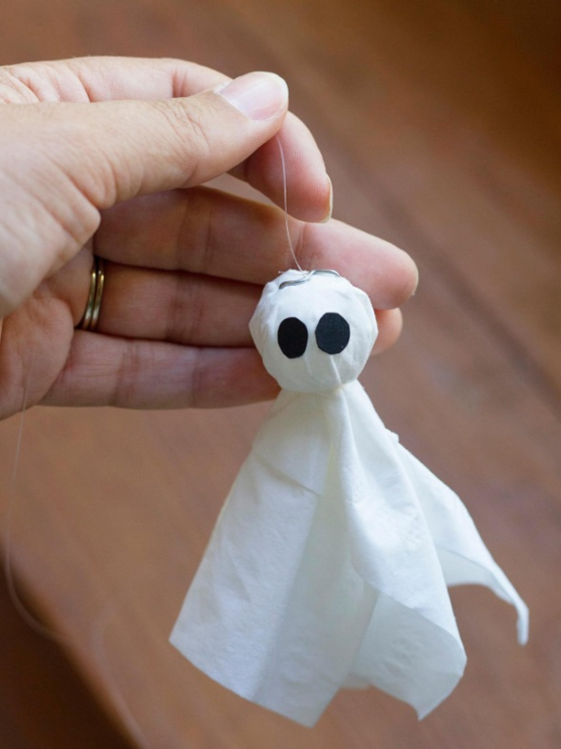
Art activities
Making a ghost from a tissue or a bat from a paper roll

Slide 26
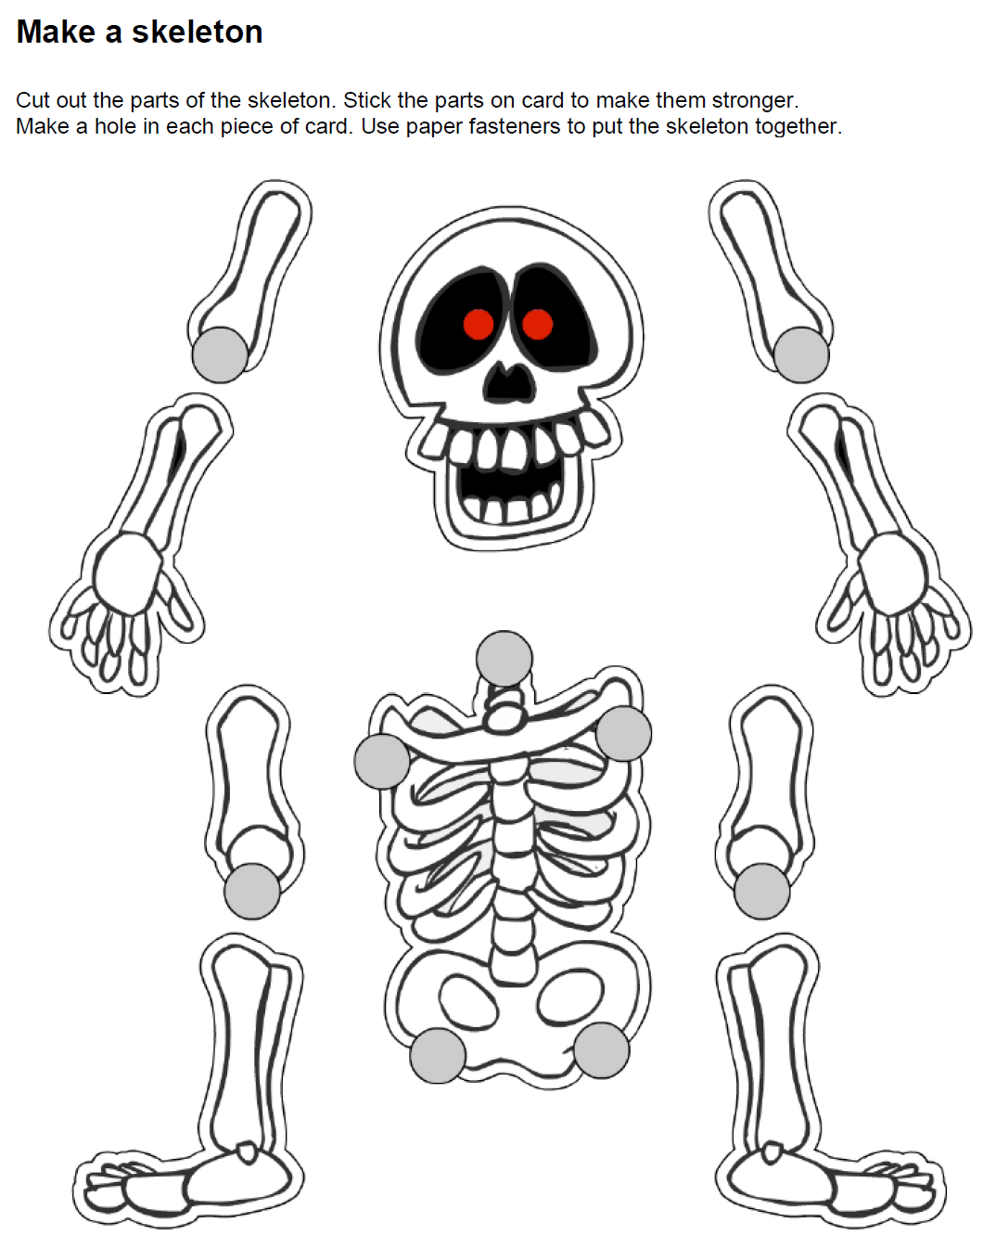
Make a skeleton

Slide 27
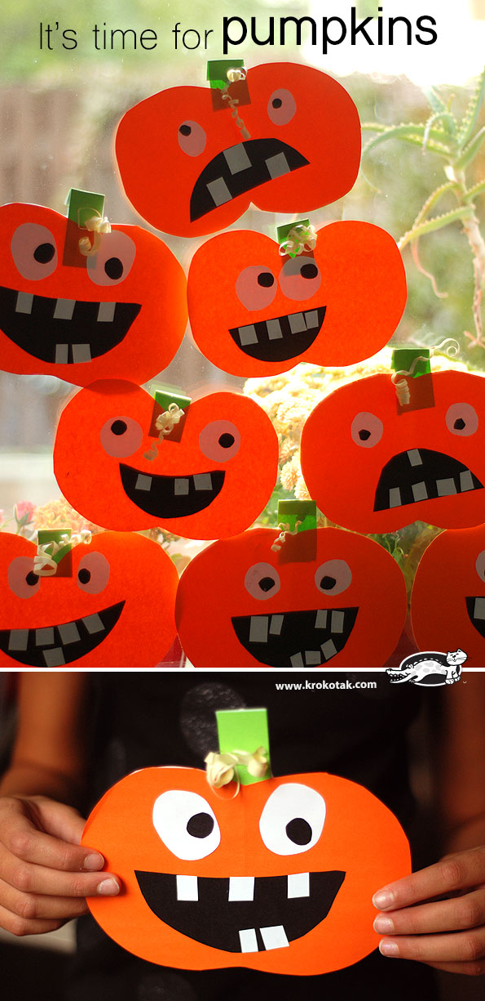
Making a pumpkin
http://krokotak.com/2015/10/itvs-time-for-pumpkins-cut-and-glue/

