Slide 1
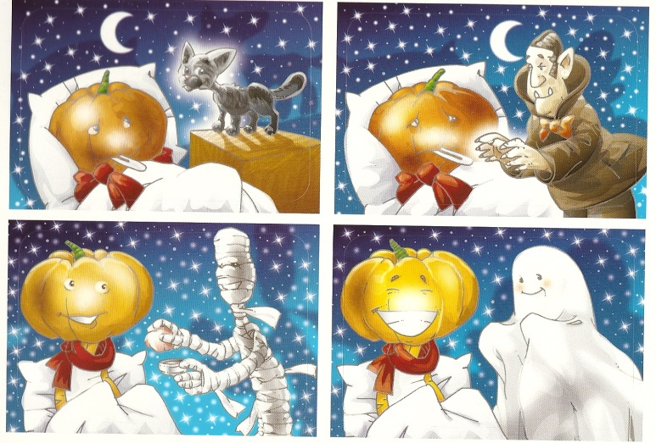
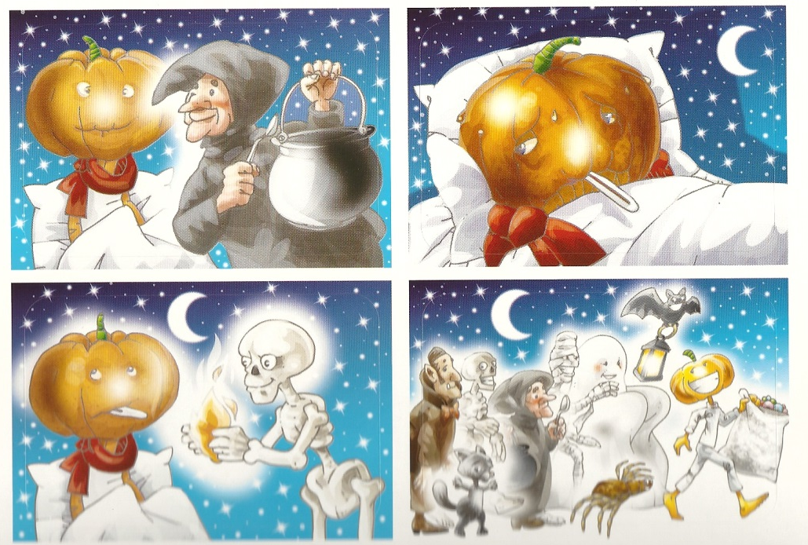
JACKIE IS ILL

Slide 2
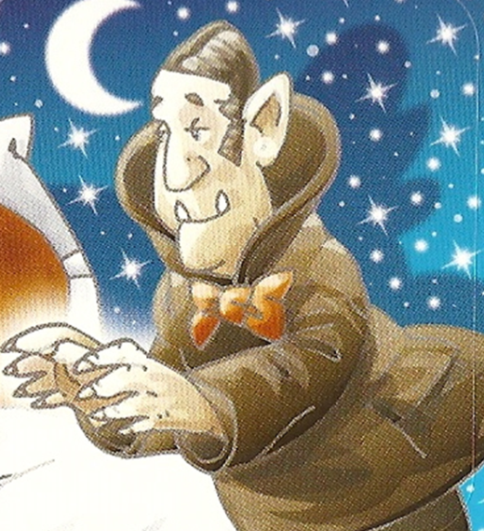
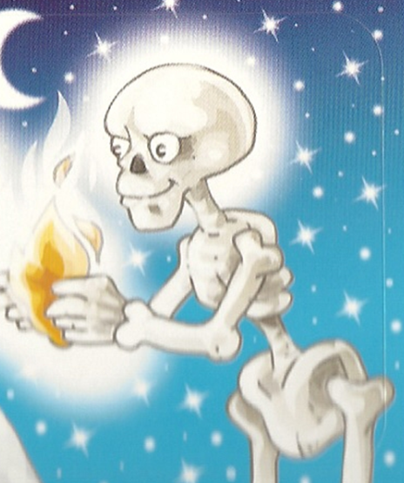
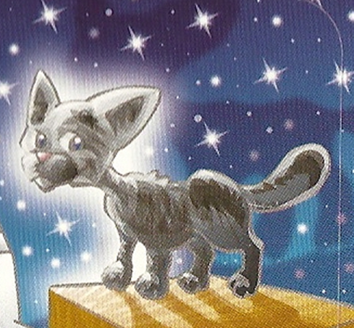
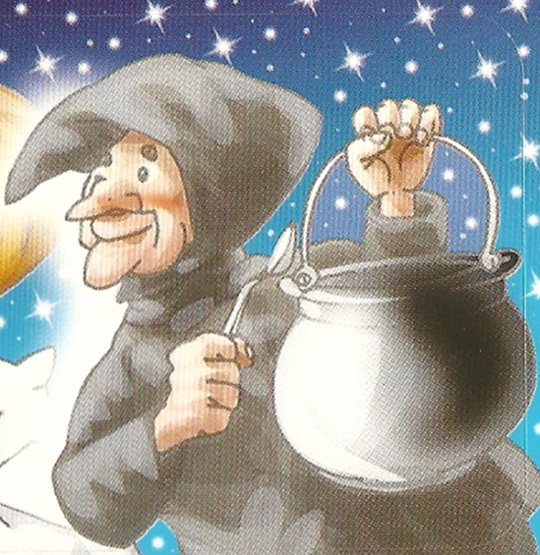
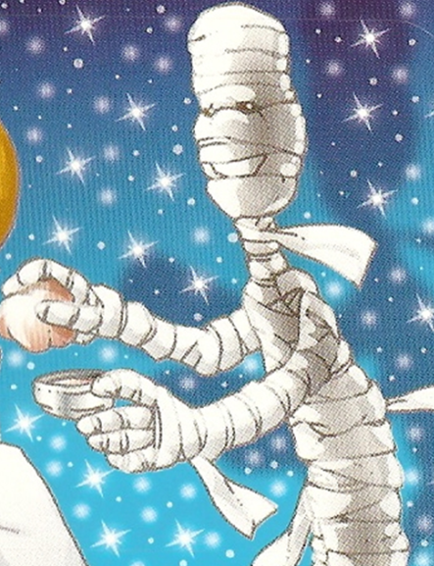
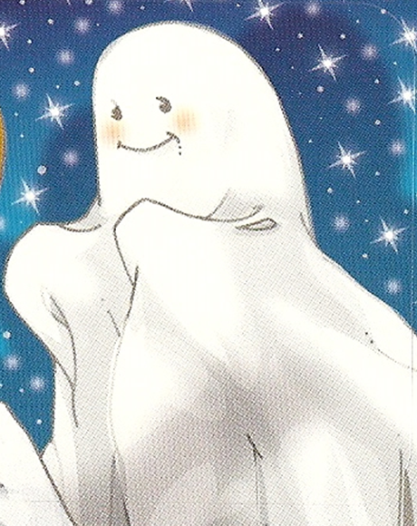
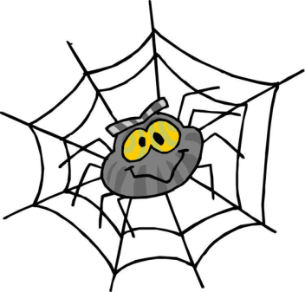

Slide 3

JACKIE, THE PUMPKIN WAS LYING IN THE BED.
SHE DIDN‘T FEEL WELL AND SHE WAS SAD AND LONELY.

Slide 4

THE VAMPIRE GAVE JACKIE A GENTLE KISS ON HER NECK.
„I HOPE THE MAGIC KISS WILL HELP YOU“.

Slide 5
THE BLACK CAT PATTED HER HEAD. JACKIE RELAXED AND HAD A SWEET DREAM.

Slide 6
SKELETON: „LET ME LIGHT THE FIRE FOR YOU.“
HE CLICKED HIS BONY FINGERS AND WARMED THE ROOM.
JACKIE WAS FEELING BETTER.

Slide 7
WITCH: „HERE YOU ARE, A DELICIOUS BROTH, MADE ESPECIALLY FOR YOU. ISN‘T IT NICE, SO GREEN AND FULL OF INSECTS AND MICE? THIS IS VERY HEALTHY FOOD.“
JACKIE TOOK THE SPOON AND TRIED THE FOOD AND SHE FELT GOOD.

Slide 8
MUMMY OPENED AN OLD BOX, FULL OF SMELLY CREAMS AND PUT THEM ON JACKIE‘S FACE.
„THIS IS A MAGIC BEAUTY MASK“
„THANK YOU MY FRIEND. NOW I LOOK REALLY NICE.“

Slide 9


SPIDER: „ALL YOU NEED NOW IS A MODERN HAIRSTYLE AND SOME MAKE UP. READY FOR PARTY“
NOW JACKIE WAS HEALTHY AND LOOKED GREAT.
SHE WAS ALOMOST READY TO GO OUT.

Slide 10
GHOST: „BOOO BOOO BOOO. MY DEAR JACKIE. YOU‘ RE SO BEAUTIFUL. I LOVE YOU.“

Slide 11
JACKIE AND HER FRIENDS WENT TRICK OR TREATING ALL NIGHT LONG.
IT WAS THE BEST HALLOWEEN OF HER WHOLE LIFE.

