Slide 1
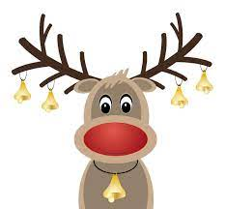
Rudolph the red-nosed reindeer

Slide 2
https://www.youtube.com/watch?v=1FuF7H0uJww

Slide 3
14, 12, 7, 2, 5, 4, 11, 15, 6, 16, 8, 3, 9, 1, 10, 13

