Slide 1
Gibraltar
This puts a whole new meaning to the saying,"Never run a red light !" Did you know Gibraltar 's Airport runway and vehicular traffic use the same intersections..

Slide 2
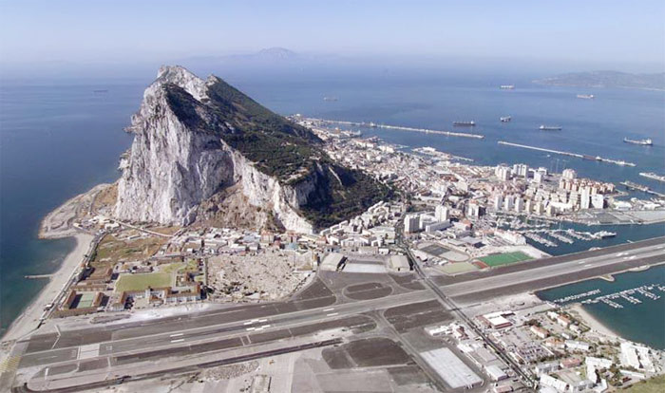

Slide 3
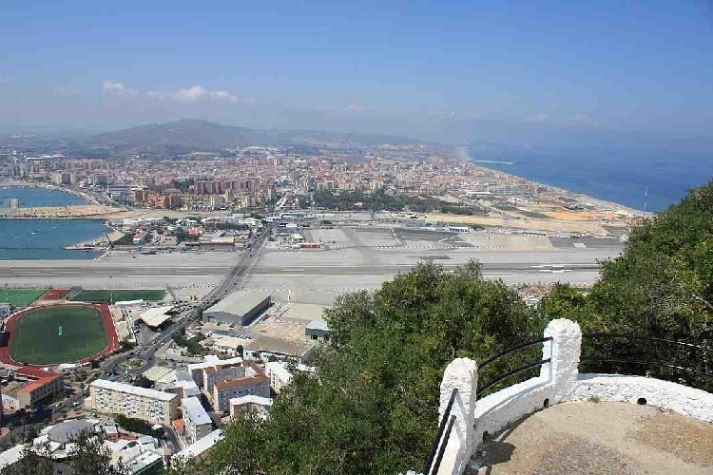

Slide 4
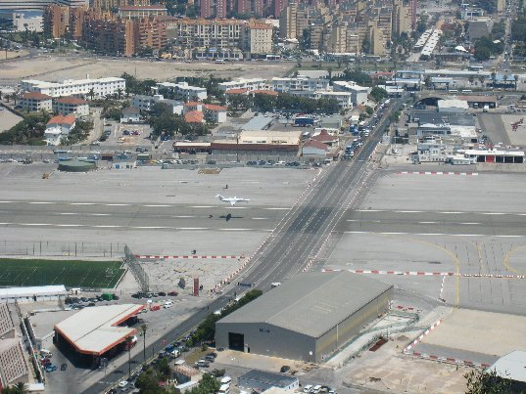

Slide 5
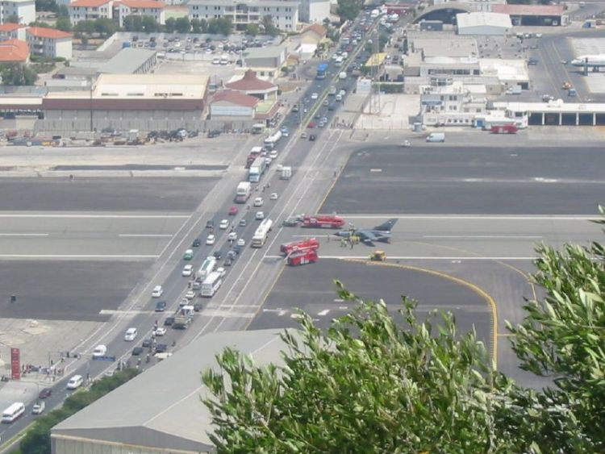

Slide 6
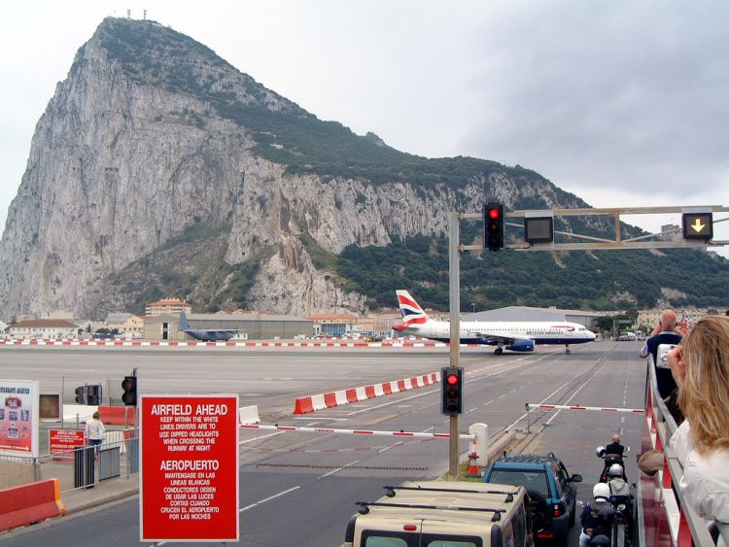

Slide 7
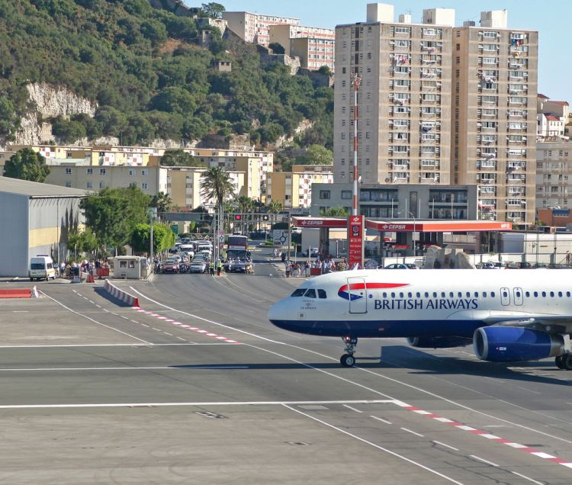

Slide 8
