Slide 1
PRIZMA _ 2. del
Zbirka nalog 2. del str 60/

Slide 2
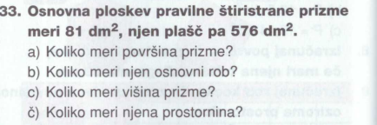
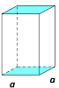





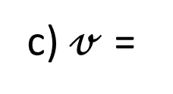



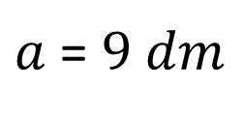



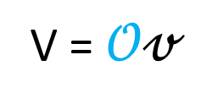

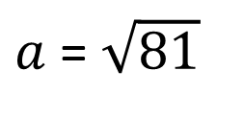
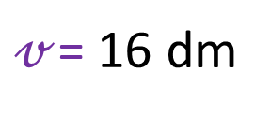

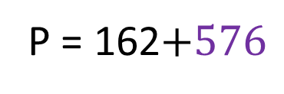

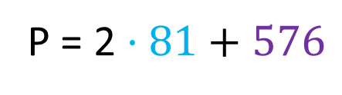
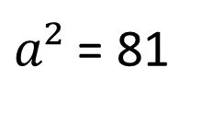
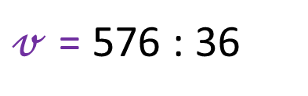
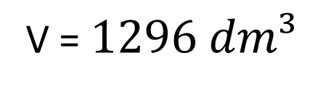
$$𝒪=81 dm²$$
P = 2$𝒪+pl$
$$𝒪=a²$$
P = 2$·81+576$
$$81=a²$$
v
P = 162$+576$
PRAVILNA ŠTIRISTRANA PRIZMA
$a²$ = 81
P =738 dm²
$$𝒪=81 dm²$$
$a$ = $\sqrt{81}$
$$pl=576 dm²$$
$a$ = $9 dm$
a) P =
738 dm²
V = $𝒪𝓋$
b) a =
9 dm
$$pl=576 dm²$$
V = $81·16$
c) $𝓋$ =
16 dm
$$pl=ℴ𝓋$$
$$pl=4a𝓋$$
V = $81·16$
č) V =
$$1296 dm³$$
$$576=4 ·9𝓋$$
V = $1296 dm³$
$$576= 36𝓋$$
$𝓋$ = 576 : 36
$𝓋$= 16 dm

Slide 3
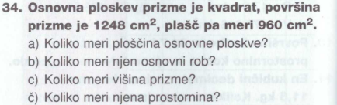
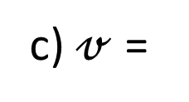
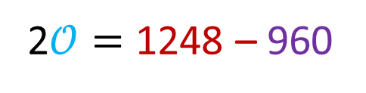
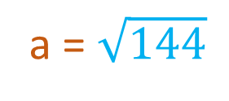
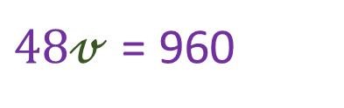
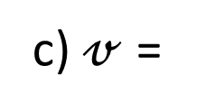
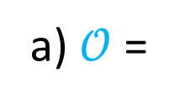
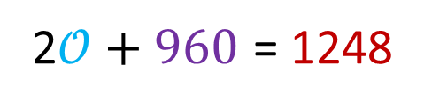
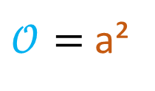

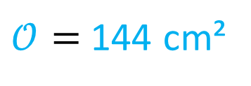

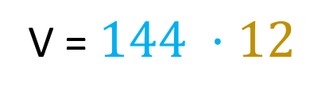
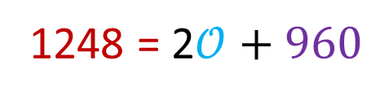


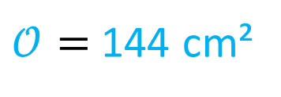

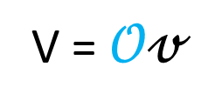

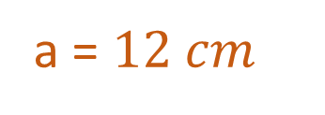


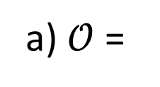
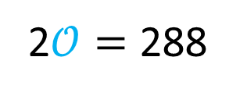

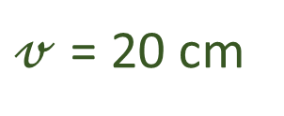
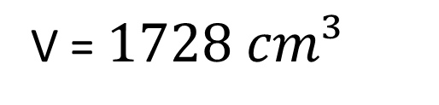
a) $𝒪$ =
P = 2$𝒪+pl$
v
1248 = 2$𝒪+960$
2$𝒪+960$ = 1248
PRAVILNA ŠTIRISTRANA PRIZMA
2$𝒪=$ 1248 – 960
$$P=1248 cm²$$
$𝒪=$ 144 cm²
2$𝒪=$ 288
/ :2
$$pl=960 cm²$$
$𝒪=$ a²
c) $𝓋$ =
$𝒪=$ 144 cm²
a) $𝒪$ =
144 cm²
144 = a²
$$pl=ℴ𝓋$$
a = $\sqrt{144}$
b) a =
$12 cm$
$$pl=4a𝓋$$
V = $𝒪𝓋$
a = $12 cm$
c) $𝓋$ =
$$960=4·12𝓋$$
V = $144 ·12$
20 cm
$$960=48𝓋$$
č) V =
$1728 cm³$
V = $1728 cm³$
$48𝓋$ = 960
/ :48
$𝓋$ = 20 cm

Slide 4
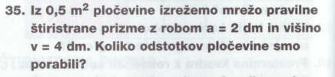




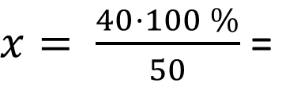


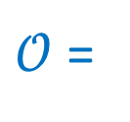

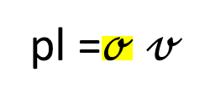



$$𝒪=a²$$
pl =$ℴ 𝓋$
$$𝒪=2²$$
pl =$4a 𝓋$
$$𝒪=4 dm²$$
PRAVILNA ŠTIRISTRANA PRIZMA
P = 2$𝒪+pl$
pl =$4·2 ·4$
a = 2 dm
pl =$32 cm²$
P = 2$·4+32$
v = 4 dm
v
P = 40 dm²
P =
40 dm²
0,5 m² = 50 dm² cela pločevina
$𝒪$ =
$$4 dm²$$
pl =
$32 dm²$
50 dm² ……… 100 %
40 dm² ……… x %
$x= \frac{40·100 \%}{50}$ =
80 %
Odgovor: Porabili smo 80 % pločevine.

Slide 5
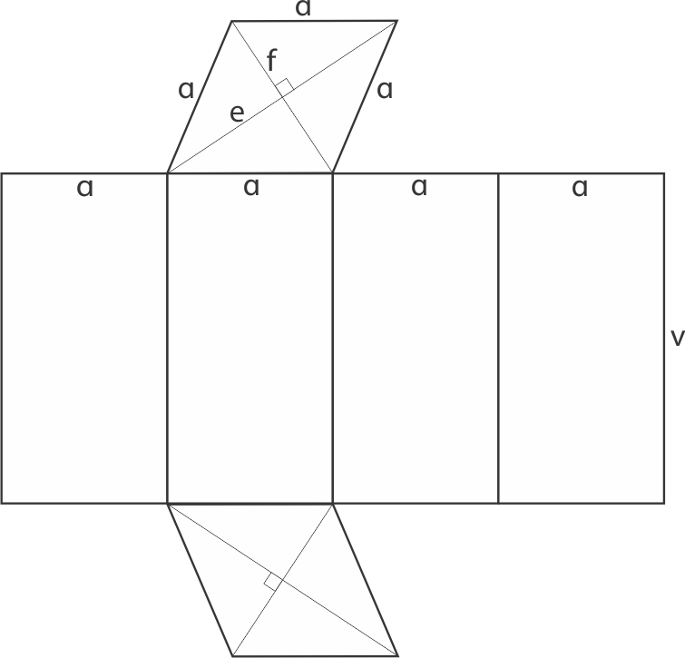

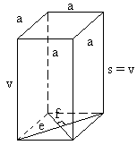
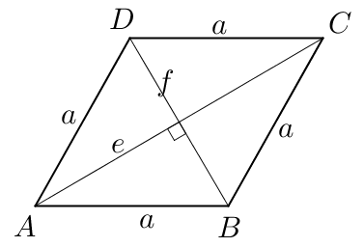
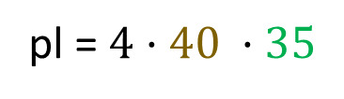
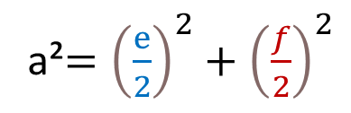
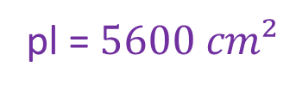
























ŠTIRISTRANA PRIZMA,
osnovna ploskev je romb
e = 48 cm
f = 64 cm
v = 35 cm
pl = $ℴ𝓋$
P =
8672 cm²
$$𝒪= \frac{e f}{2}$$
?
$$\frac{e}{2}$$
pl = $4a𝓋$
V =
$$53760 cm³$$
pl = $4·40 ·35$
$$\frac{f}{2}$$
$$𝒪= \frac{48 ·64·24}{2 ·1}$$
$𝒪$ =
$$1536 cm²$$
pl = $5600 cm²$
pl =
$5600 cm²$
$$𝒪=1536 cm²$$
a =?
pitagorov izrek
a =
$$40 cm$$
P = 2$𝒪+pl$
V = $𝒪v$
a²$={\left(\frac{ⅇ}{2}\right)}^{2}+{\left(\frac{f}{2}\right)}^{2}$
P = 2$·1536+5600$
V = $1536 ·35$
a²$=1600$
a²$={\left(24\right)}^{2}+{\left(32\right)}^{2}$
P = 3072$+5600$
V = $53760 cm³$
a$=\sqrt{1600}$
a²$=576+1024$
a$=40 cm$
P = 8672 cm²

Slide 6

















Višina prizme je 10 km.
Globina prekopa je višina trapeza in $v_{T}$ = 8 m.
$$𝒪=$$
trapez
4-strana prizma
V = $𝒪 ·v$
Osnovna ploskev je trapez.
$𝒪=$ $\frac{a+c}{2}$ · $v_{T}$
V = $320 ·100 000$
a = 58 m
c = 22 m
V = $32 000 000$ m³
$𝒪=$ $\frac{58+22}{2}$ · $8$
$v_{T}$= 8 m
v = 100 km
= 100 000 m
$𝒪=$ $\frac{80}{2}$ · $8$
V =
$𝒪=$ $40$· $8$
$$𝒪=$$
$320$m²
$𝒪=$ $320$m²
ODG: V prekopu je lahko 32 000 000 m³ vode.

