Slide 1
Merjenje kotov

Slide 2
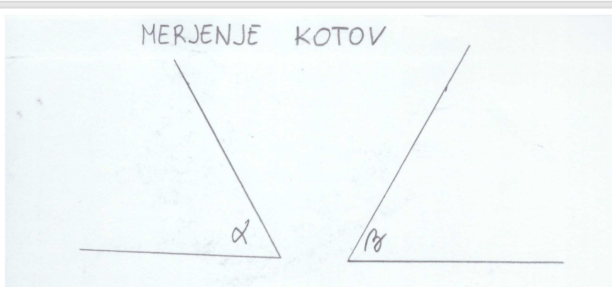
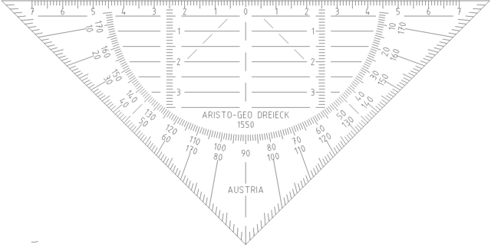


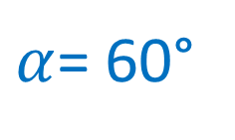
60°
$$β=60°$$
30°
10°
0°
$$0°$$
$α$= 60°

Slide 3
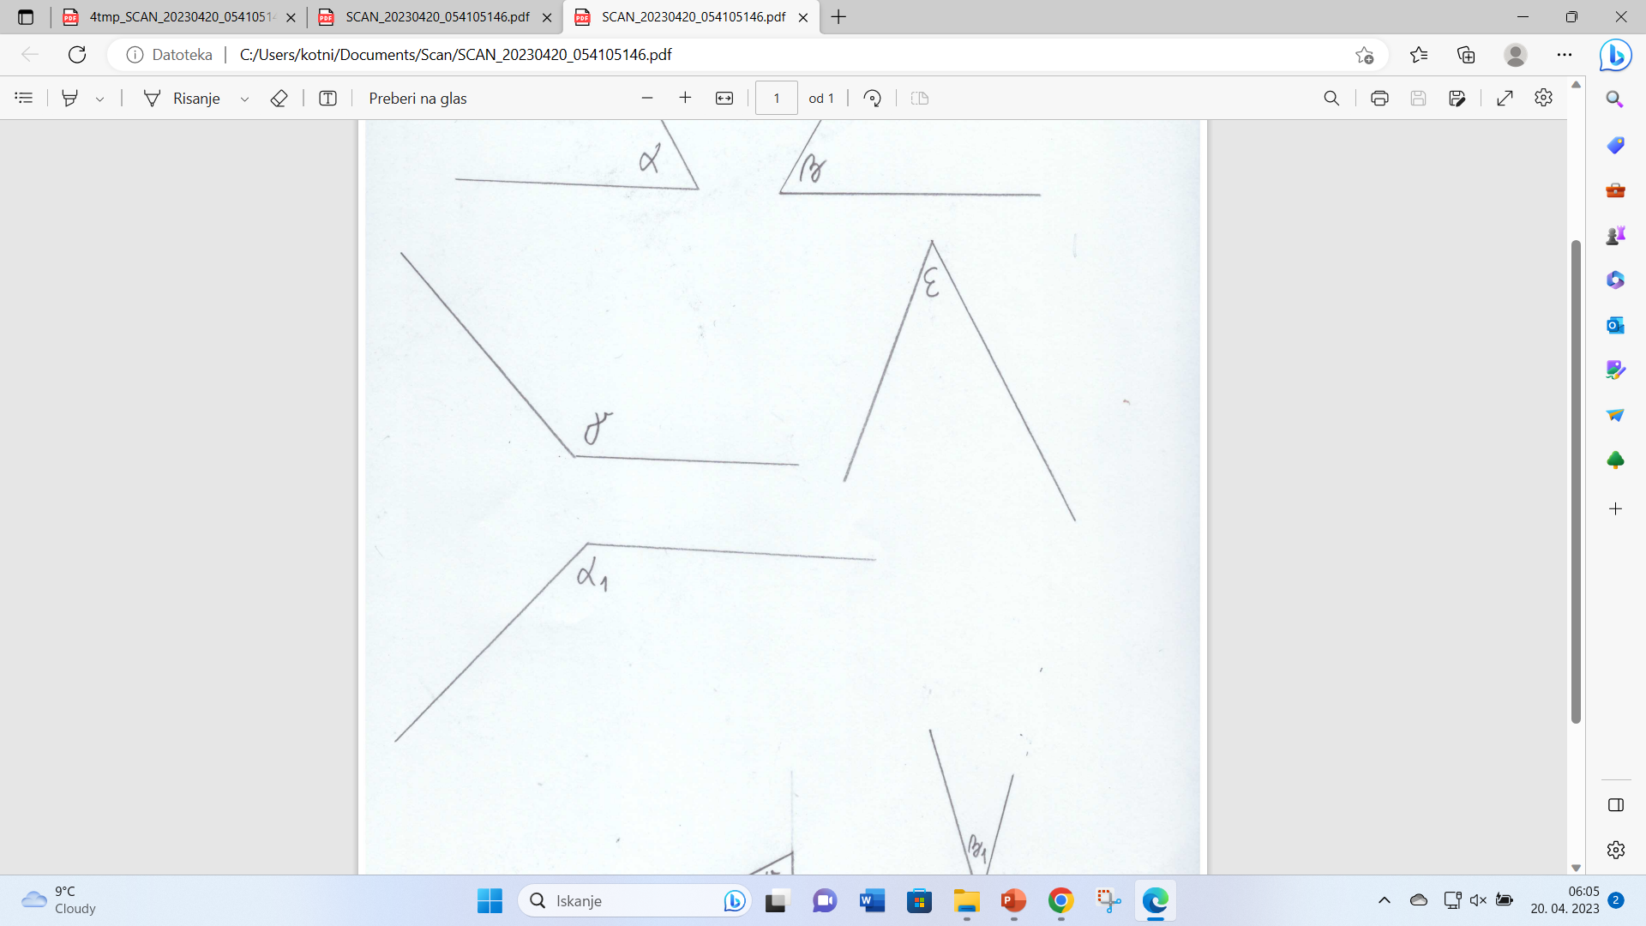

90°
110°
130°
134°
10°
0°
$$γ=134°$$

Slide 4
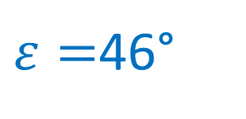
46°
40°
20°
10°
$ε=$46°
0°

Slide 5
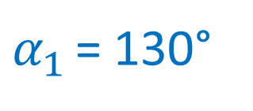
0°
10°
20°
130°
100°
$α_{1 }$= 130°
90°

Slide 6
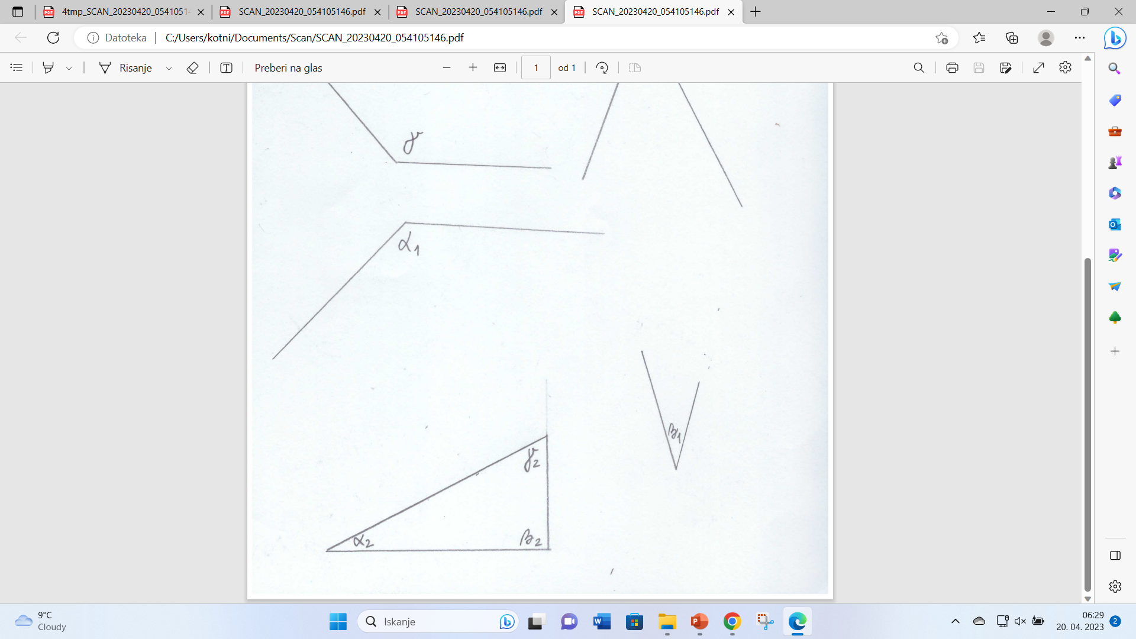
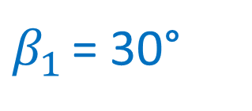
0°
10°
30°
$β_{1 }$= 30°

