Slide 1
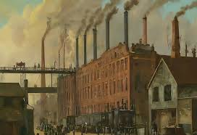
Climate change
climate change, noun
changes in the world's weather, in particular the fact that it is believed to be getting warmer as a result of human activity increasing the level of carbon dioxide in the atmosphere
Rebeka Večerić

Slide 2
Things that accelerate the pollution of Earth
Natural causes | People
volcanic eruptions fluctuations in solar radiation tectonic shifts | transportation electricity generation industry oil and gas development buildings deforestation

Slide 3
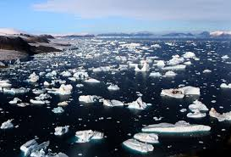
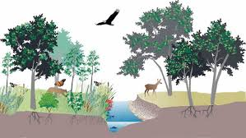
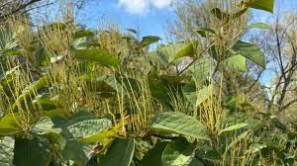
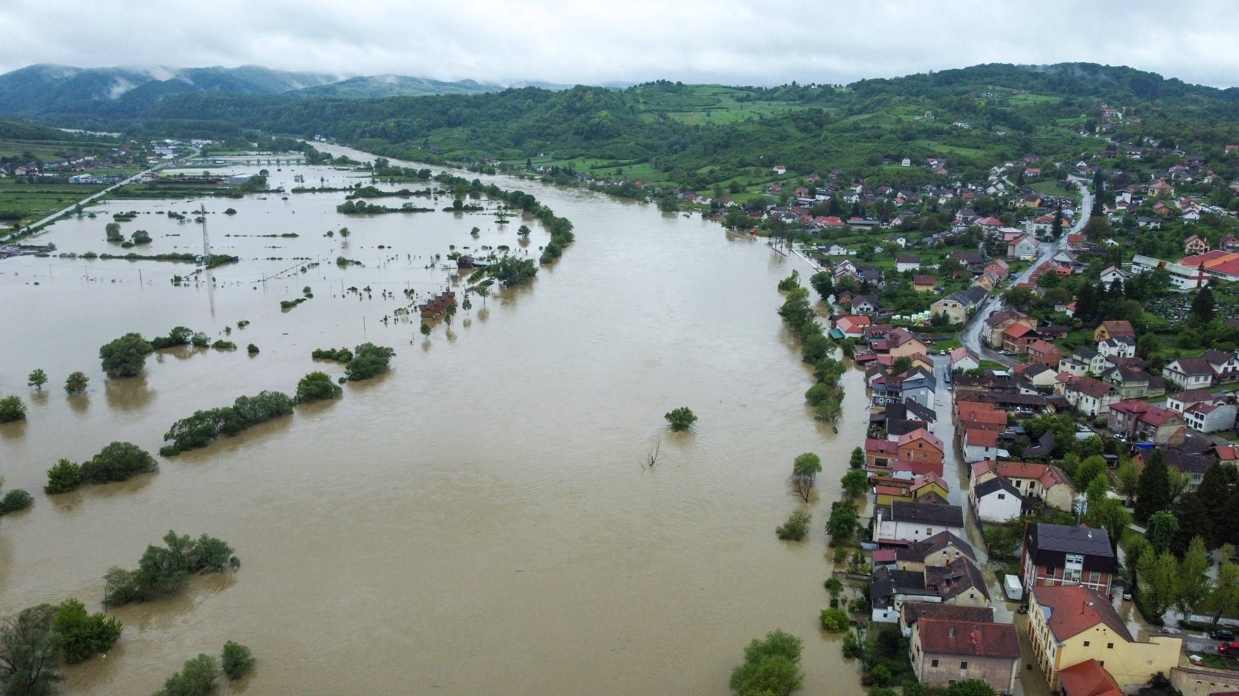
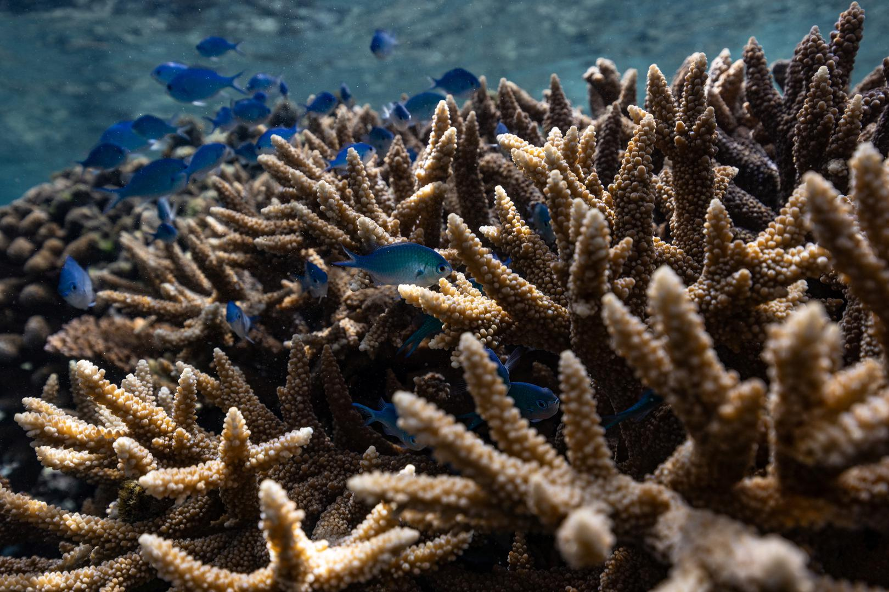
Problems that arise

Slide 4
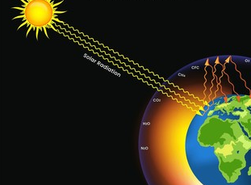
The greenhouse effet

Slide 5
What we expect in the future?
hurricanes will become stronger and more intense
global temperatures will continue to rise
Arctic is very likely to become ice-free
longer wildfire season
more droughts and heat waves

Slide 6
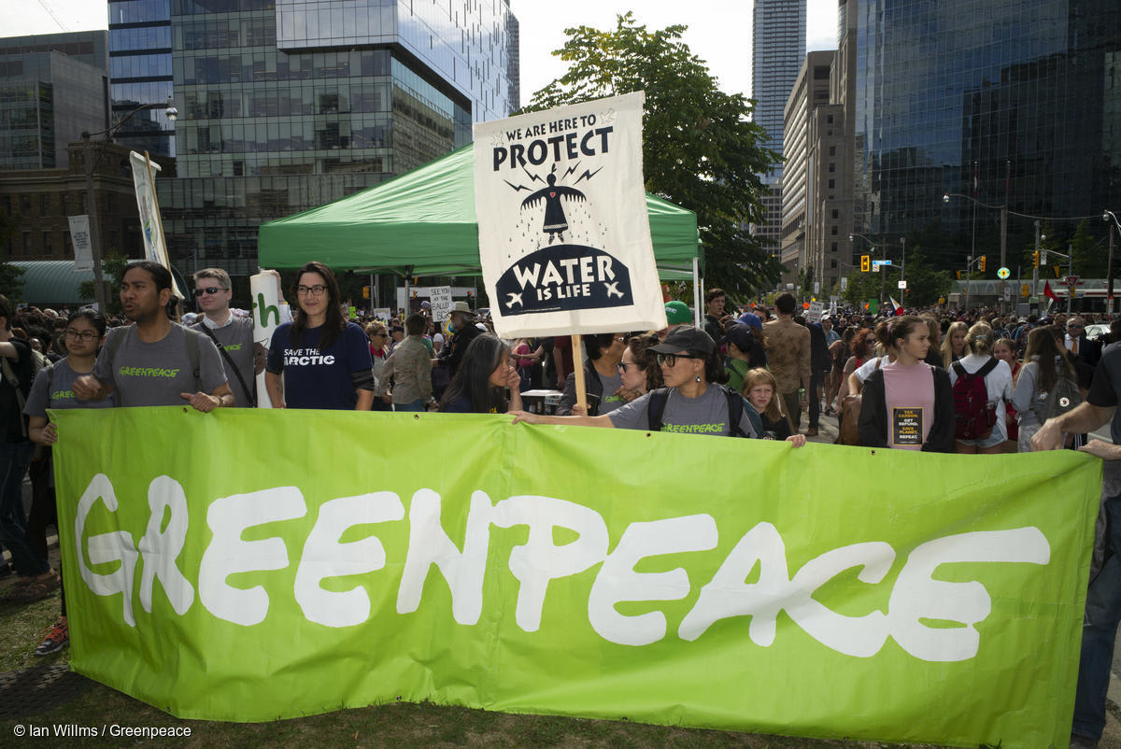

Oranizations that will help
Greenpeace (International, works to halt deforestation, protect ocean helth, stop nuclear testing…)
Helth and Environment Alliance (Europe, protect human and planetary health)

