Slide 1
TECHNOLOGY AND SCIENCE
Luka žerjav, 2. bš

Slide 2

SCIENCE
Pursuit of knowledge
Foundation of of every breakthrough we have achived
In 21st century science is not enough, we need technology to unlock its full potential

Slide 3

TECHNOLOGY
Application of scientific knowledge
Tools, systems and inventions that turn theories into reality
Technology powered by science can redifine how we live, work and communicate

Slide 4

HEALTHCARE
One of the most exited areas where technology and science converge
Scientific research has led to life-saving vaccines, cutting-edge treatmants and advancements in medicine
Technology led to data analyitics, AI and biotechnology that allows us to diagnose diseases earlier
We live healthier and longer becouse of this

Slide 5

SPACE EXPLORATION
Science has helped us to understand the universe
Technology enables us to reach beyond our planet
With their help we made a dream of landing humans to Mars reality

Slide 6
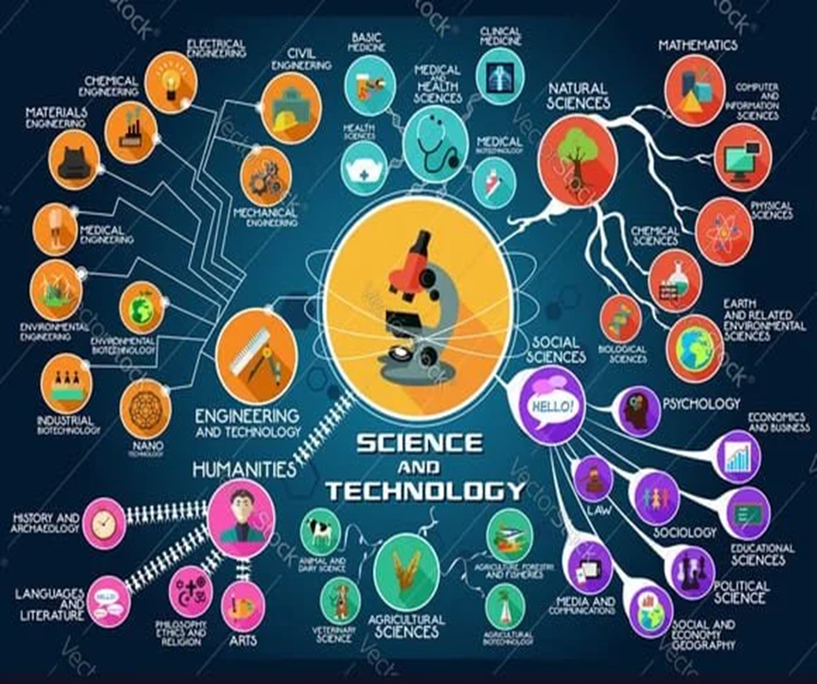
ROLE
Their role does not spot here, wether it is climate changes trough renewable energy solutions, using AI for combat poverty or advanced farming techniques…
Together, they offer solutions to some of the worlds most pressing moments

