Slide 1
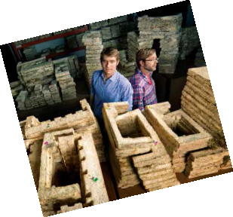
How Ecovative are You?
Questions in Context:
Do you remember something better when you are asked to think about it?
On the right, in the conversation bubble outlined in yellow, are guiding questions that you should ask the students during the associated step.
Each question should be asked separately – and a short amount of time should be allowed for responses.
Steps, Content & Hints
Main directions and content for the activity are in the boxes to the left with the orange border, like this one.
In a classroom setting, you will lead the students through the activity with a series of questions, the students’ own responses and brief explanations.
Whenever possible, find and affirm what’s right about the students’ answers.

Slide 2
Green Chemistry Introduction:
Defining Green Chemistry
Have students work in pairs for 30 seconds to come up with a definition for green chemistry. Break down the meaning of both words.
Establish that Chemistry is the science of making products.
Eco-friendly, good for the environment, sustainable.
What is Chemistry? What does chemistry mean to you? Do you think of good things or bad things? Who has heard of companies going green? What does that mean?
Chemists make “stuff,” like materials and medicines. Green chemistry is pollution prevention at the molecular level, the basic design stage. So what is it that green chemists do?
What do Chemists do?
Use wait time. Build off of their prior knowledge. Acknowledge student responses and prompt them for more information. Control the conversation by asking for a certain number of answers.
Chemists are inventors. They help to design just about every product out there.
Traditionally chemists were not taught about the environmental impact or toxicology. We have had many advances and helpful inventions but we have also had inventions that have caused harm to the environment. Green chemists design products taking into account the entire process, energy efficiency, renewable resources, the product itself along with the end-of-life impact of the product.
Is there anything in this room that a chemist invented? What about the desks, paint, floor, etc.
Who has taken medicine? Does anyone use an iPod or an mp3 player? What about a computer or a cell phone?
What do you know about styrofoam? Where does it come from? Styrofoam, or polystyrene, is made from
non-renewable petroluem products.
What do we usually use styrofoam for? Americans throw away 25 billion styrofoam coffee cups every year!
If we’re typically using styrofoam for disposable, one-time use items, how long do we need it last for?
Set the Scene:
Connect the Dots & Introduce the Activity Topic
Connect the dots for them: they are the future scientists who will help to discover and invent the solutions to the environmental challenges.
We will be learning about styrofoam today and its effect on the environment, as well as an innovative technology that is being used as an alternative.

Slide 3
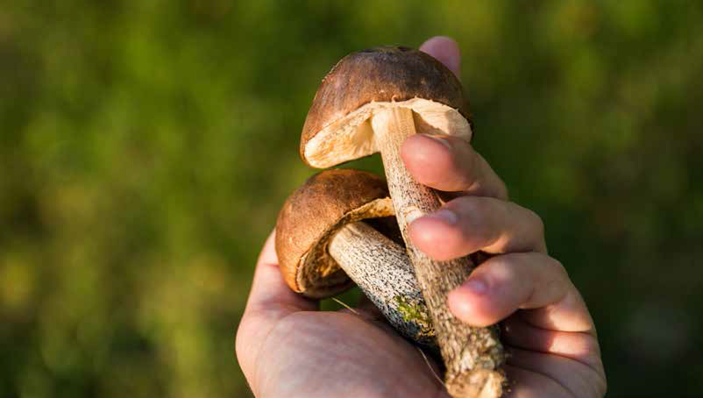
If we only want our styrofoam to be used once, we probably don’t want it to take a long time to break down after we throw it out. However, polystyrene takes up to a thousand years to break down and, in most cases, cannot be recycled. This means that it is commonly found among litter and marine debris. And, it’s estimated that about 25% of the volume of landfills in the United States is styrofoam! http://www.earthresource.org/campaigns/capp/capp-styrofoam.html
What would you change about polystyrene to address these problems?
How does nature recycle things? How can we model natures recycling system? Composting allows us to break down biological materials so they can be used to promote the life and growth of other living things.
Could green chemistry be used to create a solution to the problems with styrofoam?
Green chemistry technology considers 3 criteria: safety, cost, and performance
Green chemistry involved the design of products that are environmentally benign – it considers the whole life cycle of the product, beginning with the starting materials and ending with the product’s disposal when it is at the end of its life.
Ecovative, a packaging design company, has figured out how to put nature’s recycling system to work. Mycelium, essentially mushroom roots, can be used to create packaging that molds to virtually any form. Ecovative’s mushroom material blends local agricultural waste with mycelium to create replacements for polystyrene materials.
Have students put together life cycles of the polystyrene and Ecovative materials from the activity cards.
When these products are no longer needed, they can be readily composted, which then feeds right into nature’s recycling system. (If teacher wants more information, see TED Talk by Eben Bayer)
What would a green chemist want to consider at the beginning of a product’s life? What about at the end of a product’s life?
How do you feel about mushrooms? Have you ever seen a mushroom’s roots?
Could mushrooms be the new plastic?
What does the life cycle look like for polystyrene? A line with a start and finish. What about Ecovative life cycle? A circle, closed-loop. Which life cycle is better? Why? What happens at the end of the each of the products life? Why does this matter? What are the main differences in the steps of each life cycle? How might these difference be important? Grow vs. synthesize, etc.

Slide 4
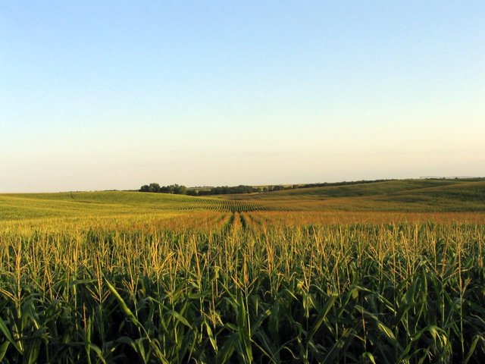
Another way to look at the benefits of Ecovative materials is the way the use agricultural waste. Agricultural waste is what’s leftover in a field after a harvest, and often times it is not dealt with sustainably. A lot of farmers will plow it into the soil or leave it on the field as compost, but in many poorer areas, this “crop residue” is burned on the field, which is very harmful to the soil environment. Using agricultural waste in Ecovative materials brings a new value to what’s left over from harvesting and promotes sustainable land management practices.
Other benefits of Ecovative:
Uses 1/10th of the energy that is used to produce polystyrene
Made from renewable resources
What is agricultural waste? If struggling for answers, you could ask: What happens to the leaves and stems after you harvest your fruits and vegetables? What’s leftover from the harvest is agricultural waste.
Image: Ian Dun/FreeImages.com/Creative Commons

Slide 5
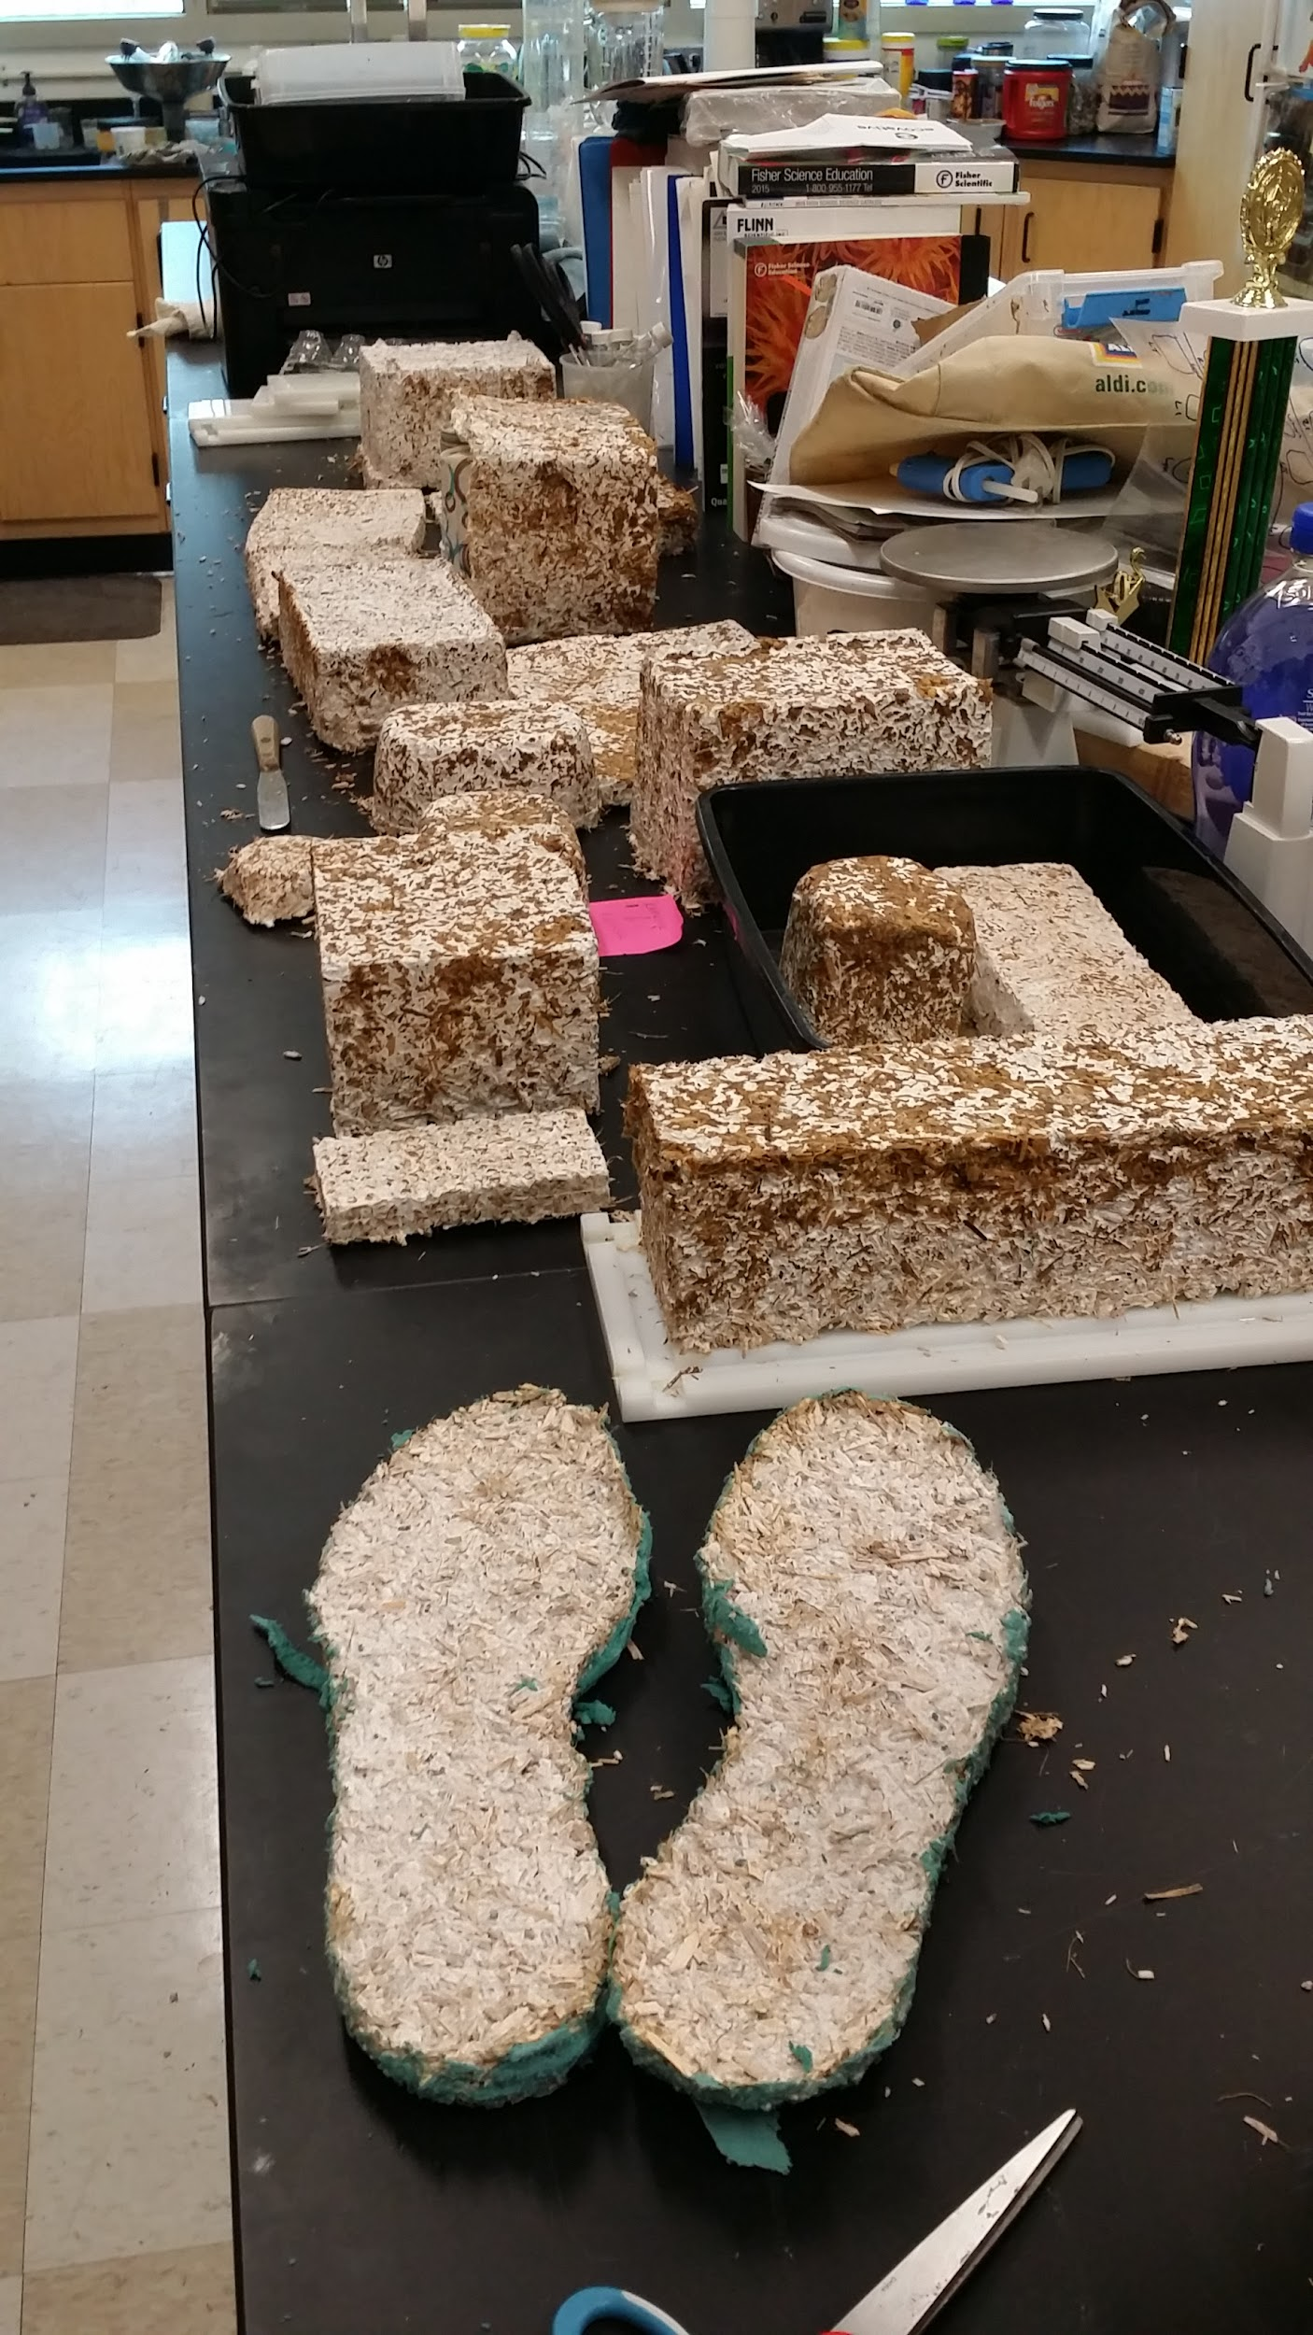
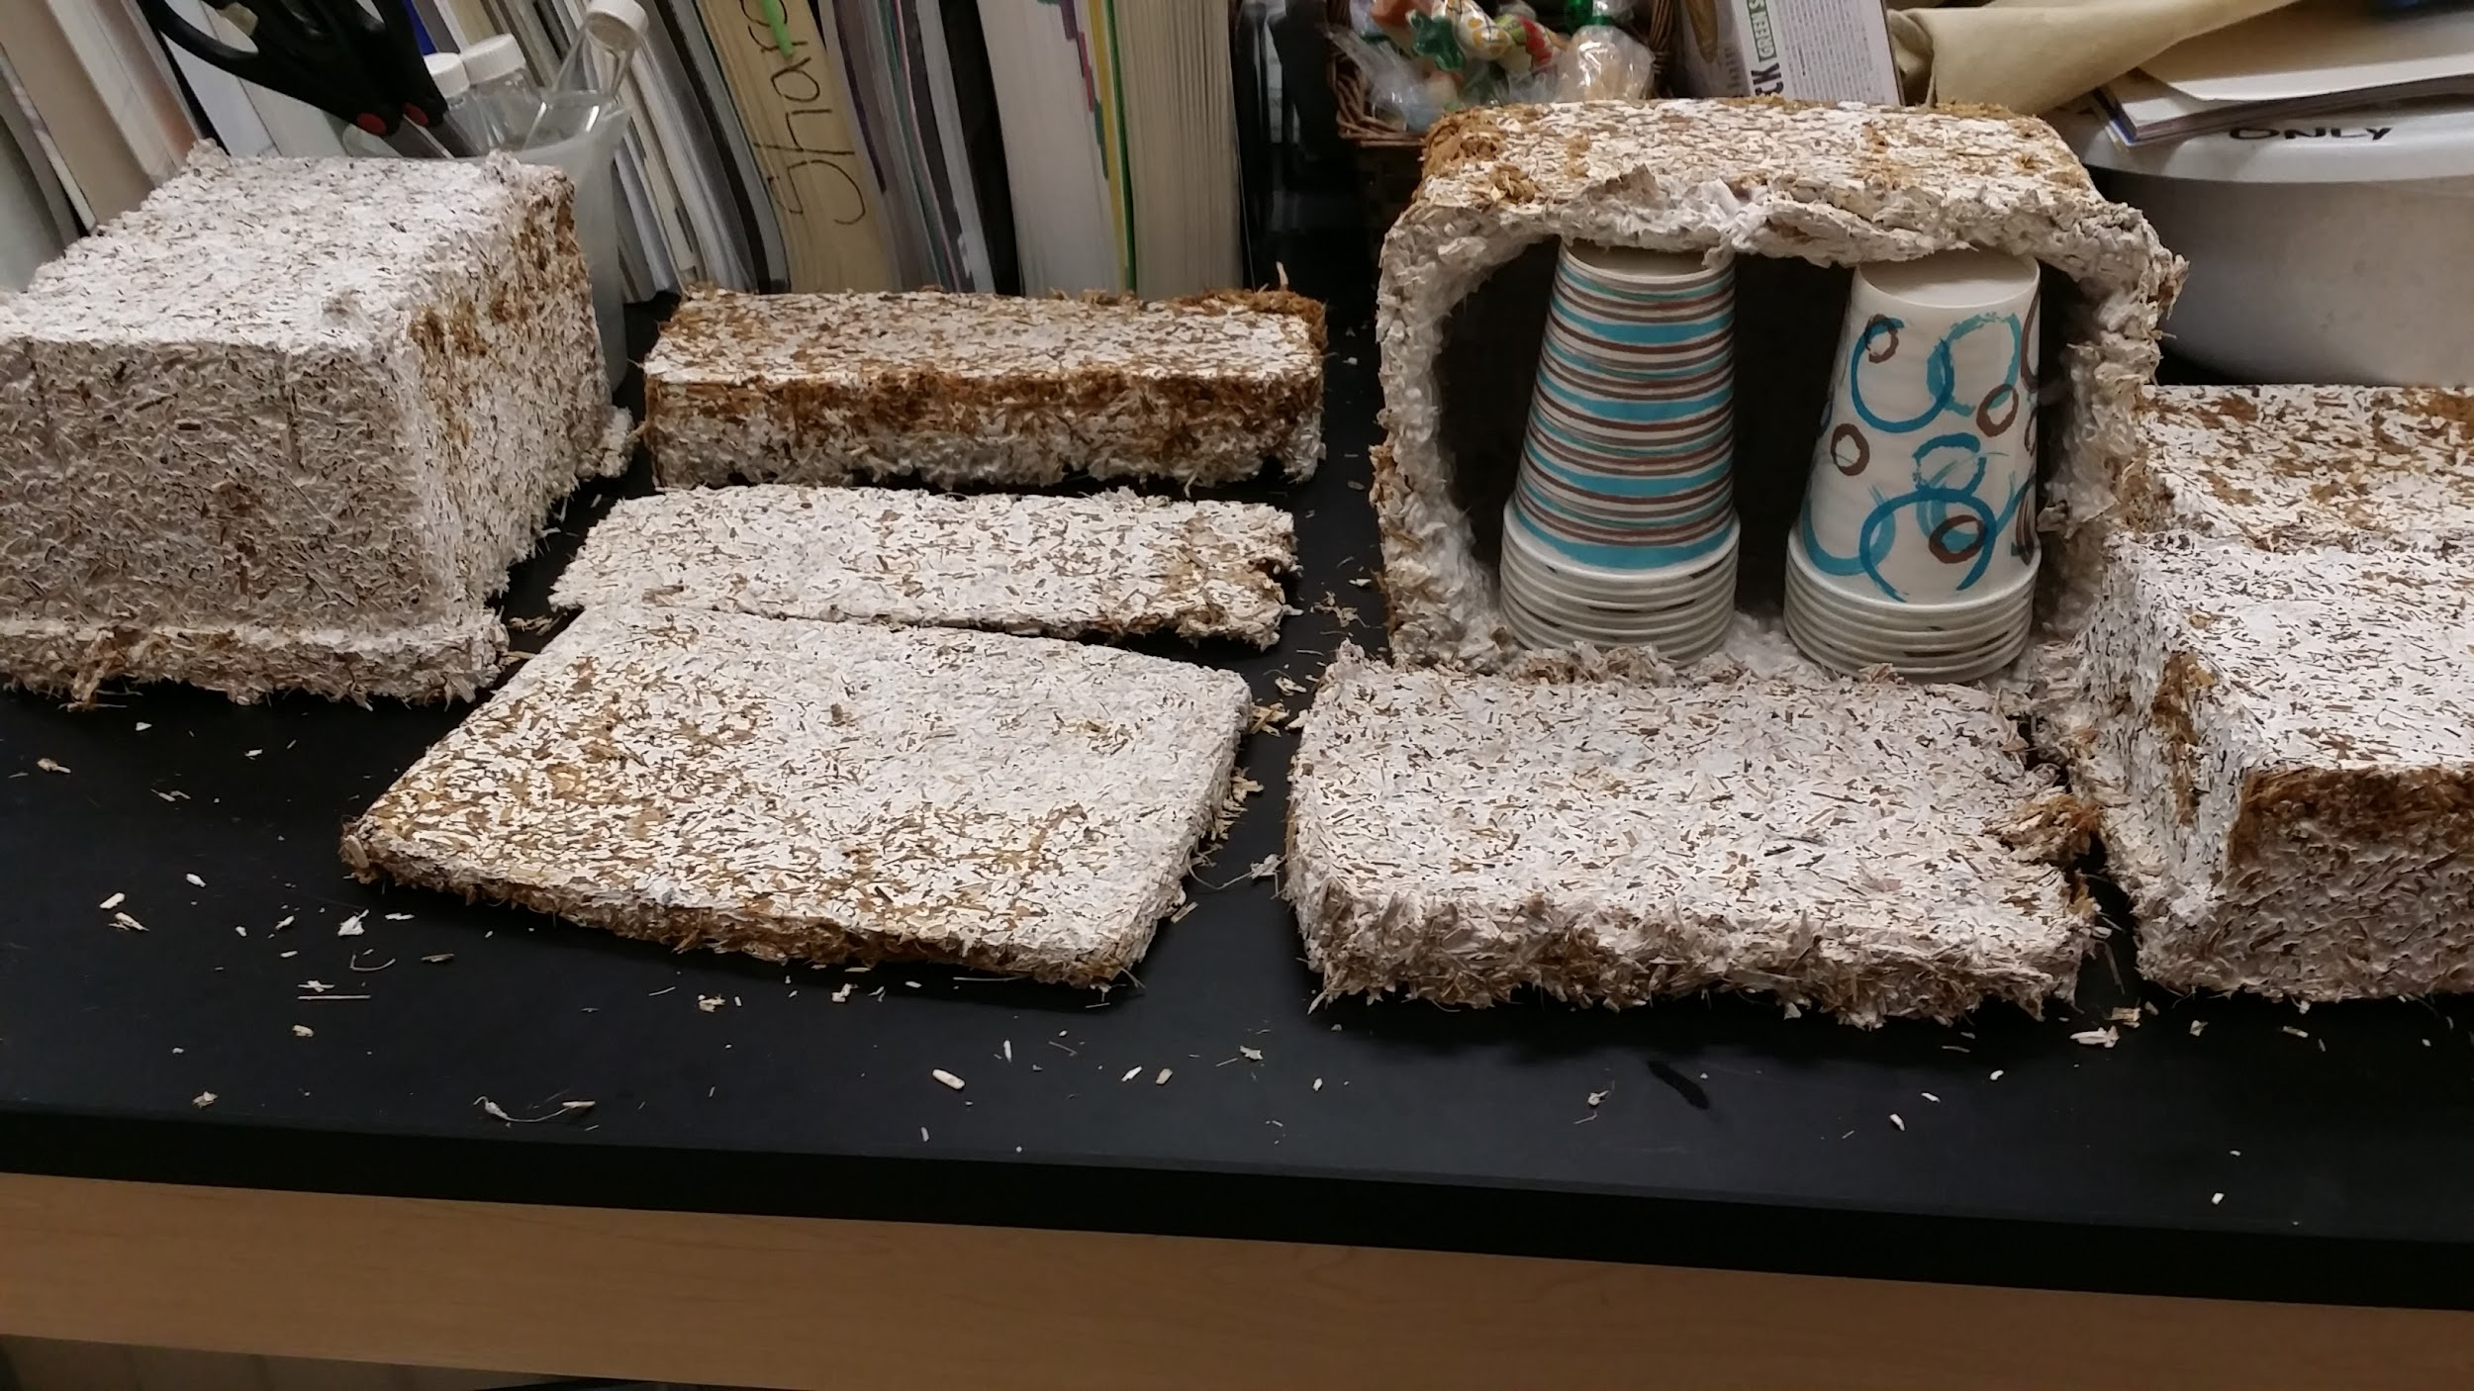
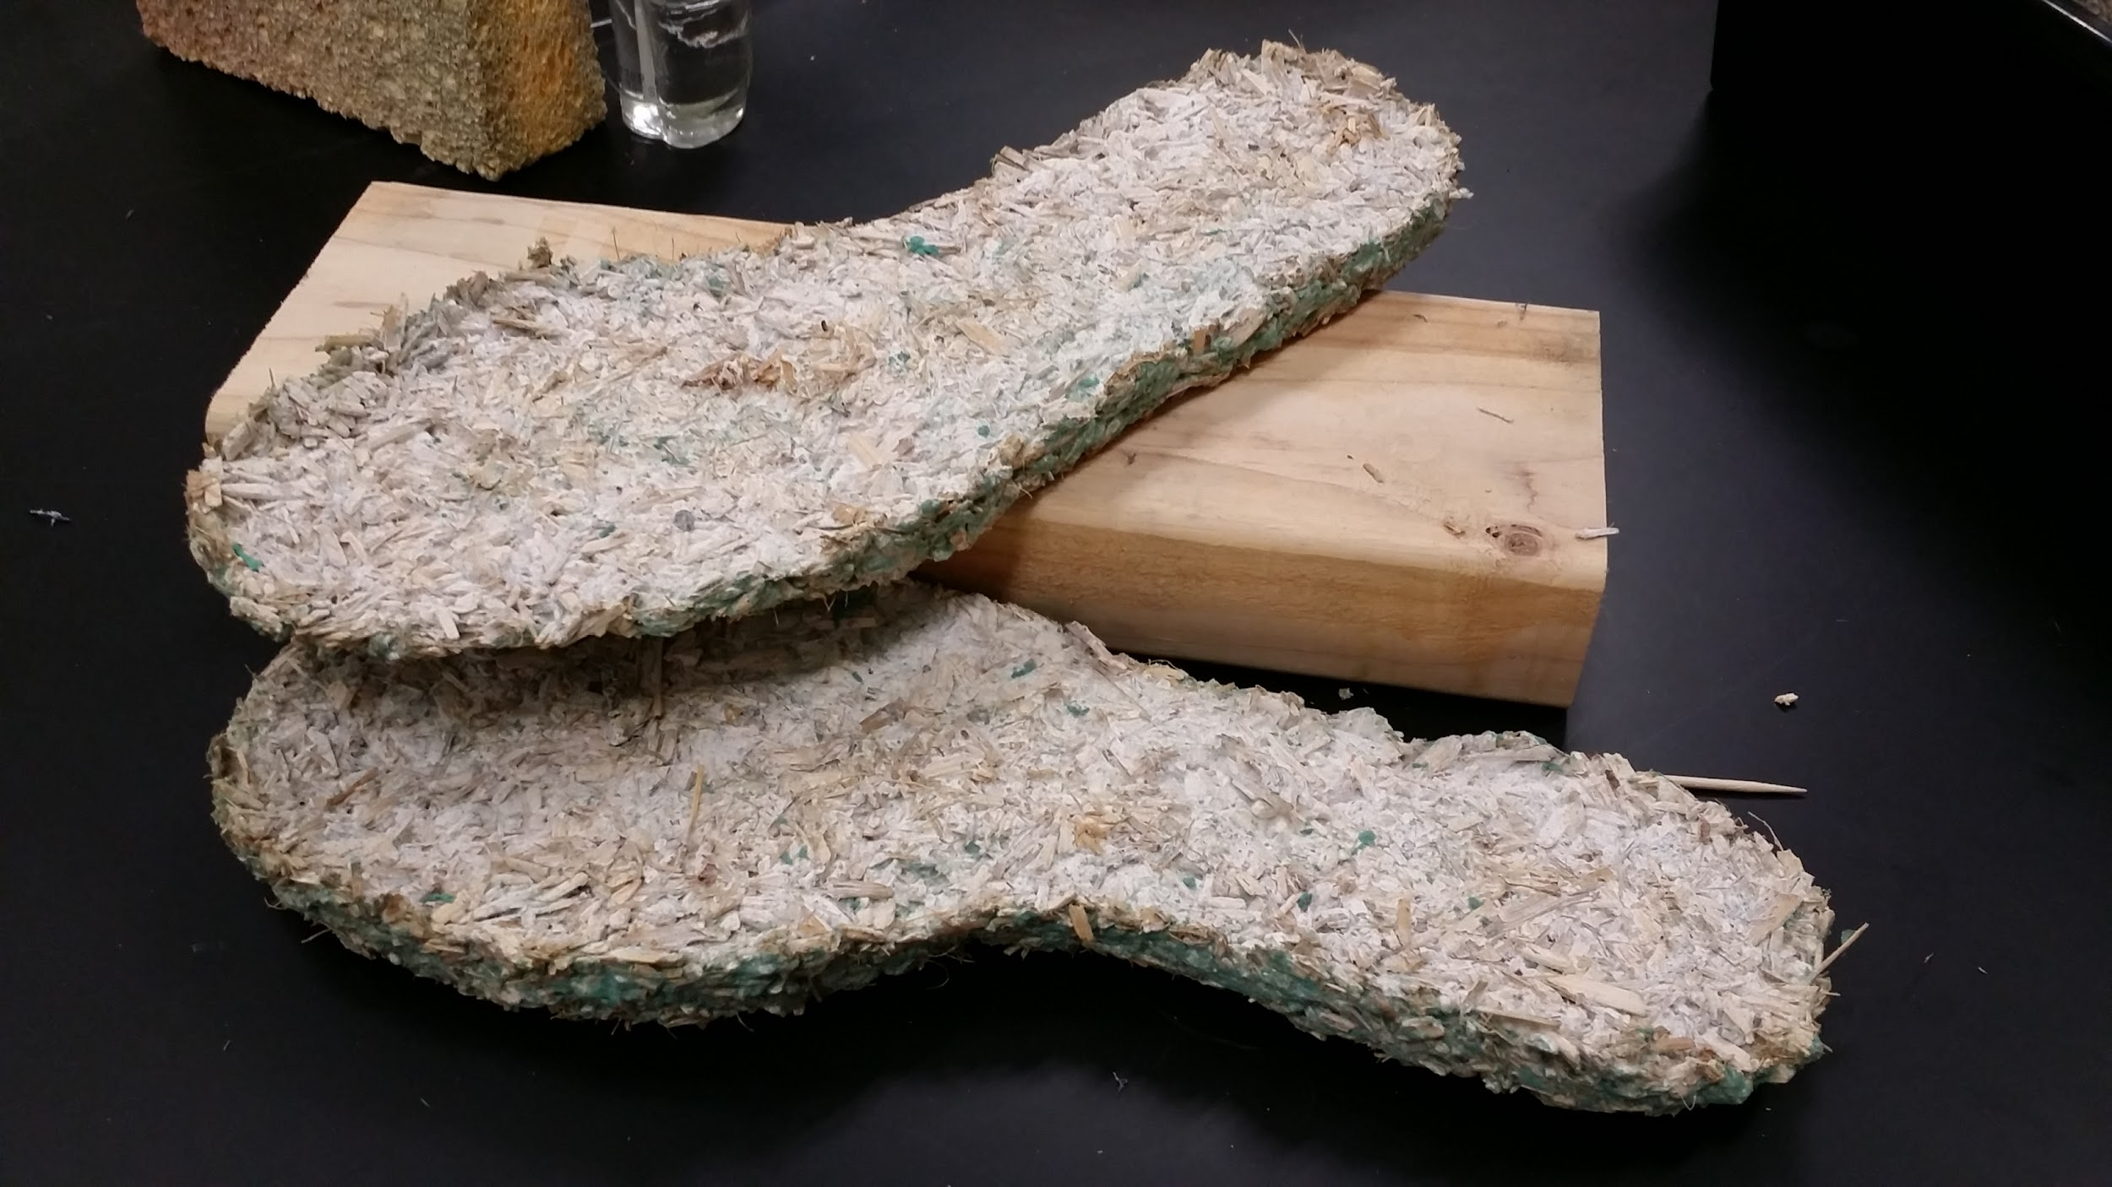
Ecovative is making materials for packaging, insulation, insides of surfboards, and so much more. Students will work with partners to design a product that would be an improvement on the product’s current life cycle.
Rehydrating the materials: See Ecovative lesson plan. Allow 3-4 days for the material to activate**
Shaping and growing: Reactivated material is ready for shaping.
Make sure work surfaces are sanitized with rubbing alcohol
Wear gloves when handling the material so skin oils do not contaminate the experiment
Guar gum and water are needed to produce a moldable, clay-like consistency.
Once a ball can be formed and hold its shape, it is ready to be molded into the desired shape.
Allow students to work out the amounts of water and guar gum needed for this step. If the resulting material is very wet, it will take longer to dry out, but its final properties will be fine.
When the materials are finished being shaped, place them in a plastic bag with a zippered seal.
Poke 10-15 holes in the bag and let the mycelium grow for 5-7 days at room temperature.
What do you use on a regular basis that you could improve the design of? What will you make?
Why do we need to add water and guar gum to our mixture? We need to feed our fungi for them to grow!
Why do we need to poke holes in the bag? So our fungi can breathe!

Slide 6
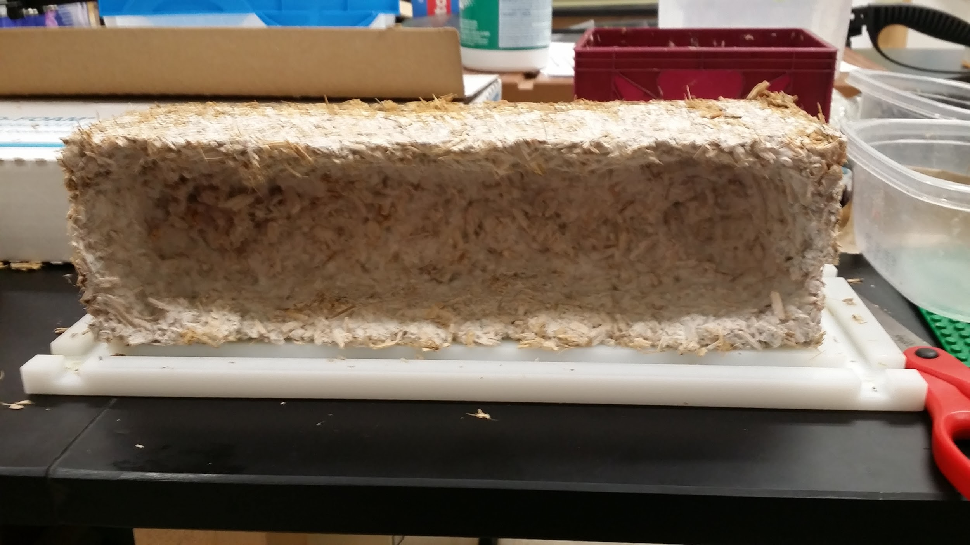
Final steps:
When material is finished growing, the shape should be mostly white in color. At this point, remove materials from molds and air dry on a baking rack for 1-3 days.
To fully deactivate mushroom growth, dry in oven at 100 C for 45 minutes.
We want our Ecovative materials to replace styrofoam. What makes styrofoam so popular? How can we compare the two materials? What properties should we look at? How can we test those properties?
Put your materials to the test!
Reflect back on three criteria for green chemistry technology.
Encourage students to decide on properties of the materials to test. Ideas include insulative properties, water resistance, strength, etc.
Examples of materials testing:
Water resistance: Take mass of ecovative material, immerse in water, then take mass again and compare whether or not absorption occurred. Compare to styrofoam.
Insulative: Pour hot water in ecovative container and in a styrofoam container. Cover both to minimize heat escaping. Use thermometer to measure change in temperature over time. Compare.
Strength: Compare the damage resulting from dropping Ecovative materials and styrofoam materials from the same height. Use measuring stick to determine height from table to drop from. To extend investigation, increase distance and determine differences in damage based on height dropped from.

Slide 7
What did you learn from your tests? In what ways were the two materials the same? In what ways were they different? What things could you do to improve your Ecovative product, based on your test results?
Review test results and circle back to criteria for green chemistry technology.
Who here asks questions about how products are made or why we have certain problems?
Sounds like we have some green chemists in the room. Who thought that this was easy? Who had fun doing this? Do you think that science is something that you can do?
Great Job! Scientists ask questions and seek out answers.
Reinforce how green chemistry is the science of solutions!
In Closing:
Green chemistry provides the tools needed for creating solutions to environmental challenges.
As a green chemist you can be a part of the solution by inventing better technologies for the future. Also remember that you do not need to be a scientist to make a difference in this world. As an informed citizen you have the power to influence change with your decision making, voting power and purchasing choices.
Any questions?
Wrapping up is always a good time to talk a little more about why you are in the classroom, what you are studying, researching or pursuing as a career.

