Slide 1
Animal, sport and famous person
Ime priimek, 6. razred

Slide 2
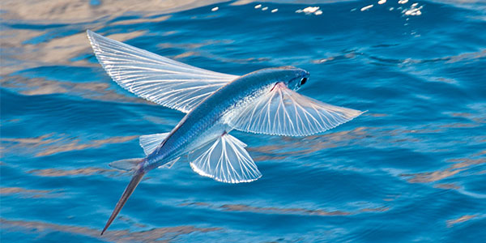
Flying fish
Pacific and Atlantic coast of US
Don‘t fly, they glide
Length: 15-30 cm
Eat: plankton
Colour:
Fins/ wings
Video: https://www.youtube.com/watch?v=bk7McNUjWgw

Slide 3
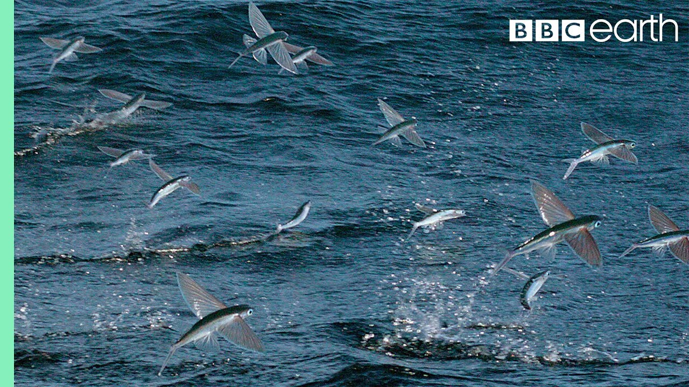
What are they doing?

Slide 4
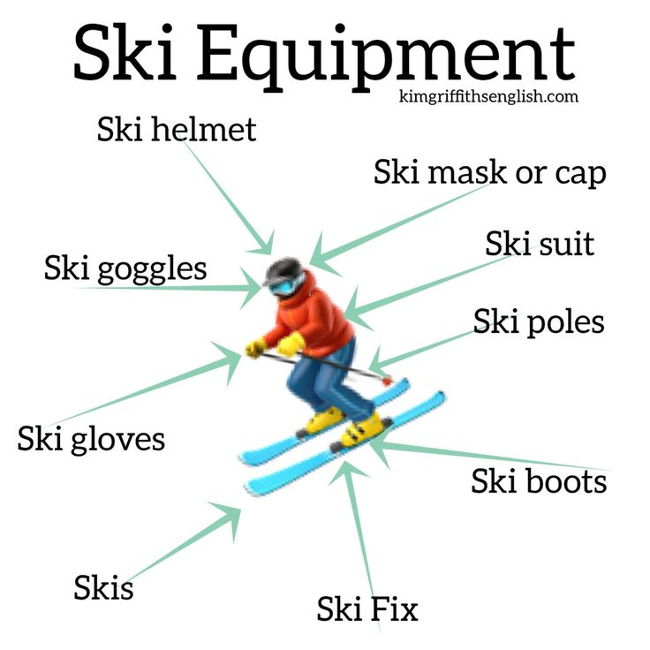
Skiing
Skies, special ski boots, ski poles, helmet, goggles, gloves
Individual or group sport
Video: https://www.youtube.com/shorts/nPwKz4qgxeU

Slide 5
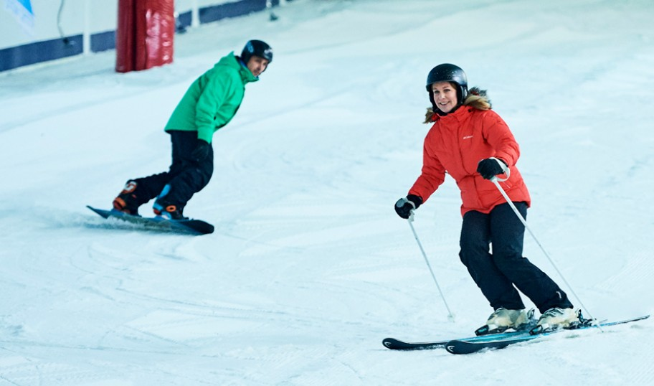
What are they doing?

Slide 6
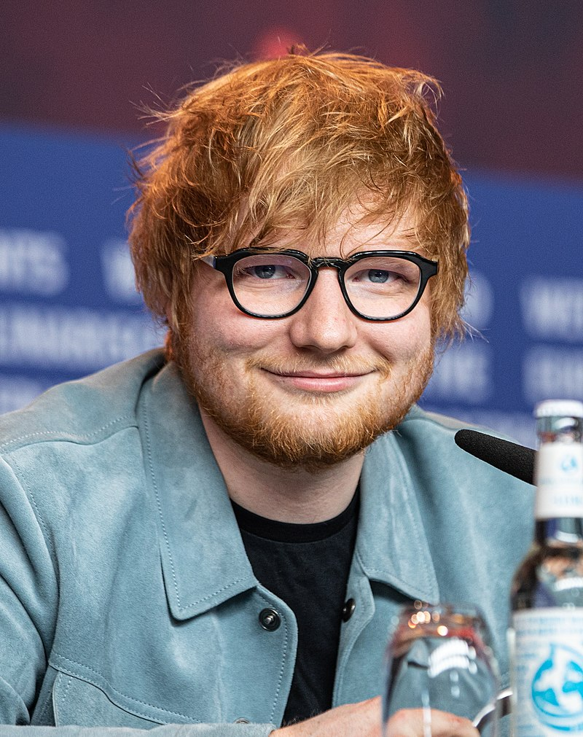
Ed Sheeran
Singer and songwriter
34 years old
Won many awards
2 children
https://www.youtube.com/watch?v=2Vv-BfVoq4g
Songs: Perfect, Azizam, Shape of you, Thinking out loud, Photograph, Bad habit
Instrument: acoustic guitar

Slide 7
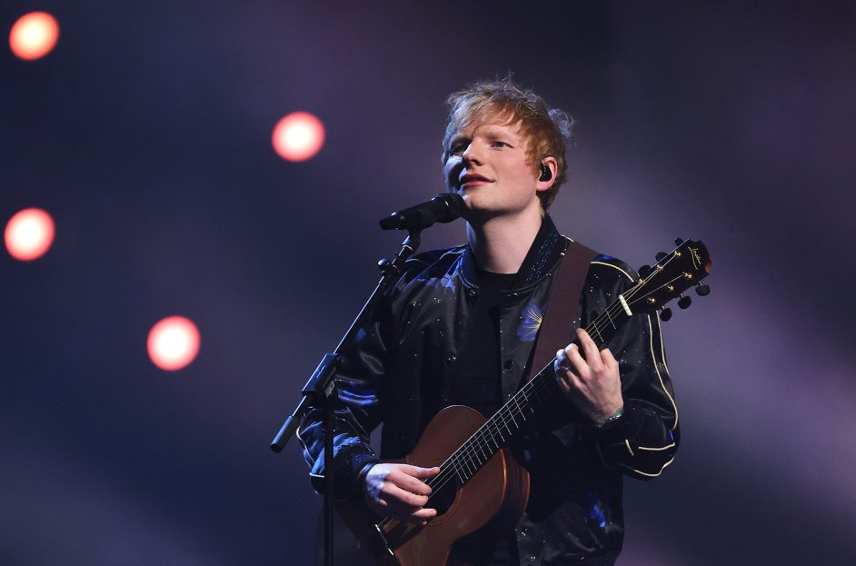
What is he doing?

