Slide 1
Animals and Plural

Slide 2
Regular plural
Irregular plural
Words with identical singular and plural
Words with multiple plurals

Slide 3
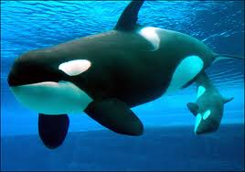
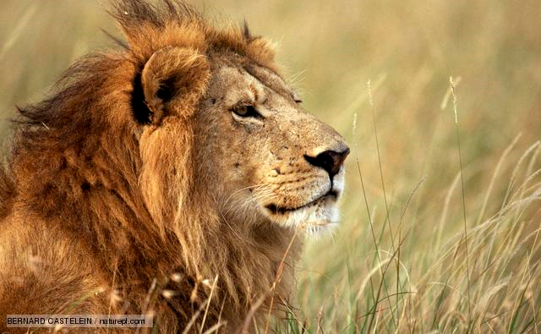
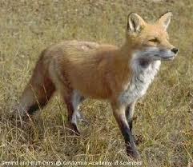
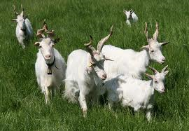
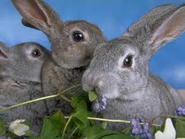
1. Adding –s or –es:
Regular plural
cat – cats
whale – whales
goat – goats
chiken – chikens
bee – bees
fox – foxes
bear - bears
lion - lions
rabbit - rabbits
horse - horses

Slide 4
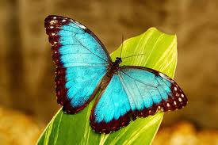
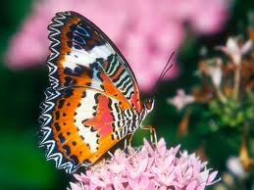
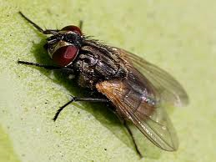
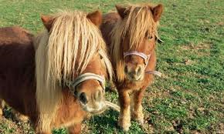
2. Words, ending in –y:
~ drop the y and add –ies:
butterfly – butterflies
pony – ponies
fly – flies

Slide 5
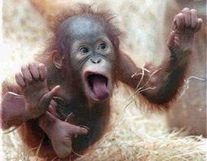
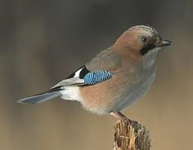
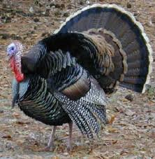
~ add the suffix –s:
monkey – monkeys
jay – jays
turkey – turkeys

Slide 6
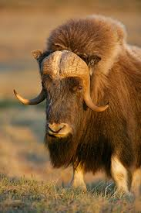
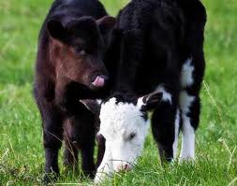
Irregular plural
ox – oxen
calf - calves

Slide 7
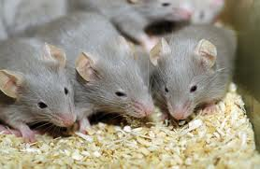
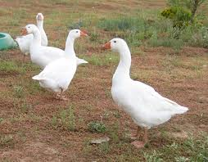
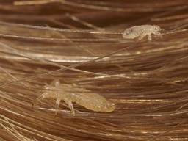
2. Ablaut plural:
mouse – mice
goose – geese
louse - lice

Slide 8
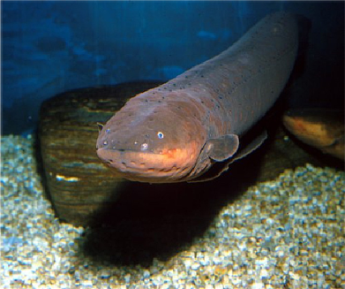
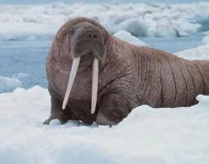
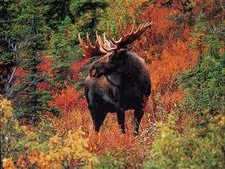
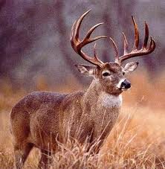
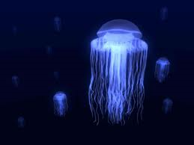
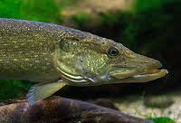
Nouns with identical singular and plural
bison
sheep
moose
deer
pike
eel
walrus
jellyfish
zebra

Slide 9
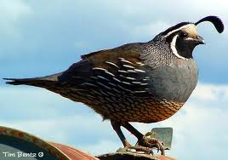
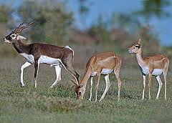
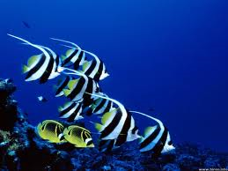
Nouns with identical singular and plural or use the –s or -es:
antelope – antelope, antelopes
cod – cod, cods
elk – elk, elks
fish – fish, fishes
quail – quail, quails
reindeer – reindeer, reindeers
salmon – salmon, salmons
trout – trout, trouts

Slide 10
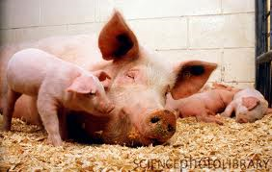
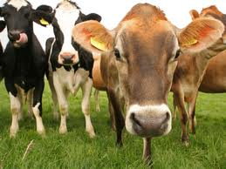
Nouns with multiple plurals
Cow – cows, kine
Pig – pigs, swine
Sow – sows, swine

Slide 11
Sources:
http://en.wikipedia.org/wiki/English_plural
http://www.englishclub.com/vocabulary/animal-terms-easy.htm
http://walkinthewords.blogspot.com/2009/04/animal-plurals.html
http://svet-anglescine.com/kategorija/35/Zivali_ Animals
Pons – splošni angleško-slovenski slovar, založba Rokus Klett, Ljubljana 2008

