Slide 1
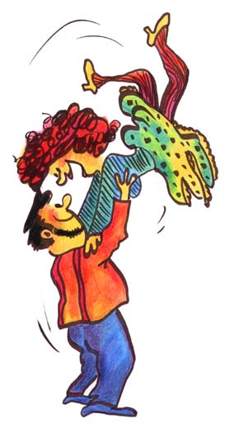

The best dance movies
Authors: Anja Heric, Magdalena Mir
Mentor: Liljana Kosič, prof.
Class: 3.a

Slide 2

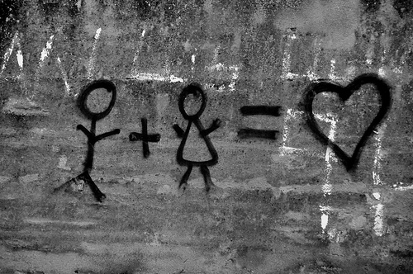


What is typical for a dance movie:
dance couple
love story
popular music
obstacle in love
atmosphere: intently, sadly, mischievously, joyfully

Slide 3

The most famous dance movies:
DIRTY DANCING
In the leading role: PATRICK SWAYZE – Johnny , JENNIFER GREY - Baby
In the 1960s, Frances (“Baby”) Houseman, a sweet 17 years old girl, goes with her family to a resort in upstate New York's Catskill Mountains. Baby has grown up in privileged surroundings and all expect her to go on to college, join the Peace Corps and save the world before marrying a doctor, just like her father. Unexpectedly, Baby becomes infatuated with the camp's dance instructor - Johnny, a man whose background is vastly different from her own. Baby lies to her father to get money to pay for an illegal abortion for Johnny's dance partner. One day Johnny is teaching Baby the dance routine, when they fall in love. It all comes apart when Johnny's friend falls seriously ill after her abortion and Baby gets her father, who saves the girl's life. He then learns what Baby has been up to, who with and worse - that he funded the illegal abortion. He bans his daughter from any further association with "those people". In the first deliberately willful action of her life, Baby later sneaks out to see Johnny - ostensibly to apologize for her father's rudeness - and ends up consummating her relationship with Johnny. A jealous fellow vacationer sees Baby sneaking out of Johnny's bungalow the next morning and in an act of retribution, tells management that he is responsible for a theft the evening before, knowing he would not furnish his real whereabouts. In an act of bravery, Baby states that Johnny is innocent, and alibis him by confessing that they were together all night. This revelation causes a huge rift in the family and Baby makes an impassioned speech to her angry and bereft father. At the closing night performances, and although he has been fired and banned from attending, Johnny returns and takes the stage to tell everyone about the woman whose faith in him and whose courage changed his life. They do one final show-stopping dance together. Baby's father learns that Johnny was not responsible for his partner's pregnancy and learns to accept that although his beloved daughter always will love him.
http://www.youtube.com/watch?v=WpmILPAcRQo

Slide 4

TIME OF MY LIFE
CHORUS:
'Cause I had the ________________
No I've never felt this way before
Yes I __________ it's the truth
And I owe it all to you
'Cause I've had the ________________
And I've searched through every open __________
Till I found the truth
and I owe it all to you.
time of my life
swear
time of my life
door

Slide 5

LAMBADA
In the leading role: J. EDDIE PECK – Kevin Laird, MELORA HARDIN – Sandy,
A Beverly Hills school teacher - Kevin Laird journeys at night to a warehouse in East Los Angeles, where a group of barrio kids gather to dance the lambada. Using his dazzling dance moves to earn the kids' respect and acceptance, Kevin then teaches them academics in an informal backroom study hall. One of his students, Sandy sees him at the club. The next morning at school while Kevin is teaching, Sandy daydreams that she and Kevin are dancing and he madly kisses her on his motorcycle. It's the best of both worlds, but then Sandy becomes a jealous and lovesick student and she exposes Kevin's double life, his two worlds collide, threatening his job and reputation.
http://www.youtube.com/watch?v=sG1dX0_JHLY&feature=related

Slide 6

SAVE THE LAST DANCE
In the leading role: JULIA STILES – Sara, SEAN PATRICK THOMAS – Derek
Sara Johnson dreams of becoming a professional ballerina. After the accidental death of her mother, Sara is forced to move from Lemont, a quiet Chicago suburb, to her father's ghetto apartment on Chicago's gritty south side. The new urban environment, very different than what she is used to, adds to Sara's feelings of loss and frustration, and her misplaced guilt, which is caused by the fact that her mother had been en route to her dance performance at the time of her death. So, her father lives on the other side of town, in a predominantly Black neighborhood. She gets transferred to a new school where she is one of the few white students there. She becomes friends with Chenille, and later, falls in love with Chenille's brother, Derek. Derek is a popular fellow student with a passion for hip hop dancing .
http://www.youtube.com/watch?v=-xzdCd15gqE

Slide 7
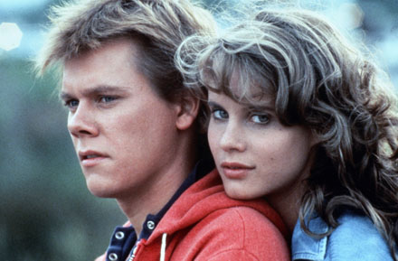
FOOTLOOSE
In the leading role: KENNY WORMALD – Ren, JULIANNE HOUGH – Ariel
Ren McCormack is an average Chicago teenager enjoying the city life when his father walks out on the family. He and his mother are forced to move in with mom's sister in a small town called Beaumont. The town is dusty, run down and slow. Ren experiences culture shock upon moving and attending school in an environment opposite his beloved city. But there is also one small pleasure, however: Ariel, a troubled but lovely blonde with a jealous boyfriend. Ren soon discovers that the town is run by the strict minister of a local church. He also learns that the teenagers are eager to let loose and have fun, but are unable to do so because of strict town rules.
One day Ren decides the community needs a change. He takes a group of teenagers across town lines to a dance hall, where he teaches them to dance.
http://www.youtube.com/watch?v=wFWDGTVYqE8&feature=related

Slide 8
FOOTLOOS
Cut loose, ___________, kick off the _________ shoes
Ooh-wee _________shake it, shake it for me
Woah, __________ come on, come on let's go
Lose your blues, everybody cut _____________.
footloose
Sunday
Marie
Milo
footloose

Slide 9

HAIRSPRAY
In the leading role: JOHN TRAVOLTA - Edna, NIKKI BLONSKY – Tracy
Tracy Turnblad, an overweight high-school student spends all of her time watching the dance show Corny Collins . This show then wake up her dream - to be on a local Baltimore teen dance program. While her father tells her to follow her dreams, her mother Edna reminds her that she doesn't look like the girls on that show. After impressing the show's host Tracy earns a coveted spot on the program, but when she becomes a popular addition to the cast, she earns the wrath of the prettiest girl in school -- a girl whose mother (Michelle Pfeiffer) just happens to operate the local television station. Tracy's visit to detention hall opens her eyes to the racial tension on the show, as does the budding relationship between her best friend (Amanda Bynes) and an African-American boy named Seaweed (Elijah Kelley). Thus empowered, Tracy attempts to integrate the races on her favorite program.
http://www.youtube.com/watch?v=kkzcNF-jlWw

Slide 10
YOU CAN'T STOP THE BEAT
'Cause you can’t stop
The motion of the _________
Or the rain from above
They ________ try to stop the paradise
We're dreaming of
But they can not stop the ___________
Of ___ __________ in love to stay
'Cause you can’t stop the beat!
ocean
can
rhythm
two hearts

Slide 11

STEP UP
In the leading role: CHANNING TATUM - Tyler, JENNA DEWAN – TATUM – Nora , DAMAINE RADCLIFF
An aspiring ballerina from a wealthy family learns some lessons about both dancing and life from a roughneck with soul in this teen drama. Tyler Gage grew up on the wrong side of the tracks in a rough section of Baltimore, and has been in and out of trouble with the law most of his life. Finding himself before the judge yet again, Tyler is sentenced to 200 hours of community service, and he ends up mopping floors at the Maryland School of the Arts. Tyler catches the eye of Nora a gifted ballet student who is trying to incorporate hip-hop moves into her classical routines. None of Nora's fellow students seem to be on the same page as her, but Tyler is a talented street dancer with strength, moves, and enthusiasm. Despite the misgivings of the school's administrators, Nora persuades Tyler to team up with her for a major class project. Tyler gains a new self-respect as he gives in to the discipline of the dance academy, but he wonders if this new opportunity means turning his back on who he really is. Matters become all the more complicated when Tyler and Nora realize they're falling in love.
http://www.youtube.com/watch?v=ZgnmCqA25-o

Slide 12

http://www.youtube.com/watch?v=DWm7OSOOF2E&feature=related

