Slide 1
An Ideal Husband
Characters

Slide 2
Characters
Lady Chiltern
Lady Basilion, Mrs Marchmont, Lady Markby
Mabel Chiltern
Lord Caversham
Mrs Cheveley
Sir Robert Chiltern
Lord Goring
Vicomte de Nnjac
Mr Montford

Slide 3
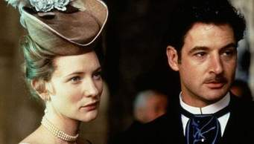
Sir Robert Chiltern
At the start of the play …………………….is the "ideal husband" who gives the play its title. He is 40 years old, clean cut, and good-looking. Dark-haired and dark-eyed with a personality of mark and deeply respected by the many. Perfect manners with a touch of pride.

Slide 4
ACT 1 - plot
In Act 1 he is proud of himself and all he has done in his career and for his country. He is also content with and proud of his marriage. However, his career rests upon a secret: when he was just starting out he sold a government secret illegally to a speculator, who used it to make himself and Sir Robert a lot of money. He is therefore not nearly as pure as he would claim, or as strong: when Mrs. Cheveley, a blackmailer, threatens to expose his secret if he doesn't do what she wants, he crumbles quickly. When he asks his friend Lord Goring for help with the situation, he spends a lot of time justifying his actions. Instead of telling his wife the truth, he initially conceals it from her. Sir Robert is a good man but he has, as he himself points out, "feet of clay." Sir Robert is both honorable in his career, his politics, and his love for his wife but dishonorable in his criminal past and the way he has lied about it. The tension between these opposites form his character and challenge the audience to consider what it means to be flawed. British audiences might recognize something in Sir Robert's name that American audiences would not. Members of Parliament cannot technically resign their posts. Instead they take a paid government position, which disqualifies them to serve. The term for this is "taking the Chiltern Hundreds." Chiltern's last name would by itself signal a character who will have to resign from the government in disgrace.

Slide 5
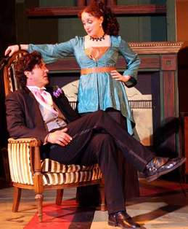
Mrs. Laura Cheveley
…………….is tall and rather slight. Her lips are very thin and highly-coloured, a line of scarlet on a pallid face. Venetian red hair, aquiline nose. Extremely graceful, a work of art but showing the influence of too many schools. She looks like an orchid and she is the play's villain. She is continually bad but also multi-layered. She enjoys flirtation and values money and social connections. However, she is also good-looking and charming enough that she and Lord Goring had planned to marry once upon a time.

Slide 6
She pulls off some of the play's wittiest observations. Her primary crime in the play is attempting to blackmail Sir Robert so she can make a lot of money on the Argentine Canal scheme. However, there are other crimes in her past. She stole a diamond brooch from Lord Goring's cousin Mary Berkshire and was expelled from school for theft when she was young. Mrs. Cheveley is openly out for her own good and doesn't try to hide it, although her means are underhanded. While she clearly lusts after money and material goods, she sometimes has other goals in mind. When she attempts to blackmail Sir Robert, she is after more than money. She despises Lady Chiltern's attitude of moral purity and therefore superiority. Blackmailing Sir Robert, who wants to hide his dirty dealings in the past from his clean-minded wife, gives Mrs. Cheveley an opportunity to disrupt the Chilterns' marriage by exposing its underlying moral hypocrisy. This would give her as much satisfaction as making a financial profit from the transaction.

Slide 7
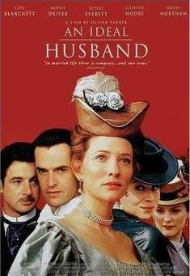
Lady Gertrude Chiltern
Wilde describes the 27-year-old as having a "Greek beauty." She loves her husband, but she also loves the idea of her husband, who she believes is beyond moral reproach. She loves his success and his reputation as an ethical statesman.

Slide 8
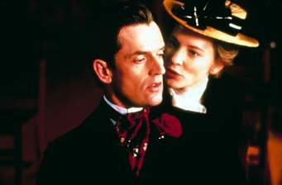
…………………………is 34 years old. Handsome and intelligent, he lives a life of pleasure and idleness as a flawless dandy, devoting himself to the latest styles and fashions. This often makes him appear superficial, but in reality he alternates between being verbally playful and being quite serious and direct. In this respect he is one of the play's most paradoxical characters. He is fond of being misunderstood.

Slide 9
Mabel Chiltern
….a perfect example of English type of pretiness with sunlight in her hair and a little mouth with parted lips, like the mouth of a child.
She is not just young but innocent, even naive but also throughout the play she proves herself witty, and in her own way a skilled manipulator.

